Slide 1
📊 Diabetes Analytics Dashboard: A Data-Driven Approach to Early Detection
Team Members:
Ahamed Mulla (46) – Preprocessing & Dashboard Integration
Yogesh Mane (47) – EDA & Visualization
Ziyad Kakhandkikar (48) – Modeling & Evaluation
Institute: Walchand Institute of Technology, Solapur
Department: Electronics & Computer Engineering
Faculty: Dr. S.R. Gengaje, Mrs. P.V. Katare, Mr. R.P. Nagarkar
Notes:
Slides: Prepare a short slide deck (10-12 slides) summarizing the project objectives, methodology, and key results.

Slide 2
Abstract
This project leverages data analytics and machine learning to predict diabetes from real clinical data. Using a noisy, unclean dataset, we cleaned, analyzed, modeled, and visualized patterns using an interactive Streamlit dashboard.
The system aids medical professionals by revealing the most influential health factors and providing visual interpretability for diagnosis support.

Slide 3
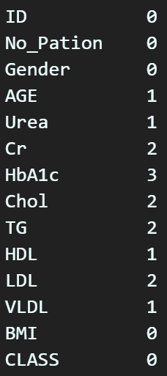
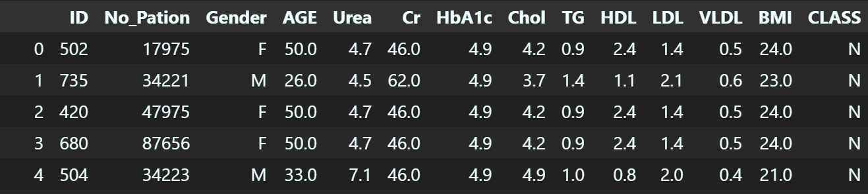
Problem Definition & Objectives
The dataset contained missing values, invalid zero entries, and inconsistent class labels.
The objective was to convert this raw clinical data into reliable insights and predictive models.
Objectives:
Clean and preprocess healthcare data
Perform Exploratory Data Analysis (EDA)
Build classification models
Visualize results interactively
Derive actionable insights

Slide 4
System Architecture
Data Collection
Data Preprocessing
EDA
Model Training
Evaluation
Dashboard

Slide 5
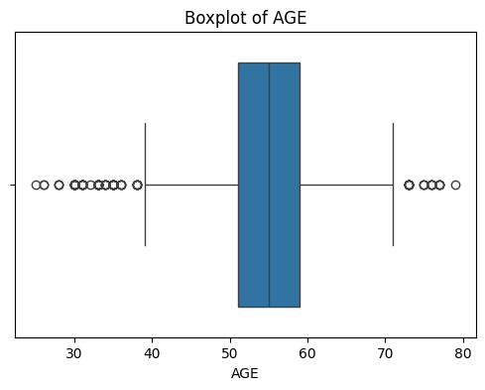
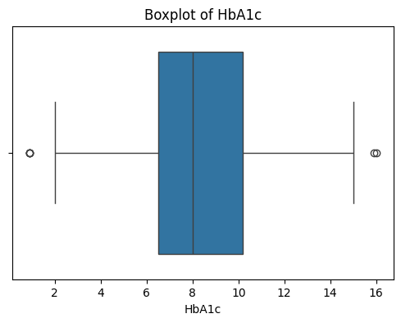
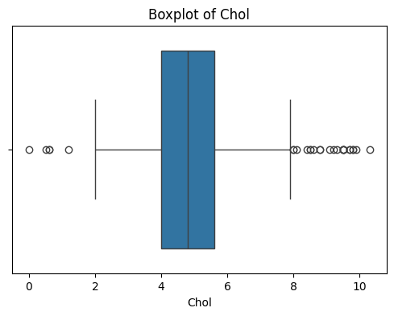
Outliers in variables
Since the outliers reflect real, valid measurements rather than errors, they have been kept in the analysis.

Slide 6
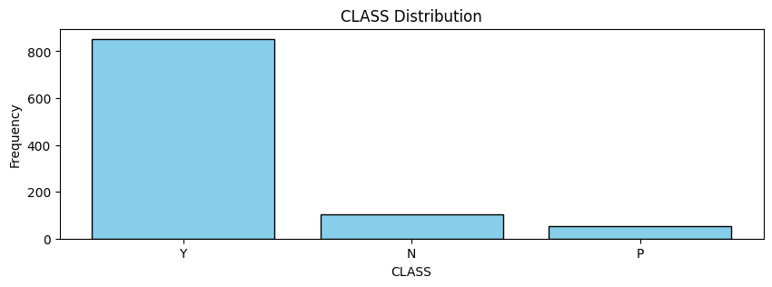
Class Distribution
Y (Diabetic): This category is clearly the largest on the graph, indicating the majority of individuals are diabetic.
N (Non-diabetic): This class appears with much lower frequency, representing a smaller portion of the dataset.
P (Pre-diabetic): Similarly, this group has few observations, highlighting its minority status in the data.

Slide 7
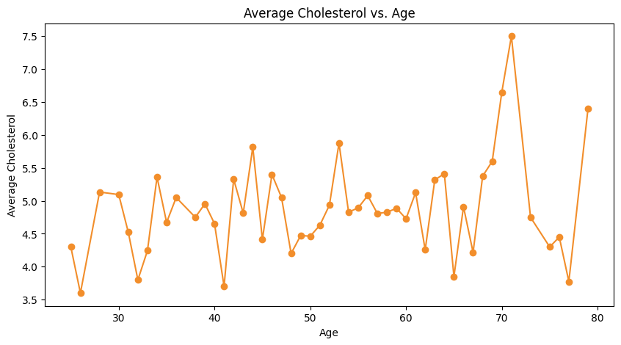
Average Cholesterol vs Age Line Graph
Cholesterol levels vary across different ages, with noticeable ups and downs.
A clear jump appears after age 70, suggesting older adults often have higher cholesterol.
Younger ages show some fluctuation, but levels remain lower overall.
Regular checks may be more crucial as individuals move into later life stages.

Slide 8
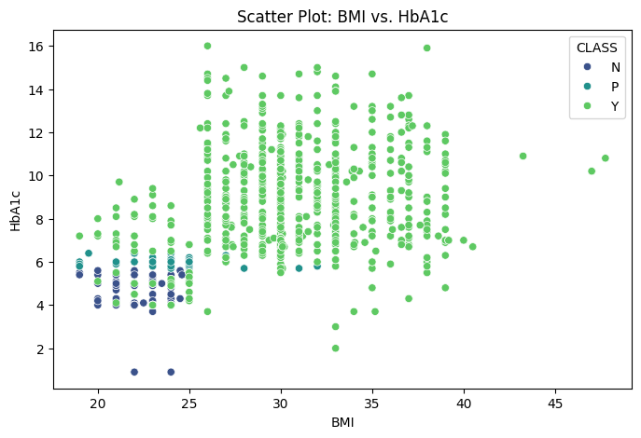
Scatterplot of BMI vs Hemoglobin among the classes
A positive correlation exists between BMI and HbA1c.
The non-diabetic group (N) is concentrated at lower BMI and HbA1c values.
The pre-diabetic group (P) falls in an intermediate range with some overlap.
The diabetic group (Y) extends to higher values of both metrics.

Slide 9
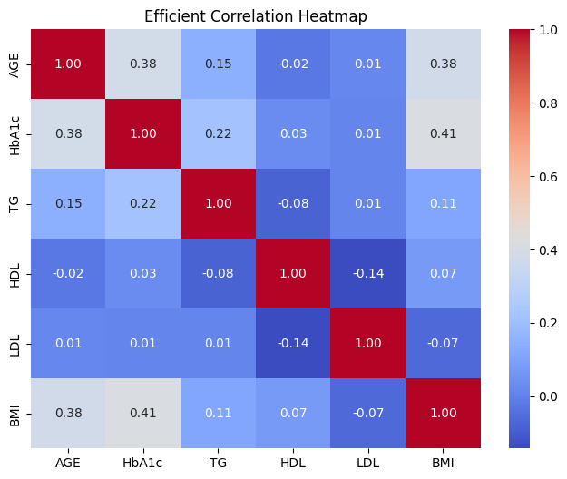
Co-relation using Heatmap
Age vs. HbA1c & BMI: Age shows a moderate positive correlation with HbA1c and BMI, suggesting older individuals may have higher HbA1c levels and BMI.
LDL vs. HDL: These two measures are moderately negatively correlated, matching the typical pattern that higher HDL usually means lower LDL.
BMI vs. HbA1c: A moderate positive correlation indicates that higher BMI often corresponds to elevated HbA1c.

Slide 10
Machine Learning Models & Evaluation
Models Implemented:
Logistic Regression — serves as a linear baseline model
Random Forest Classifier — ensemble of multiple decision trees for robust non-linear learning
Approach:
Data split: 80 % training / 20 % testing, stratified by class
Features standardized using StandardScaler
Evaluation metrics:
Accuracy
ROC–AUC Score
Confusion Matrix
Classification Report (Precision, Recall, F1)
Model | Accuracy | ROC–AUC | Remark
Logistic Regression | 0.960 (96 %) | 0.987 | Performs well on linearly separable data
Random Forest | 0.985 (98.5 %) | 1.000 | Captures complex, non-linear relations

Slide 11
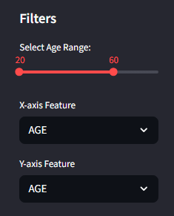
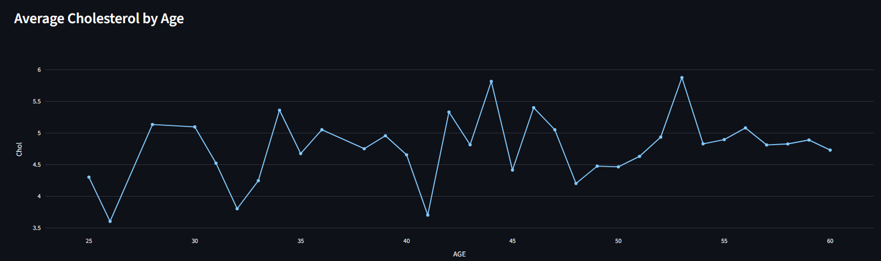
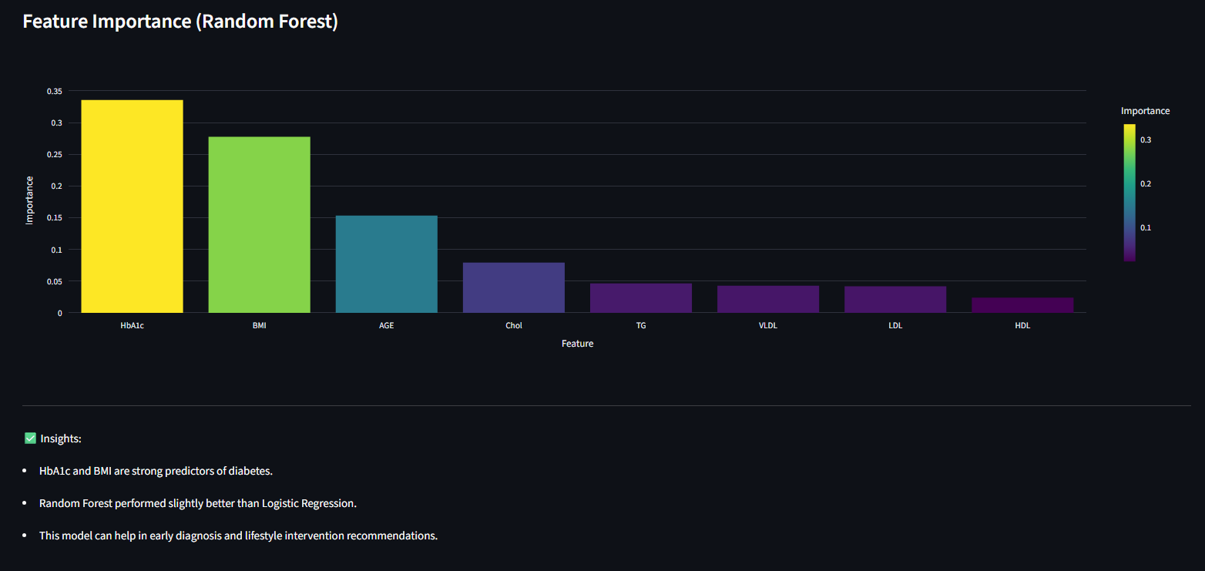
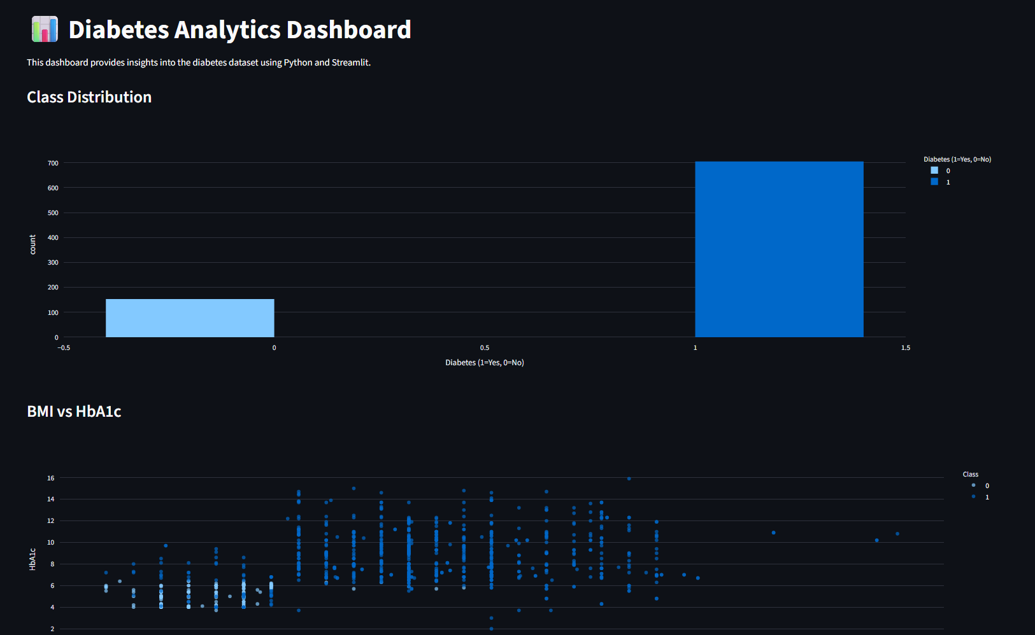
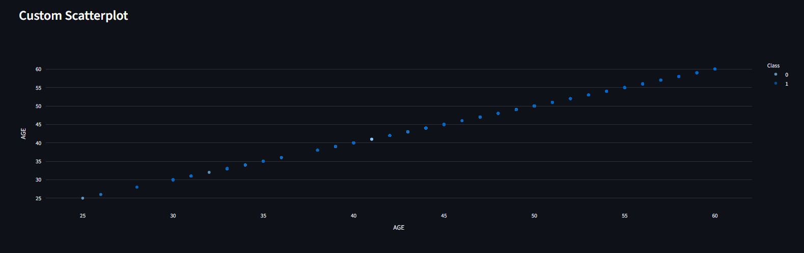
Interactive Streamlit Dashboard

Slide 12
Conclusion
Built a complete analytics pipeline from raw data to insights.
Validated clinical expectations: HbA1c and BMI are key predictors.
Dashboard provides a clear, interactive visualization layer.
References: https://www.kaggle.com/datasets/ryugorocks/diabetes-unclean

Slide 13
Future Scope
Add more data and balance classes (e.g., SMOTE).
Experiment with XGBoost, SVM, Neural Networks.
Deploy live on Streamlit Cloud or hospital data system.

Slide 14
References
Kaggle Dataset: https://www.kaggle.com/datasets/ryugorocks/diabetes-unclean
Github Repository: https://github.com/ah4md/DatathonProject

Slide 15
Thank you!
Notes:
thank you very much for joining this PPT, keep learning.
15

