Slide 1
Bidding and Allocation in Combinatorial Auctions
Noam Nisan
Institute of Computer Science
Hebrew University

Slide 2
Combinatorial Auctions
Bids Items
7 for {a AND b AND c}
(6 for a) OR (8 for b)
(6 for a) XOR (8 for b)
10 for (ANY 3 items)
….
a
b
c
d
e

Slide 3
Sample Applications
“Classic”:
  (take-off right) AND (landing right)
  (frequency A) XOR (frequency B)
Online Computational resources:
  Links: ((a--b) AND (b--c)) XOR ((a--d) AND (d--c))
  (disk size > 10G) AND (speed >1M/sec)
E-commerce:
  chair AND sofa -- of matching colors
  (machine A for 2 hours) AND (machine B for 1 hour)

Slide 4
Underlying Assumptions
Each bidder has a valuation, v(S), for every possible subset, S, of items that he may get.
The valuation satisfies:
  Free disposal: S⊇T implies v(S)≥v(T)
  No externalities: v() is a function of just S
It may have, for some disjoint S and T:
  Complementarity: v(S∪T) > v(S)+v(T)
  Substitutability: v(S∪T) < v(S)+v(T)

Slide 5
This Talk
Consider only Sealed Bid Auctions
Bidding languages and their expressiveness
Allocation algorithms (maximizing total efficiency)
Will not deal with payment rules and bidders’ strategies (VCG/GVA useful, but has problems)

Slide 6
Representing v: How to Bid?
Bidder sends his valuation v as a vector of numbers to auctioneer.
  Problem: Exponential size
Bidder sends his valuation v as a computer program (applet) to auctioneer.
  Problem: requires exponential access by any auctioneer algorithm

Slide 7
Bidding Language Requirements
Expressiveness
  Must be expressive enough to represent every possible valuation.
  Representation should not be too long
Simplicity
  Easy for humans to understand
  Easy for auctioneer algorithms to handle

Slide 8
AND, OR, and XOR bids
{left-sock, right-sock}:10
{blue-shirt}:8 XOR {red-shirt}:7
{stamp-A}:6 OR {stamp-B}:8

Slide 9
General OR bids and XOR bids
{a,b}:7 OR {d,e}:8 OR {a,c}:4
  {a}=0, {a, b}=7, {a, c}=4, {a, b, c}=7, {a, b, d, e}=15
  Can only express valuations with no substitutabilities.
{a,b}:7 XOR {d,e}:8 XOR {a,c}:4
  {a}=0, {a, b}=7, {a, c}=4, {a, b, c}=7, {a, b, d, e}=8
  Can express any valuation
  Requires exponential size to represent
    {a}:1 OR {b}:1 OR … OR {z}:1

Slide 10
OR of XORs example
{couch}:7 XOR {chair}:5
OR
{TV, VCR}:8 XOR {Book}:3

Slide 11
OR-of-XORs example 2
Downward sloping symmetric valuation: Any first item is valued at 9, the second at 7, and the third at 5.
{a}:9 XOR {b}:9 XOR {c}:9 XOR {d}:9
OR
{a}:7 XOR {b}:7 XOR {c}:7 XOR {d}:7
OR
{a}:5 XOR {b}:5 XOR {c}:5 XOR {d}:5

Slide 12
XOR of ORs example
The Monochromatic valuation: Even numbered items are red, and odd ones blue. Bidder wants to stick to one color, and values each item of that color at 1.
{a}:1 OR {c}:1 OR {e}:1 OR {g}:1
XOR
{b}:1 OR {d}:1 OR {f}:1 OR {h}:1

Slide 13
Bidding Language Limitations
Theorem: The downward sloping symmetric valuation with n items requires exponential size XOR-of-OR bids.
Theorem: The monochromatic valuation with n items requires exponential size OR-of-XOR bids.

Slide 14
OR* Bidding Language (Fujishima et al)
Allow each bidder to introduce phantom items, and incorporate them in an OR bid.
Example: {a,z}:7 OR {b,z}:8 (z phantom)
  equivalent to (7 for a) XOR (8 for b)
Lemma: OR* can simulate OR-of-XORs
Lemma: OR* can simulate XOR-of-ORs

Slide 15
Allocation
A computational problem:
  Input: bids
  Outputs: allocation of items to bidders
  Difficult computational problem (NP-complete)
Existing approaches:
  Very restricted bidding languages (Rothkopf et al)
  Search over allocation space (Fujishima etal, Sandholm)
  Fast heuristics (Fujishima etal, Lehman et al)

Slide 16
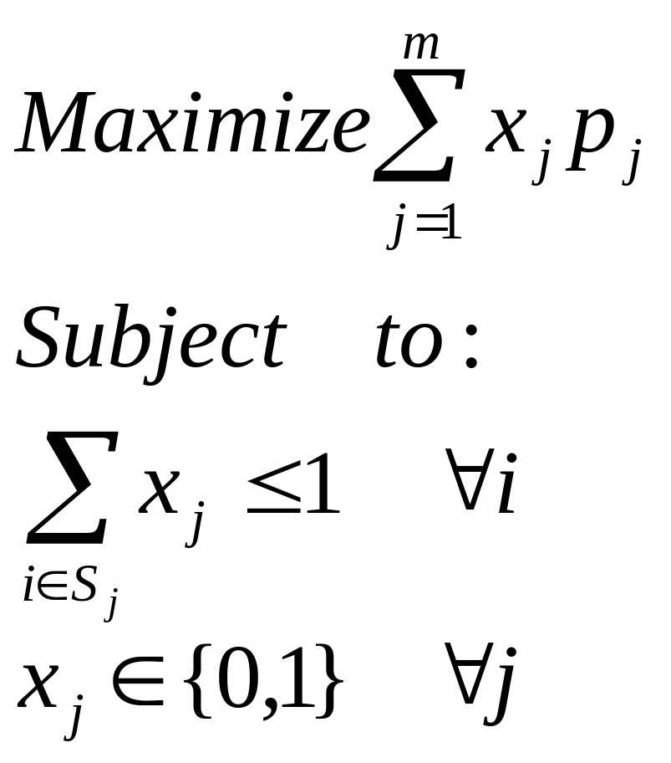
Integer Programming Formalization
n items -- indexed by i (some may be phantom)
m atomic bids: (Sj,pj)
(maybe multiple ones from same bidder)
Goal: optimize social efficiency

Slide 17
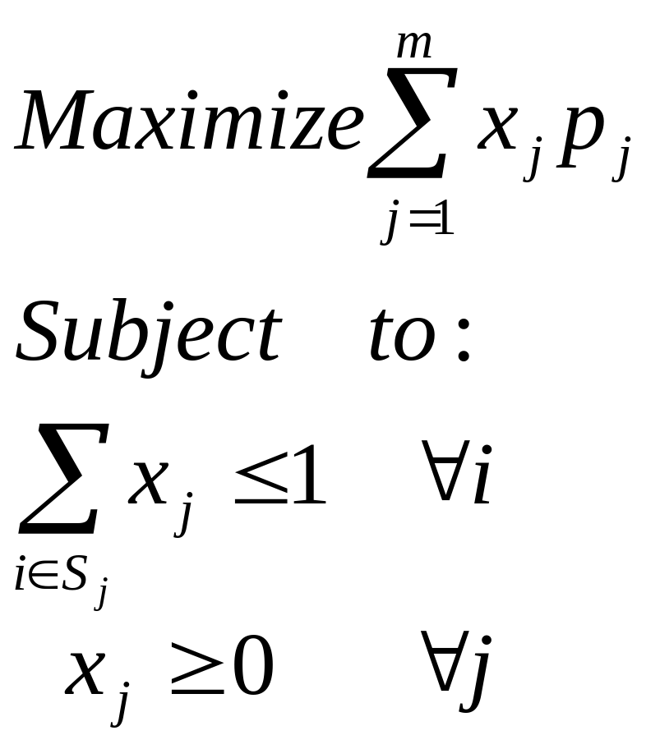
Linear Programming Relaxation
Will produce “fractional” allocations: xj specifies what fraction of bid j is obtained.
If we are lucky, the solution will be 0,1

Slide 18
Rest of talk
Intuition for using the LP relaxation -- characterization by individual item prices
When does this produce optimal results?
What to do when it doesn’t:
  Greedy Heuristic
  Branch-n-bound

Slide 19
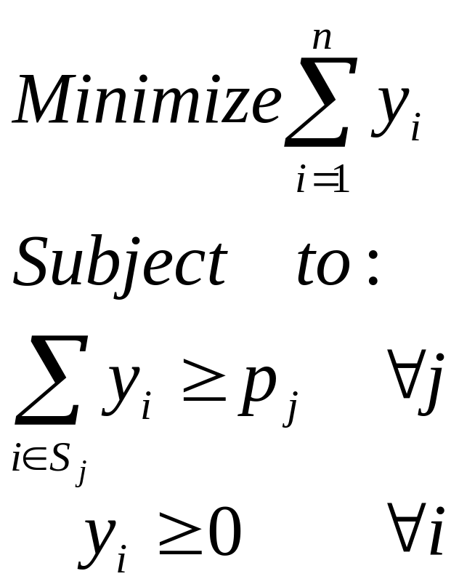
The Dual Linear Problem
Primal
Dual

Slide 20
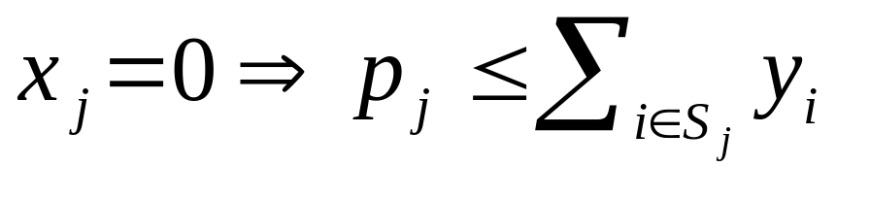
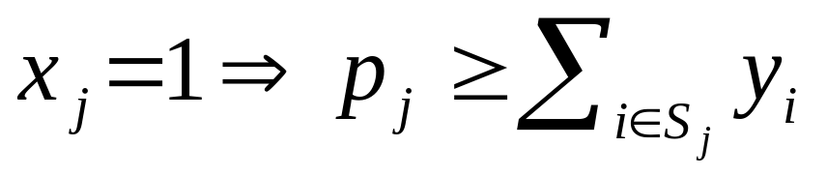
The meaning of the dual
Intuition: yi is the implicit price for item i
Definition: Allocation {xj} is supported by prices {yi} if
Theorem: There exists an allocation that is supported by prices iff the LP solution is 0,1

Slide 21
When do we get 0,1 solutions?
Theorem: in each one of the cases below, the LP will produce optimal 0,1 results:
  Hierarchical valuations
  1-dimensional valuations
  Downward sloping symmetric valuation
  OR of XORs of singletons
  “independent” problems with 0,1 solutions
  problem with 0,1 solution + low bids

Slide 22
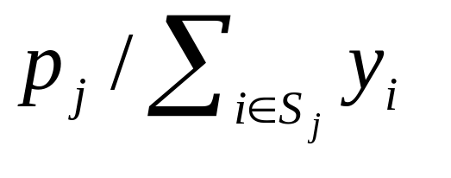
Greedy Algorithm
Run the LP relaxation
Re-order the bids to achieve decreasing xj and decreasing
for j=1…m
  if Sj is disjoint from previously taken bids
    take this bid

Slide 23
Elements for branch-n-bound
Basic Search: Try letting first bid win and
try letting first bid loose
Upper Bound Algorithm: The LP value.
Lower Bound Algorithm: The greedy solution.

Slide 24
branch-n-bound algorithm
Input: auction sub-problem, low-value
Algorithm:
  IF Upper bound < low-value THEN fail/return
  IF Lower bound > low-value THEN update
  Let (S,p) be the bid with highest xj
  Try: allocating S and recursively the rest
  Try: ignoring S and recursively allocate the rest

