Slide 1
Cryogenic Classical Control Architectural Simulations
March 14, 2017

Slide 2
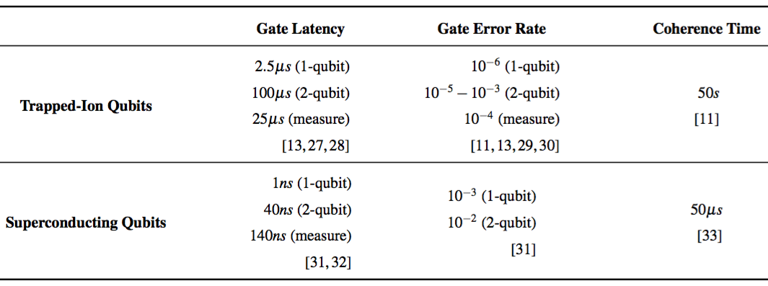
Qubit Parameters

Slide 3
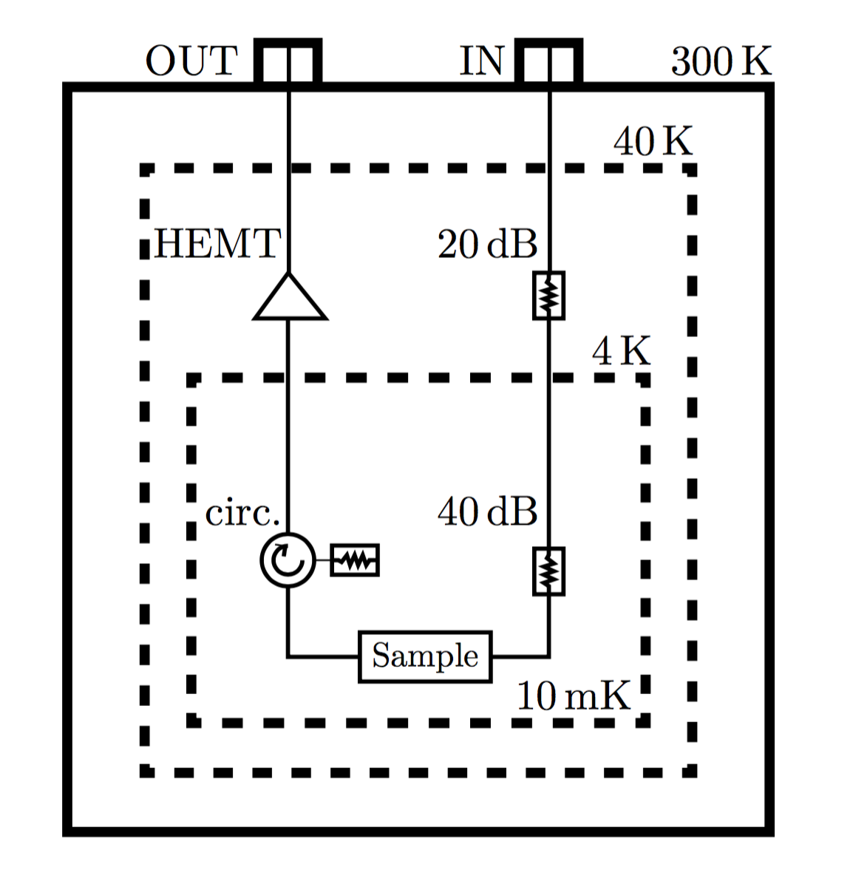
Model Parameters
Thermal Zone Characteristics
Control Interconnect Schematic
Zone | Capacity | Overhead
45K | 40 W | 10X
4K | 1.5 W | 200X
120 mK | 600 uW
100 mK | 400 uW
20 mK | 14 uW | 5 x 10⁴ X
A
A
B
B
Interconnect Hardware
Hardware | Power Dissipation | Latency
RF Coaxial Cable | P = λA(δT)/L | A: 10 ns (45K->4K) B: 1ns (4K->20mK)
HEMT Cryoamplifier | 4 mW – 12 mW | N/A
Electrical Attenutator | Passive | N/A

Slide 4
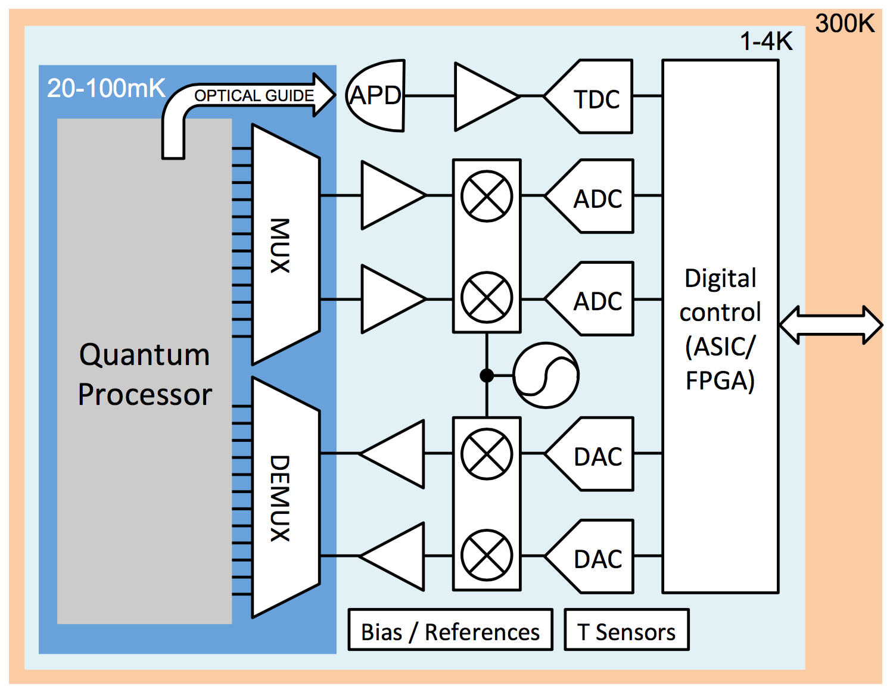
CryoCMOS Model
Serial I/O
≥ 10ns Latency
Two Interconnects in/out of 20mK zone
MUX within 20mK – including DC bias

Slide 5
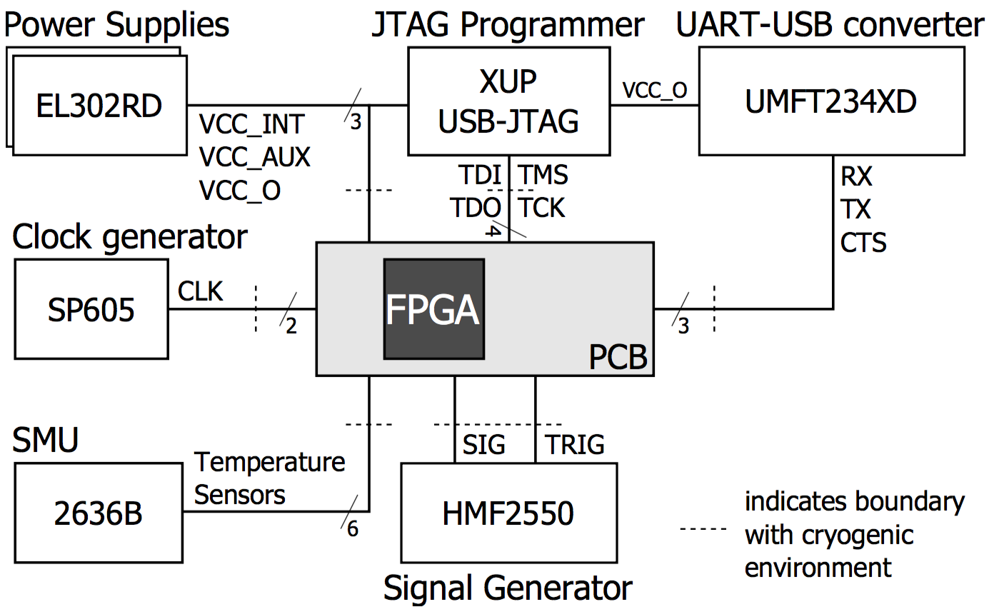
CryoCMOS Controller Parameters
Operation
Charbon Control Schematic
Serial I/O (JTAG + UART) 10ns latency/<bandwidth>
Bandwidth: 1 bit | 1 byte
1 bit: 640 ns/cycle: 1.5 MHz
1 byte: 80 ns/cycle: 12.5 MHz
Operating Frequency
700 MHz – MSFT
Power Dissipation
10⁻¹⁵ J/operation
100K logic elements
Maximum: 70 mW

Slide 6
CryoCMOS Memory Parameters
Access Times
Power Dissipation
I/O external memory latency
10 ns / 1 byte
Cycle time
1.42 ns = 1 / 700 MHz
Single instruction latency
80 ns = 56 cycles
Cache line (single instruction) access time
1 cycle
Cache miss penalty
896 cycles = 16 lines x single instruction latency
For a 64 KB cache size:
12 mW per read
21 mW per write
Rough estimates

Slide 7
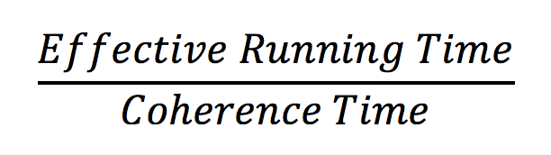
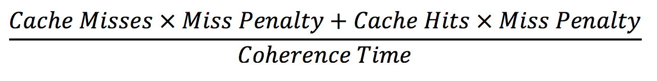
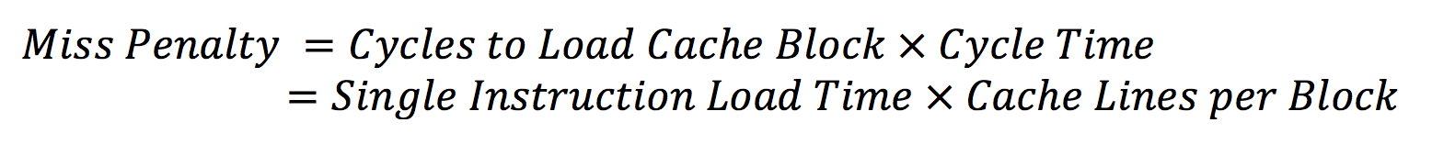
Normalization: Number of Required ECC Cycles
Each application – flattening configuration:
Operational time steps (number of SIMD instructions)
Cache behavior (hit rate, miss rate)
Number of ECC Cycles Required calculated by:
=

Slide 8
Serial I/O Application Statistics Fully Flattened Applications
Serial I/O without internal memory requires many ECC cycles to execute applications with reasonable success probability (≥ 50 %)

Slide 9
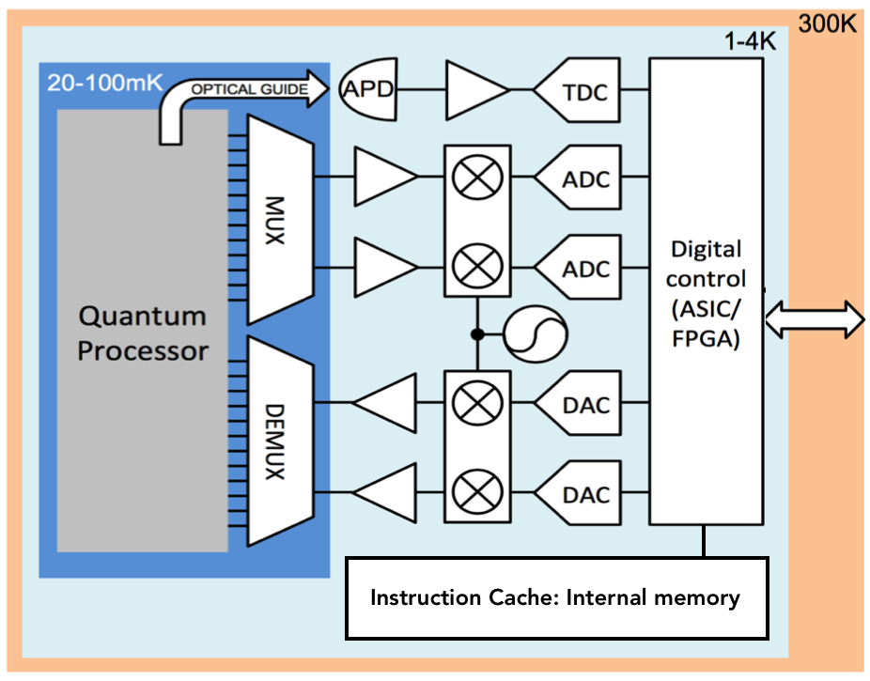
CryoCMOS Model with Memory
Serial I/O
≥ 10ns Latency
Internal memory with single instruction bandwidth, fast access time

Slide 10
Internal Memory Application Statistics Unflattened Applications
Adding internal memory of 64KB shows a trade off: good caching requires low exposed parallelism

Slide 11
Internal Memory Application Statistics 100K Flattened Applications
Adding internal memory of 64KB shows a trade off: good caching requires low exposed parallelism

Slide 12
Internal Memory Application Statistics 2M Flattened Applications
Only largely parallel applications benefit from flattening – smaller and more serial applications suffer drastically

