Slide 1
Cryogenic Classical Control Architectural Simulations
March 14, 2017

Slide 2
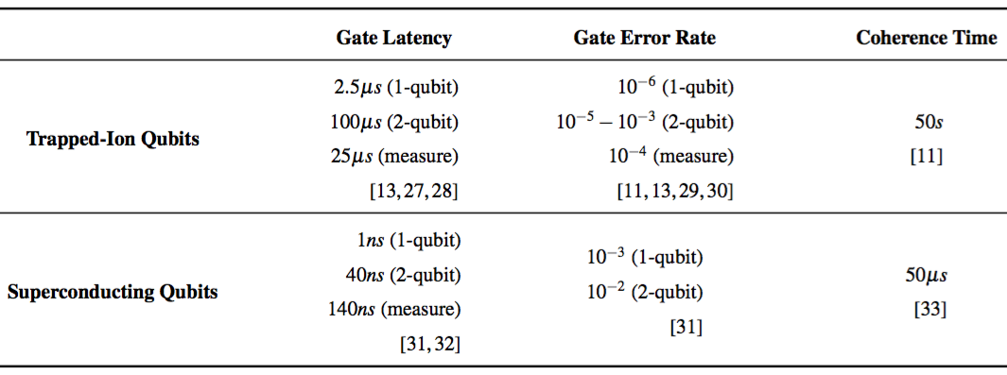
Qubit Parameters

Slide 3
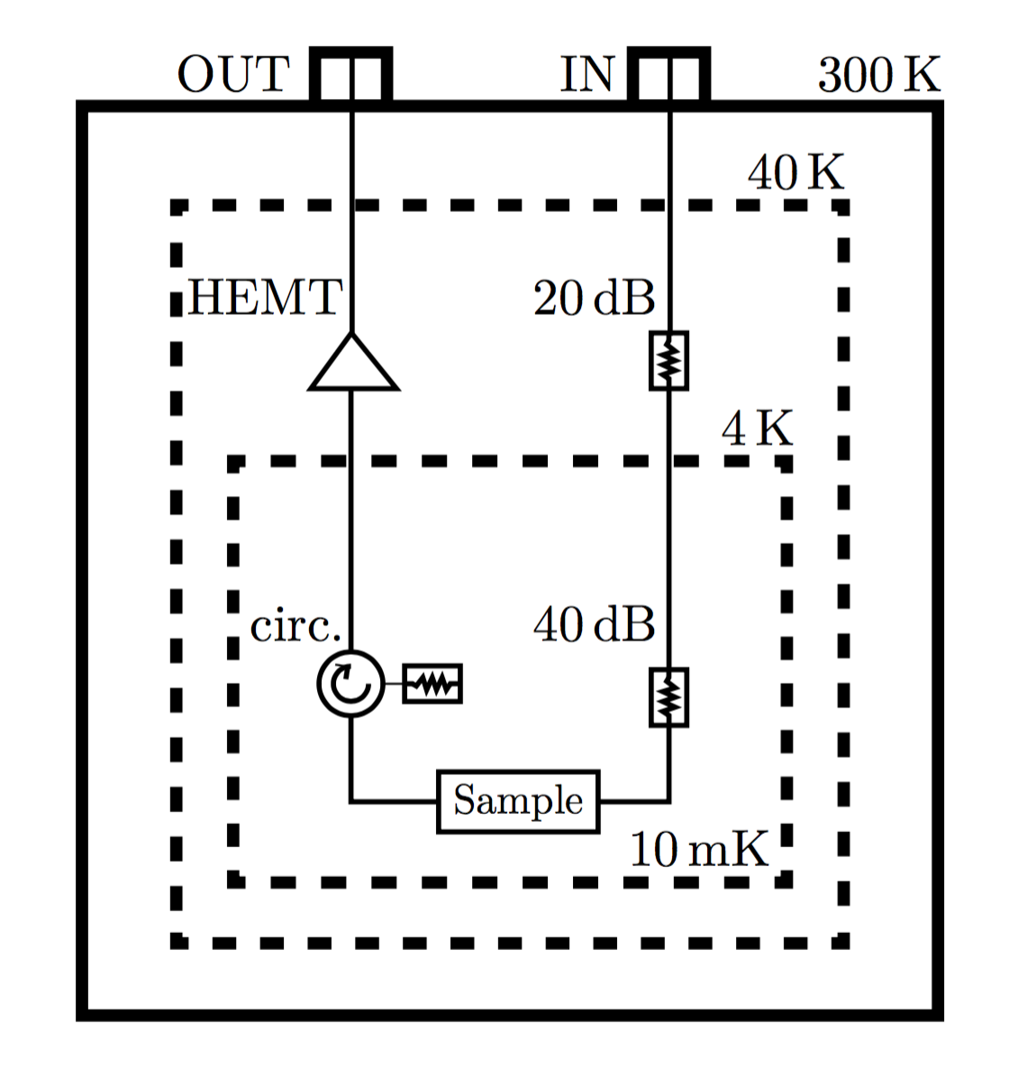
Model Parameters
Thermal Zone Characteristics
Control Interconnect Schematic
Zone | Capacity | Overhead
45K | 40 W | 10X
4K | 1.5 W | 200X
120 mK | 600 uW
100 mK | 400 uW
20 mK | 14 uW | 5 x 10⁴ X
A
A
B
B
Interconnect Hardware
Hardware | Power Dissipation | Latency
RF Coaxial Cable | P = λA(δT)/L | A: 10 ns (45K->4K) B: 1ns (4K->20mK)
HEMT Cryoamplifier | 4 mW – 12 mW | N/A
Electrical Attenutator | Passive | N/A

Slide 4
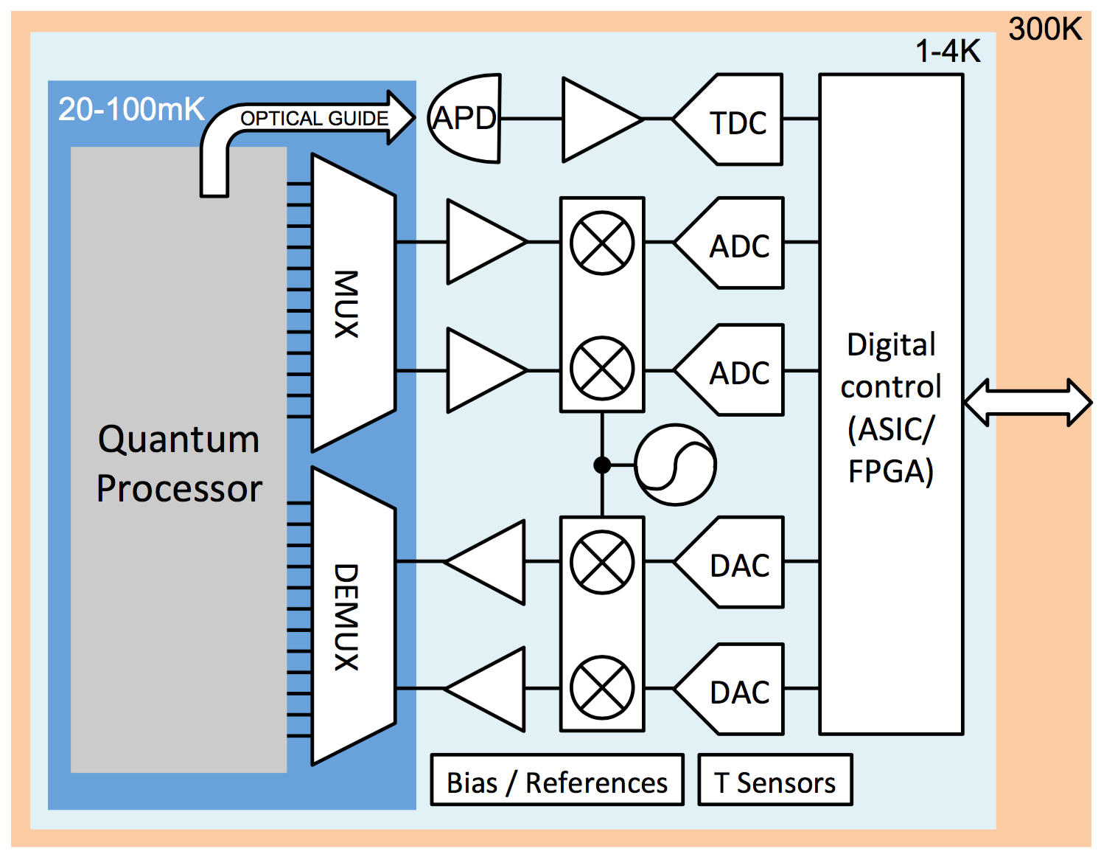
CryoCMOS Model
Serial I/O
≥ 10ns Latency
Several Interconnects in/out of 20mK zone
MUX within 20mK – including DC bias

Slide 5
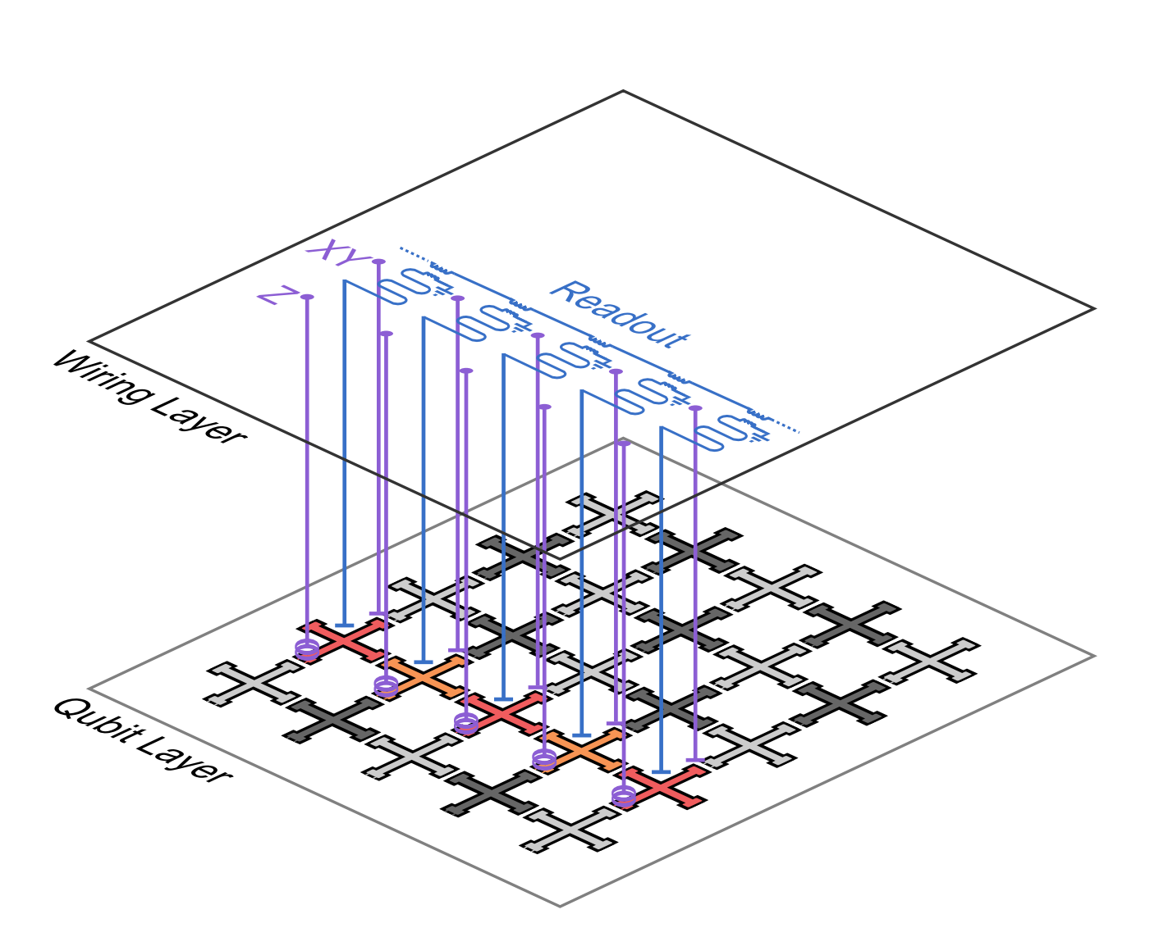
Interconnect Structure
Interconnects are 3d layered with through silicon vias and bump bonds.
Each qubit control is independent, brought together by multiplexers in the same 20 mK region.
Each control line from the multiplexers must also carry DC bias for individual qubit frequency tailoring

Slide 6
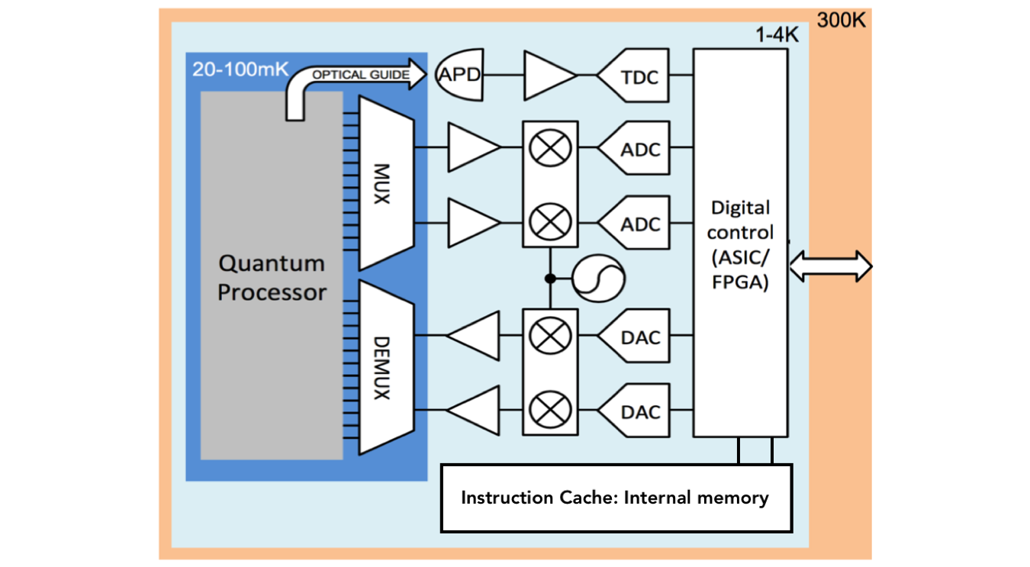
CryoCMOS Model with Memory
Serial I/O
≥ 10ns Latency
Internal memory with single instruction bandwidth, fast access time

Slide 7
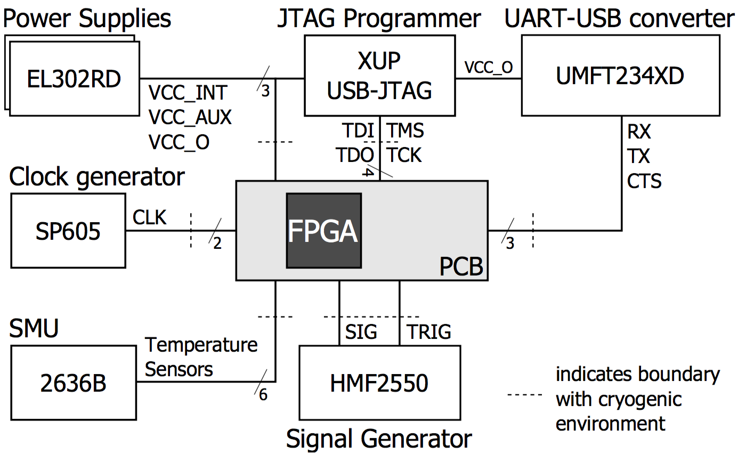
CryoCMOS Controller Parameters
Operation
Charbon Control Schematic
Serial I/O (JTAG + UART) 10ns latency/<bandwidth>
Bandwidth: 1 bit | 1 byte
1 bit: 640 ns/cycle: 1.5 MHz
1 byte: 80 ns/cycle: 12.5 MHz
Target Operating Frequency
700 MHz
Power Dissipation
10⁻¹⁵ J/operation
100K logic elements
Maximum: 70 mW

Slide 8
CryoCMOS Memory Parameters
Access Times
Power Dissipation
I/O external memory latency
10 ns / 1 byte
Cycle time
1.42 ns = 1 / 700 MHz
Single instruction latency
80 ns = 56 cycles
Cache line (single instruction) access time
1 cycle
Cache miss penalty
896 cycles = 16 lines x single instruction latency
For a 64 KB cache size:
2.6 mW per read operation
0.13 mW memory cells + bit lines
2.47 mW CMOS decoder + word lines
3.27 nJ / access, given 400 ps access time
This can cause energy budget pressure at high access rates
Van Duzer et al. IEEE June 2013

Slide 9
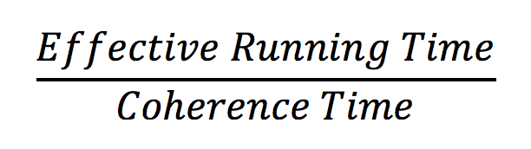
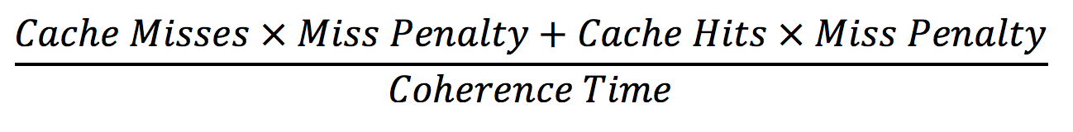
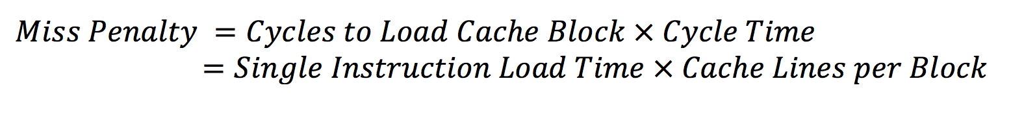
Normalization: Number of Required ECC Cycles
Each application – flattening configuration:
Operational time steps (number of SIMD instructions)
Cache behavior (hit rate, miss rate)
Number of ECC Cycles Required calculated by:
=
The following charts depict pseudo-SIMD instruction scheduling – a single instruction per operation time step is scheduled. This proxies SIMD instructions.

Slide 10
Serial I/O Application Statistics Fully Flattened Applications
Serial I/O without internal memory requires many ECC cycles to execute applications with reasonable success probability (≥ 50 %)

Slide 11
Internal Memory Application Statistics Unflattened Applications
Adding internal memory of 64KB shows large immediate improvement in all applications: average reduction in ECC cycles of 100x

Slide 12
Internal Memory Application Statistics 10K Flattened Applications
Flattening at the smallest threshold causes code size changes that result in approximately 1.5x increase in ECC cycles required across all applications

Slide 13
Internal Memory Application Statistics 2M Flattened Applications
In the cache-performance dimension, the code size increases significantly outweigh performance gains from exposing parallelism: average increase in ECC of 2.3x

Slide 14
Internal Memory Application Statistics 25M Flattened Applications
25M flattening is full flattening for most applications (excluding BWT). The changes are small from 2M flattening, average 1.1x increase in ECC cycles.

Slide 15
Power Dissipation
Internal Memory
No Internal Memory: Measured FPGA
2.6 mW measured
Access time : 1 cycle
3.72 nJ / access cycle (*)
4K power capacity: 1.5 W
Temp (K) | Idle Power (mW)
300 | 83
40 | 153
4 | 228
Frequency (MHz) | Hit Rate | Power
700 | 100 % | 2.6 W
Logic Operations
10⁻¹⁵ J/logic gate
10⁵ gates
700 MHz frequency
=> 70 mW dynamic power
Power dissipation rate can cause energy budget pressure at target operating frequency
Van Duzer, Theodore, et al. "64-kb hybrid Josephson-CMOS 4 Kelvin RAM with 400 ps access time and 12 mW read power." IEEE (2013)
* Depends upon measurement method – this could be as high as the full 2.6 mW

Slide 16
Next Steps
SIMD Instructions: need formatting
Finish implementation of rotation sequence compression – see impacts on code size
Calculate new statistics for model including SIMD instructions and energy constraints from cache accesses
Build similar model for RSFQ/RQL system

