Slide 1

Using Machine Learning Techniques for Predicting and Visualizing Covid-19 Vaccinations Process
First Draft
Project
Ahmed Alanazi
Rasheed Alhazmi

Slide 2
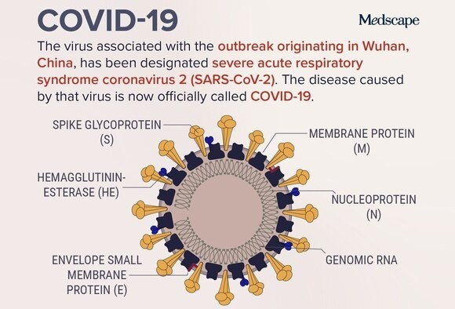
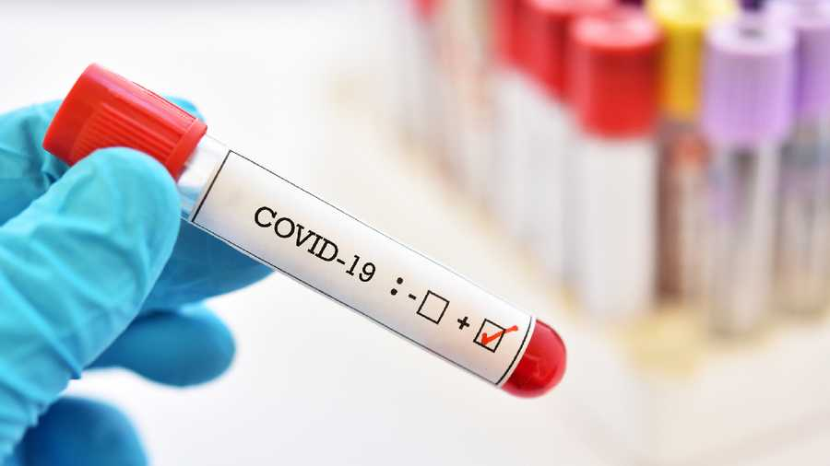
Introduction
COVID-19 has become a world pandemic in the past two years.
In December 2019, the first case of Coronavirus was reported in China.
Vaccinations started almost 134 days ago.
The Python/Deep Learning course is the opportunity.
Predicting possible number of people fully vaccinated.
Machine learning techniques are the key.

Slide 3
Machine Learning
Use different supervised and unsupervised machine learning techniques.
Train and clean the dataset that was chosen.
Compare different algorithms such as the K-means.
Try getting an accurate result of predicting.

Slide 4
Dataset
Dataset holds number of countries vaccinations statistics.
The main attributes in the datasets are Total Vaccinations, Daily Vaccinations, People Vaccinated and People Fully Vaccinated.
There are more attributes but our focus on the mentioned attributes.
The target attributes is the vaccine brand.
Some of the values in the dataset is not accurate.
Dataset from Kaggle

Slide 5
Dataset continued
Daily vaccination state number vaccinations.
Daily vaccination state people can be recorded twice.
Daily vaccination can determine phases.
Daily vaccination did not determine total vaccinations correctly.

Slide 6
Dataset continued
People vaccinated can be accurate.
People fully vaccinated has less accuracy.
Vaccines’ brand can show people preference.
In the United States

Slide 7
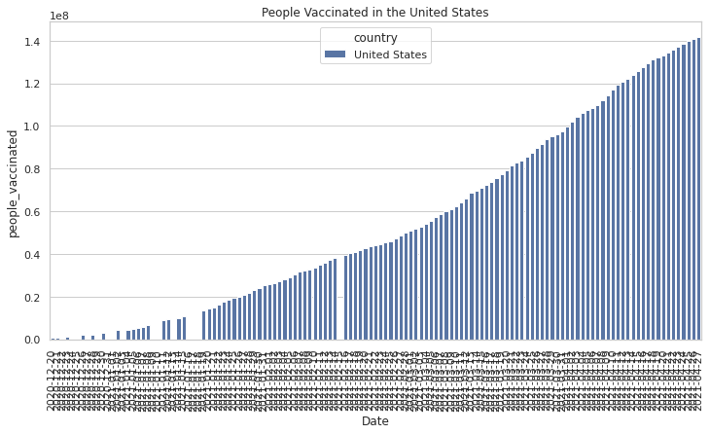
Dataset continued
People vaccinated increasing everyday

Slide 8
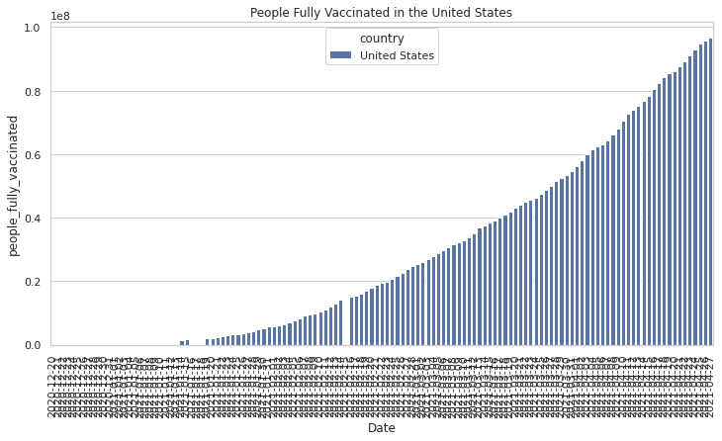
Dataset continued
People fully vaccinated increasing everyday

Slide 9
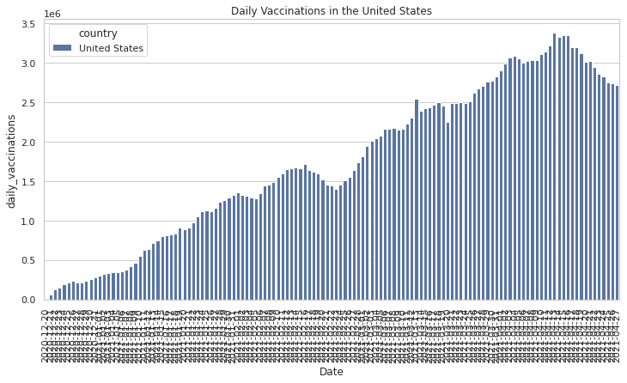
Dataset continued
Daily vaccinations increasing everyday

Slide 10
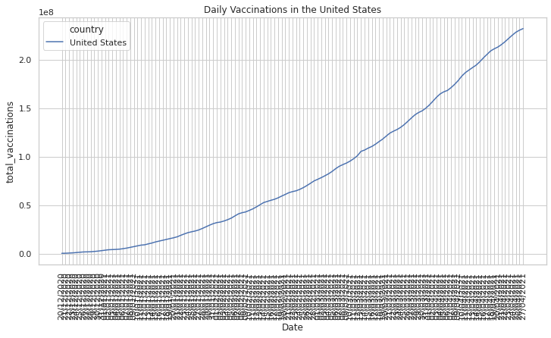
Dataset continued
Total Vaccinations

Slide 11
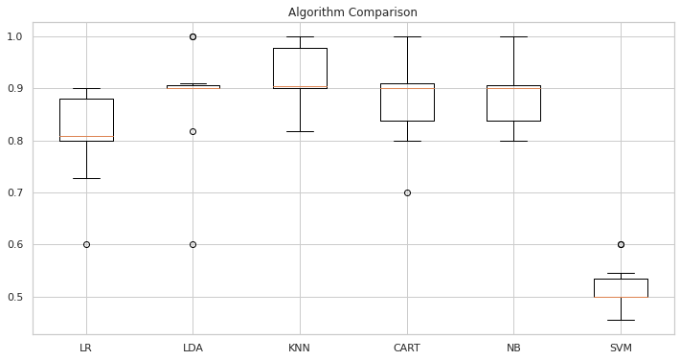
Fitting Dataset
Algorithms Comparison

Slide 12
Fitting Dataset
The dataset had a null values which were replaced with mean values.
Dataset was fitted into several algorithms to pick the best.
List of algorithms:
Logistic regression
linear discriminant analysis
k-nearest neighbors
decision tree classifier
Naive Bayes classifier
support vector machine

Slide 13
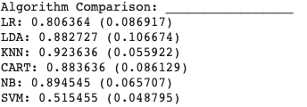
Fitting Dataset
The best algorithm was picked according to its accuracy score is KNN of 0.92.

Slide 14
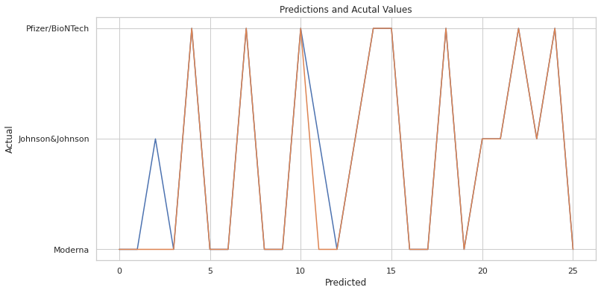
Fitting Dataset
Fitting and predicting the dataset into KNN. This prediction does not seem accurate; therefore, another algorithm was used.

Slide 15
Fitting Dataset
K means clustering was chosen to be applied with this dataset. Also, to find with values related to another in terms of numbers or groups.
Elbow technique was performed to find the best n_cluster values.

Slide 16
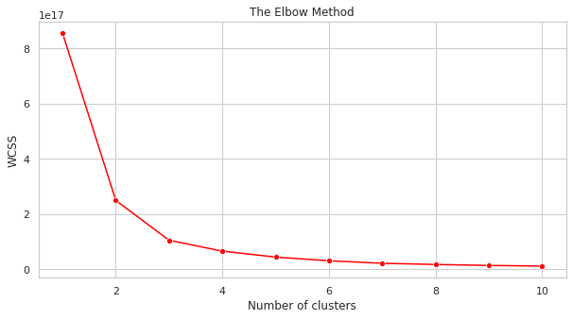
Fitting Dataset
K means clustering

Slide 17
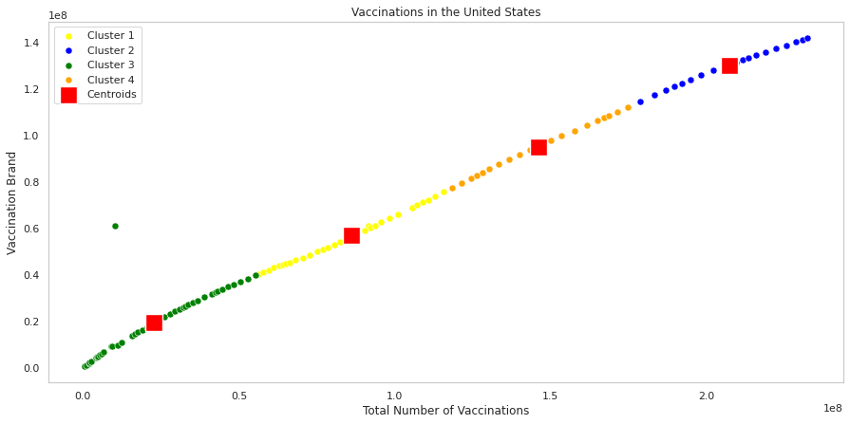
Fitting Dataset
K means clustering

Slide 18
Conclusions
As a conclusion, this project is completed, however, it shows the accuracy not fully 100 percent due some issues such as the dataset, training the dataset, or choosing an algorithm. It was very challenging to find a clean or perfect data that way we ended up having hard time spent in understanding and training the dataset. Overall, this project gave us a big opportunity to learn a new programming language and machine/deep learning.

Slide 19
References
[1] What is Coronavirus. (n.d.). Retrieved May 05, 2021, from https://www.who.int/health-topics/coronavirus#tab=tab_1
[2] Pfizer–BioNTech COVID-19 vaccine. (2021, May 02). Retrieved May 05, 2021, from https://en.wikipedia.org/wiki/Pfizer%E2%80%93BioNTech_COVID-19_vaccine
[3] Brownlee, J. (2020, August 19). Your first machine learning project in python Step-By-Step. Retrieved May 06, 2021, from https://machinelearningmastery.com/machine-learning-in-python-step-by-step/
[4] Your machine learning and data science community. (n.d.). Retrieved May 06, 2021, from https://www.kaggle.com/
[5] Amolbhivarkar. (2018, March 26). KNN for classification using scikit-learn. Retrieved May 06, 2021, from https://www.kaggle.com/amolbhivarkar/knn-for-classification-using-scikit-learn
[6] Sklearn.cluster.kmeans¶. (n.d.). Retrieved May 06, 2021, from https://scikit-learn.org/stable/modules/generated/sklearn.cluster.KMeans.html

