Slide 1
CSP - 571 Data Preparation and Analysis Group 8 Project Team Members : Ahad Hussain – A20543489 Pranshu Pathak – A20545207 Manan Hiren Shah – A20544907 Ayushi Vala – A20545571

Slide 2
Predicting Bank Marketing Campaigns
Project

Slide 3
Introduction
This dataset contains banking marketing campaign data and we are using it to optimize marketing campaigns to attract more customers to term deposit subscription.
1. Prediction of the results of the marketing campaign for each customer and clarification of factors which affect the campaign results. This helps to find out the ways how to make marketing campaigns more efficient.
2. Finding out customer segments, using data for customers, who subscribed to term deposit. This helps to identify the profile of a customer, who is more likely to acquire the product and develop more targeted marketing campaigns.
Notes:
In this Project we will get into how to use the dataset and model the recommendation system for the user based on their product ratings.
The dataset provides a wide range of fine food products. The selected dataset of fifteen million reviews across these product categories provides an opportunity to study how user tastes develop and change due to the act of consuming more products. This allows for the creation of a recommendation system that acknowledges and accounts for a user's level of experience, offering products they might enjoy at their current level while considering how their tastes might change in the future. Ultimately, the dataset provides insights into the relationship between user experience and preference, leading to improved recommendation models.

Slide 4
Dataset Information
Rows : 11162
Columns : 17
Features: ['age', 'job', 'marital', 'education', 'default', 'balance', 'housing',
'loan', 'contact', 'day', 'month', 'duration', 'campaign', 'pdays',
'previous', 'poutcome', 'deposit’]
Notes:
Used Existing data set and research paper from below link :
https://snap.stanford.edu/data/web-FineFoods.html
To understand further about making up of model from a dataset I have used sites like Quara and stack overflow.
I faced the challenge when I was not able to understand the model specifics like equations dealing with random data from the dataset.
But on further scrutinizing the process of model creation from a dataset I got a clear picture about how things are working in sync.
With the help of linear regression, the points which are clustered together are referencing the most preferable recommendation a user can have.
One shortcoming was as the data was old it does not tell the current scenario and the user preferences can be shifted overtime.
Assumed that a user will be buying similar products and not considering the occasions he buys on.

Slide 5
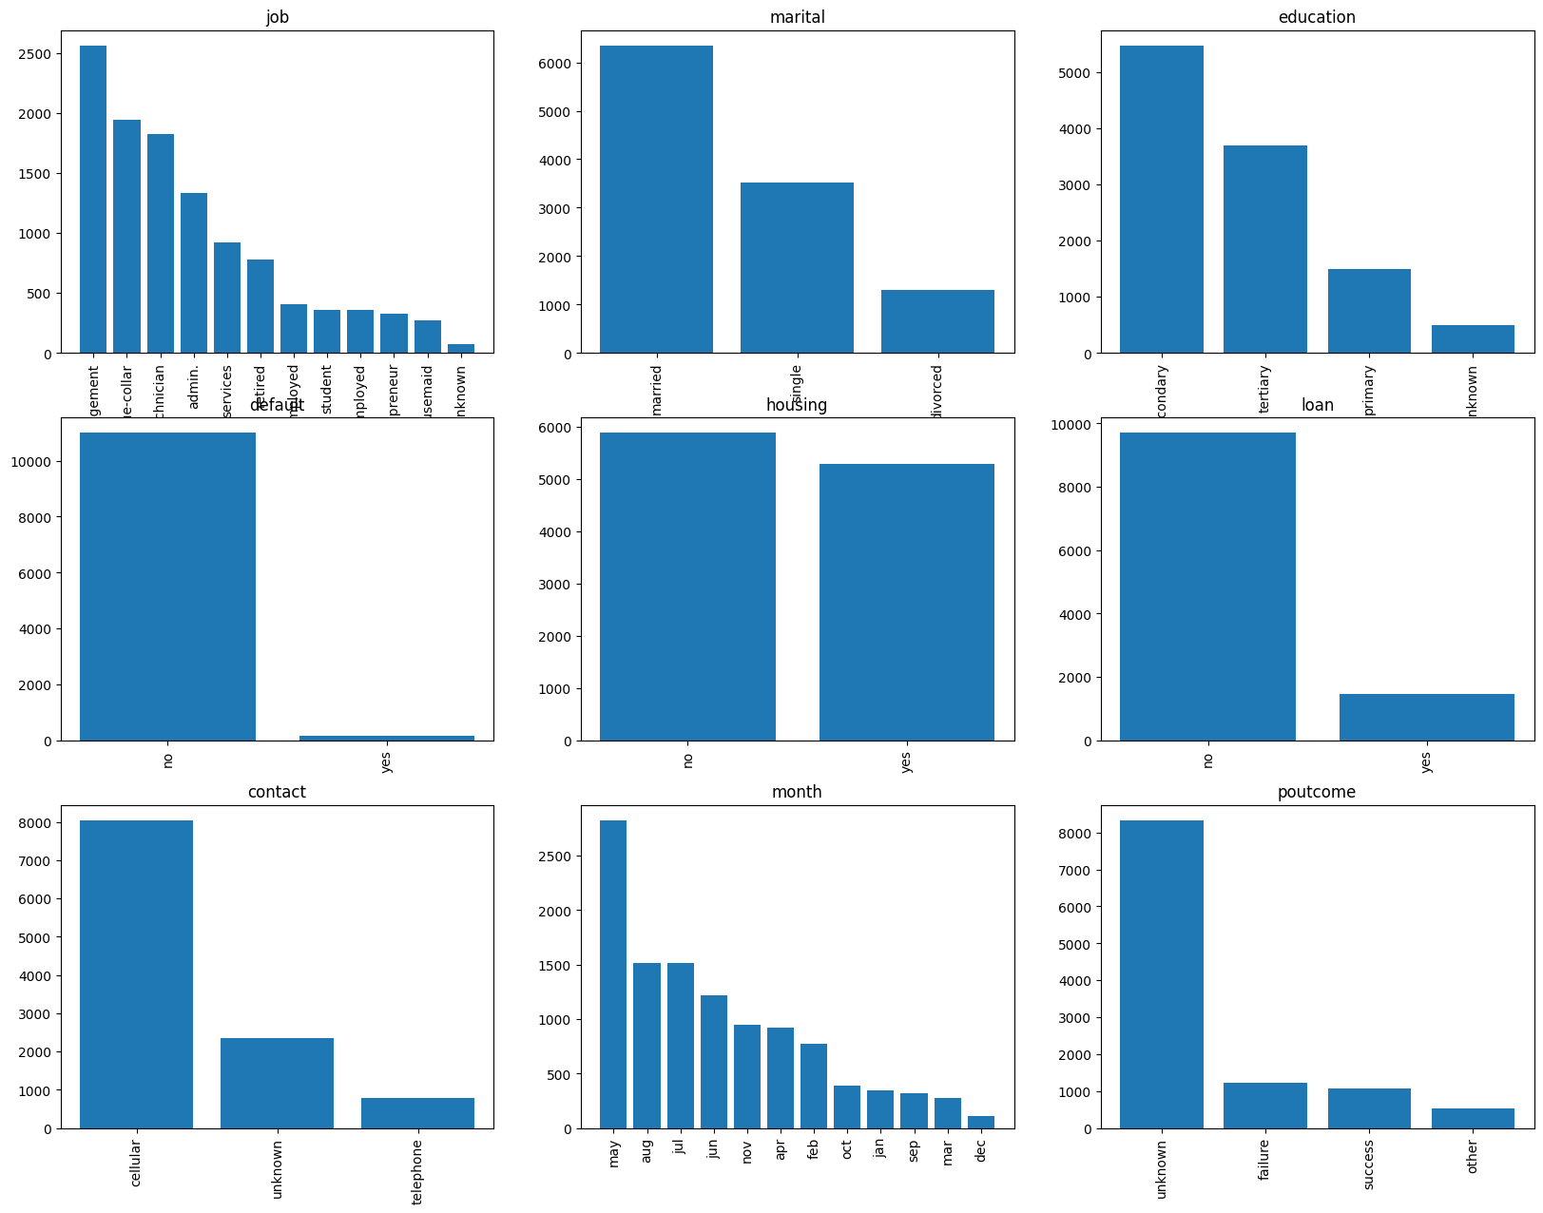
Data Exploration
These are graphs showing different exploration in between the features of the dataset.
Notes:
In this Project we will get into how to use the dataset and model the recommendation system for the user based on their product ratings.
The dataset provides a wide range of fine food products. The selected dataset of fifteen million reviews across these product categories provides an opportunity to study how user tastes develop and change due to the act of consuming more products. This allows for the creation of a recommendation system that acknowledges and accounts for a user's level of experience, offering products they might enjoy at their current level while considering how their tastes might change in the future. Ultimately, the dataset provides insights into the relationship between user experience and preference, leading to improved recommendation models.

Slide 6
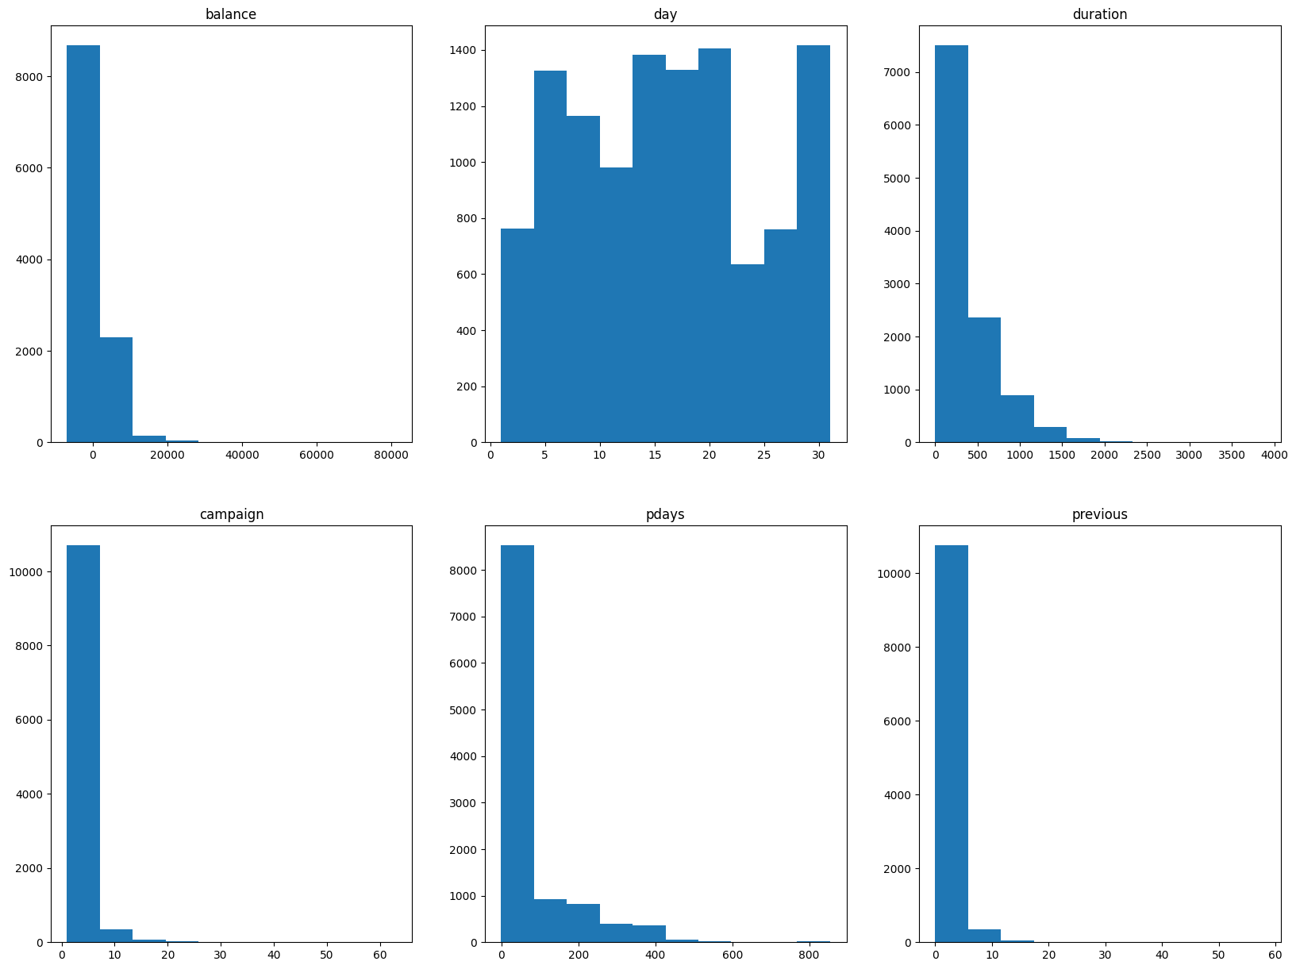
Data Exploration
These are graphs showing different exploration in between the features of the dataset.
Notes:
In this Project we will get into how to use the dataset and model the recommendation system for the user based on their product ratings.
The dataset provides a wide range of fine food products. The selected dataset of fifteen million reviews across these product categories provides an opportunity to study how user tastes develop and change due to the act of consuming more products. This allows for the creation of a recommendation system that acknowledges and accounts for a user's level of experience, offering products they might enjoy at their current level while considering how their tastes might change in the future. Ultimately, the dataset provides insights into the relationship between user experience and preference, leading to improved recommendation models.

Slide 7
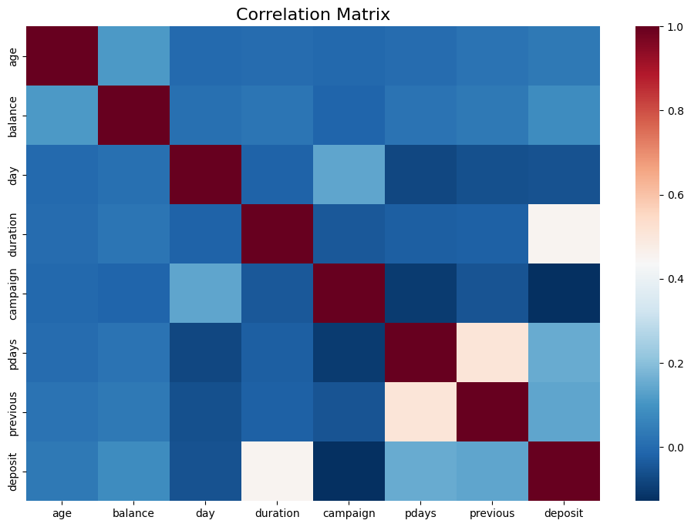
Correlation Matrix
Completed initial dataset analysis
Generated correlation matrices between features
Heatmap showing relationships among features (e.g., age, balance, duration)
With that we can determine if duration has influence on term deposits.
Notes:
In this Project we will get into how to use the dataset and model the recommendation system for the user based on their product ratings.
The dataset provides a wide range of fine food products. The selected dataset of fifteen million reviews across these product categories provides an opportunity to study how user tastes develop and change due to the act of consuming more products. This allows for the creation of a recommendation system that acknowledges and accounts for a user's level of experience, offering products they might enjoy at their current level while considering how their tastes might change in the future. Ultimately, the dataset provides insights into the relationship between user experience and preference, leading to improved recommendation models.

Slide 8
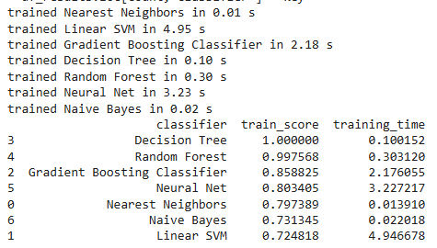
Model Performance
Implemented seven models:
Decision Tree
Random Forest
Gradient Boosting Classifier
Nearest Neighbors
Naive Bayes
Linear SVM
Neural Net
Notes:
In this Project we will get into how to use the dataset and model the recommendation system for the user based on their product ratings.
The dataset provides a wide range of fine food products. The selected dataset of fifteen million reviews across these product categories provides an opportunity to study how user tastes develop and change due to the act of consuming more products. This allows for the creation of a recommendation system that acknowledges and accounts for a user's level of experience, offering products they might enjoy at their current level while considering how their tastes might change in the future. Ultimately, the dataset provides insights into the relationship between user experience and preference, leading to improved recommendation models.

Slide 9
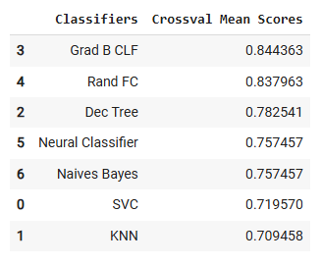
Cross Validation Technique
Scores after cross validation techniques.
Notes:
In this Project we will get into how to use the dataset and model the recommendation system for the user based on their product ratings.
The dataset provides a wide range of fine food products. The selected dataset of fifteen million reviews across these product categories provides an opportunity to study how user tastes develop and change due to the act of consuming more products. This allows for the creation of a recommendation system that acknowledges and accounts for a user's level of experience, offering products they might enjoy at their current level while considering how their tastes might change in the future. Ultimately, the dataset provides insights into the relationship between user experience and preference, leading to improved recommendation models.

Slide 10
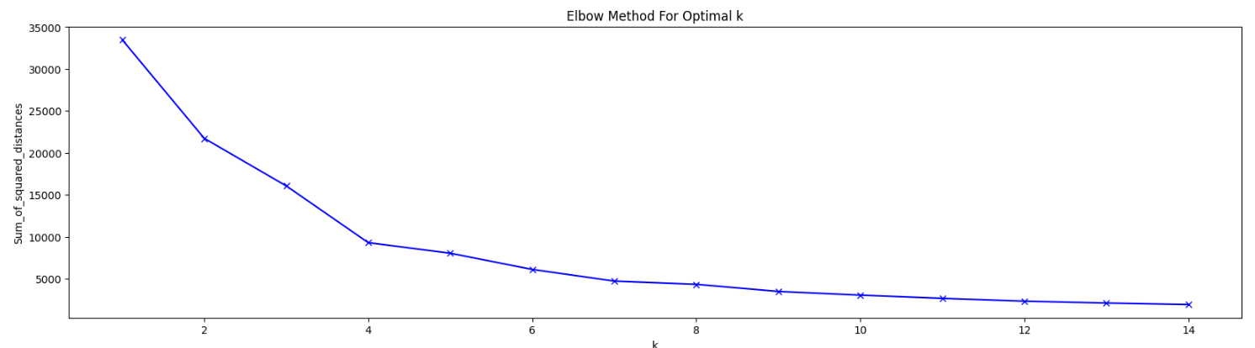
Elbow Method
Here we can see the curve which shows the optimal value of K which is coming in between 4 and 6.
Notes:
In this Project we will get into how to use the dataset and model the recommendation system for the user based on their product ratings.
The dataset provides a wide range of fine food products. The selected dataset of fifteen million reviews across these product categories provides an opportunity to study how user tastes develop and change due to the act of consuming more products. This allows for the creation of a recommendation system that acknowledges and accounts for a user's level of experience, offering products they might enjoy at their current level while considering how their tastes might change in the future. Ultimately, the dataset provides insights into the relationship between user experience and preference, leading to improved recommendation models.

Slide 11
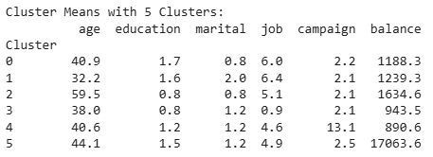
K Means
Below we can see the K means for the features.
Notes:
In this Project we will get into how to use the dataset and model the recommendation system for the user based on their product ratings.
The dataset provides a wide range of fine food products. The selected dataset of fifteen million reviews across these product categories provides an opportunity to study how user tastes develop and change due to the act of consuming more products. This allows for the creation of a recommendation system that acknowledges and accounts for a user's level of experience, offering products they might enjoy at their current level while considering how their tastes might change in the future. Ultimately, the dataset provides insights into the relationship between user experience and preference, leading to improved recommendation models.

Slide 12
Conclusion
Key outcomes of the analysis are the recommendations for future marketing campaigns:
The customer's account balance has a huge influence on the campaign's outcome. People with account balance above 1490$ are more likely to subscribe for term deposit, so future address those customers.
The customer's age affects campaign outcome as well. Future campaigns should concentrate on customers from age categories below 30 years old and above 50 years old.
Number of contacts with the customer during the campaign is also very important. The number of contacts with the customer shouldn't exceed 4.
Notes:
In this Project we will get into how to use the dataset and model the recommendation system for the user based on their product ratings.
The dataset provides a wide range of fine food products. The selected dataset of fifteen million reviews across these product categories provides an opportunity to study how user tastes develop and change due to the act of consuming more products. This allows for the creation of a recommendation system that acknowledges and accounts for a user's level of experience, offering products they might enjoy at their current level while considering how their tastes might change in the future. Ultimately, the dataset provides insights into the relationship between user experience and preference, leading to improved recommendation models.

Slide 13
Planned Improvements
Implement dimensionality reduction techniques to improve our model performance (PCA).
Perform dimensionality reduction analysis.
Unsupervised Learning Implementation
Apply clustering algorithms to identify customer segments
Conduct anomaly detection for unusual patterns
Cross-Validation Enhancement
Implement stratified k-fold cross-validation
Develop more robust evaluation metrics
Notes:
In this Project we will get into how to use the dataset and model the recommendation system for the user based on their product ratings.
The dataset provides a wide range of fine food products. The selected dataset of fifteen million reviews across these product categories provides an opportunity to study how user tastes develop and change due to the act of consuming more products. This allows for the creation of a recommendation system that acknowledges and accounts for a user's level of experience, offering products they might enjoy at their current level while considering how their tastes might change in the future. Ultimately, the dataset provides insights into the relationship between user experience and preference, leading to improved recommendation models.

Slide 14
Thank you

