Slide 1

BHAO.PK
Centralized E-Commerce Product Search & Price Monitoring Engine
Supervised by: Dr. Najam Aziz
Muhammad Ahad Ali Khan
Sheryar Karim
Muhammad Haris Jamali
BCS213129
BCS221074
BCS221027
Department of Computer Science
Capital University of Science & Technology, Islamabad
Fall 2025

Slide 2
THE PROBLEM
1
No Centralized Platform
2
Manual Price Tracking
Pakistani consumers have no unified platform to compare prices across multiple e-commerce stores like Daraz, PakStyle, and iShopping.
Shoppers manually visit multiple websites and social media groups to find the best deals — a time-consuming and unreliable process.
3
No Price History
4
Missed Deals
There is no way to view historical price trends, making it impossible to know if a “sale” price is genuinely discounted.
Without automated alerts, consumers miss price drops on products they’re interested in, often paying more than necessary.

Slide 3
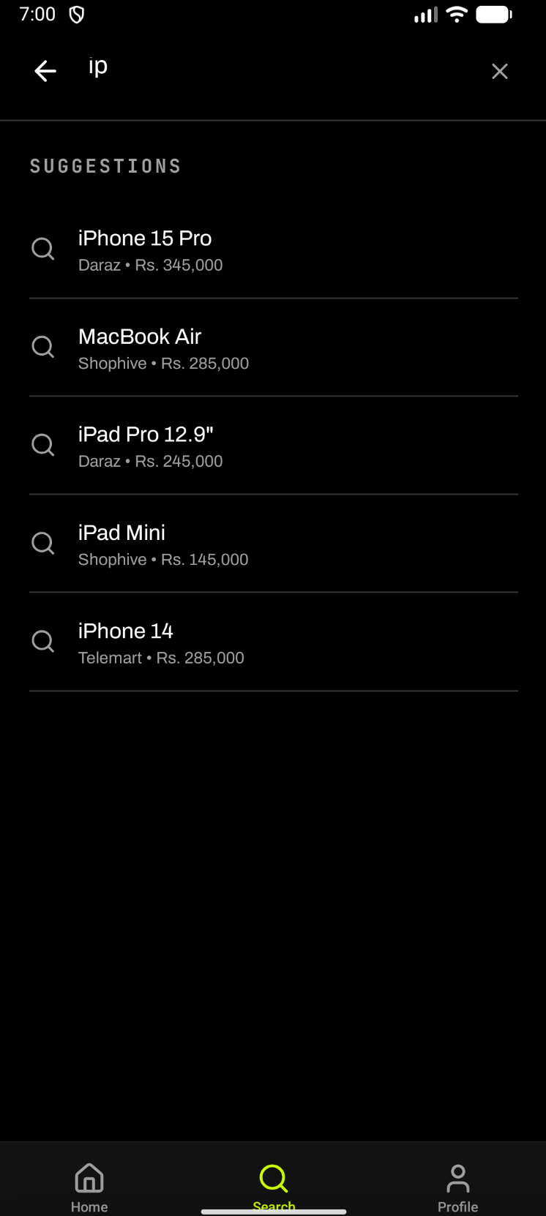
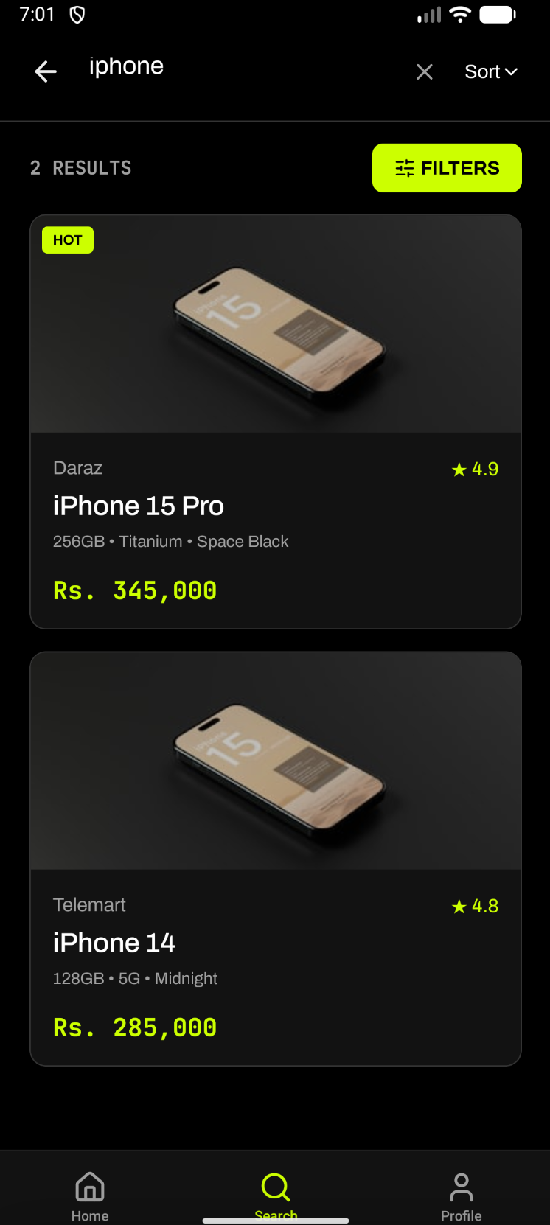
OUR SOLUTION
Bhao.pk is Pakistan’s first intelligent price comparison platform that aggregates products from multiple Pakistani e-commerce stores into one unified experience.
Search once, compare prices across Daraz, Shopive, Telemart & more
Sort & filter results by price, store, and category
Track price history with visual charts
Set price alerts — get notified when prices drop
Save products to your personal wishlist
Available on both Mobile App and Web

Slide 4
KEY FEATURES
01
02
03
04
Smart Search
Price Comparison
Sort & Filter
Price Alerts
Search products across multiple Pakistani stores with a single query. Real-time suggestions as you type.
View prices from different vendors on a unified product page. Instantly spot the best deal.
Sort results by price (low to high) and filter by specific stores or price ranges.
Set a target price for any product. The system monitors prices and notifies you when it drops.
05
06
07
08
Price History
Wishlist
User Accounts
Admin Dashboard
View graphical charts showing how a product’s price has changed over time across stores.
Save interesting products to your personal wishlist for quick access later.
Create an account to sync your wishlist, alerts, and preferences across devices.
Administrative panel for monitoring platform statistics and system health.

Slide 5
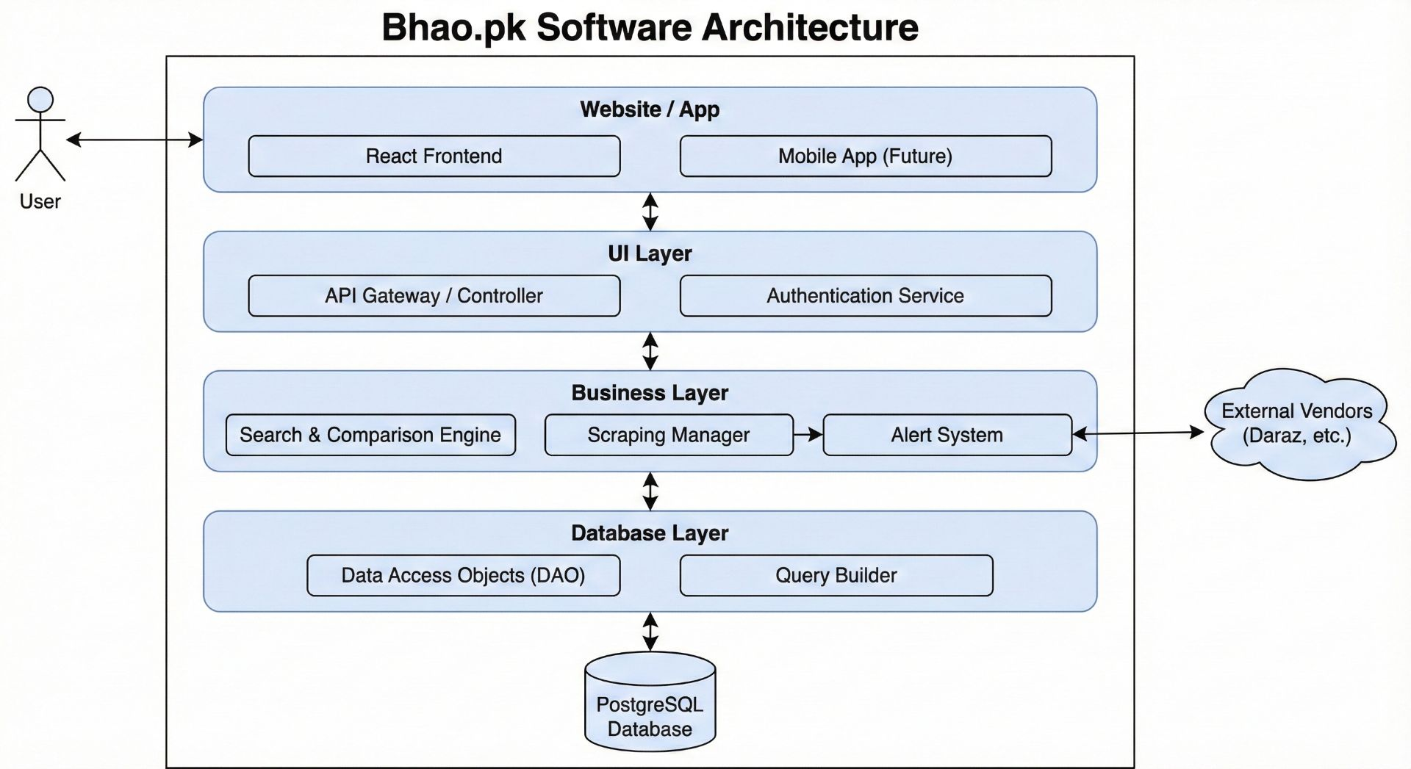
SYSTEM ARCHITECTURE

Slide 6
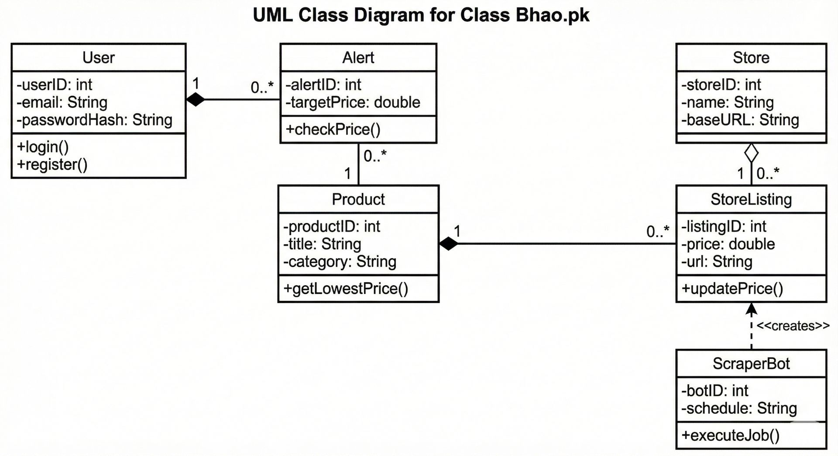
CLASS DIAGRAM

Slide 7
TECHNOLOGY STACK
MOBILE APP
WEB APP
BACKEND
DESIGN
React Native 0.81
Next.js
RESTful API
Dark Theme UI
Expo SDK 54
React 19
JWT Authentication
Archivo Font Family
TypeScript
TypeScript
Web Scraping
Component Library
AsyncStorage
Responsive Design
Price Monitoring
Cross-Platform

Slide 8
HOW IT WORKS
1
2
3
4
5
SEARCH
AGGREGATE
COMPARE
DECIDE
TRACK
User types a
product name
System searches
across all stores
Prices displayed
on a single page
User picks the
best deal
Set alerts &
save to wishlist
Bhao.pk automatically collects product data from multiple Pakistani e-commerce platforms. When a user searches for a product, the system instantly shows prices from every available store, helping users find the lowest price without visiting each site individually.

Slide 9
SEARCH & COMPARE
One Search. Every Store.
Type any product name in the search bar
See real-time suggestions as you type
Results from Daraz, Telemart, Shopive appear together
Each result shows the product name, price, and which store it’s from
Tap any product to see the full product page with price history

Slide 10
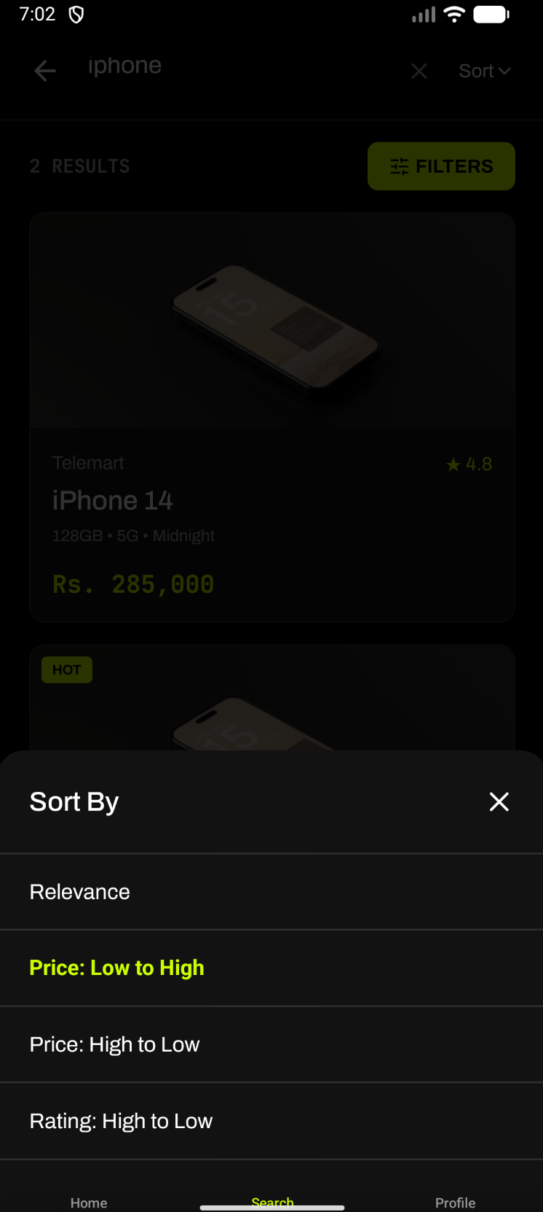
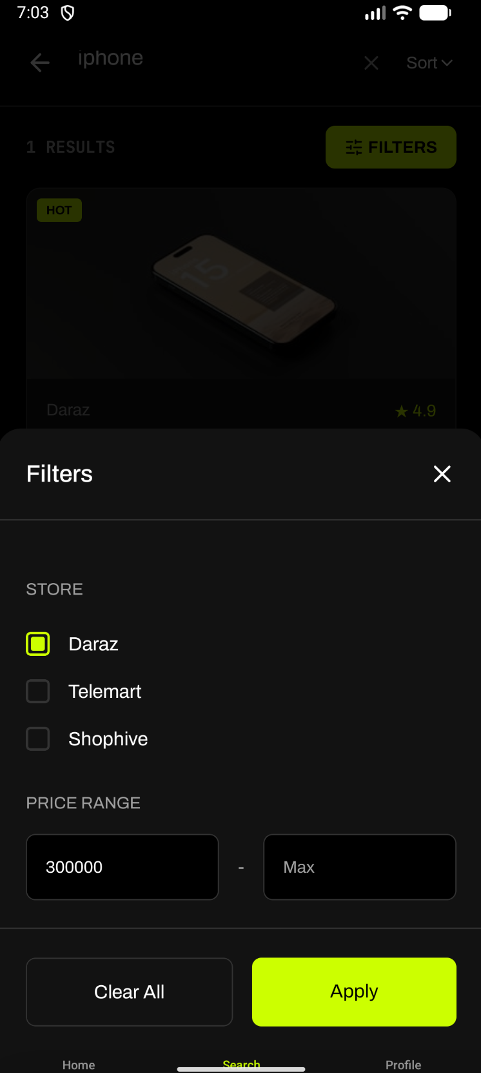
FILTER & SORT
Find Exactly What You Need
Sort results by price: lowest first or highest first
Filter by specific store (e.g., show only Daraz products)
Set a minimum and maximum price range
Combine filters to narrow down the perfect product
Results update instantly when filters change

Slide 11
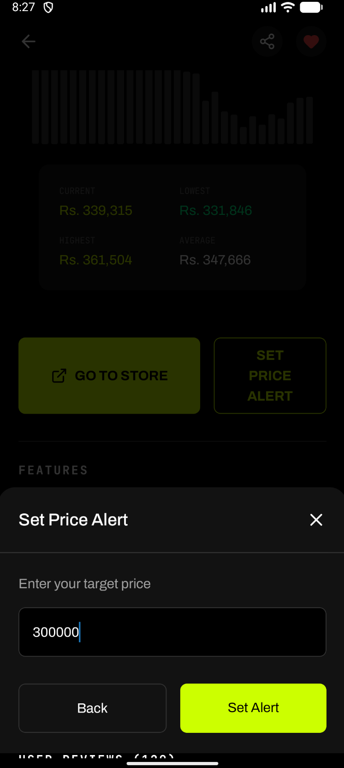

PRICE ALERTS & WISHLIST
Never Miss a Deal
Set a target price for any product you’re watching
The system continuously monitors prices in the background
Get notified immediately when the price drops to your target
Save products to your wishlist with one tap
Access your saved items anytime from your profile

Slide 12
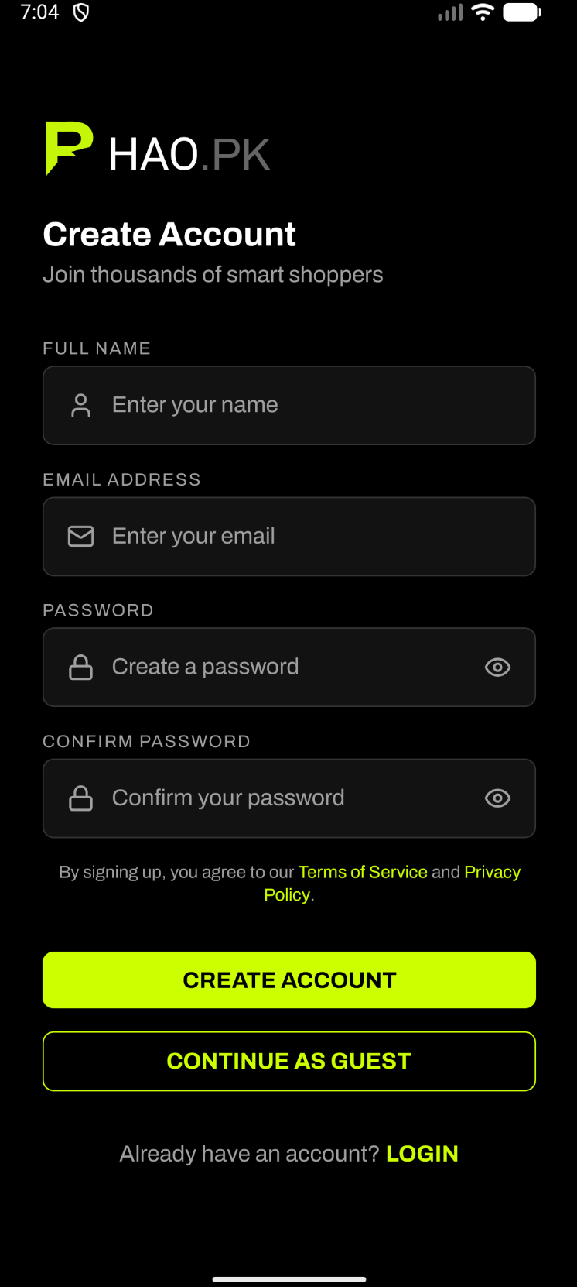
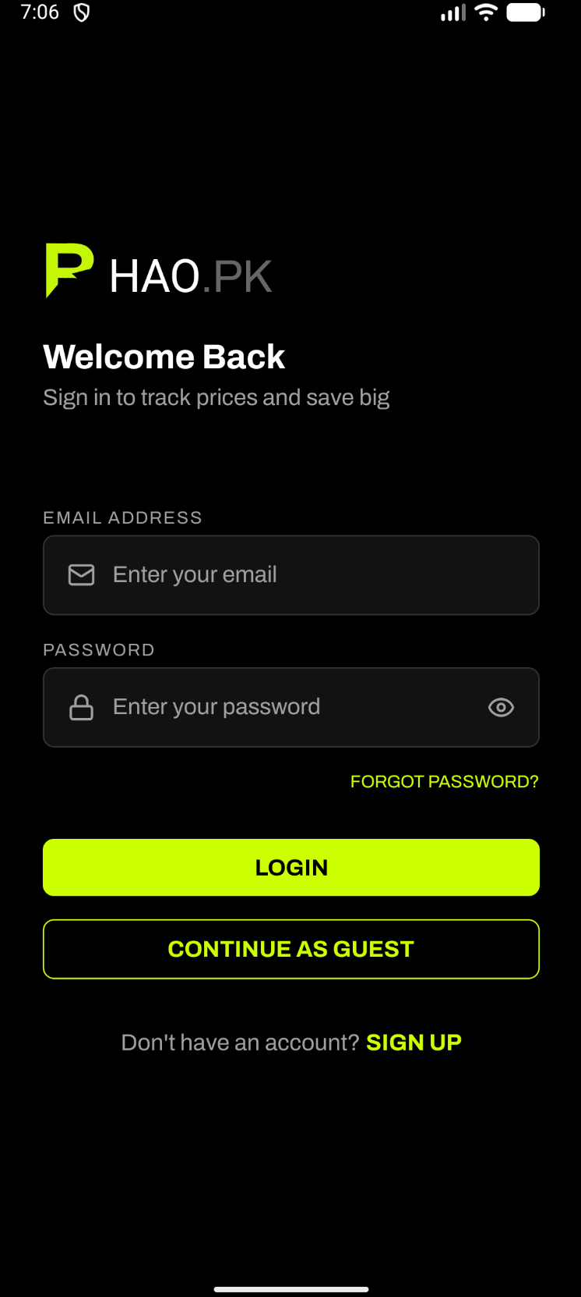
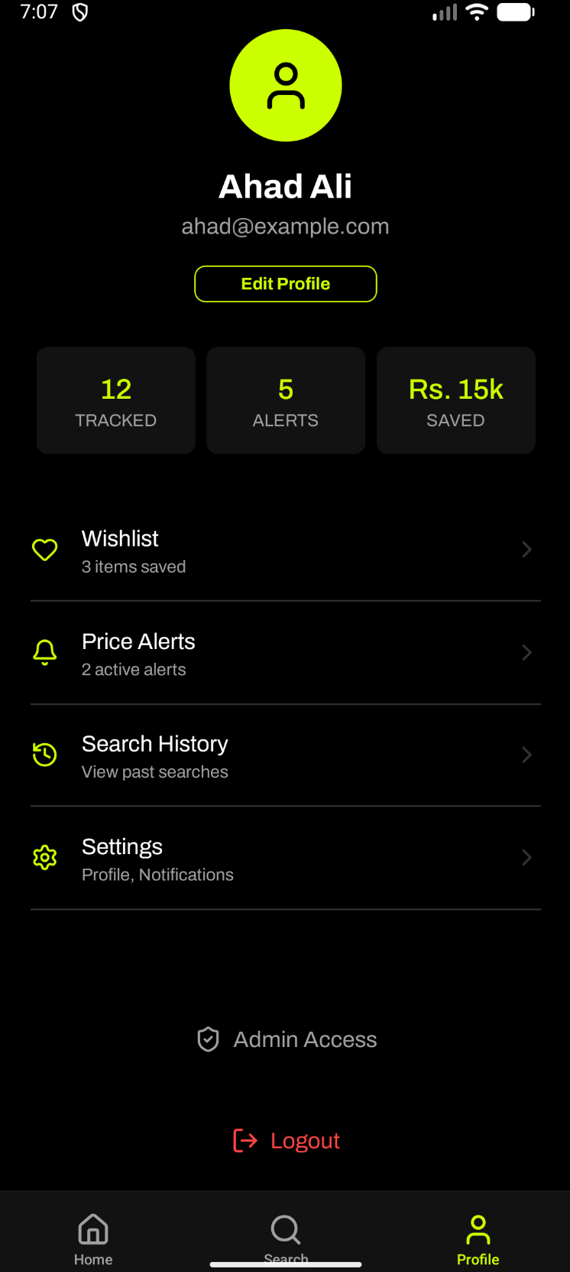
USER ACCOUNTS
Secure & Simple
Create an account with name, email, and password
Smart form validation catches errors before submission
Secure login with password visibility toggle
Password recovery via email for forgotten passwords
Guest mode available — browse without signing up
One-tap logout with confirmation for safety

Slide 13
TESTING RESULTS
Black Box Testing — 8 functional requirements tested, all passed
TC-01
TC-02
TC-03
TC-04
Product Search
Sort by Price
Filter by Store
User Sign Up
PASSED
PASSED
PASSED
PASSED
TC-05
TC-06
TC-07
TC-08
User Login
User Logout
Add to Wishlist
Set Price Alert
PASSED
PASSED
PASSED
PASSED
8 / 8 TEST CASES PASSED — 100% SUCCESS RATE

Slide 14
FUTURE ENHANCEMENTS
1
Push Notifications
2
Email Notifications
Real-time mobile push alerts when tracked product prices drop below the user’s target price.
Email digests for price drops, weekly deal summaries, and alert confirmations.
3
Personalized Recommendations
4
Scheduled Price Refresh
Intelligent product suggestions based on user browsing history, wishlist, and search patterns.
Automated background price updates at regular intervals to ensure data is always current.
5
More Store Integrations
6
Browser Extension
Expand coverage to additional Pakistani e-commerce platforms and international stores.
A Chrome/Firefox extension that shows Bhao.pk price comparisons while browsing any store. (Not in project scope but in the future)

Slide 15
THANK YOU
Questions & Discussion
Muhammad Ahad Ali Khan • Sheryar Karim • Muhammad Haris Jamali
Supervised by Dr. Najam Aziz
Department of Computer Science
Capital University of Science & Technology, Islamabad

