Slide 1
Toward exploring virtual disks using a file manager!
Arik Hadas
Principal Software Engineer
Red Hat
02/02/2019

Slide 2
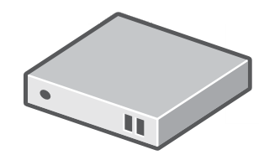
Virtualization

Slide 3


Virtualization

Slide 4
Benefits of Virtualization
Security
Emulation of
other OSs
Easier to back up
Easier to clone to
another machine
...
Abstraction!

Slide 5

But Abstraction Comes with a Cost
How can I copy data to or
from within a virtual machine?

Slide 6
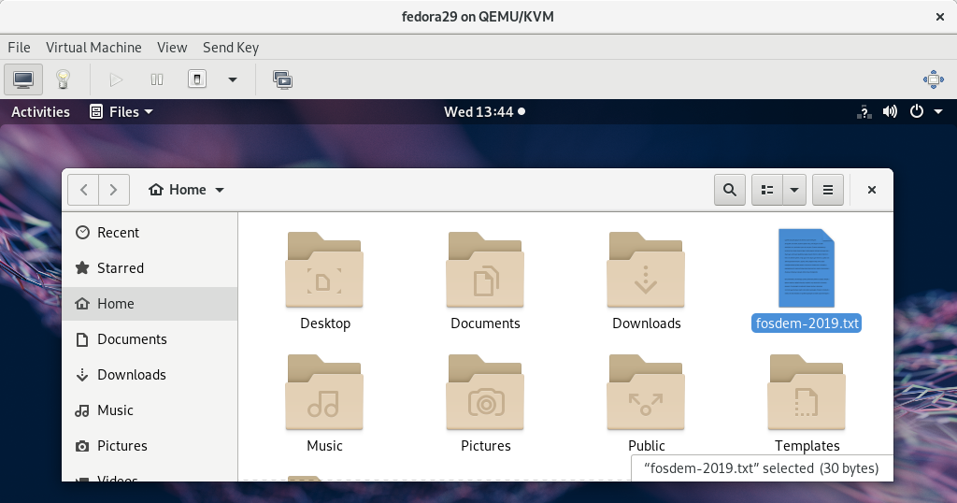
Case #1: From a Running VM
How to copy a file from this guest?

Slide 7
Case #1: Possible Solutions
Slow
Browser-based solutions
  Email, file-sharing service (e.g., dropbox), ...
Lan-based solutions
  SCP, NFS share, ...
Guest agent-based solutions
  Shared-folder / Exposing a service
Complex
Vendor
Specifc

Slide 8
Case #2: From a Virtual Disk
How can I copy to/from a disk?

Slide 9
Case #2: Possible Solutions
How can I copy to/from a disk?
Non-bootable disk
Bootable disk
Attach to a VM
Attach to a VM /
Start a VM
Slow and
more complicated
Cannot write
to the disk

Slide 10


The Proposed Approach
muCommander
Libguestfs
Browsing and modifying
virtual disks using a file manager

Slide 11
Libguestfs
Tools for accessing and modifying virtual machine disk images

Slide 12
Capabilities of Libguestfs
secure — does not need root and with multiple layers of defence against rogue disk images
Can access almost any disk image imaginable
Can access proprietary
systems like VMware and
Hyper-V.
Can access disk images
on remote machines or
on CDs/USB sticks
All this functionality is available through a scriptable shell
called guestfish, or an interactive rescue shell virt-rescue.

Slide 13

muCommander – The Short Form
"I have found jesus. He came to me in the form of muCommander."
            - A happy user

Slide 14
muCommander – The Long Form
muCommander is a lightweight, cross-platform file manager with a dual-pane interface. It runs on any operating system with Java support (macOS, Windows, Linux, *BSD, Solaris...)

Slide 15
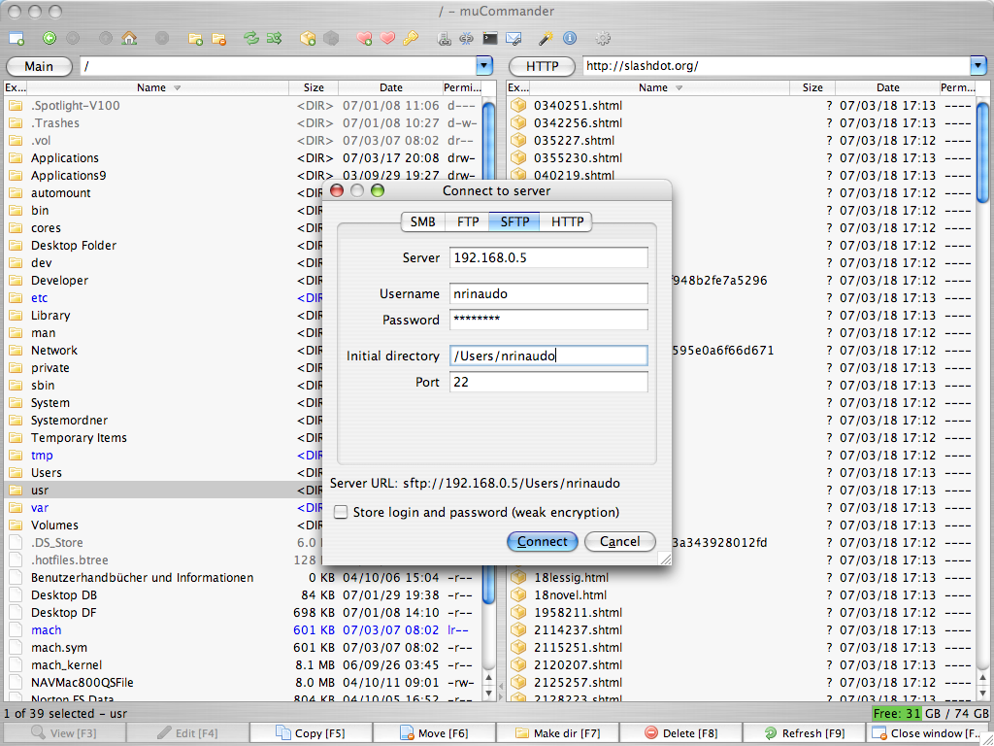
muCommander – Screenshot

Slide 16
muCommander – Major Features
Quickly copy, move, rename files, create directories, email files...
Browse, create and uncompress ZIP, RAR, 7z, TAR, GZip, BZip2, ISO/NRG, AR/Deb and LST archives
Virtual filesystem with support for local volumes, FTP, SFTP, SMB, NFS, HTTP, Amazon S3, Hadoop HDFS and Bonjour
ZIP files can be modified on-the-fly, without having to recompress the whole archive
Universal bookmarks and
credentials manager
Multiple windows support
Tabbed navigation
Full keyboard access
Highly configurable
Available in 27 (!) languages
Free and open source
(GPL)

Slide 17
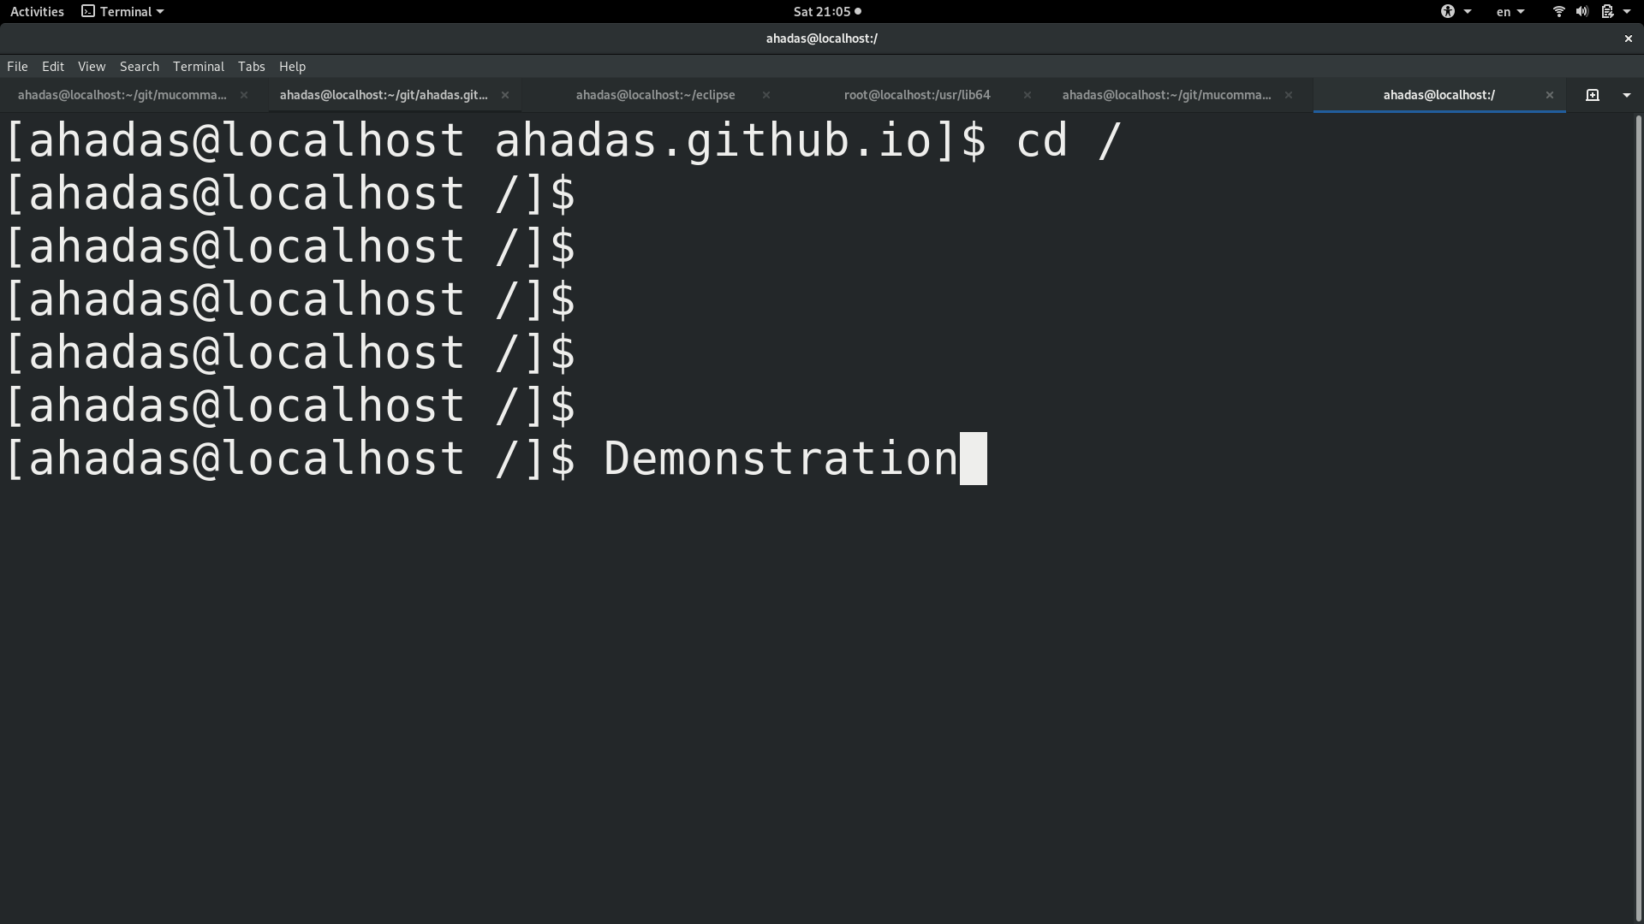
Let’s See It in Action

Slide 18
Challenges
How to model virtual disks (in muCommander)
  Local as archive files
  Need lazy inspection as protocol files
How bridge different APIs
  For listing the content of a virtual disk
  For reading and writing data to the disk
How to ship it

Slide 19

Challenge #1: Model Virtual Disks
Archive Files
Protocol Files
Local Files
Within a file-system,
No authenication
Remote,
Authenication needed
Within a file-system,
No authenication
Query their
entire structure
Query their structure in a lazy way
Virtual disks fit neither of these groups

Slide 20
Challenge #2: Bridge Different APIs
(1) Query content
Archive Files
(2) Full structure
Libguestfs does not support querying full structure
Bridge the difference using the visitor pattern
Output stream
Files
Input stream
Libguestfs does not support streams
Bridge the difference using temporary files

Slide 21
Challenge #3: How to Ship
libguestfs.jar
libguestfs-java
Needed at compile time
Needed at run time
Part of libguestfs-java
Might be missing
Provide as a plugin
that requires libguestfs-java

Slide 22
Open Questions
How to present the content of the disk
  Guest view – slow, requires OS & all disks
  Filesystem view – harder to use
  Maybe a combination of the two?
Do we want to interact with Libvirt?
How to implement caching
  Cannot rely on the disk’s modification date

Slide 23

The Vision: Pluggable File Manager
ZIP
SFTP
QCOW
RAR
VMDK
oVirt?
Dropbox?
...
Google Drive?

Slide 24
Roadmap
v0.9.0: Dec 19, 2015
v0.9.1: Oct 21, 2016
v0.9.2: Jun 7, 2017
v0.9.3: Nov 13, 2018
  v0.9.3-1: Dec 8, 2018
  v0.9.3-2: Dec 15, 2018
  v0.9.3-3: Jan 12, 2019
v0.9.4: TBD

Slide 25
Summary
Plugin for virtual disks in muCommander
  Based on an integration with Libguestfs
  Provides user-interface for Libguestfs
Status: work-in-progress
  Published a POC in Nov, 2018
  Discussed on libguestfs mailing-list
  Estimated release date: second half of 2019
  Your feedback is welcome!

Slide 26
THANK YOU!
http://www.mucommander.com/
http://libguestfs.org/
https://github.com/mucommander/
https://gitter.im/mucommander
ahadas@redhat.com

