Slide 1
High Availability with
No Split Brains!
Arik Hadas
Principal Software Engineer
Red Hat
27/01/2018

Slide 2

Virtual Data Center – Physical Servers

Slide 3


Virtual Data Center – Virtual Machines

Slide 4

Virtual Data Center - Applications

Slide 5
Some Applications are More Critial

Slide 6



High Availability - Application-Level

Slide 7


High Availability - Application-Level

Slide 8
High Availability - Application-Level
Higher resource consumption
More responsibility on the application
Backup lives in a different environment
  Different IP address(es)
  Different disk(s)

Slide 9
High Availability - VM-Level

Slide 10
High Availability - VM-Level

Slide 11
High Availability - VM-Level
More efficient resource consumption
Solution in the infrastructure level
Backup starts in the same environment
  Same IP address(es)
  Same disk(s)

Slide 12


Central Monitoring Unit

Slide 13
Fault Detection
HA VM
went down!

Slide 14
Automatic Restart
Restart
the VM

Slide 15
Automatic Restart – Not That Simple
What if:
  Inaccessible resources
  VM is locked
  VM is being intentionally shut down
Restart
the VM

Slide 16

Automatic Restart – Not That Simple
What if:
  Inaccessible resources
  VM is locked
  VM is being intentionally shut down
AutoStartVmsRunner
https://github.com/oVirt/ovirt-engine/blob/master/backend/manager/modules/bll/src/main/java/org/ovirt/engine/core/bll/AutoStartVmsRunner.java

Slide 17

AutoStartVmsRunner
Lock VM
Should Restart
No More Tries
Run

Slide 18

Fault Detection – Even More Complex
Is the left
server alive?

Slide 19

Fault Detection – Manual Confirmation
The server has
been rebooted

Slide 20
Fault Detection – Manual Confirmation
Restart
the VM

Slide 21
Fault Detection – Manual Confirmation
Slow
Error-prone
  Mistakes may lead to a split-brain

Slide 22
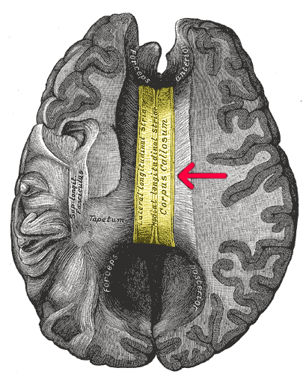
Split Brain of Virtual Machines
A scenario in which several VMs that may write to the same disk(s) are running simultaneously

Slide 23
Split Brain

Slide 24

Split Brain
May lead to data corruption!

Slide 25
Split Brains May Happen Due to Bugs
Only the right
VM is reported
(on startup)

Slide 26
Split Brains May Happen Due to Bugs
Restart
the left VM

Slide 27

Our Solution to Split Brains: VM Leases

Slide 28
Our Solution to Split Brains: VM Leases
VM will not
start while its
lease exists

Slide 29
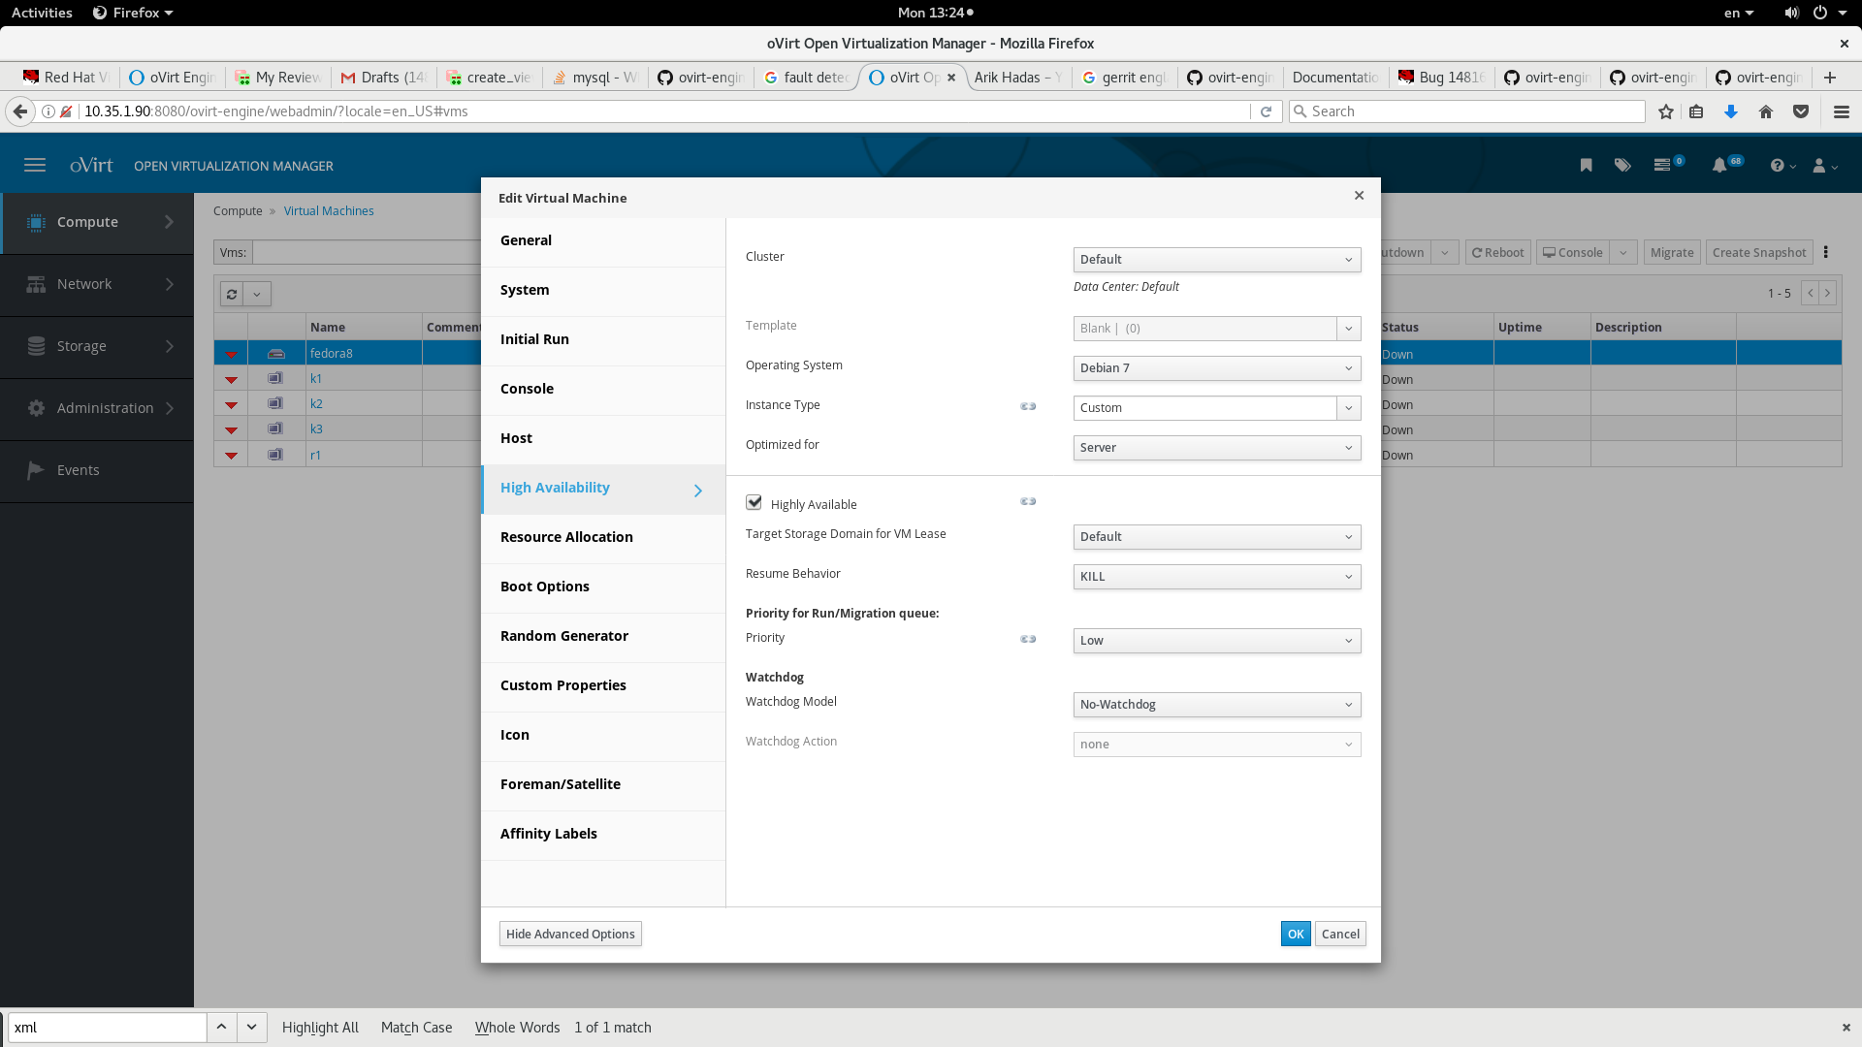
VM Lease Creation

Slide 30
VM Lease Creation

Slide 31

VM Lease Creation
SPM
“Create VM Lease for
VM X in storage domain Y”

Slide 32
VM Lease Creation
“Create a Lease X in
lockspace Y”
SPM
“Create VM Lease for
VM X in storage domain Y”

Slide 33
VM Lease Creation
“Create a Lease X in
lockspace Y”
SPM
“Create VM Lease for
VM X in storage domain Y”
“Path P to xleases
volume and Lease
offset O”

Slide 34
xleases volume
Sanlock does not manage leases allocation
Volume layout:
Same format in block and file storage
Deep Dive - VM leases (youtube)
lockspace
index
master
lease
user
lease 1
user
lease 2
....

Slide 35
Running a VM with a Lease
<domain type='kvm' id='6'>
<name>fedora8</name>
... skipped ...
<devices>
... skipped ...
<lease>
<lockspace>571184ae-79da-41fb-a3fb-c3117991abae</lockspace>
<key>cbd783e4-45f8-4b51-93ca-4460d4dad772</key>
<target path='/rhev/data-center/mnt/10.35.1.90:_srv_Default/571184ae-79da-41fb-a3fb-c3117991abae/dom_md/xleases' offset='3145728'/>
</lease>
... skipped ...
</domain>

Slide 36




Running a VM with a Lease
Acquires the Lease
using Sanlock
Lease
Domain XML
with Lease

Slide 37
Non-Responsive Host Treatment

Slide 38
Non-Responsive Host Treatment
60+ sec of
grace period

Slide 39
Non-Responsive Host Treatment
Fence (power
Management )

Slide 40

Non-Responsive Host + VM is Down
Restart VMs
with a Lease

Slide 41
Non-Responsive Host + VM is Down
VM starts on
another host

Slide 42
Non-Responsive Host + VM is UP
Restart VMs
with a Lease

Slide 43
Non-Responsive Host + VM is UP
Restart VMs
with a Lease

Slide 44
Disconnected Host + VM is UP

Slide 45
Disconnected Host + VM is UP (1)
(1) Lease expires
(2) VM is terminated

Slide 46
Disconnected Host + VM is UP (2)
(2) Lease is released
(1) VM is paused

Slide 47
Summary
VM Lease – an important new element
  Prevents split-brains
  Enables automatic restart of unreported VMs
Available since oVirt 4.1
  Polished in oVirt 4.2
May be used to restart paused VMs in the future

Slide 48
THANK YOU!
http://www.ovirt.org
ahadas@redhat.com
ahadas@irc.oftc.net#ovirt

