Slide 1
Import/Export OVA
Arik Hadas
Deep Dive

Slide 2
Scope
Existing OVA support:
  Importing VMware-compatible OVAs (external OVAs)
Desired OVA support:
  Exporting oVirt-VMs to OVA
    An alternative to export domains*
  Exporting oVirt-templates to OVA
    An alternative to export domains
    To share templates between RHV environments
  Importing oVirt-OVAs

Slide 3
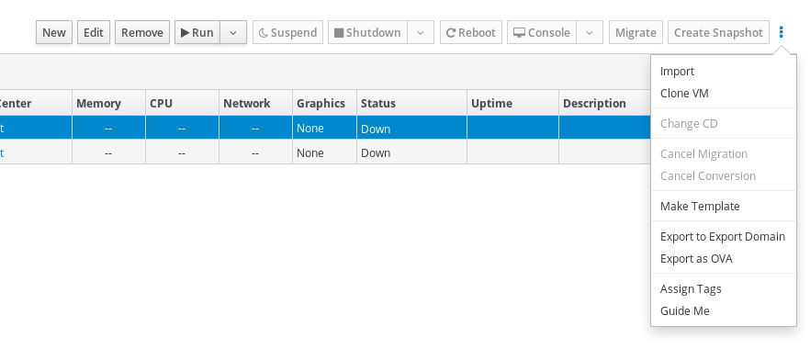
Exporting oVirt-VMs to OVAs

Slide 4
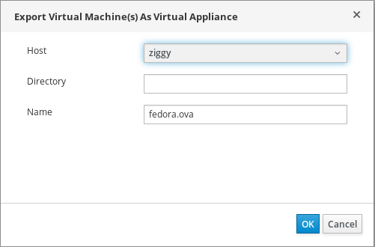
Exporting oVirt-VMs to OVAs

Slide 5
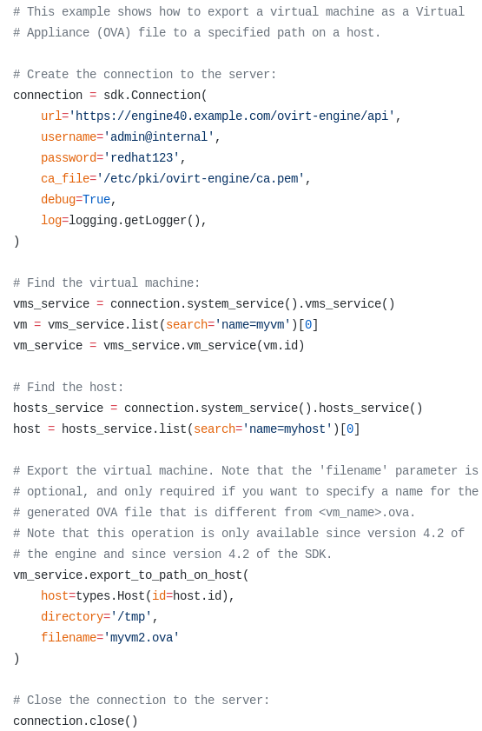
Exporting oVirt-VMs to OVAs
Full SDK Example (github)

Slide 6
Exporting oVirt-VMs to OVAs
Engine
Clone
Disks
Generate
OVF
Generate
OVA
Ansible
SPM
Proxy
Host
Pack the
OVF and cloned
disks into a
tar file
Copy+
Collapse
Disks

Slide 7
Exporting oVirt-VMs to OVAs
engine.log
CopyAllOvaDisksCommand
CopyImageGroupCommand
....
CopyImageGroupCommand
CreateOvaCommand
ovirt-export-ova...log
Playbook ovirt-ova-export
engine.log
RemoveDiskCommand
....
RemoveDiskCommand

Slide 8
Playbook ovirt-ova-export
Role: ovirt-ova-export-pre-pack
Validate the target folder
Prepare <ova name>.ova.tmp file
Role: ovirt-ova-pack
Pack OVF and disk into the file
Role: ovirt-ova-export-post-pack
Rename to <ova_name>.ova
Remove OVA file on failure

Slide 9
Exporting oVirt-templates to OVAs
Not available yet
  Planned for the next release
Very similar process to export VM to OVA
Provides a way of sharing templates

Slide 10
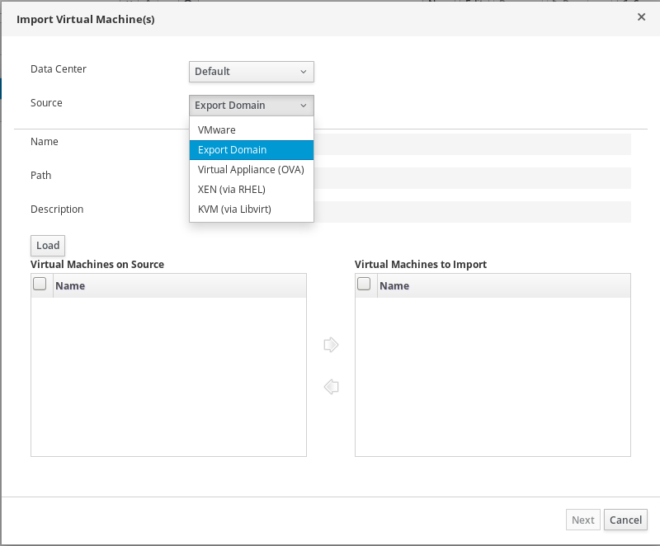
Importing oVirt-OVAs

Slide 11
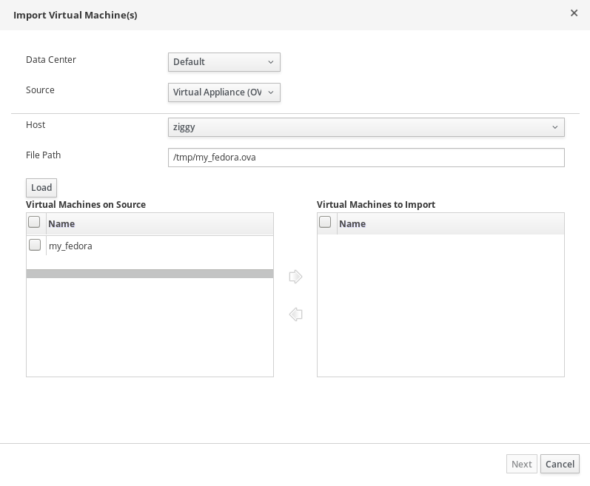
Importing oVirt-OVAs

Slide 12
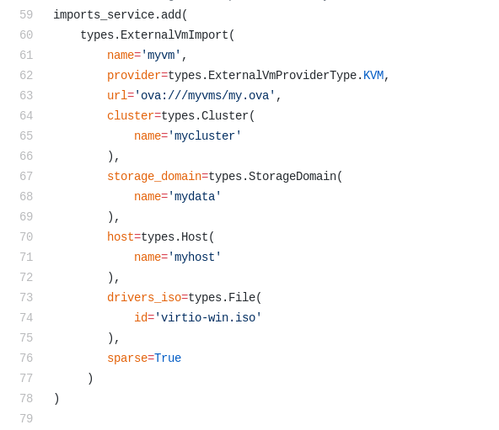
Importing oVirt-OVAs
Full SDK Example (github)

Slide 13
Importing oVirt-OVAs
Similar to importing an external OVA
  From the client side
Does not involve virt-v2v
  Distinguish oVirt-OVAs by ‘ovirt’ namespace
  Use the configuration within the OVF
  Copy the disk volumes to storage domains
Does not support templates yet
Tar file
<ovf:Envelope
xmlns:ovf="http://schemas.dmtf.org/ovf/envelope/1"
...
xmlns:ovirt="http://www.ovirt.org/ovf">
...
vm.ovf
QCOW Volume
QCOW Volume

Slide 14
Importing oVirt-OVAs
engine.log
ImportVmFromOvaCommand
AddDiskCommand
....
AddDiskCommand
ExtractOvaCommand
ovirt-import-ova...log
Playbook ovirt-ova-extract
engine.log
TeardownImageCommand
....
TeardownImageCommand

Slide 15



Uploading OVA
Create a VM from an OVA that resides out of the DC
  Currently, limited to VMs
  In 4.2, limited to oVirt-OVA
  In 4.2, limited to the SDK
Does not involve Ansible
RHV
(1) Upload disks
Machine with SDK
(2) Import configuration

Slide 16
Sharing Vms/templates Efficiently
Using a shared storage (TBD: Glance)
Uploading to another environment
RHV-1
RHV-2
(1) Export
(2) Import
(1) Export
(2) Upload disks
RHV-1
RHV-2
(3) Import configuration

Slide 17
Known Limitations and Pitfalls
May introduce new issues with external OVAs
  Due to unifying OVF parsing
Not an exact alternative to export domain
  For instance, OVAs do not contain snapshots
OVA cannot be produced on block storage
No support for oVirt-OVA as a folder (rather than tar file)
‘File Path’ should point to an OVA
  Although it may seem that the import dialog supports specifying a folder of OVAs as well
Using direct I/O

Slide 18
THANK YOU!
Question?

