Slide 1

Introduction to Deep Learning
With Ahad Jawaid

Slide 2
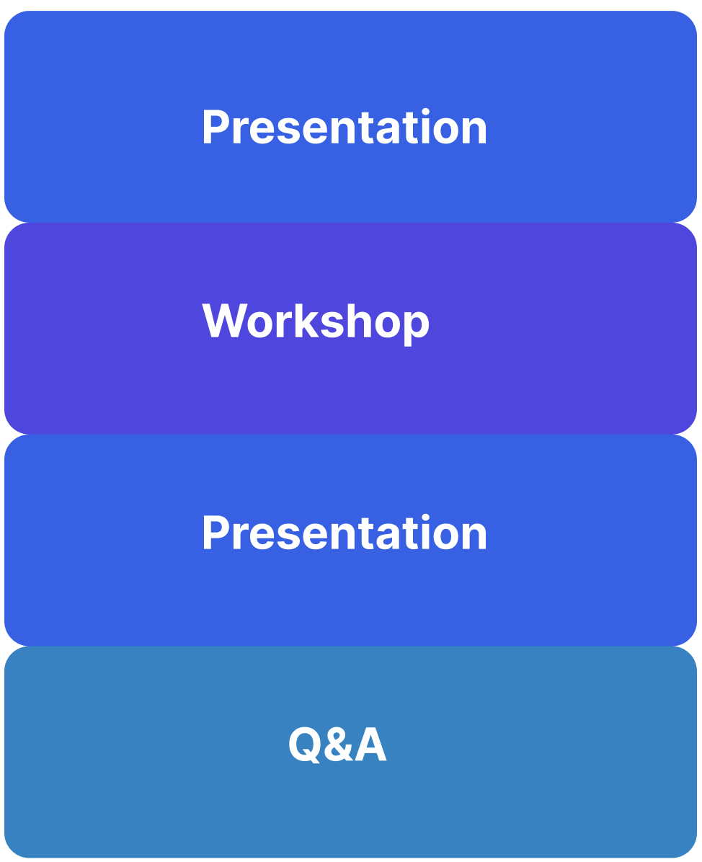
Overview

Slide 3
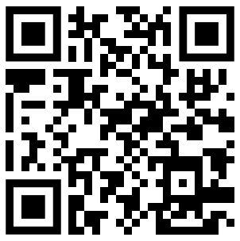
Sign In
SIGN IN CODE: 1959

Slide 4

Function
Outputs
Inputs

Slide 5
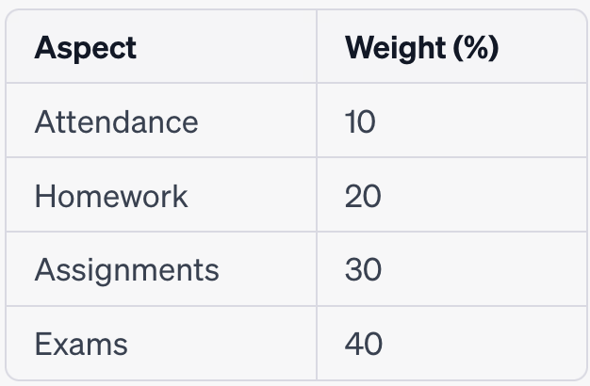
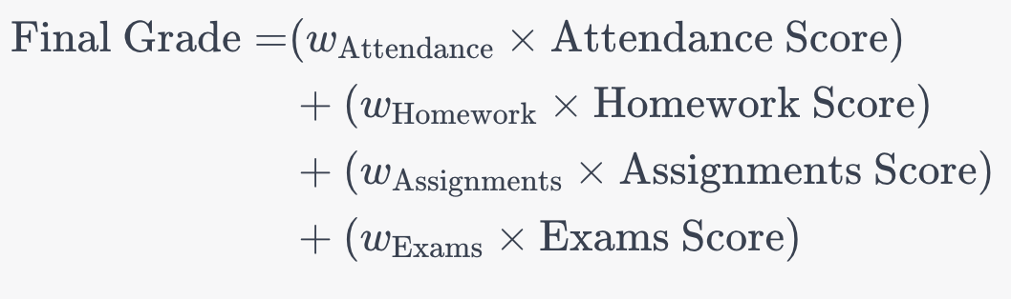
What are weights?

Slide 6


Buying a house

Slide 7


How to value the house?
Size
Age

Slide 8

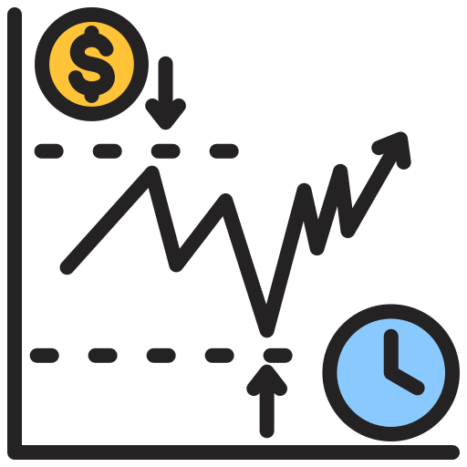


Workshop Time!!!
Think of different attributes for a problem that we can model
Insurance Price
Stock Prices
Sales Prediction
Temperature Prediction

Slide 9

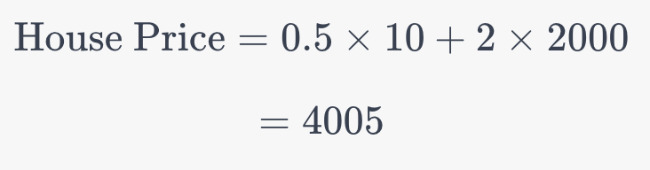
Creating a weighted function

Slide 10
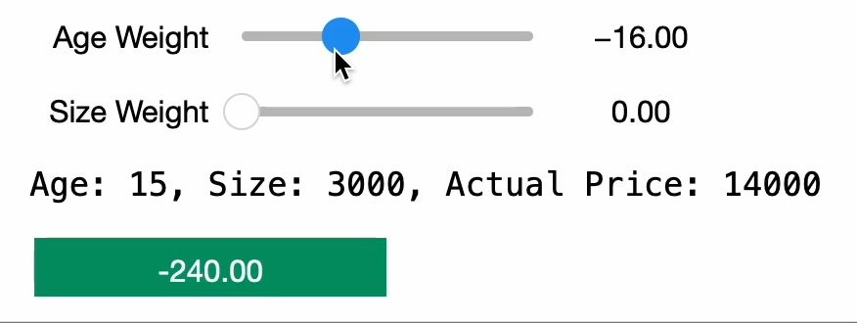
Adjusting the weights

Slide 11


Comparing the difference

Slide 12
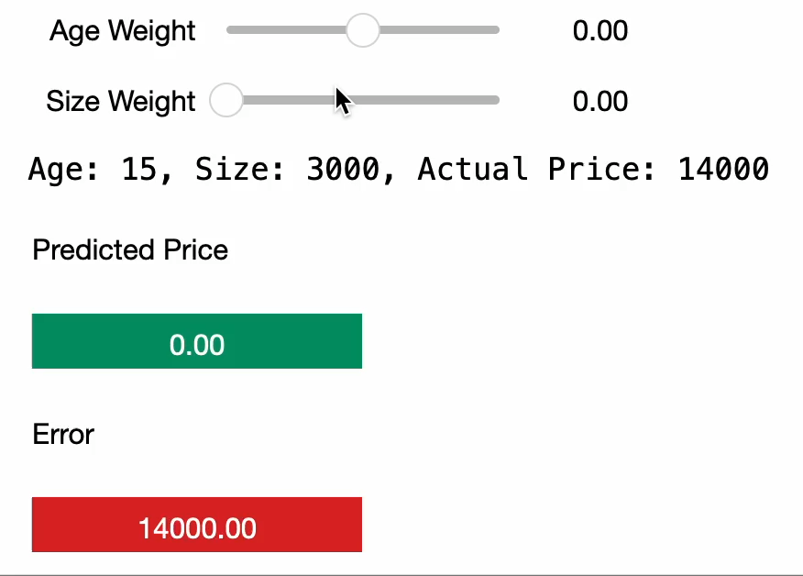
Error as a guide

Slide 13
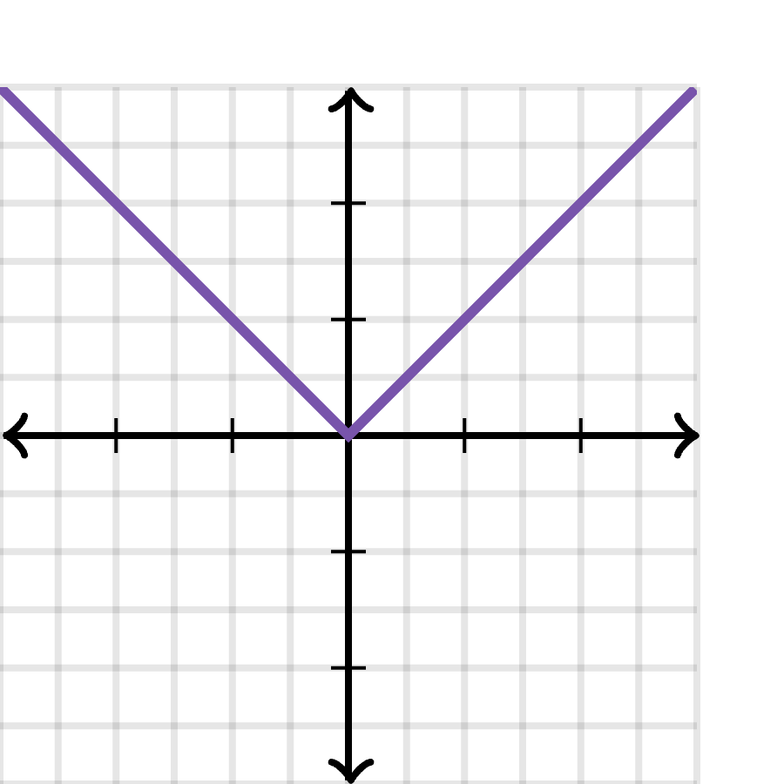
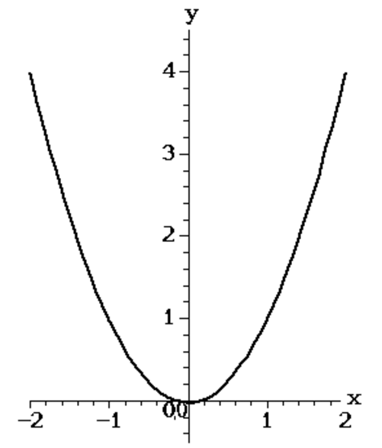
Plotting the differences

Slide 14
Automating it!
Error
Error

Slide 15
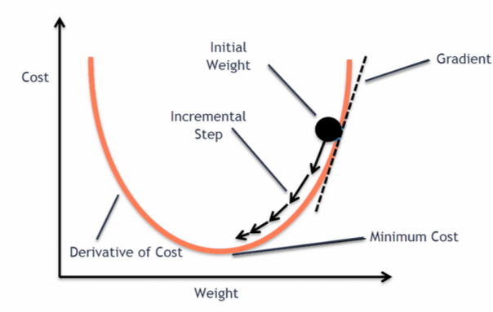
Gradient descent

Slide 16
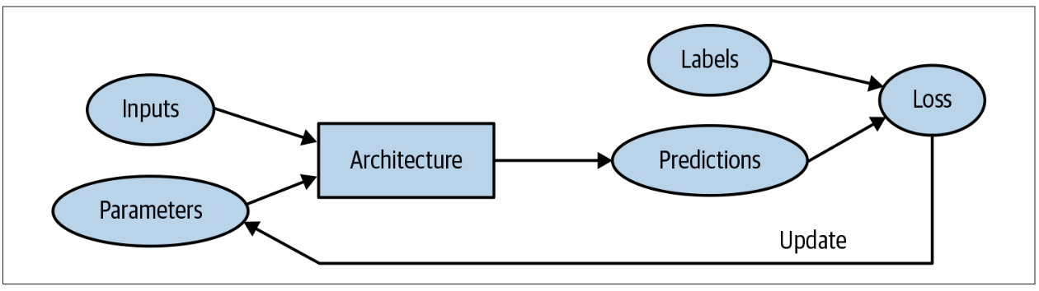
Putting it together

Slide 17
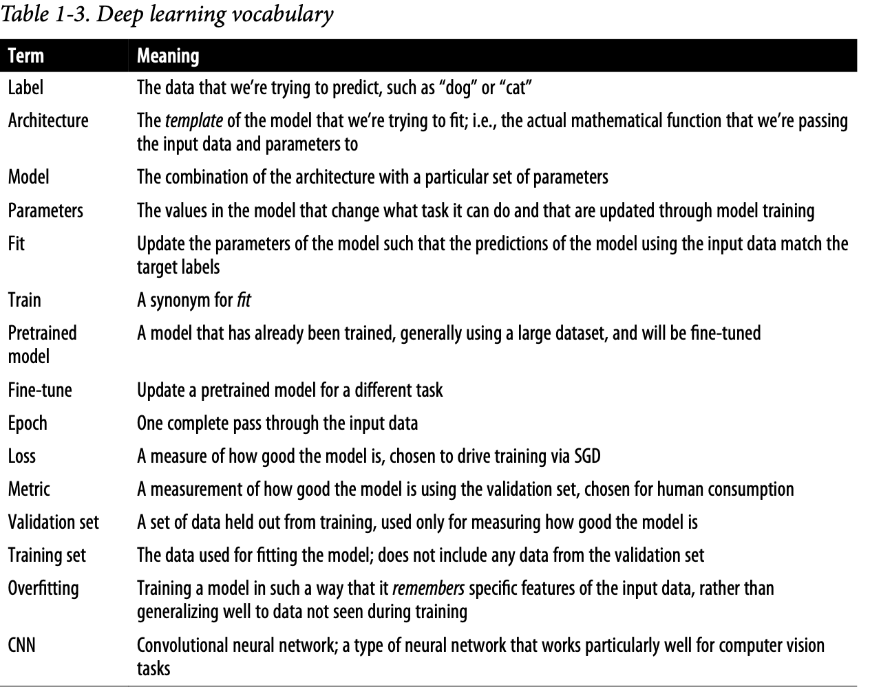

Slide 18
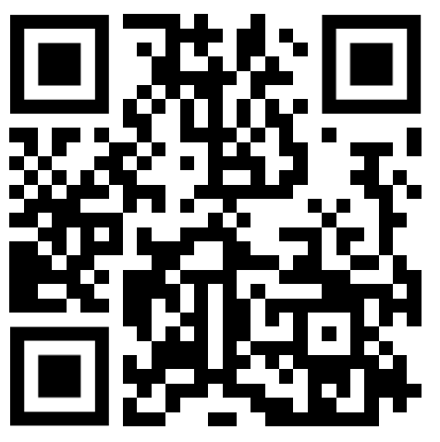
Workshop Time!!
Feedback Form
https://forms.gle/bGwxGQVxcjBr3jQP7

