Slide 1
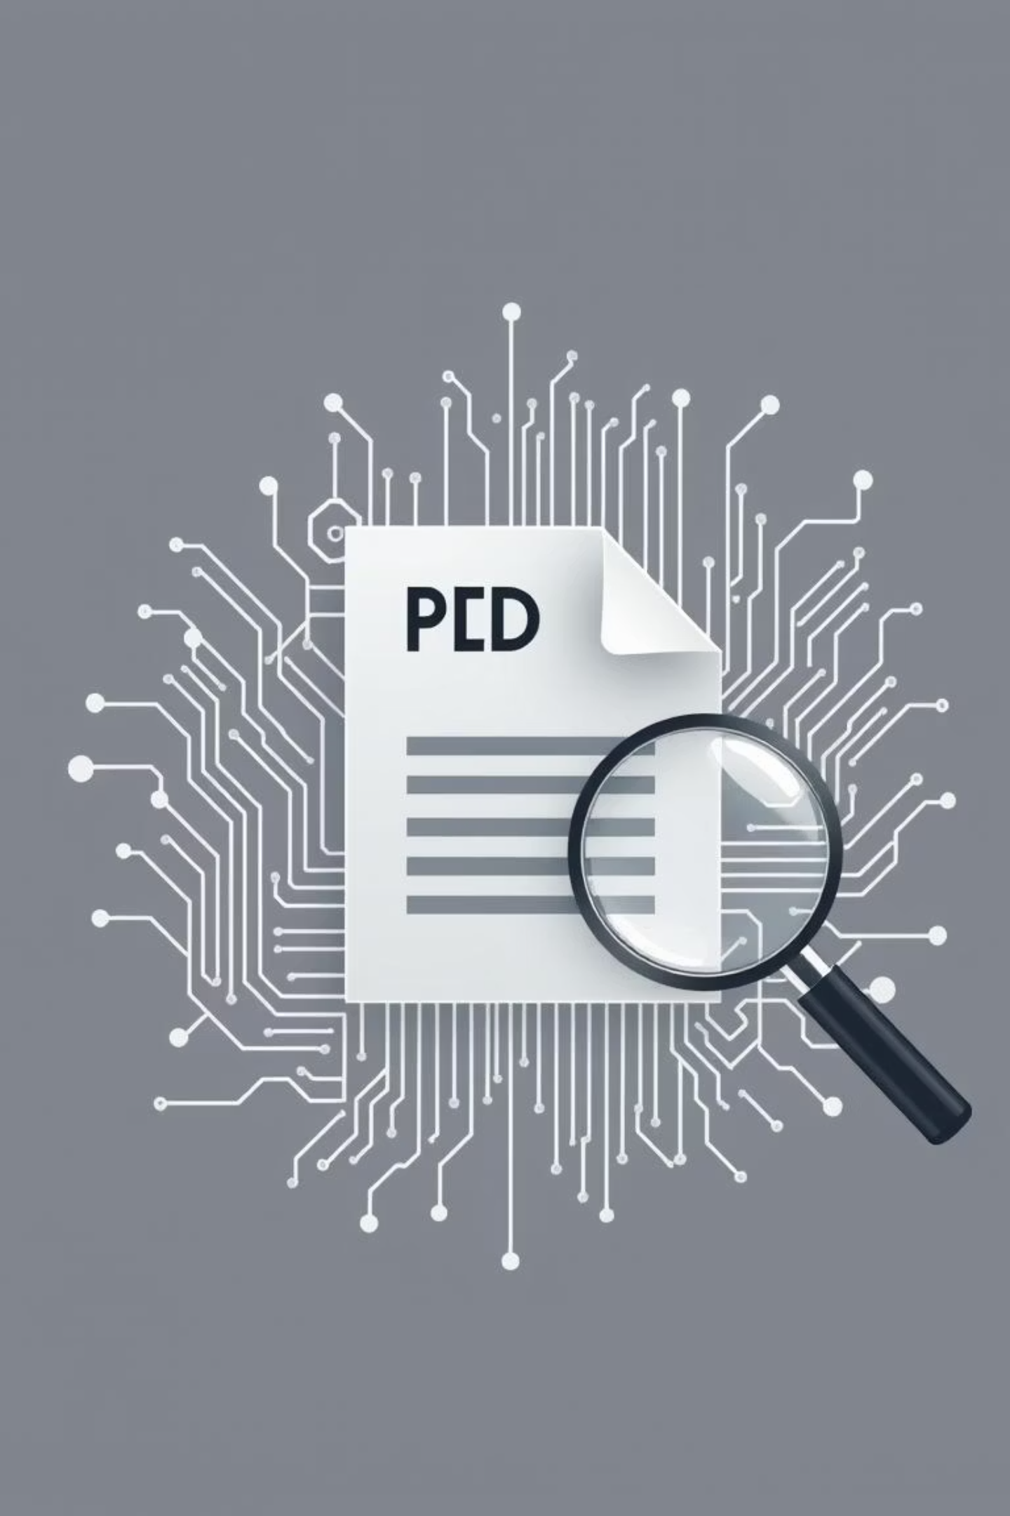
DocuMind - RAG-Based PDF AI Assistant
Developer
Ahad Ahmad Khan
Project Overview
AI assistant for PDF analysis.
Key Innovation
RAG architecture for document conversations.
Tech Stack
Python, Streamlit, Google Gemini 1.5-Flash, ChromaDB.

Slide 2
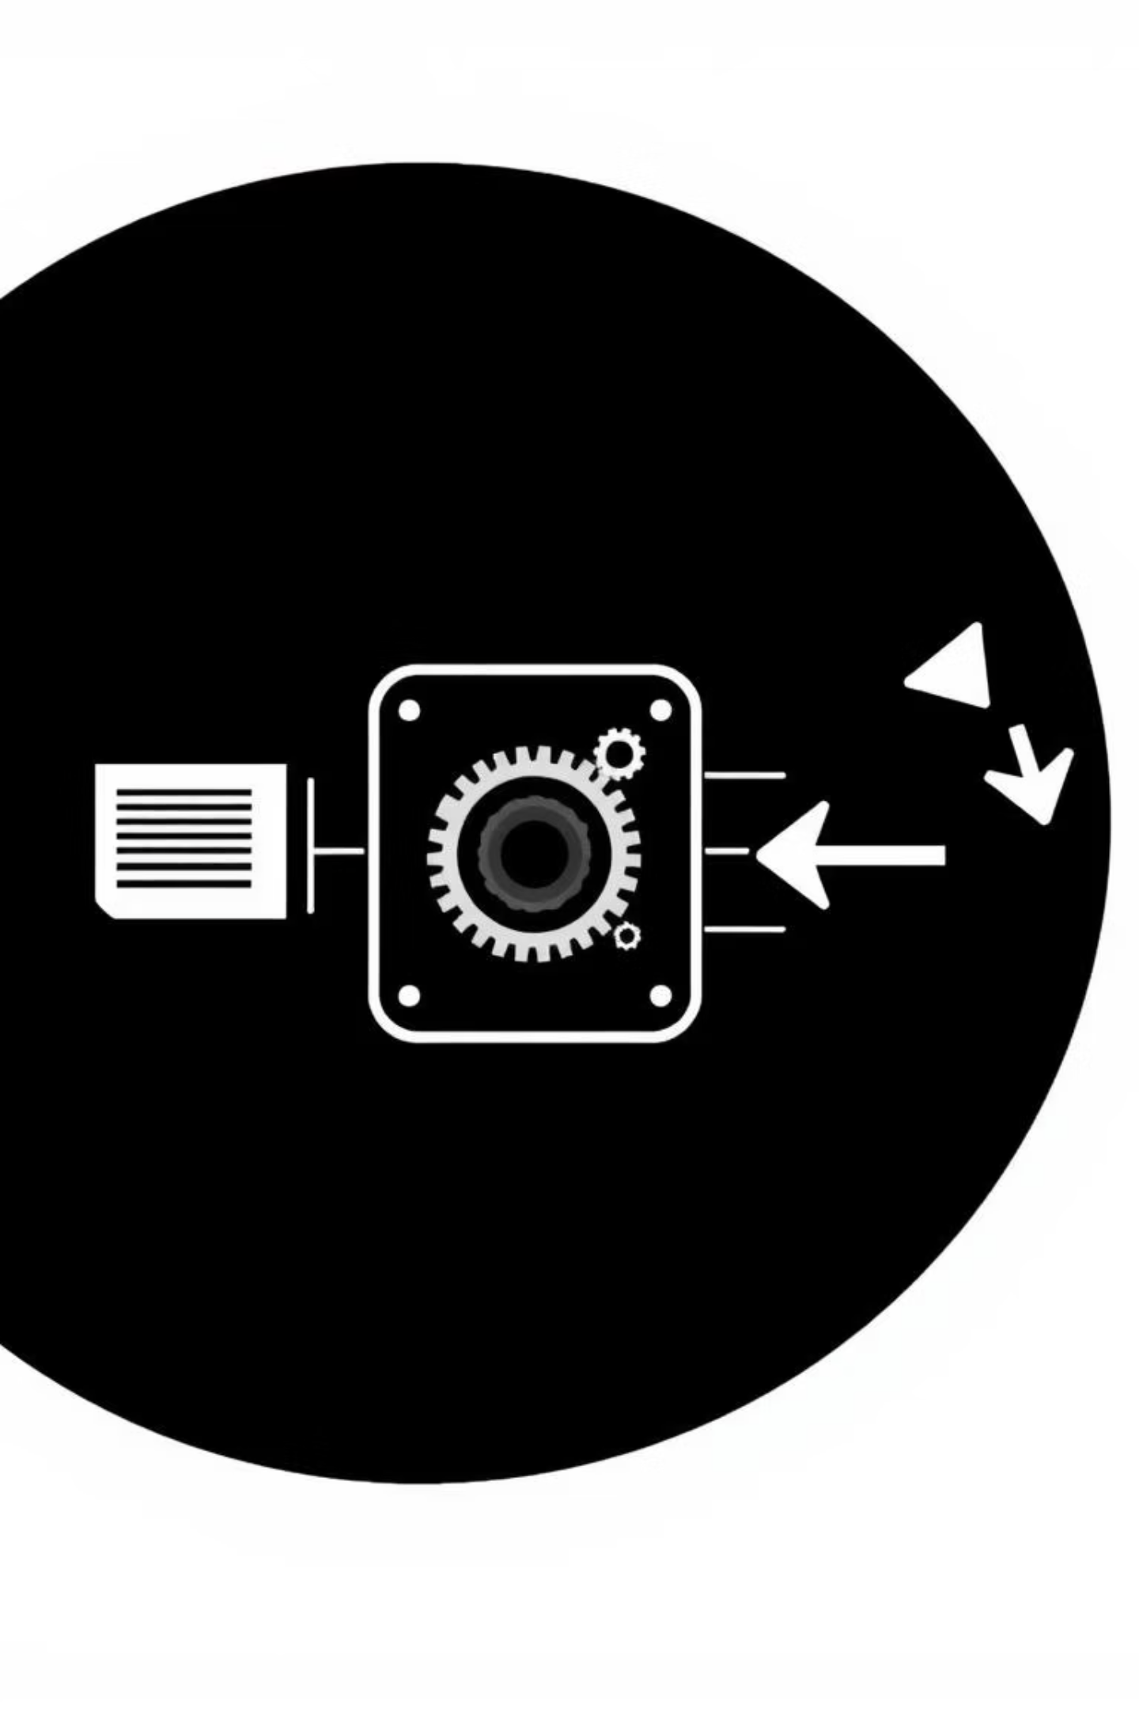




Why RAG Architecture?
Problem
AI lacks specific document access.
RAG Solution
Retrieval + Augmentation + Generation.
Implementation
PDF → Vectors → Search → AI response.
Key Benefit
Exact source attribution.

Slide 3
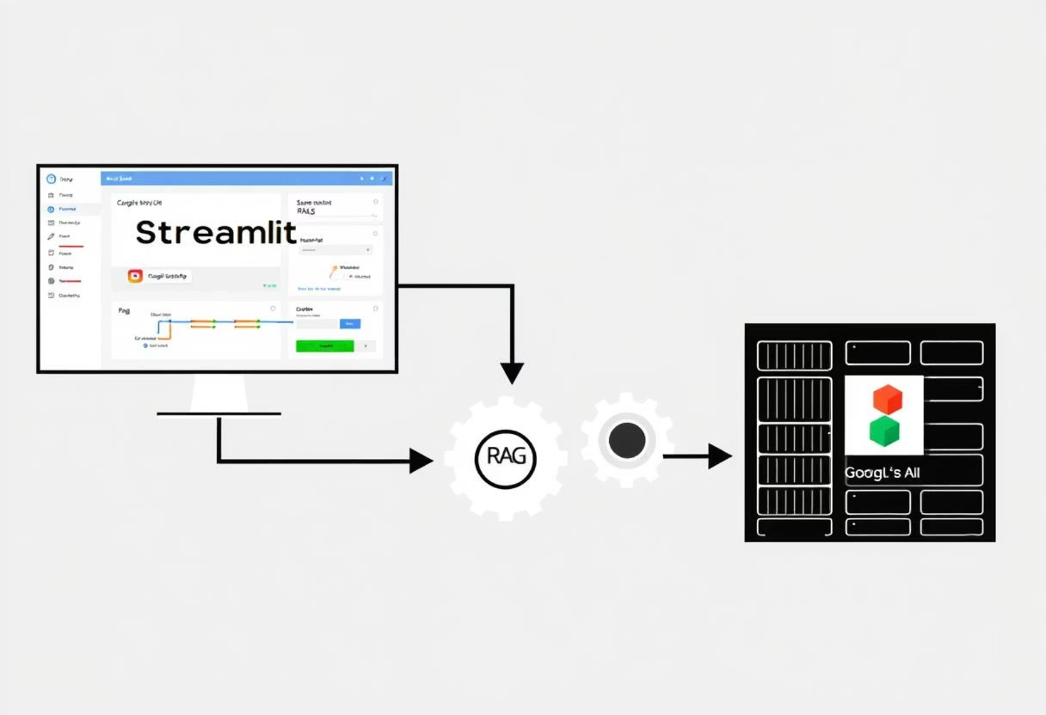
Technical Architecture Overview
Component Flow
Streamlit UI → RAG Pipeline → Google AI.
Core Components
pdf_processor.py, vector_store.py, google_ai.py, chat_manager.py.
Data Flow
PDF Upload → Text Processing → Embeddings → ChromaDB.
Query Flow
User Question → Vector Search → Context → AI Response.

Slide 4
Core RAG Pipeline Implementation
Document Processing
PyPDF2 extraction, 1000-word chunks, 200-word overlap.
Embeddings
Google text-embedding-004, task-specific optimization.
Vector Storage
ChromaDB local database with metadata.
Response Generation
Gemini-1.5-Flash with conversation context.

Slide 5




Engineering Solutions
Context Preservation
Chunk Boundaries
Error Handling
Sliding window for conversation history.
Overlapping chunks prevent info loss.
Multi-layer resilience, graceful fallbacks.
Source Attribution
Complete traceability to document.

Slide 6
Working System Demonstration
PDF Upload
Real-time processing and embedding.
Natural Conversations
Ask questions about document content.
Source Citations
Every response shows exact sources.
Conversation Memory
Context maintained across questions.
Performance
2-3 seconds response, 90%+ accuracy.

Slide 7
Tech Stack Justification & Achievements
Streamlit
Results
Rapid prototyping, built-in chat.
Complete RAG pipeline.
Google Gemini
Source attribution.
Conversation memory.
Cost-effective ($0.075/1K tokens), fast.
Performance
ChromaDB
3-5 sec processing.
Local-first, zero setup, development-friendly.
1-2 sec queries.

