Slide 1
MODULE 5
DATA SCIENCE BOOTCAMP
Presenter:

Slide 2
Module Outline
Set up Web Service
Test Web Service

Slide 3
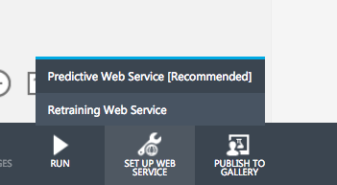
Setting your Experiment as a Web Service
Notes:
Select the “Predictive Web Service”

Slide 4
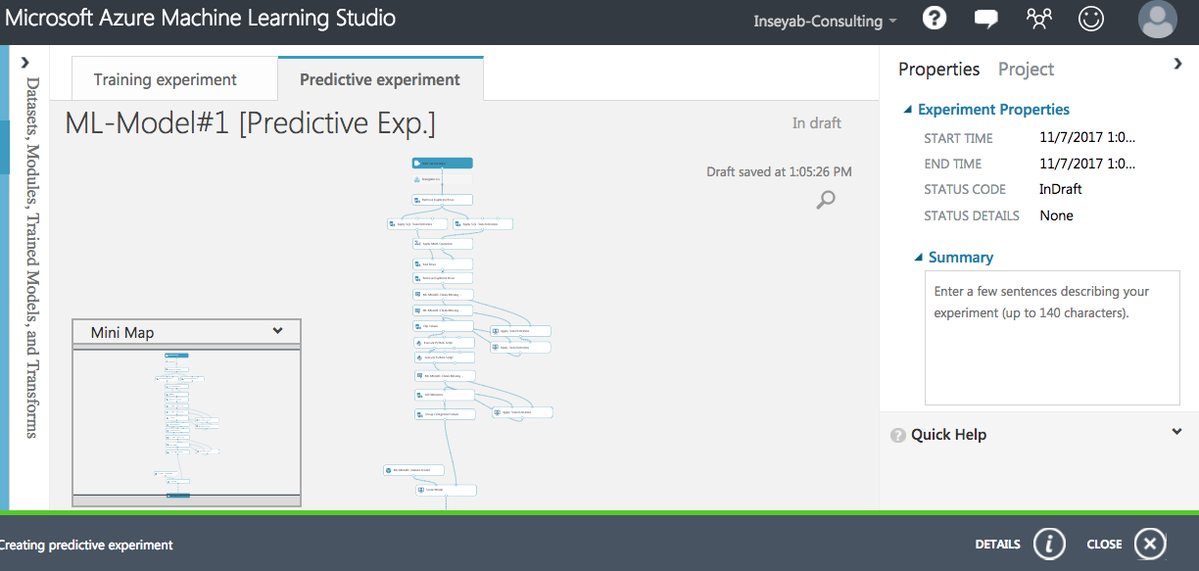
Setting your Experiment as a Web Service (Cont’d)

Slide 5
Setting your Experiment as a Web Service (Cont’d)
Run the Web Service.
Deploy the Web Service.

Slide 6
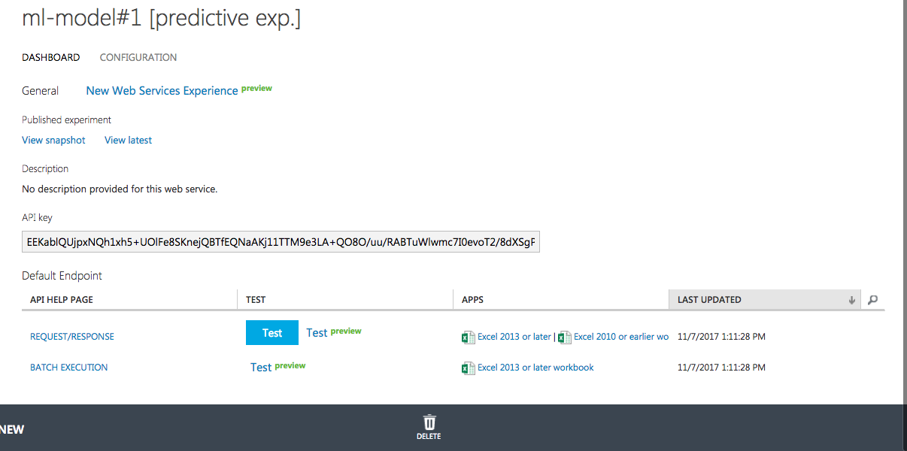
Setting your Experiment as a Web Service (Cont’d)
Notes:
Observe your own unique API key.

Slide 7
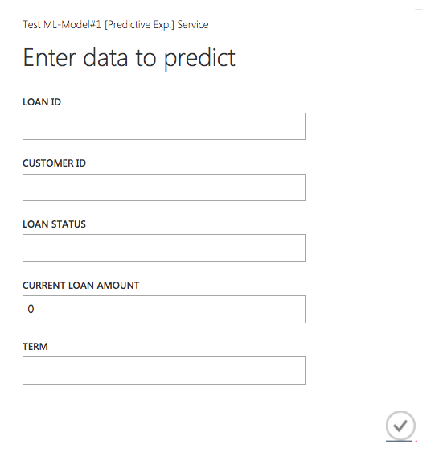
Setting your Experiment as a Web Service (Cont’d)
Notes:
- Showing your “TEST” of your web service python API.

Slide 8
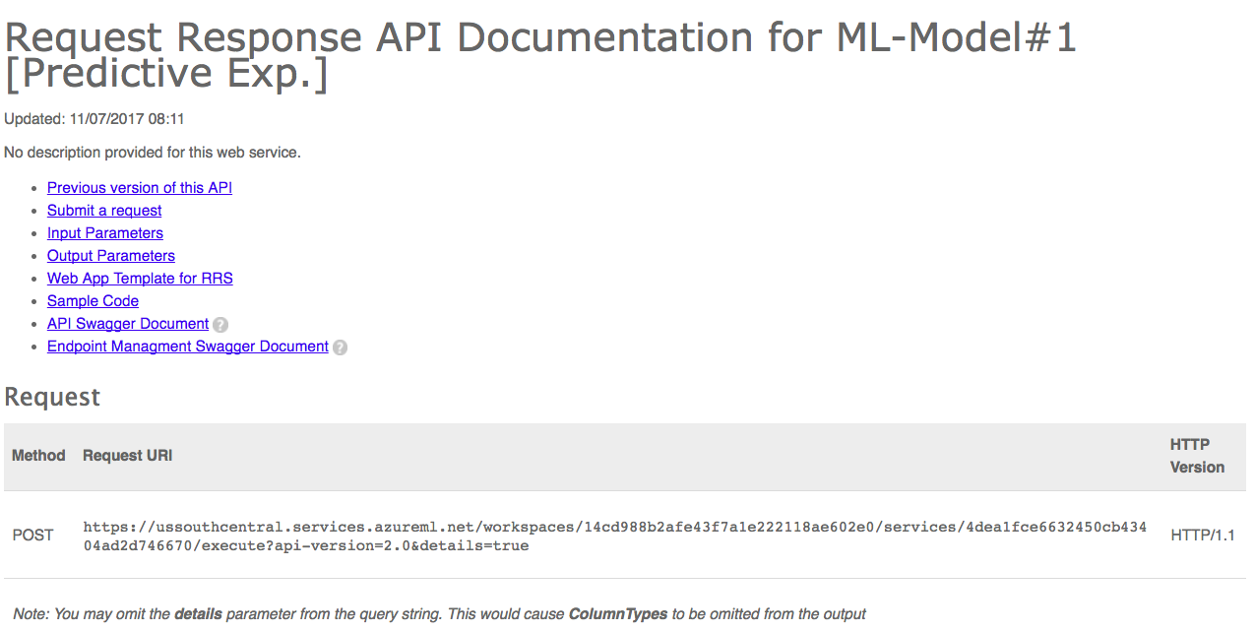
Setting your Experiment as a Web Service (Cont’d)
Notes:
- Your own created web services/ API documentation created automatically with useful information.

Slide 9
END OF MODULE 5

