Slide 1
Sugar to SugarCube to GDSII

Slide 2
Table of contents
Page No.
Sugar to SugarCube
Create a MEMS in Sugar 4
Sample Sugar netlist 5
Transfer netlist to SugarCube 6
Load the model in SugarCube 9
SugarCube Interface 10
Static analysis-I 11
Static analysis-II 12
Static analysis-III 13
Sinusoidal analysis 14
Steady-state analysis 15
SugarCube to GDSII
Generating layout for a single device 17
GDSII layout for a single device 18
Generating layout for a row of devices 19
GDSII layout for a row of devices 20
Generating layout for an array of devices (3x5) 21
GDSII layout for an array of devices (3x5) 22

Slide 3
Sugar to SugarCube

Slide 4
Create a MEMS netlist in Sugar
See the tutorial on how configure MEMS in Sugar
Save netlist, as say, ‘NL_nanosonics_tutorial_1.m’
To load, simulate, and display the netlist, the commands are
net=cho_load('NL_nanosonics_tutorial_1.m'); figure(1); q=cho_dc(net); cho_display(net,q);
A sample netlist and image are shown in the following page

Slide 5
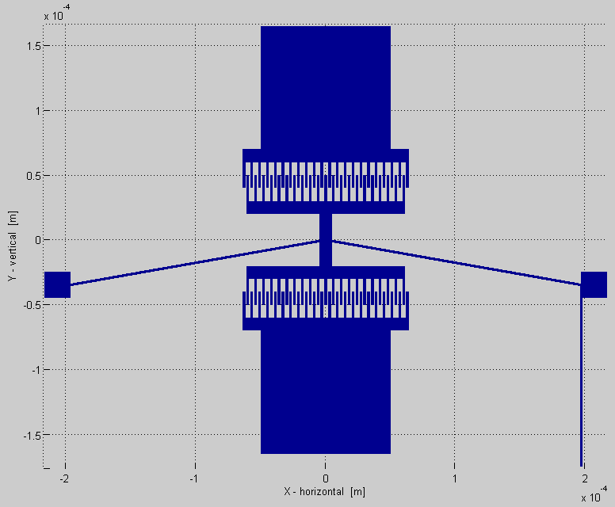
Example Sugar netlist
uses mumps.net
%Ambient temperature is 300 Kelvin.
uses subnet_comb_drive_3.net
param V = 10
param w = 2u
param angle = 10
angle = angle * pi/180
param L = 200u
param dT = 0
T = 300+dT
param gap = 2u
param h = 2u
param nf = 10
wp1 = 2u
wp0 = 0.5u
wsupport = 10u
OL = 5u
Lbackbone = 20u
lf = 20u
%Backbone
beam3d p1 [middle up][l=Lbackbone w=10u h=h+1n oz=pi/2]
beam3d p1 [middle dn][l=Lbackbone w=10u h=h+1n oz=-pi/2]
%Flexures
anchorsize = 20u
beam3d p1 [left_anchor middle][l=L w=w h=h oz=angle T=T]
bondingpad p1 [right_anchor][l=anchorsize w=anchorsize h=4u oz=0]
beam3d p1 [middle right_anchor ][l=L w=w h=h oz=-angle T=T]
bondingpad p1 [left_anchor][l=anchorsize w=anchorsize h=4u oz=pi]
%Comb drives
subnet_comb_drive_3 p1 [dn B][ V=V Nf=nf gapf=gap Lf=lf Wf=w Hf=h overlap=OL W_support=wsupport ]
subnet_comb_drive_3 p1 [up C][ oz=pi V=V Nf=nf gapf=gap Lf=lf Wf=w Hf=h overlap=OL W_support=wsupport ]
%Bond pads
bondsize = 100u
bondingpad p1 [B][l=bondsize w=bondsize h=1.9u oz=-pi/2]
bondingpad p1 [C][l=bondsize w=bondsize h=1.9u oz=pi/2]
%Oxide
beam3d p1 [B sb] [h=10u l=2u+wp1/2+wp0/2 w=10u oy=pi/2]
%P0 ground layer
Len2 = wsupport/2 + (lf-OL*2)/2
Len = (wsupport/2 + lf-OL*2 + lf + wsupport + Lbackbone)*2 - Len2*2
% beam3dlink p0 [sb sm] [h=0.5u l=Len w=L*2+anchorsize*2 oz=pi/2 L1=Len2 L2=Len2]
%To tracer
Len3 = (wsupport/2 + lf-OL*2 + lf + wsupport + Lbackbone)
commonground p1 [right_anchor tracer] [h=0.5u l=Len3-L*sin(angle)+bondsize+10u w=2u oz=-pi/2]
% anchor p1 [tracer][l=anchorsize w=anchorsize h=4u oz=-pi/2]
bondingpad is used to automatically
generate a bonding pad that has all the
layers
commonground is used to automatically
generate tracers that connect to a
common ground with all layers

Slide 6
Making a netlist readable by SugarCube
Identify key parameters that you would like to be parameterizable within the SugarCube GUI.
For example: Voltage; flexure width, angle, or length; temperature change; comb drive gap or number of fingers.
Identify node(s) where performance output is to be analyzed.
For example: Node ‘up’ is a node on the comb drive that may be of interest.
Specify such parameter(s) and node(s) in the netlist using the ‘sugarcube’ model.
Syntax for the sugarcube model is:
sugarcube * [ ] [ Param1 = ‘Name, Unit, Default value, Min, Max’
Param2 = ‘Name, Unit, Default value, Min, Max’
:
Param9 = ‘Name, Unit, Default value, Min, Max’
nodes = ‘Node1, Node2, Node2, Node4, Node5’ ]
For example, to make the example netlist readable by SugarCube, add the following sugarcube model to the netlist
sugarcube * [] [ V = 'Voltage, V, 10, 0, 20'
w = 'Flexure Width, m, 2e-6, 1e-6, 3e-6'
angle = 'Angle, deg, 10, 0, 30'
L = 'Flexure Length, m, 200e-6, 50e-6, 250e-6'
dT = 'Temp. increase, K, 0, 0, 10'
gap = 'Gap between fingers, m, 2e-6, 0, 3e-6'
nf = 'Number of fingers, N, 10, 0, 20'
nodes = 'up' ]
where these parameters override the corresponding parameters within the netlist.

Slide 7
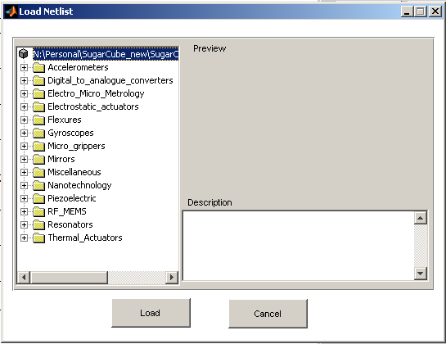
File issues to make netlists readable by SugarCube
File extension: Save the netlist with *.m extension so that SugarCube may identify it
Folder: The netlist needs to be placed in folder, i.e. SugarCube/Models/Category
where ‘Category ‘ is the name of a particular sub-category for the SugarCube library GUI.
E.g., a resonator should be saved to the directory /SugarCube/Models/Resonators/
Supporting files: Additional supporting files, like subnets,can be placed in the root directory of SugarCube i.e. /SugarCube/
SugarCube library GUI

Slide 8
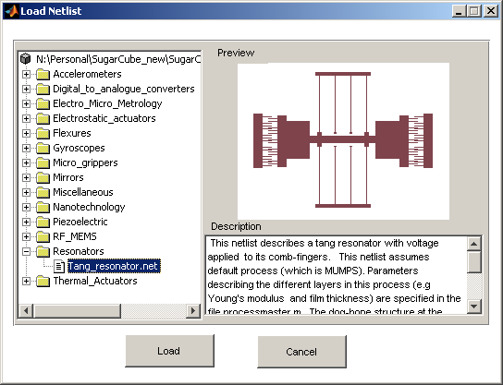
Optional: Image preview for library
For previewing an image and description in the library GUI of SugarCube, do the following:
Image: Save an image of the device with the same file name but with extension *.TIF, and place it in the same file.
Caption: Enter a commented description at the top of the netlist, by using ‘%’.
Example: The figure shows a preview image and description
If the above two steps are not performed, the preview and description will be blank

Slide 9
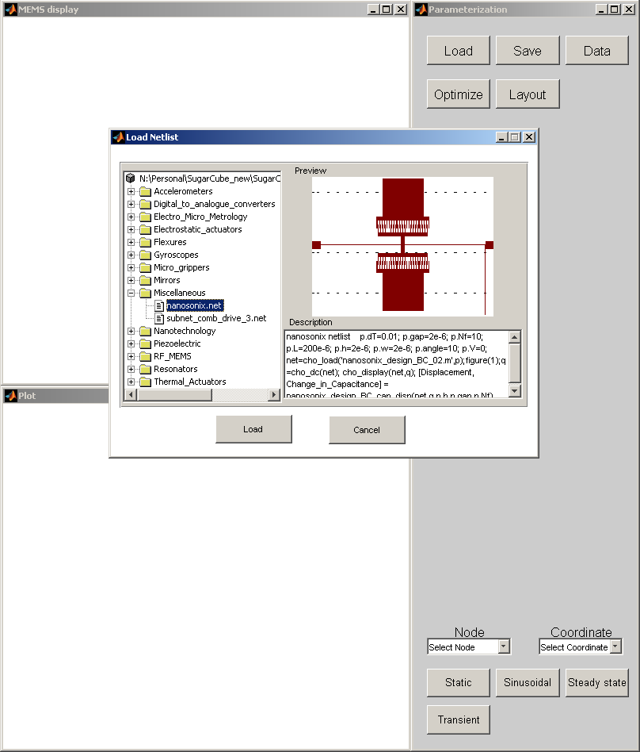
Loading MEMS into SugarCube
Start SugarCube by typing the following command in command window
> SugarCube
1
Follow these steps to load a MEMS into SugarCube
Click on Load button (1) on
Parameterization window
A load window appears showing the
root directory of models
Double-click on it to display the tree of all
categories (see figure)
Now expand the desired category to see
the netlists
Single click on the netlist to see the review
image and description
Once the desired netlist is selected, click
on Load button (2) of this window to load
it into SugarCube
2

Slide 10
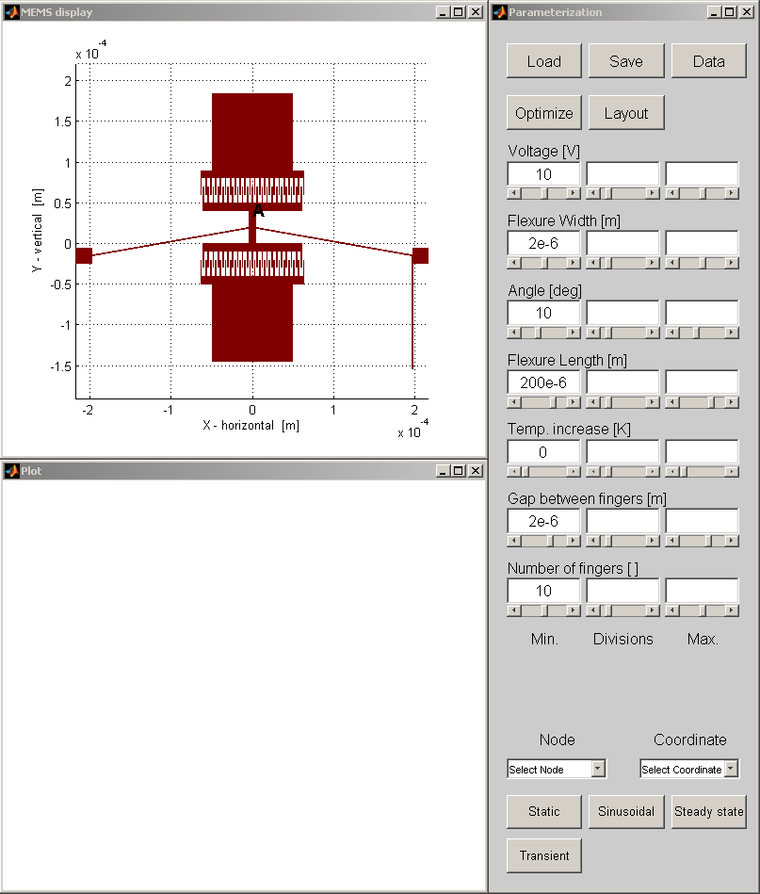
SugarCube Interface

Slide 11
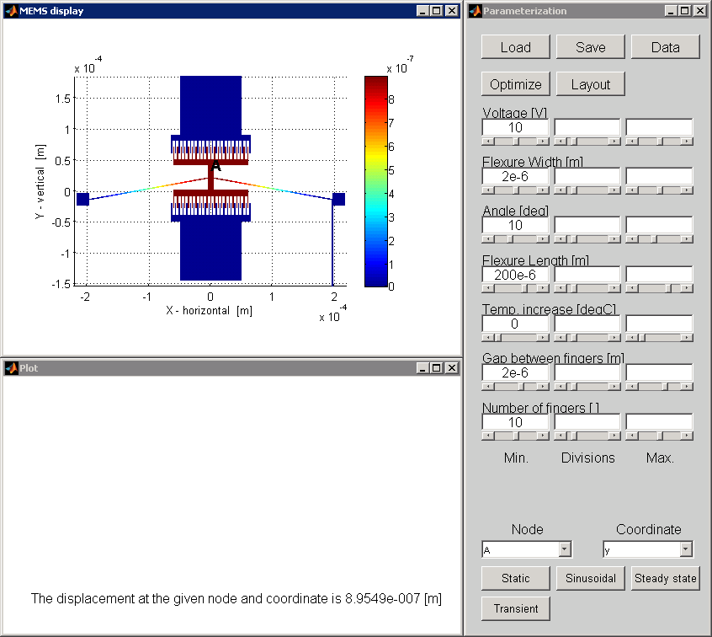
Static analysis - I
Analysis is performed using
a single initial value for all
the parameters
Procedure:
Enter the desired values for
each parameter (single value)
Select the Node and
Coordinate at which the
performance has to be
tracked using the pull-down
menus located at the bottom
of Parameterization window
Click on Static button
The displacement is shown in
Plot window (see right)
1
2
3

Slide 12
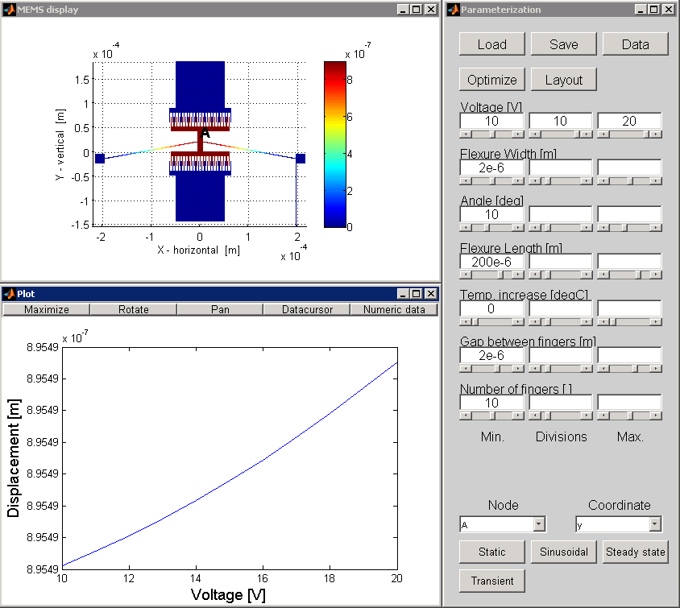
Static analysis - II
Analysis is performed over
a range of values for a single
parameter
Procedure:
Enter the desired values for
each parameter. In addition,
enter the range of values for
one desired parameter (In
the example here, this
parameter is Voltage)
Select the Node and
Coordinate as explained
above and click on Static
button
The 2D displacement plot is
shown in Plot window (see
right)

Slide 13
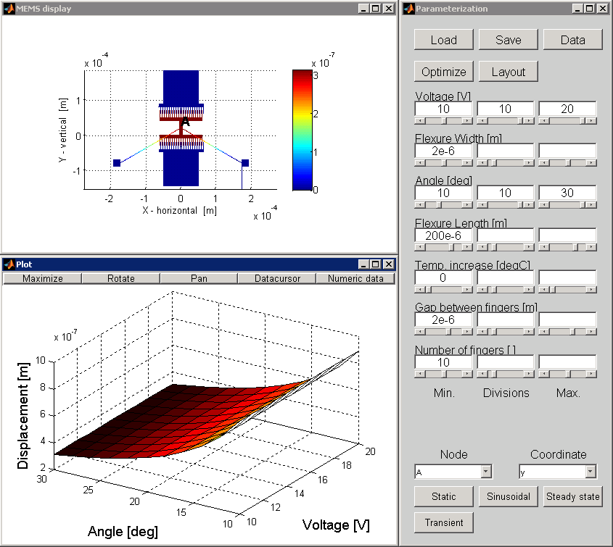
Static analysis - III
Analysis is performed over
a range of values for a two
parameters
Procedure:
Enter the desired values for
each parameter. In addition,
enter the range of values for
two desired parameters (In
the example here, these
parameters are Voltage and
Angle)
Select the Node and
Coordinate as explained
above and click on Static
button
The 3D SurfacePlot is
shown in Plot window (see
right)

Slide 14
Sinusoidal analysis
This analysis is performed to
find the eigen frequencies
and shapes of various modes
of a device
Procedure:
Click on Sinusoidal button. A
window pops up asking for
no. of modes required. Enter
a value for this and click OK
SugarCube computes the
entered number of modes
and displays a pull-down
menu in Plot window which
has all the modes.
Go to the pull-down menu
and select the desired mode
to display the shape and
corresponding frequency of
that mode

Slide 15
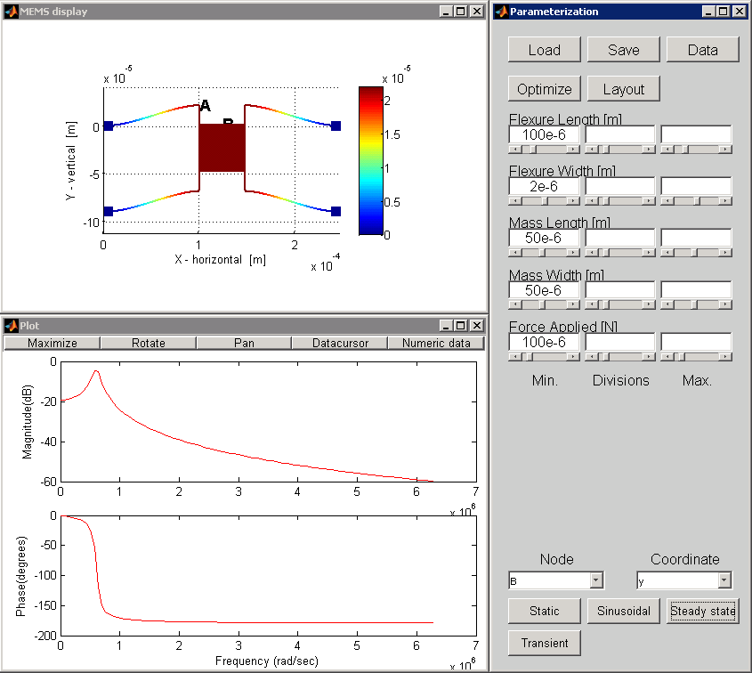
Steady-state analysis
This analysis is performed to
compute the frequency
response of the device
Procedure:
Select the desired Node and
Coordinate form the pull-
down menus and click on
Steady State button
A window pops-up asking for
initial frequency, final
frequency, and the number
of steps between initial and
final frequency
Enter the desired values and
click OK. A bode plot is
generated in Plot window
(see right)

Slide 16
SugarCube to GDSII

Slide 17
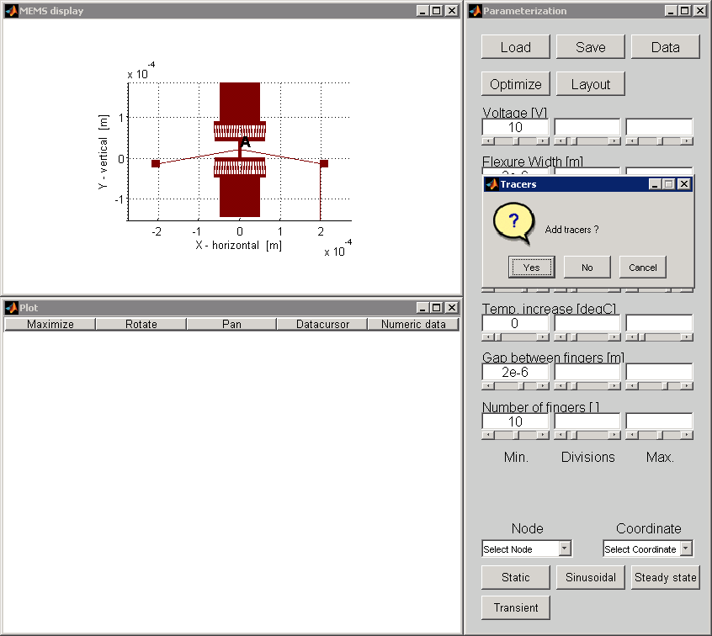
Generating layout for a single device
SugarCube automatically generates tracers for wirebonding!!

Slide 18
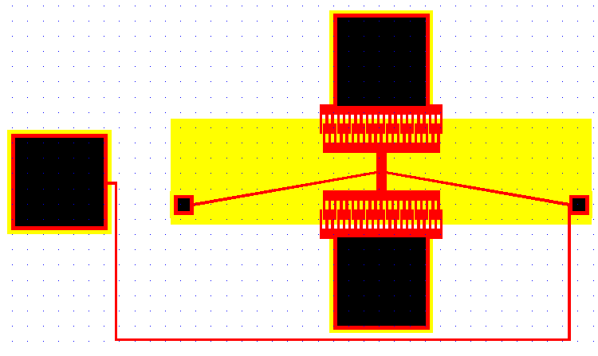
GDSII layout for a single device
Note: The layer on the bottom of the device is poly0(yellow). It is not showed in SugarCube display window to avoid confusion that might occur due to overlapping of layers

Slide 19
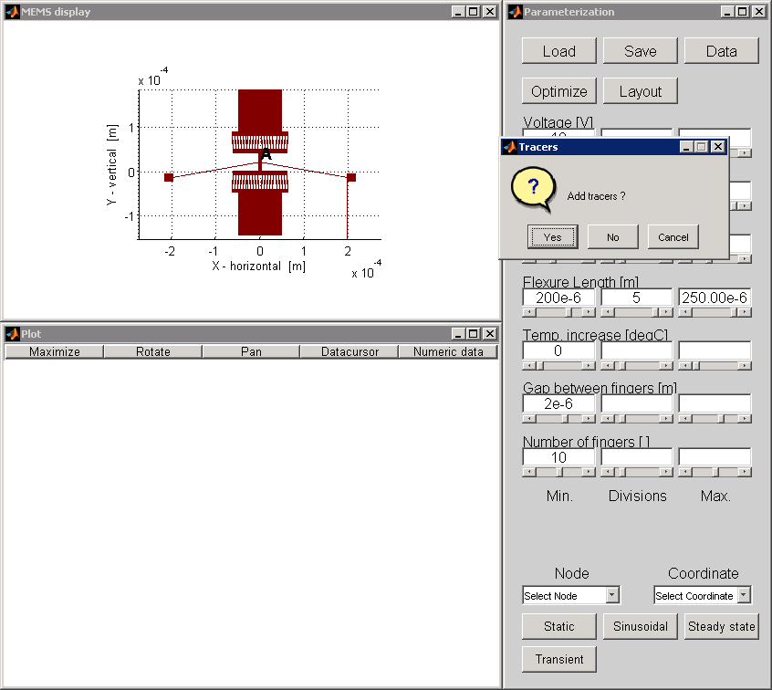
Generating layout for a row of devices

Slide 20
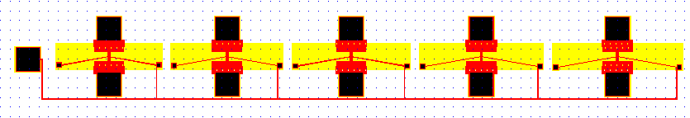
GDSII layout for a row of devices

Slide 21
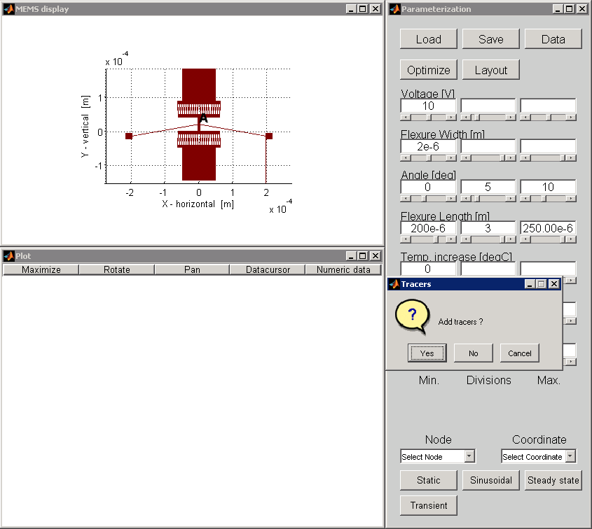
Generating layout for an array of devices (3x5)

Slide 22
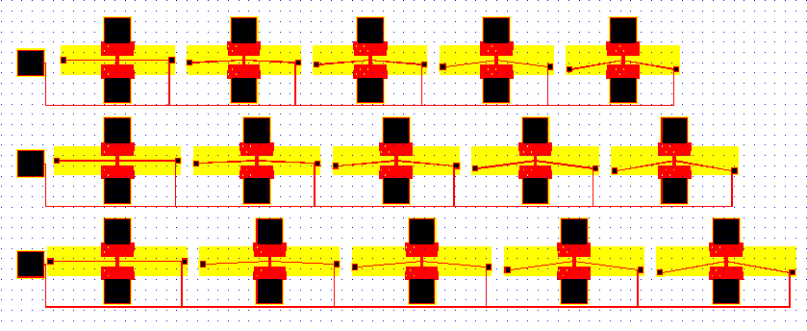
GDSII layout for an array of devices (3x5)

Slide 23
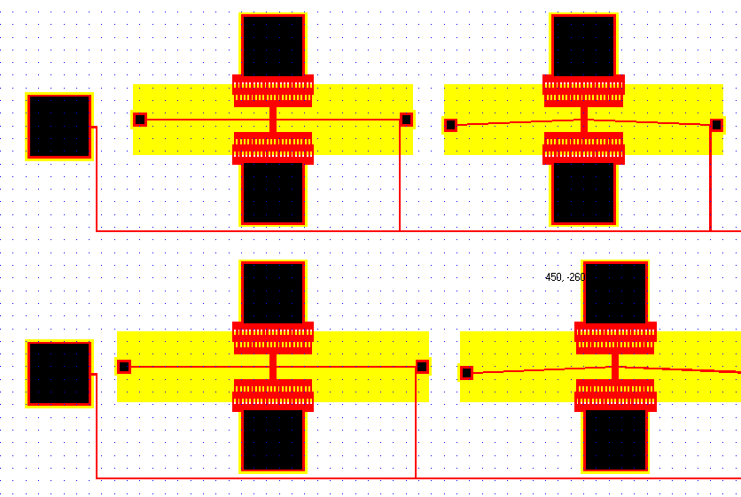
GDSII layout for an array of devices (3x5)

Slide 24
Notes
The layout that is automatically generated by Sugar2GDSII adheres to a set of design
rules that are given as input in a process file
The rules that are currently used are called enclosure rules. Enclosure rules define the
minimum distance to be maintained from layer to layer that enclose each other. We
currently follow design rules defined by a standard PolyMUMPS process*
These rules can be edited if the user wants to use this tool for a customized
fabrication process. This can be done by editing the parameters in the process file
A standard process file used by Sugar2GDSII is shown in slides 25, 26 followed by
graphical explanation of design rule parameters in slide 27
The structures in different layers of the device (like poly0,poly1,poly2,metal, etc.) can
be specified by using the corresponding layer names provided by Sugar (like p0, p1,
p2, met, etc.)
Ex: anchor p1 [a] [l=10u w=10u oz=pi]
beam3d p1 [a b] [l=100u w=4u oz=0]
beam3d p0 [b c] [l=30u w=2u oz=pi/2] %tracer
* Allen, C., Greg, H., DeMaul, M., Steve, W., and Busbee, H., 2005, "PolyMUMPS Design Handbook, a MUMPS process."

Slide 25
Sugar2GDSII process file
process poly = [
Poisson = 0.3 %Poisson's Ratio = 0.3
thermcond = 2.33 %Thermal conductivity Si = 2.33e-6/C
viscosity = 1.78e-5 %Viscosity (of air) = 1.78e-5
fluid = 2e-6 % Between the device and the substrate.
density = 2300 %Material density = 2300 kg/m^3
Youngsmodulus = 165e9 %Young's modulus = 1.65e11 N/m^2
permittivity = 8.854e-12 %permittivity: C^2/(uN.um^2)=(C.s)^2/kg.um^3;
sheetresistance = 20 %Poly-Si sheet resistance [ohm/square]
stress = 0
straingradient=0
thermalexpansion=2.6e-6
ambienttemperature=0
%Enclosure design Rules
p0ep1=-4e-6 %minimum distance between layer p0 enclosing layer p1 = 4e-6[m]
p0ea2=-5e-6 % minimum distance between layer p0 enclosing layer anchor2 = 5e-6[m]
p0ep2=-5e-6 % minimum distance between layer p0 enclosing layer p2 = 5e-6[m]
p1ea1=-4e-6 % minimum distance between layer p1 enclosing layer anchor1 = 4e-6[m]
p2em=-3e-6 % minimum distance between layer p2 enclosing metal layer = 3e-6[m]
a1ea2=-0e-6 % minimum distance between anchor1 layer enclosing anchor2 layer = 0
a2em=-4e-6 % minimum distance between anchor2 layer enclosing metal = 4e-6[m]
poly1_wid=100e-6 %Dimensions of poly1 bondpad (for common ground)
]
Cont..

Slide 26
process p0 : poly = [
h = 0.5e-6 %poly0 layer – generally used for electrodes and tracers
layer='p0'
]
process p1 : poly = [
h = 2e-6 %poly1 layer – mostly this is the device layer
layer='p1'
]
process p2 : poly = [
h = 1.5e-6 %poly2 layer – this also acts like a device layer. Sometimes, this is combined with poly1
layer='p2'
]
process met : poly = [ %metal layer –Used for depositing metal on the bondpads
h = 1.5e-6
layer='met'
]
process o1 : poly = [ %oxide1 layer (called as anchor1 in Sugar2GDSII). This layer is used to etch oxide1
h = 1.5e-6
layer='o1'
]
process o2 : poly = [ %oxide1 layer (called as anchor2 in Sugar2GDSII). This layer is used to etch oxide2, oxide1
h = 1.5e-6
layer='o2'
]
process o12 : poly = [ %poly1poly2via. This layer is used to connect structures in poly1 layer to poly2 layer
h = 1.5e-6
layer='o12'
]

Slide 27
Enclosure design rules
p0ep1
p1ea1
a1em

