Slide 1
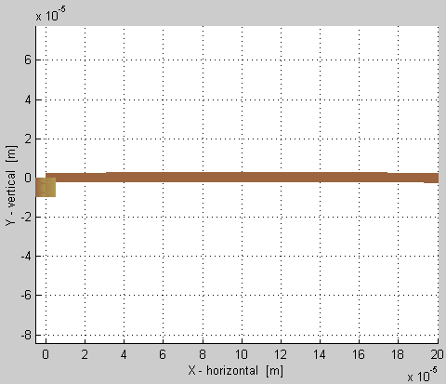
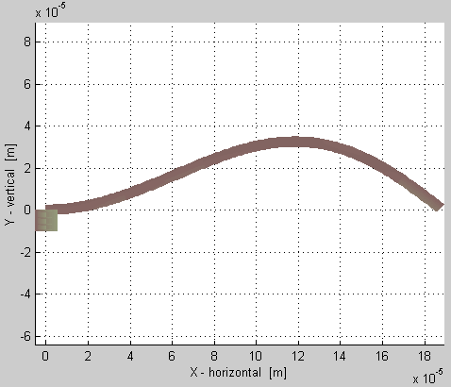
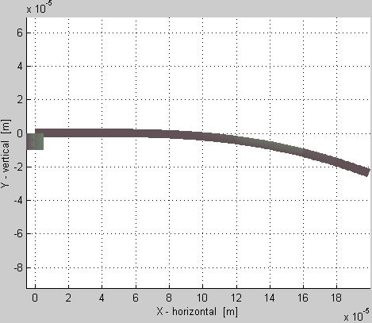
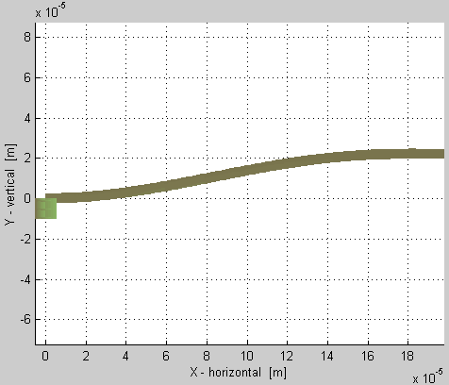
Horizontal tip-load applied to a beam that’s initially slightly displaced
F=0
This is what a small initial qy and qoz displacement looks like with NO load.
F
Small initial qy and qoz displacement.
F
F
Same qoz, but slightly larger qy
than used on the one above,
Small initial qoz displacement only.

