Slide 1
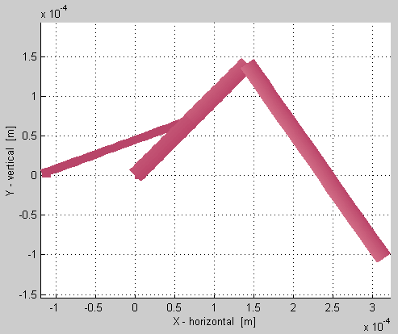
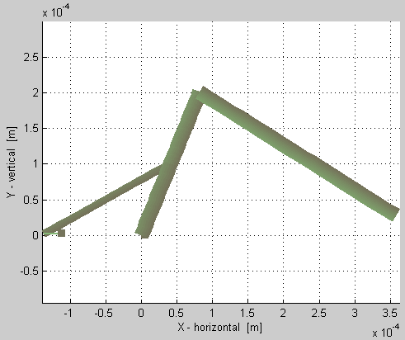
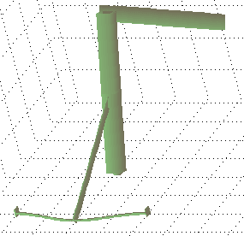
INITIAL STATE
ACTUATED STATE
rigid-joint
tendon
leg
down
Leg lifts up
free-hinge
fixed-hinge
free-hinge & spring
Horizontal force is applied here
Initial results of sugar using 3 kinds of joints (fixed-hinge, free-hinge, & the usual rigid-joint).
Rigid-joints are sugar’s regular joints. Fixed-hinges were shown last week. Free-hinges are what’s new.
The pictures show 1) the initial state of a “simple” robot leg, 2) an actuated state where a tendon pulls up the leg, & 3) a top view of picture 2).
Top view of
actuated state
force

Slide 2
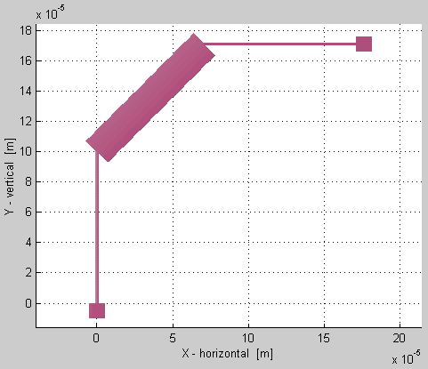
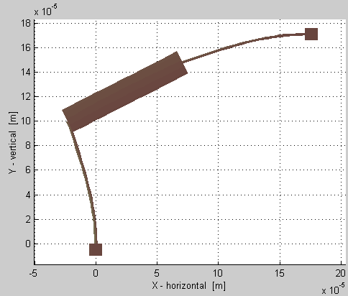
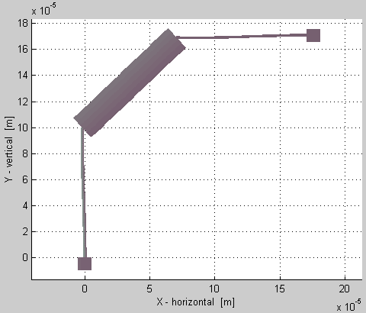
π/4
Demonstration of free-hinge beam
pushing on other beams.
The wide beam has free-hinges on both ends so it doesn’t bend. Notice that the relative angles between the beams do change, and the other beams do bend.
However, wide beam is NOT rigid. It WILL stretch if you pull on it hard enough.
anchor
π/4
free-hinges
Initial state
anchor
30μN
30μN
Actuated state
using hinge joints
Actuated state
using regular joints

