Slide 1
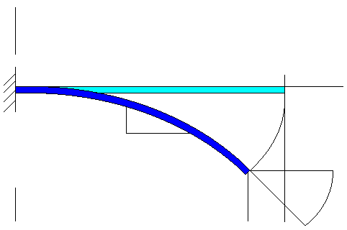
y
Nonlinear cantilever with simultaneous
Fx – axial force
Fy – transverse force
M – moment
EI
L
x
1
ds
dy
Ψ
Fy
Y/L
dx
M
Fx
2
X/L
Ψ₀
Δ

Slide 2
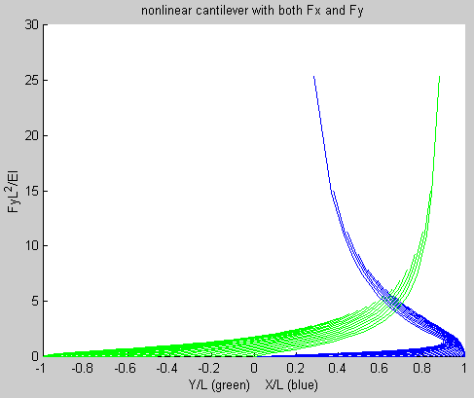
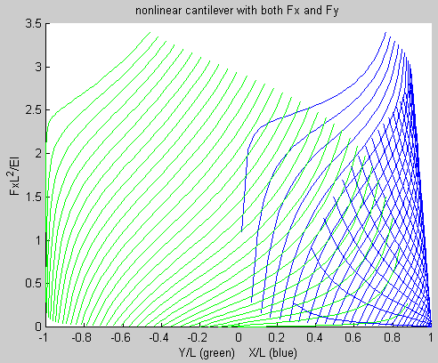
Defections by sweeping both Fx and Fy
The left figure show Fy as a function Y/L (transverse deflection)
and X/L (beam shortening) and Fx sweeps.
The right figure shows the same thing, but with Fx on the y-axis.

