Slide 1
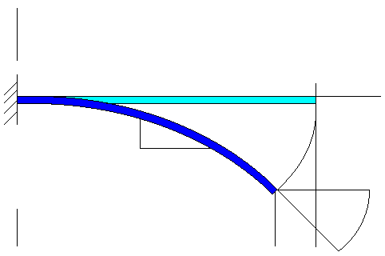
Nonlinear beam with simultaneous Fx,Fy,M
y
Fx – axial force
Fy – transverse force
M – moment
EI
L
x
1
ds
dy
Ψ
Fy
Y/L
dx
M
δ
Fx
2
X/L
Ψ₀
Δ

Slide 2
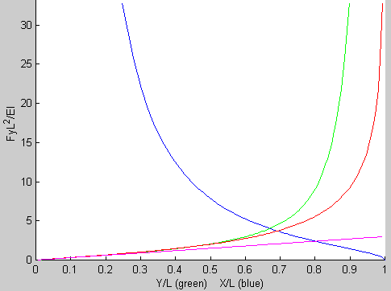
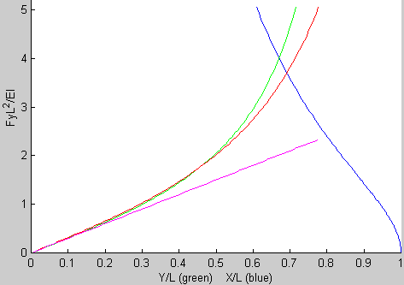
The usual graph you’ve always seen when only Fy is applied.
See e.g. M. Judy’s 1994 PhD dissertation p72.
Close-up view
of the crossing
Nondimensional units
Y/L
tip angle
psi/(pi/2)
X/L
Linear

Slide 3
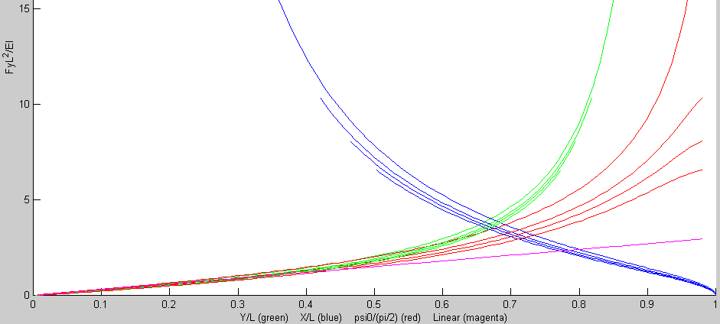
Using a more general formulation:
Increasing values of Fx, from Fx=0 on up
Fy only
Fy only
Fy only
Increasing Fx from 0;
while the net force Fy+Fx remains constant!
Fx
Fx
Fx
Linear

Slide 4
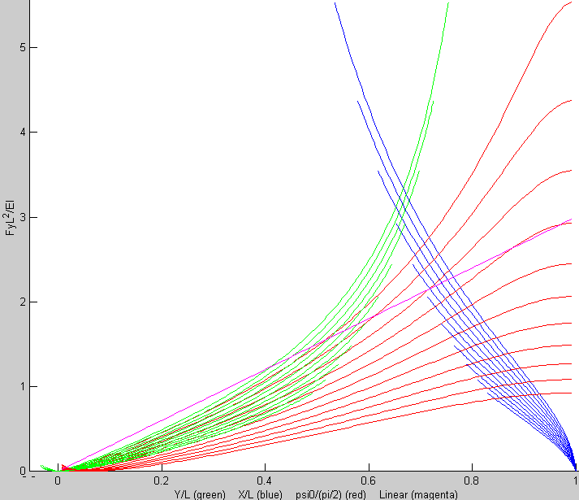
Continued increasing values of Fx, from Fx last slide on up
Interesting (see next slide)
Linear

Slide 5
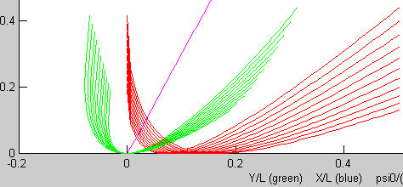
Something to think about.
Maybe the beam is now buckling at these values of Fx
Linear

Slide 6
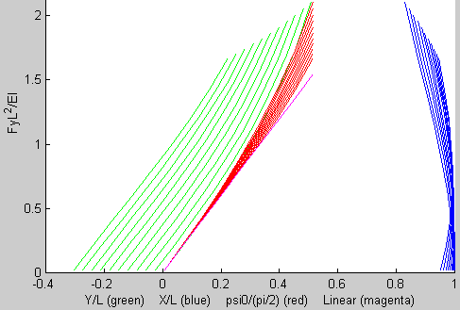
Now lets try increasing moment from 0; Fy=constant; Fx=0
Linear

Slide 7
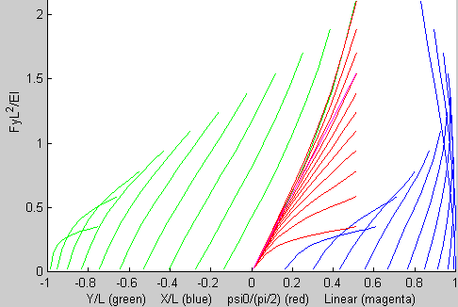
Moments increasing even more

Slide 8
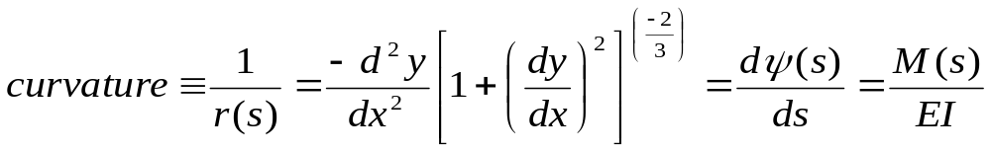
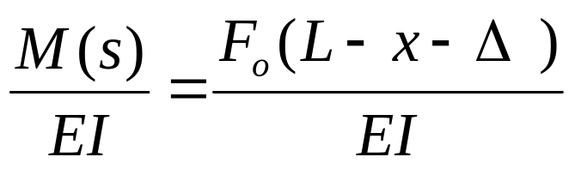
Derivation:
Beam Curvature due to M and F
The curvature at each point s along the beam is defined to be
If an external transverse force is applied at the node 2, the curvature at s is
(1)

Slide 9
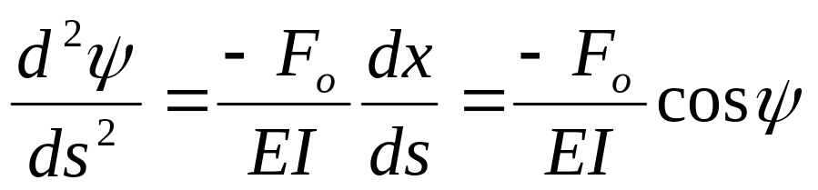
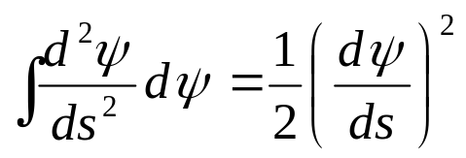
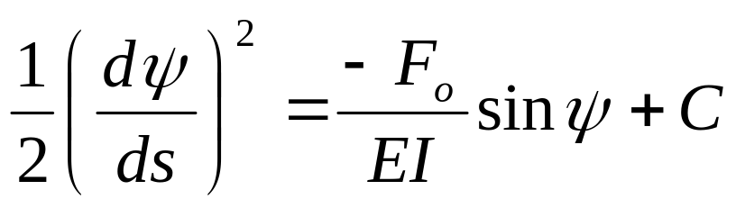
Change of variables
Equation (1) contains two independent variables, s and x. Eliminate x by differentiating (1) with respect to s, then re-integrate it.
Noting dx/ds=cos(ψ) , differentiating (1) gives
Applying the identity , the integration of (2) leads to
(2)
(3)

Slide 10
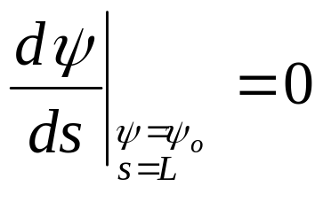
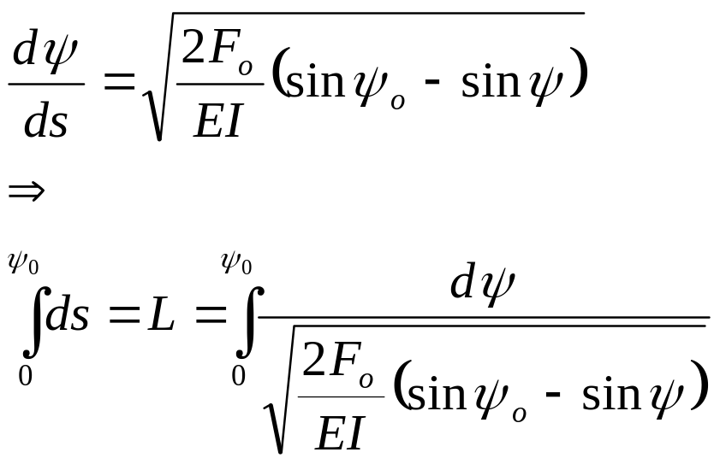

Boundary conditions
To solve for the integration constant in (3) apply the following boundary condition at the end node 2
since the moment vanishes at node 2. Therefore, equation (3) becomes
But we need to end up with a solution of the form
(4)
(5)
(6)

Slide 11
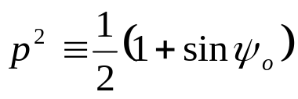
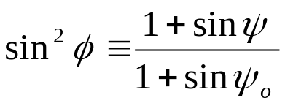
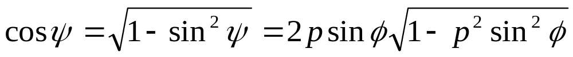
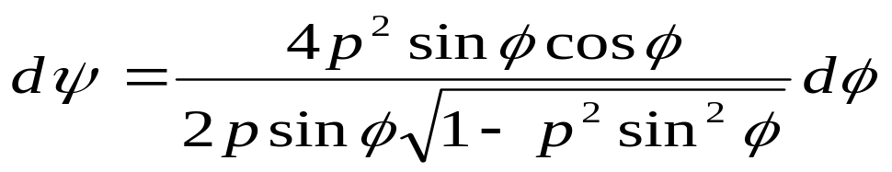


Transformation to Elliptic Integrals
Elliptic integrals have been well characterized (see M. Abramowitz, A. Stegun, Handbook of Mathematical Functions). Transforming equation (6) to an elliptic integral form provides us with their benefits.
Introducing two new variables p and φ defined as
Seek substitutions for dΨ, sin(Ψ), and sin(Ψ₀) in equation (6).
Find the differential element dΨ by the differentiation of equation (8) with respect to φ, and then using the trigonomic identity
This leads to
And from (7) & (8)
(7)
and
(8)
(9)
(10)
(11)
(12)

Slide 12
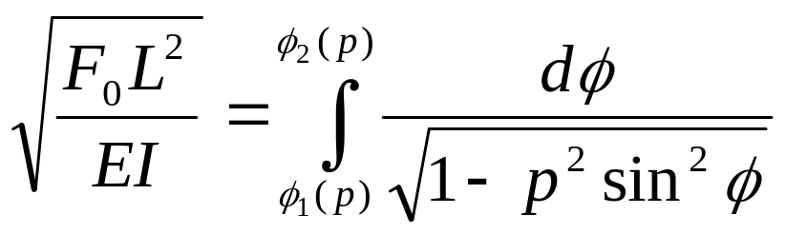
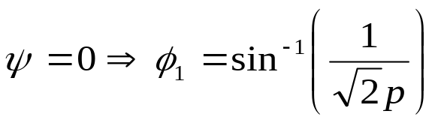
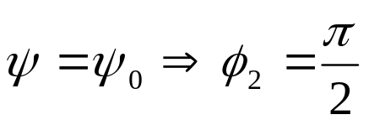
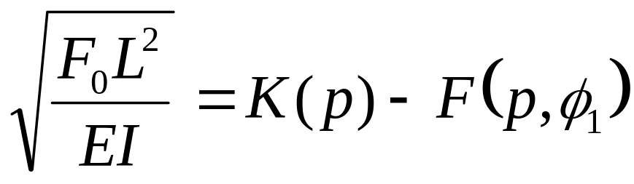
The Elliptic Integral Forealization of Force and Displacement, SIMO
Substitution of equations (10-12) into equation (6) results in
where the lower and upper limits of the integral are determined from equation (11)
Associating equation (13) with the complete and incomplete elliptic integrals of the first kind, we have
(13)
(14)
(15)

Slide 13


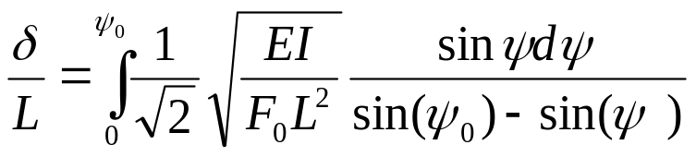

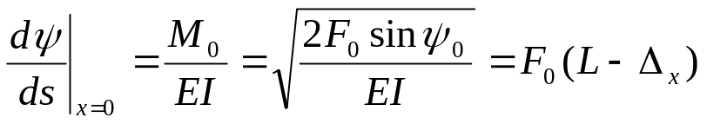
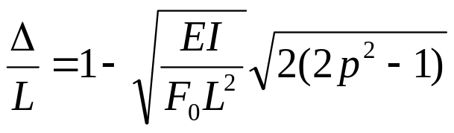
Realization of Force and Displacement, SIMO
Given , it’s required force is found by plugging (7) & (14) into (15).
Equation (15) is the nondimensionalized external force at node 2.
After finding the nondimensional force, the relationship
gives us the nondimensional transverse deflection, δ/L=δ(Ψ₀)/L
(16)
Equation (1) with the BCs , and
gives the nondimensional projected beam shortening as
(17)

Slide 14
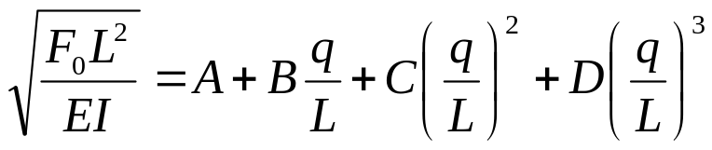
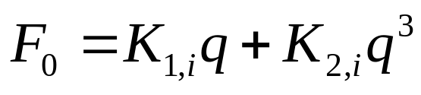
Nonlinear StiffnesPlot of Nonlinear Stiffness vs Theory
The outputs of equations (15-17) as functions of the input Ψ₀ are plotted as “O’s” below. The solid curves are 3rd order, piecewise continuous, polynomial fits.
To obtain nonlinear stiffness, we first assume that the curves can be approximated by a third order polynomial of the form
were q stands for θ, x, y, etc. Seeing that the solution has odd symmetry, we only need to keep constants B and D, which also eases iterative computations. Absorbing the material and geometric terms into B and D, respectively K₁ and K₂, we find that
The coefficients of these polynomial curves are associated with the linear stiffnesses K_{1,i} and the cubic nonlinearities K_{2,i}.
In order to maintain accuracy, (19) is applied in a continuous piecewise fashion by dividing the total physical range into, say, 4 intervals, were i(q)=[1,4]. (Fig 2)
(18)
(19)

Slide 15
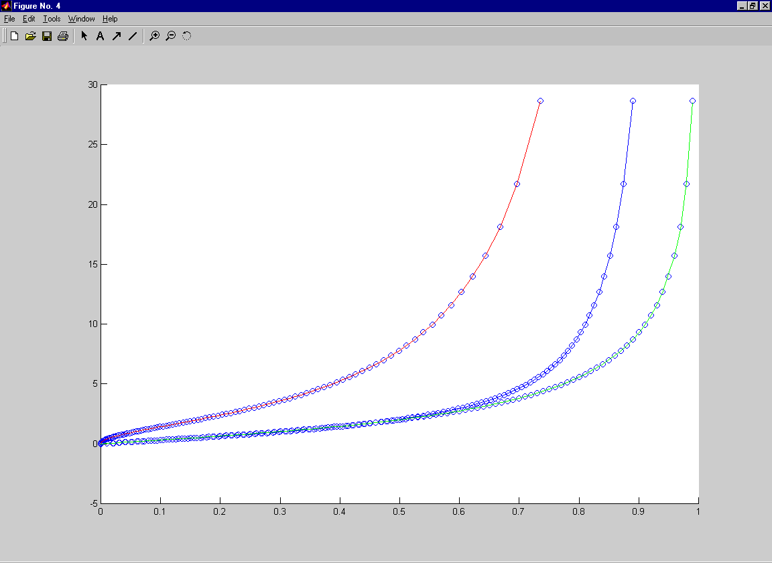


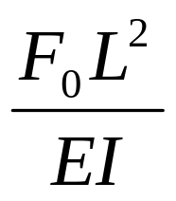
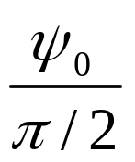
Plot of Nonlinear Stiffness vs Theory
Piecewise Model – solid lines
Theory - circles
Fig 2

Slide 16
Intuition can be gained by a geometrical representation:
Principle of Elastic Similarity
Using the geometric properties of the above elliptic integrals together with the principle of elastic similarity we find an intuitive relationship. This type of analysis was first reported by [R. Fay, “A new approach to the analysis of the deflection of thin cantilevers,” Journal of Applied Mechanics 28, Trans. ASME, 83, Ser. E (1961) 87].
From similarity:
From Fig 1, using your imagination, assume that the beam, which remains anchored at node 1, continues arching to the left of node 1 until it reaches a new node 0. Node 0 is such that it is oriented normal to the horizontal axis (see Fig 3). The length of the section from node 0 to 1 is L₂. Also imagine that the shape of L₂ is the shape that would be required if L₁ is to remain unaltered when node 1 is no longer fixed.

Slide 17
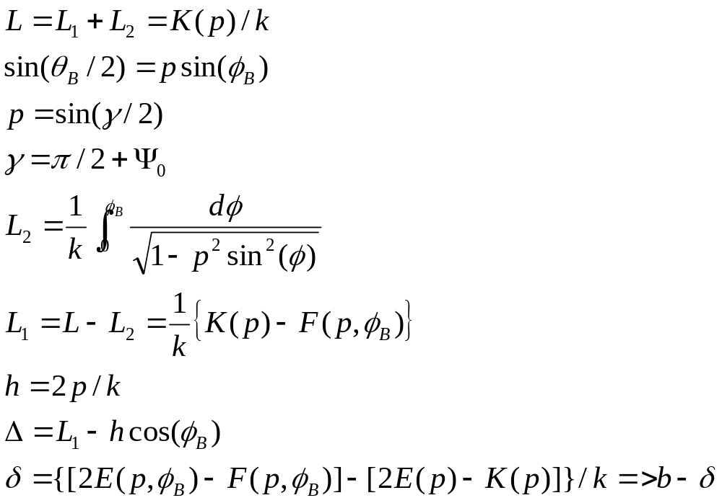
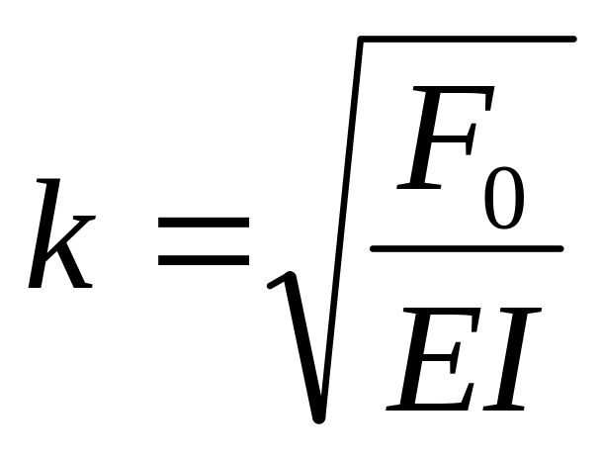
Geometric Properties
From geometry: From the geometric properties of the elliptic functions, we make the following identifications.

Slide 18
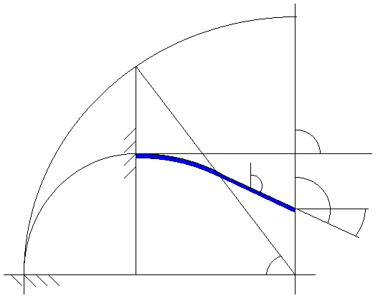
Identification of terms
F₀
θ_{B}=π/2
1
L₁
θ(x,y)
γ
δ
L₂
b
2
Ψ₀
L₁-Δ
φ_{B}
0
h
Fig 3

Slide 19
Nonlinear Beam Deflection - F_{x}, F_{y}, & M
Here we attempt answer the question:
Given the angles of node2, determine θ, x, y, F_{x}, F_{y}, and M.
Method of derivation:
By intuition, jumping straight to elastic similarity and the geometric properties of elliptic integrals.
End result:
θ, x, & y as a function of F_{x}, F_{y}, and M
F = K₁q + K₂*q³ => F=F(q)

Slide 20
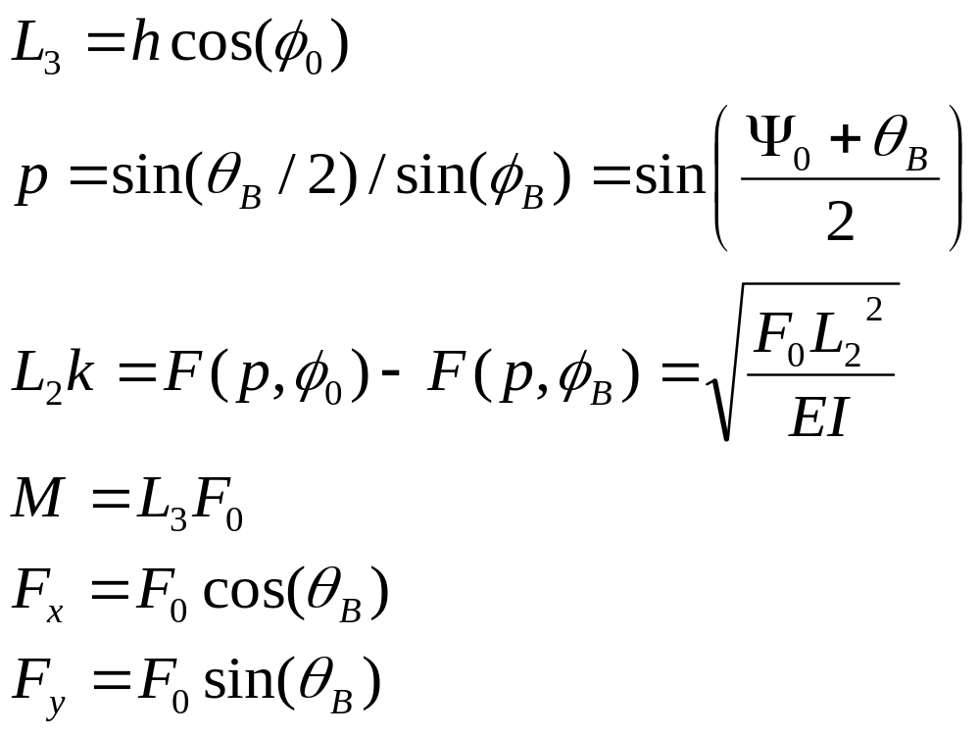
Here’s my modification to analyzing nonlinear beams, for simultaneous Fx, Fy, and M Forces.
I now present a way to extend the above method to a more general situation where Fx, Fy, &M are simultaneously applied.
The geometric quantities listed below are self-described in the new geometric representation shown in Fig 4.
Given
Ψ₀ and θ_{B}, the following holds (see fig 4)

Slide 21
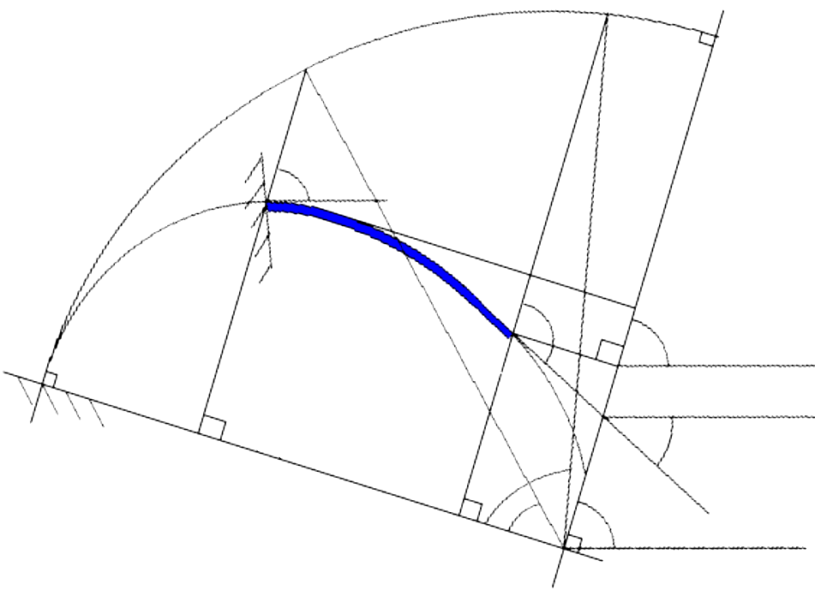
Here’s My Modified Geometric Representation for Fx,Fy,M
M=F*L3
Fx=F₀cos(θ_{b})
Fy=F₀sin(θ_{b})
F₀
θ_{B}
1
L₂
L₁
θ₀
θ_{B}
L₃
0
2
Ψ₀
φ₀
h=2p/k
θ_{B}
φ_{B}
Fig 4

Slide 22
So, to get the nonlinear results, this is what I do:
Input: Ψ₀ and θ_{B} angles
Output: Fx, Fy, M, X/L, & Y/L
θ₀ = θ_{b} + Ψ_{0;}
p=sin(θ₀ /2);
L3k=2*p*cos(φ₀); %associated with moment
φ_{b}=asin(sin(θ_{b}/2)/p);
%elliptic integration
Ephib=quad8('elliptic',0,φ_{b},[],[],p,2); %elliptic integral of the second kind
Fphib=quad8('elliptic',0,φ_{b},[],[],p,1); %elliptic integral of the fist kind
Ephi0=quad8('elliptic',0,φ₀,[],[],p,2); %elliptic integral of the second kind
Fphi0=quad8('elliptic',0,φ₀,[],[],p,1); %elliptic integral of the first kind
L1k=Fphi0-Fphib; %associated with force
L1minusXoverL1=2*p*(cos(φ_{b})-cos(φ₀))/L1k; %beam shortening
YoverL1=(2*Ephib-Fphib)/L1k - (2*Ephi0-Fphi0)/L1k; %beam transverse deflection
FL2EIx=L1k^2*cos(θ_{b}); %nondimensional force
FL2EIy=L1k^2*sin(θ_{b}); %nondimensional force
MLEI=L3k*L1k; %nondimensional moment

