Slide 1
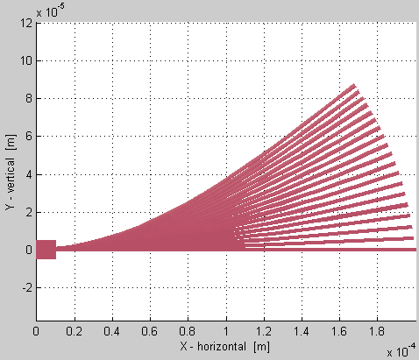
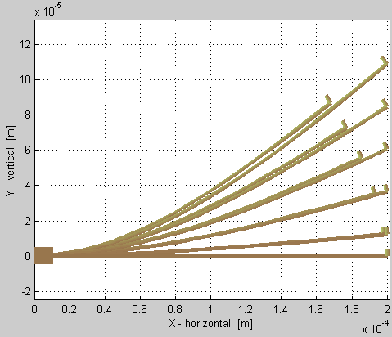
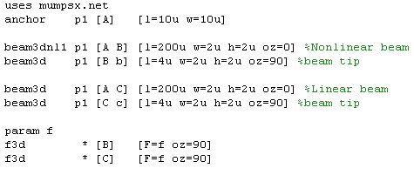
Initial results of Sugar’s nonlinear beam model function
vs.
Linear
Nonlinear
Nonlinear beam,
varying Fy
Netlist (right Fig.):
sweeping Fy=0:9μN

