Slide 1
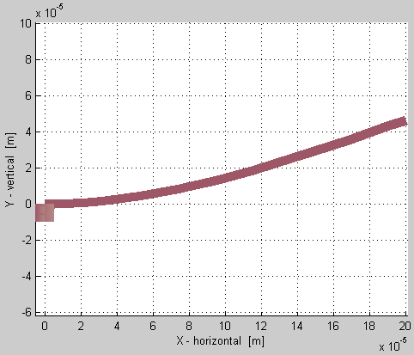
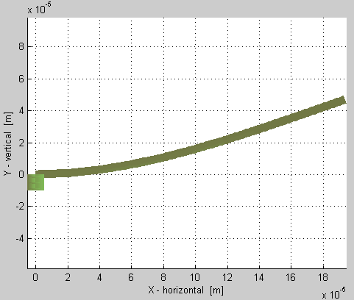
After running cho_dc on a linear beam:
Before running cho_dc on a pre-disp beam:
F
F=0 !!!
Linear beam
Pre-displaced beam
The usual linear beam model does not have the “beam shortening” effect. As seen here, the deflected beam still has an x-axis projection of 200um. That means that the beam’s length as displayed is actually greater than 200um.
Here you can see that pre-displaced beam has “beam shortening.” The length along its bent neutral axis is 200um, however its projection onto the x-axis is less than 200um.

Slide 2
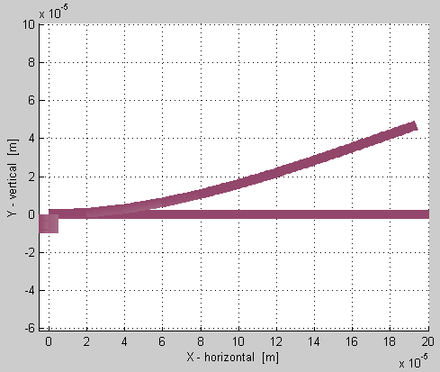
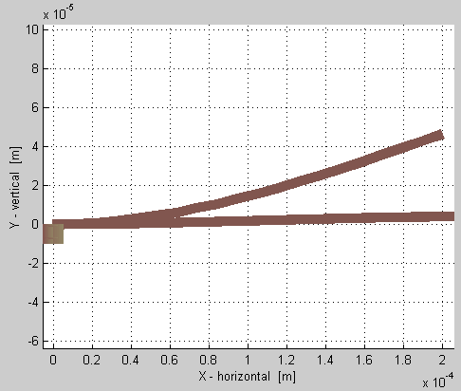
Pre-displaced beam vs linear beam, before and after running cho_dc:
Before running cho_dc on both beams
After running cho_dc on both beams
F
F=0
Pre-displaced beam
Linear beam
F=0
“switched”
stressed
Linear beam
Pre-displaced beam
As you can see, the beams “switch” places after equilibrium is reached in cho_dc. This is because I put an upwards force on the linear beam (to make it “look” like its pre-displaced counterpart). At the same time, the pre-displaced beam is pre-stressed, so it tries to deflect downward for its own equilibrated state.
You may have notice that the “switch” isn’t prefect. Ideally the pre-stress in the pre-displaced beam should have completely straightened out the beam. So there’s still more thinking to do.

Slide 3
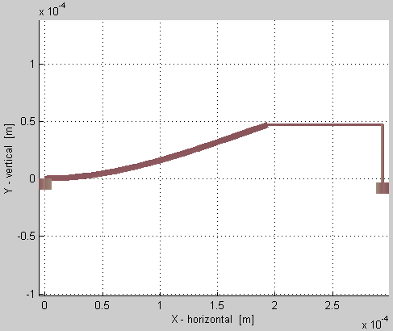
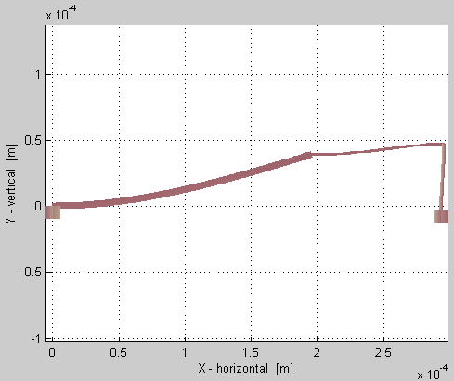
Mixed beams reacting together
Before running cho_dc on system
After running cho_dc on system
Linear beams
Equilibrium reached
Pre-displaced beam
Pre-displaced/stressed beam
Initial state
Final state
The stress in the pre-displaced beam deflects down, & over, the attached linear beams.
This netlist element looks like this:
predisplacedbeam p1 [A B] [l=200u w=5u oz=0 qoz=0.35 qy=47u]
where the other pre-displacements qz qx qox & qoy default to zero if not specified.

Slide 4
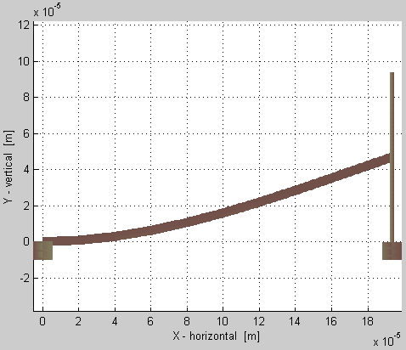
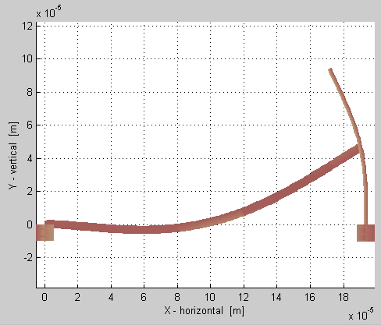
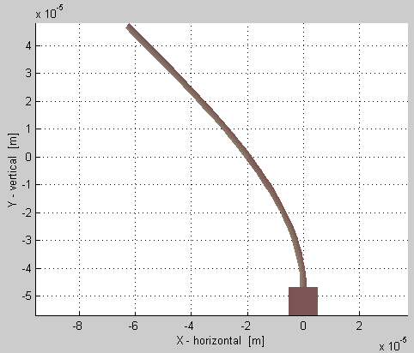
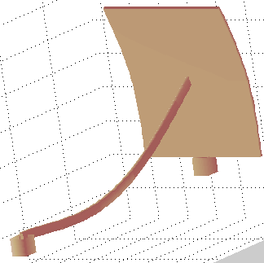
Displaced beam propping up a plate:
Before running cho_dc on system
After running cho_dc on system
Initial state
Final equilibrium state
“plate”
Linear wide beams
F
F
Pre-displaced beam
F
This shows the reaction of the pre-displaced beam due to a plate that’s being forced over. Notice the increased curvature of the pre-displaced beam.
The small insert shows how much the plate would bend if no beam is attached, ~3 times more.
Another view
of above

