Slide 1
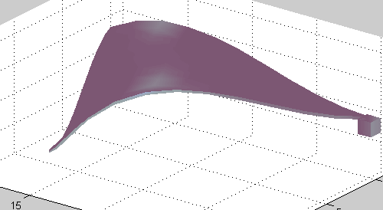
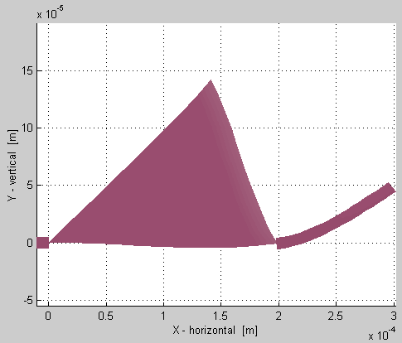
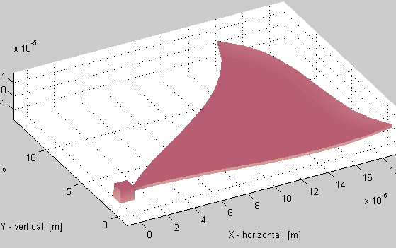
Initial triangular plate results
Out-of-plane forces
Huge moments
Mixed elements
plate, beam, anchor
F
M
F

