Slide 1

SQL FOUNDATION SKILLS

Slide 2


SQL COMMANDS
01
DAY
13-Feb-2023
DDL
TCL
DML
DQL
DCL

Slide 3
Software installations & Practical
02
DAY
14-Feb-2023
Getting privileges
Oracle
SQL
SQL Plus
Software
Practical

Slide 4

SQL Fundamentals
03
DAY
15-Feb-2023
Data Types
Clauses
Char
Number
Where
Group by
Varchar
Date
Order by
Having

Slide 5

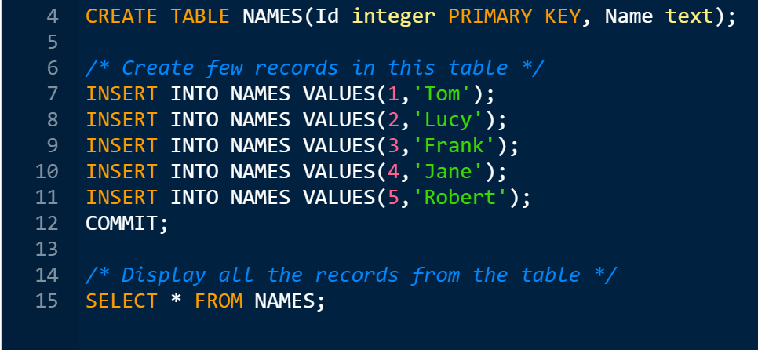
Programming in SQL Tools
04
DAY
16-Feb-2023

Slide 6
Programming in SQL Tools
05
DAY
17-Feb-2023
Data Model, Schemas and instances
Relational database concept
Restricting and Sorting data
Functions & Joins
Operators and indexes
Database Normalization

Slide 7
THANK YOU

