Slide 1
introductoryR
Austin Haffenden a.haffenden@keele.ac.uk
William Smith: WS1.16 www.github.com/ahaffenden

Slide 2
What is R?
An interpreted computer language.
  User-visible functions written in R
  Possible to interface with other programming languages
  System commands can be called from within R
Used for:
  data manipulation, statistics and graphics
Is made up of:
  Operators (+ - <- * %*% …) for calculations on arrays & matrices
  Large, coherent, integrated collection of functions
  Facilities for making unlimited types of publication quality graphics
  User written functions & sets of functions (packages); 800+ contributed packages so far & growing

Slide 3
Open Source
Not just free:
  Provides full access to code
  Ability to fix bugs and extend software
  Forum allowing researchers to explore and expand methods
  Cutting Edge! Constant development
  Ensures that scientists are the co-owners of software tools needed to carry out research
  Promotes reproducible research by providing open and accessible tools
  Most of R is written in… R! Making it (relatively) easy to see what functions are actually doing.

Slide 4
R Advantages
Fast and free.
State of the art
2nd only to MATLAB for graphics.
Active user community
Excellent for simulation, programming, computer intensive analyses, etc.
Forces you to think about your analysis.
  You need to understand what you are doing
Interfaces with database storage software (SQL)

Slide 5
R Disadvantages
Steep learning curve
No commercial support; can be frustrating
  (see above)
Easy to make mistakes (= learning)
Working with very large datasets is limited by RAM (physical memory)
  Newer packages developed to deal with this
Little, but improving, support for 3D or dynamic graphics

Slide 6
R Packages
Repository:
http://cran.r-project.org/src/contrib/PACKAGES.html
Enormous advantage - new techniques available without delay and you already know the language
Allows construction of customized statistical programs
Around 4000 packages on CRAN

Slide 7
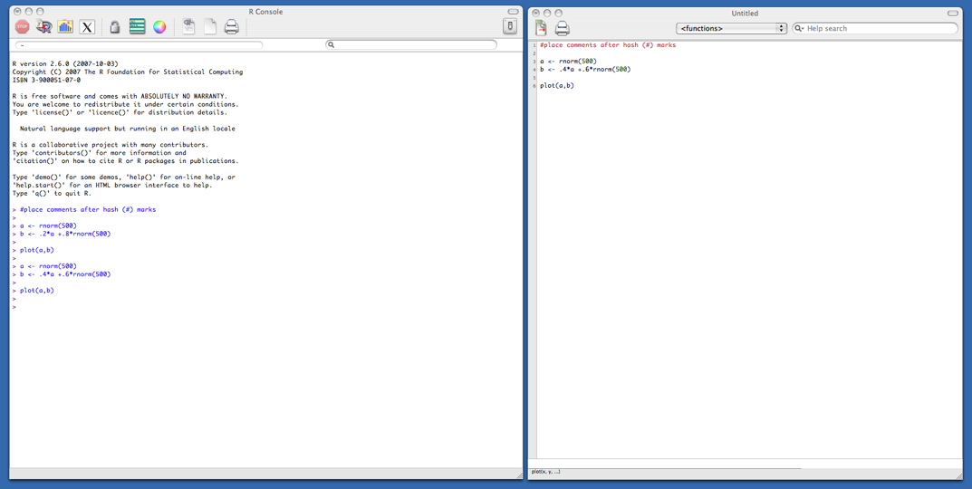
Typical R session
Start up R via the GUI or favorite text editor
Two windows:
  1+ new or existing scripts (text files) - these will be saved
  Terminal – output & temporary input - usually unsaved

Slide 8
Typical R session
R sessions are interactive
Write small bits of code here and run it

Slide 9
Typical R session
R sessions are interactive
Write small bits of code here and run it
Output appears here. Did you get what you wanted?

Slide 10
Typical R session
R sessions are interactive
Output appears here. Did you get what you wanted?
Adjust your syntax here depending on this answer.

Slide 11
Typical R session
R sessions are interactive

Slide 12
Typical R session
R sessions are interactive
At end, all you need to do is save your script file(s) - which can easily be rerun later.

Slide 13
Learning R
Swirl package
Search for answers on Google
Play with your data and make mistakes
help(lm) or ?lm gives you help on lm function.
  Read the help files.
  Try the example code provided
Subscribe to r-help and ask questions (politely)
  https://stat.ethz.ch/mailman/listinfo/r-help
The more time that you spend using R the easier it gets.

Slide 14
R Document Resources
Available from CRAN (https://cran.r-project.org
  An Introduction to R
  Writing R Extensions – package development
  R Data Import/Export
A multitude of tutorials, cheat sheets, scripts etc. available on the web.

