Slide 1


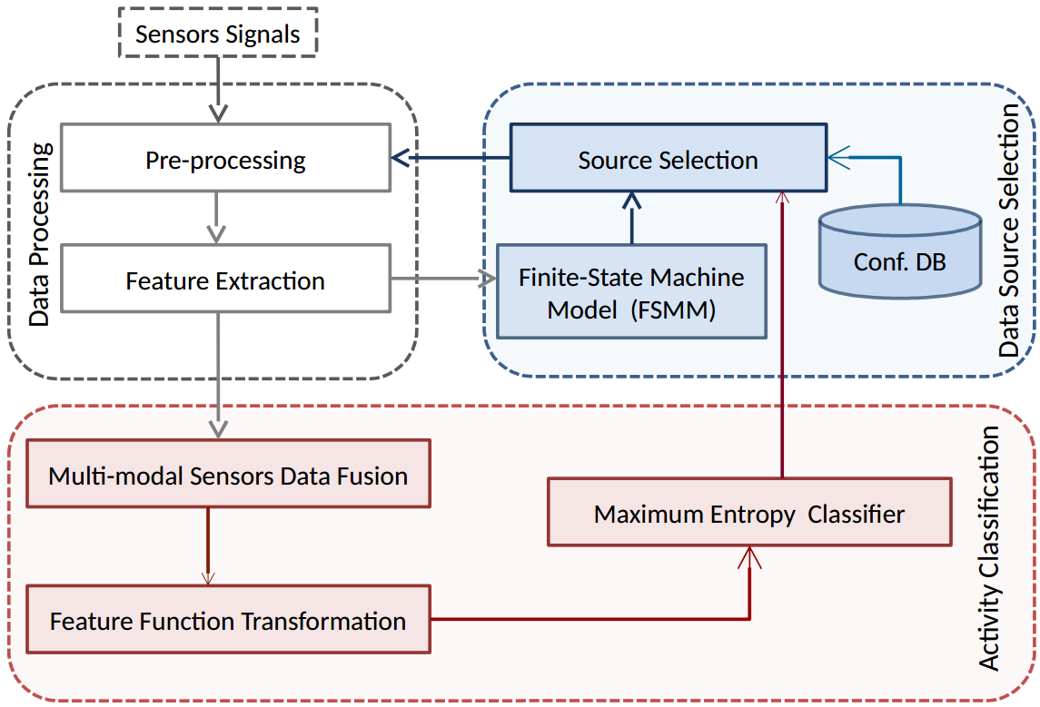
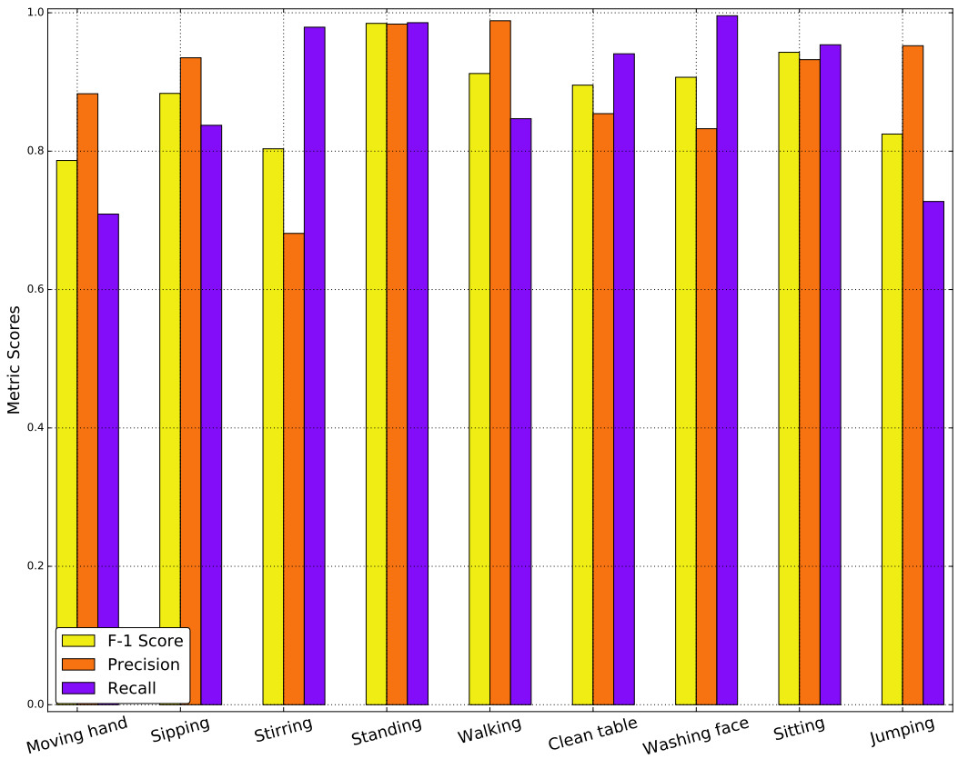
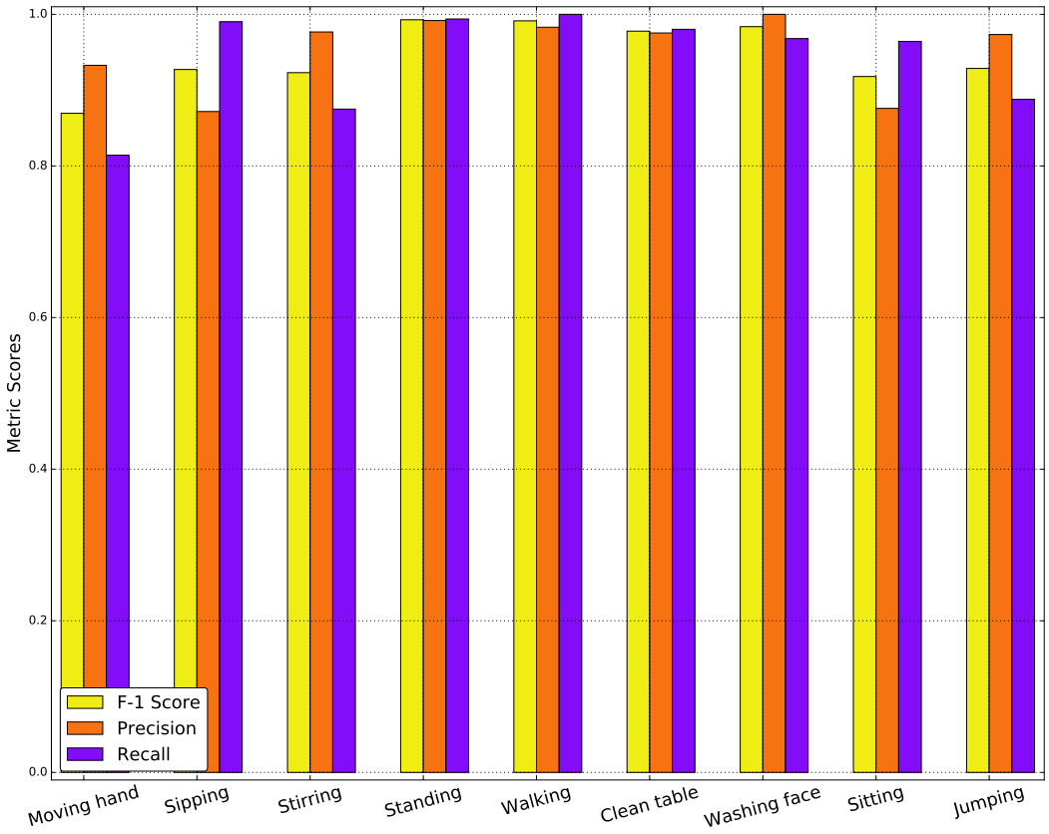
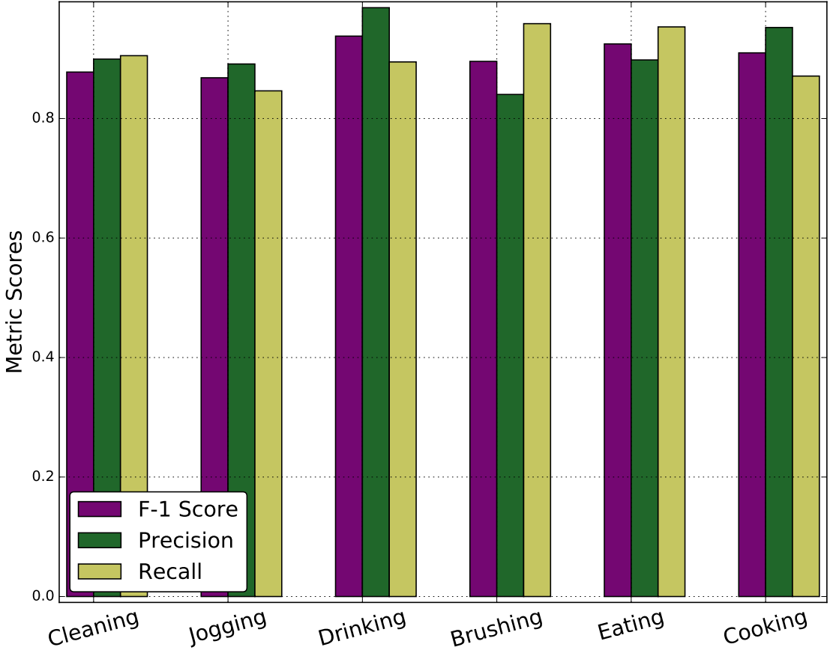
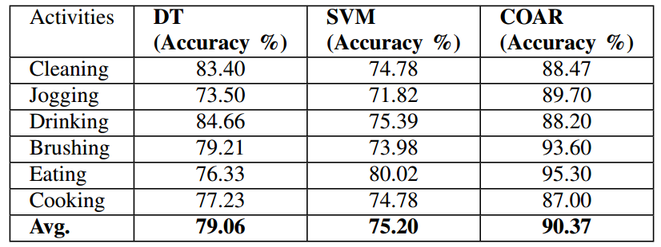
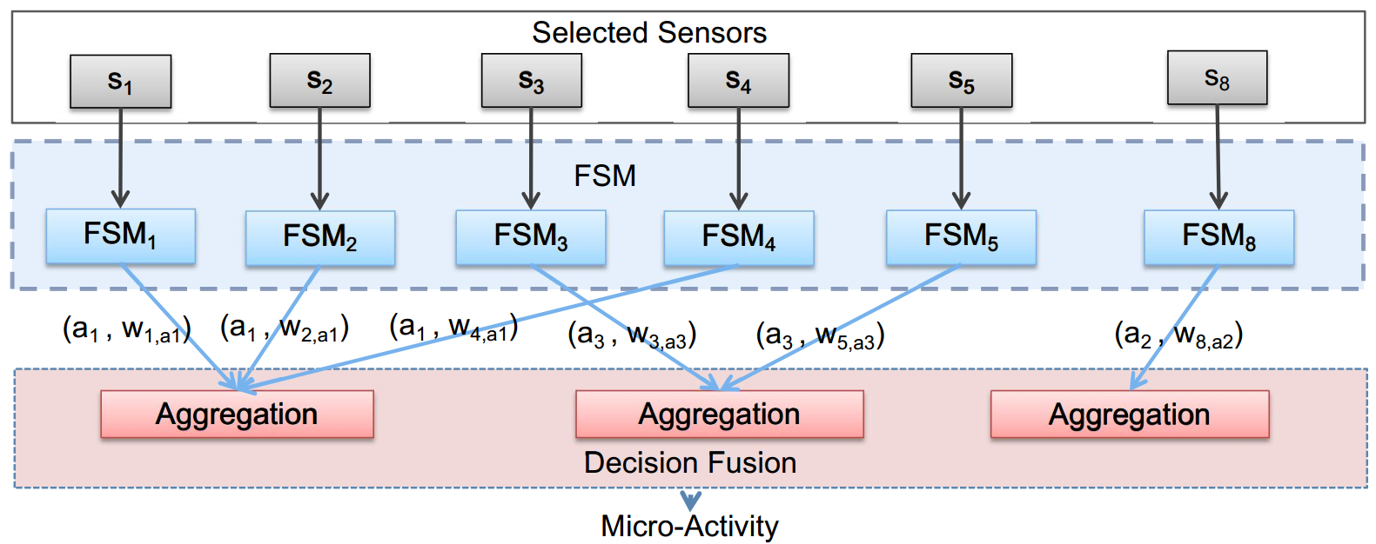
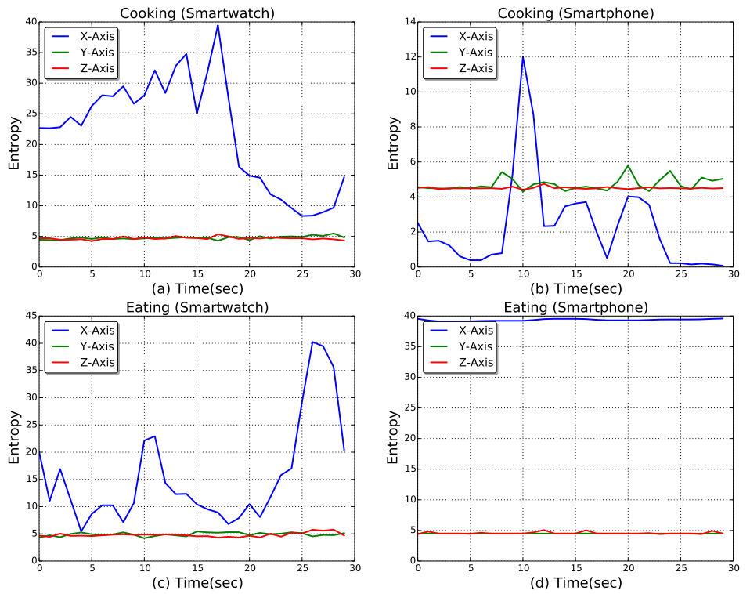
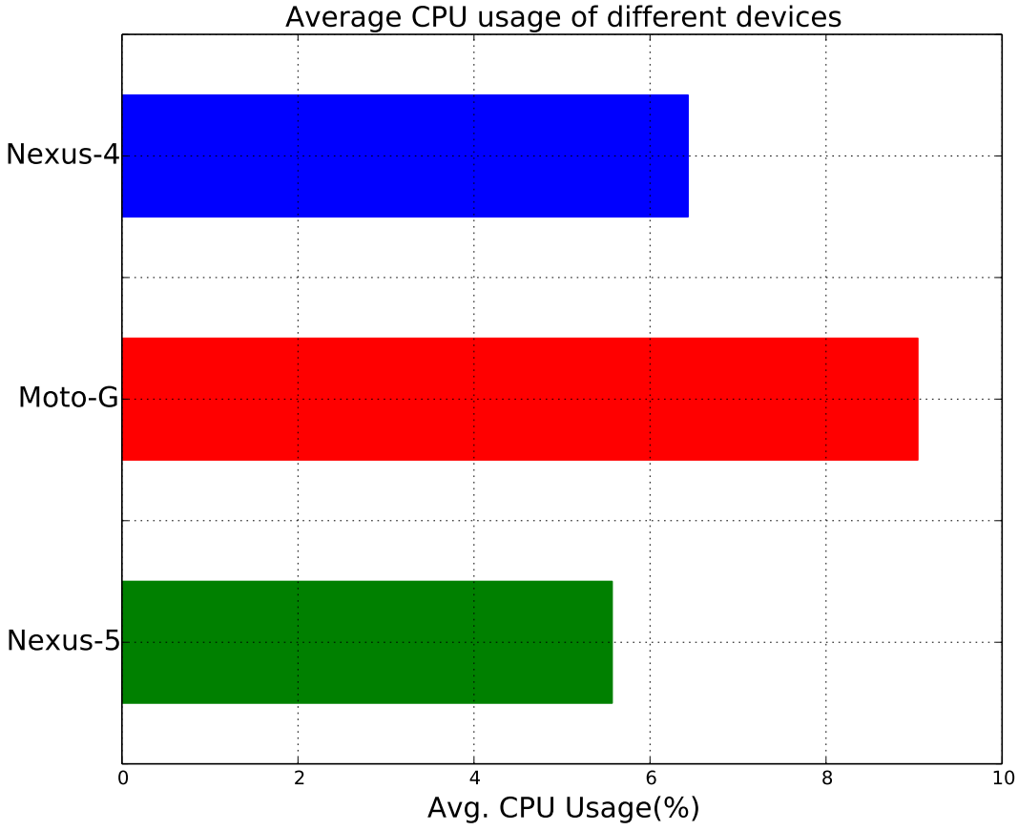
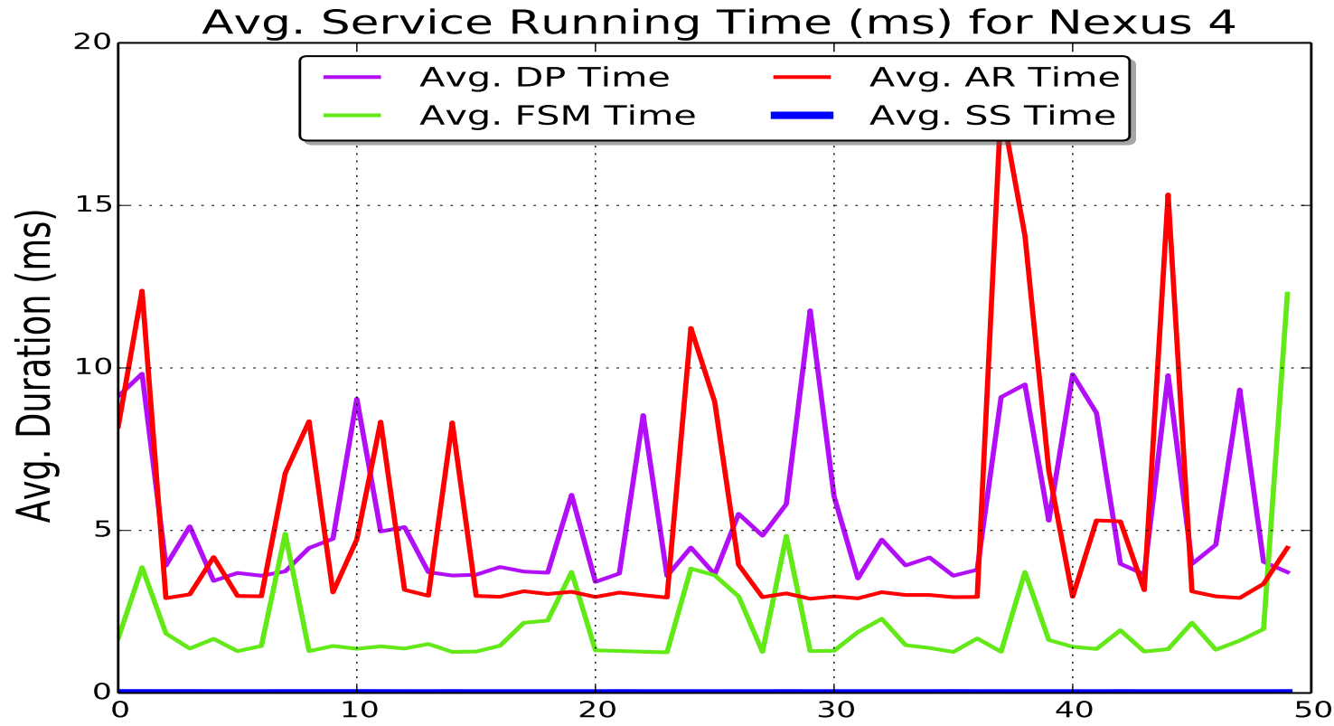



COAR: Collaborative and Opportunistic Human Activity Recognition
Md Abdullah Al Hafiz Khan, Nirmalya Roy, H M Sajjad Hossain
Mobile, Pervasive and Sensor Computing (MPSC) Lab, University of Maryland Baltimore County
Motivation
COAR Framework
Results
ADLs are composed of physical gestures and ambulation states
Human Activities share analogous micro-activities
Incomplete complex activity context with single sensor
Embedded Smart devices
  Heterogeneous sensors -Accelerometer, Gyroscope, etc.
Unified AR model
  Infer context dynamically
  Real-time light-weight AR
Sensor Usage (FSM)
  Offline FSM performance
  Online FSM Performance
  COAR Activity Recognition
Finite State Machine Model (FSMM)
Challenges
Micro-activity changes frequently
Real-time context detection
Context-wise sensor selection
Multimodal sensor fusion
  Real-time Performance
  State of the art comparison
Service Running Time (Nexus-4)
CPU Usage
Experimental Setup
Implementation
Five smartphones and a smartwatch
  Body positions - head, upper arm, waist, thigh, shin, wrist
  6 activities (i.e., Eating , Cooking, Brushing etc.)
10 subjects (7 male and 3 female)
Ground truth microsoft kinect
Java-based Android
2.58 sec (128 samples) segment
50% overlapping window
Batch size 64
Configuration DB maps data sources, activities, micro-activities
References
Diane J Cook and et. al. Detection of social interaction in smart spaces. Cybernetics and Systems, 2010.
Luis A. Castro and et al. Collaborative opportunistic sensing with mobile phones. In UbiComp’14
Zhang, Yu et al. "Transfer metric learning by learning task relationships." SIGKDD 2016.

