Slide 1


Firearm Detection Using Wrist Worn Tri-Axis Accelerometer Signals
IEEE WristSense'18
March 19th, 2018
Md Abdullah Al Hafiz Khan, David Welsh, Nirmalya Roy

Slide 2
Overview
Introduction
Motivation
Related Work
Methodology
Data Collection
Results and Discussion
Limitations and Future Work

Slide 3
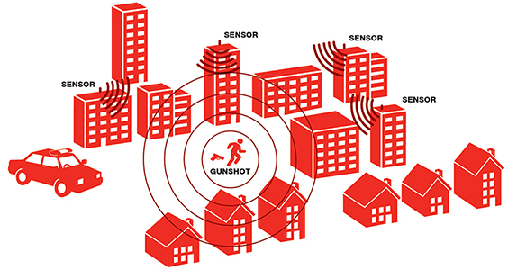

Motivation
Improve crime solving applications
Acoustical 30 yard accuracy
Expand sensor data use
Assist in training
Pervasive & non intrusive
User specific adaptability
Leverage existing sensors

Slide 4
Related Work
Limited aspects of gunshots examined
Acoustics, muzzle flash, bullet direction
Handgun only recoil
Different sensor applications
Limited wrist worn and smartphone
Embedded in firearms
Military base and city wide systems
Refinement of acoustic detection algorithms

Slide 5
Sensing Paradigm
Custom devices exploit these distinguishable features
Shot timers use sound and or recoil detection
Military counter sniping detects muzzle flash and direction finding through sound
City sensor networks locate sound point of origin
Limited and or expensive custom built sensors

Slide 6
Solutions?
Smart Devices- Smartphone, Watch,
Available Sensors – Accelerometer, Gyroscope,
Microphone, etc.
Our Objectives –
Recognize Firearm, Firearm type, Firearm Category
Our comprehensive study –
15 Firearm, Single shooter
Which sensor we use? - Accelerometer.

Slide 7
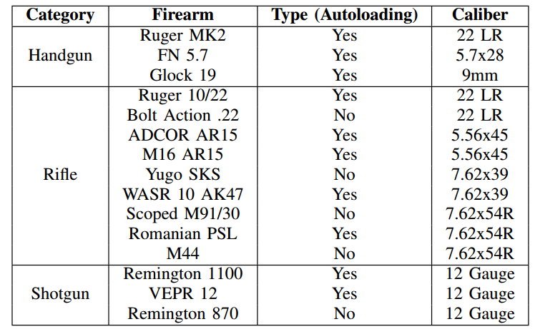
Different Firearms
15 firearms
Category
Handgun
Rifle
Shotgun
Type
Autoloading
Manual
Firearm Details
Notes:
Write the notes for the presenter

Slide 8
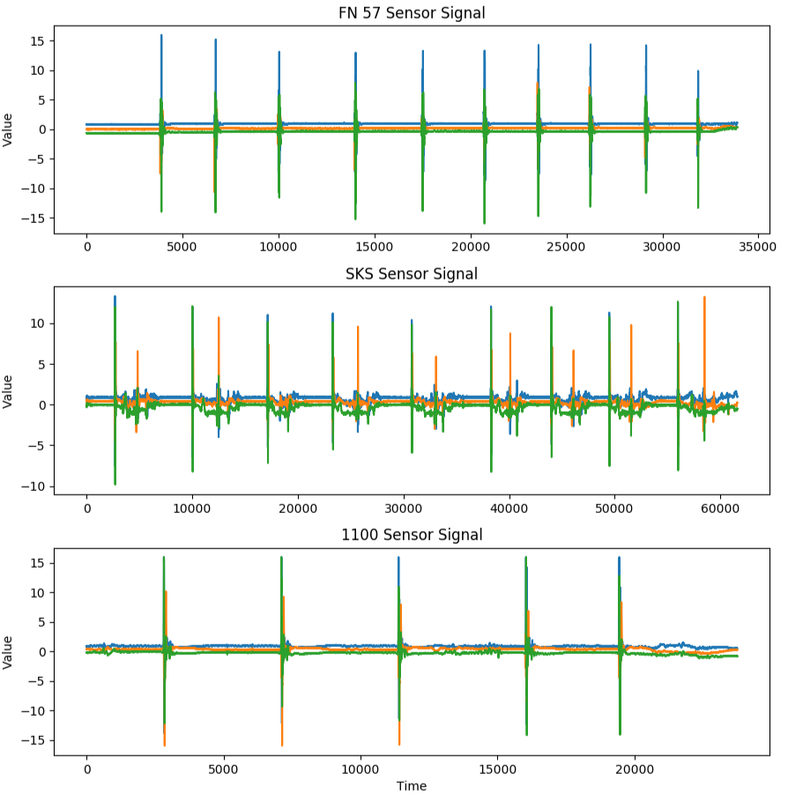
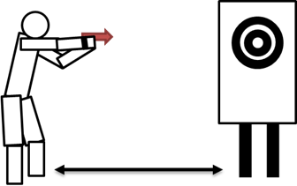
Solutions
Firearms have different
Shooting Style
Hand positions
Recoil force
Wristworn Accelerometer sensors
Unique sensor signals for each firearm
Three shooting styles
Accelerometer Sensor Signals
Shooting Style
Notes:
Write the notes for the presenter what are the shooting styles, how the sensor signals for different shooting style, specially note about the accelerometer sensor signals figures

Slide 9
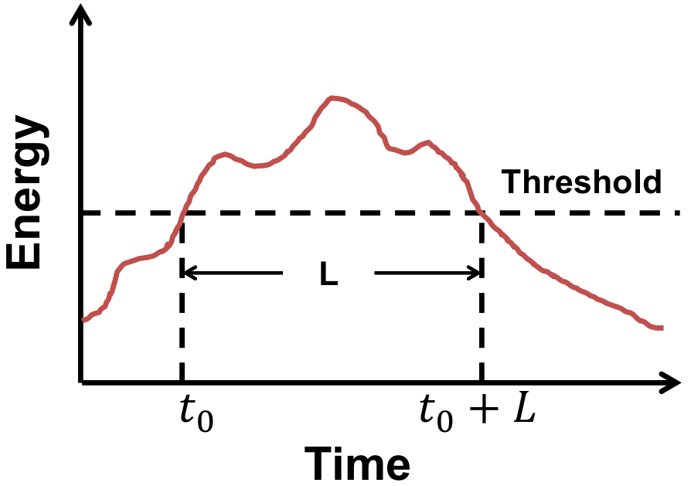
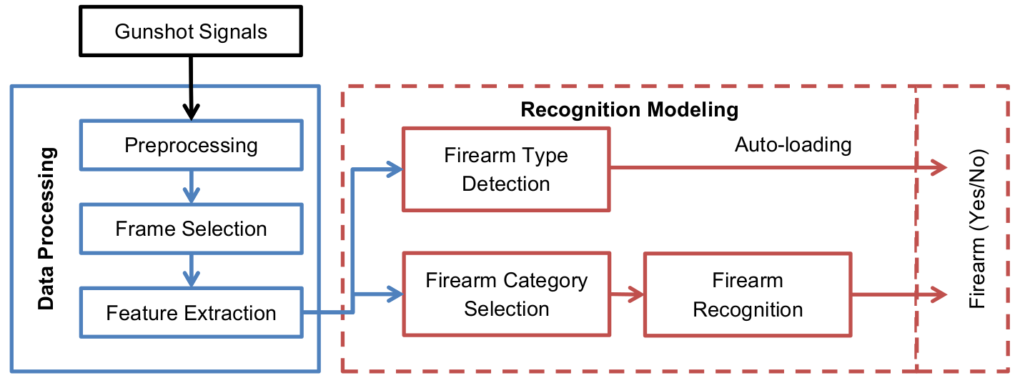
Our Framework
Preprocessing
Create frames (1600 samples).
Remove noise low-pass filter (150 Hz)
Frame Selection
Gunshot related frames has Higher Energy (E > threshold)
Feature Extraction
Statistical and frequency domain features
Firearm Category Selection
Decision Tree Classifier
Ease of implementation
Realtime detection
Firearm Recognition
Decision Tree (DT)
Firearm Type Detection
1-class SVM
Autoloaded samples as positive insntaces
All others are negative instances
Frame Selection
Framework
Notes:
Provide details for each of the module in the note so that presenter can present it nicely.

Slide 10

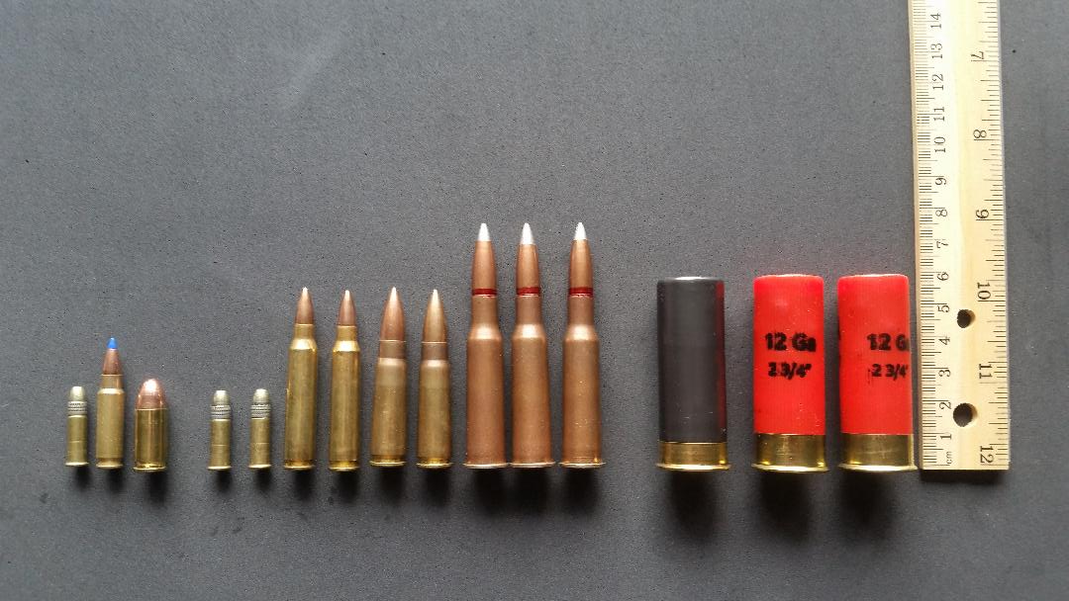
Experimental Setup
Wristworn Sensors
AX3 Watch, Axivity Ltd tri axis accelerometer
Sampling frequency 1,600 Hz, offset +-16 G’s
Dominant wrist of shoot
Participants
Only one participant
Height - 6'2'', Age 27, Weight - 180
Firearm shooting
10 rounds for recoil under 10 ft/lbs
5 rounds for recoil over 10 ft/lbs
Shooting Environments and Settings
Private shooting range
Flat level ground
Target placed at torso height
Target positioned 10 yards down range
Shooter in standing position
Shooting styles
Handgun
Rifle/Shotgun
Different types of Bullets

Slide 11
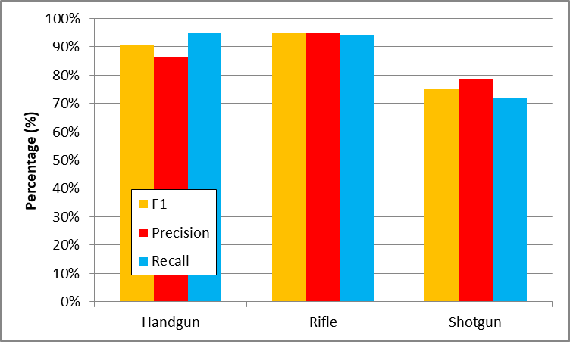
Evaluations
Firearm Category Inference
Three categories
Handgun, Rifle, Shotgun
Randomly split train and test set.
training set contains 70% data
Testing set contains 30% data
F1 scores for handgun 90%, rifle - 93%, shotgun 76%.
Different category has distinctive sensor signals.
Category Inference

Slide 12
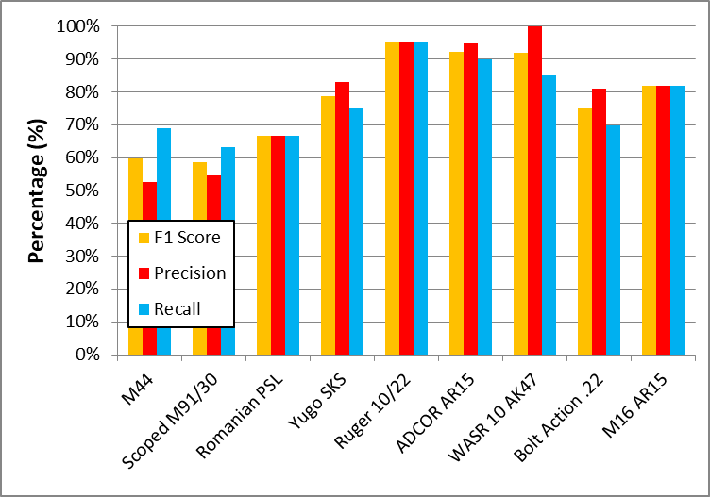
Evaluations
Firearm Detection
Use Decision Tree to detect individual firearm
Rifle detection
'M44' and 'Scoped M91/30' have F1 score 60%, 58%.
Both have similar impact on accelerometer sensor.
Use same cartridge
Both are non-autoloading
Frame selection module selects non-gunshot related signals.
Ruger 10/22 has F1 score 93%
Unique low recoil force
Auto-loading
Rifle Inference Results

Slide 13
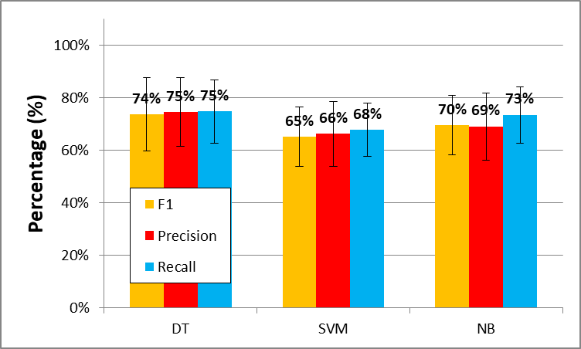
Evaluations
Firearm Detection Comparison
10-fold cross-validation
Evaluated using DT, SVM, NB model.
F1 scores for rifle for DT, SVM, NB is 73%, 65%, 66% respectively
More number of rifle instances SVM performance dropped
Manual loading contains noises
Rifle Inference Comparison

Slide 14

Evaluations
Firearm Type Detection
Oneclass SVM
Auoloading as positive instances
Manual loading as negative instances
Dataset was splitted randomly 70-30% as train and test
Accuracy 90%
Firearm Type detection

Slide 15
Limiatations
Sensor performance
Sound level vs sound recording
Requires high sample rates
Event length of 0.1 prevented data smoothing
Overestimating accuracy
Training and testing samples
Even vs uneven, 10 fold vs testing
Ambiguous conditions of shooting for HAR
Walking and shooting sample

Slide 16
Conclusions and Future work
Firearm, type and category deteced
Firearm detection accuracy
Category Detection Accuracy
Type detection accuracy
Feature extraction
Sliding-window spike detector
Pre spike and post spike
Multi-subjects investigations

Slide 17
Thank you?
Sriram Chellappan
Associate Professor
University of South Florida
Dept. of Computer Science and Engineering
Email: sriramc@usf.edu
http://www.csee.usf.edu/~sriramc/

