Slide 1


COAR: Collaborative and Opportunistic Human Activity Recognition
IEEE DCOSS’17
June 07th, 2017
Md Abdullah Al Hafiz Khan, Nirmalya Roy, H M Sajjad Hossain

Slide 2
Motivation
Everyday Smart Devices
Smartphones, smartwatches, smart jewelries, smartshoes
Sensors - Accelerometer, Gyroscope, etc.
Influences on everyday activities and lifestyle
Gesture, Social Interaction, Gaming
Task and resource sharing among devices
Context sensing applications type
Centralized
Distributed

Slide 3
Research Questions?
Distributed Activity Recognition (AR) framework challenges
How to select collaboratively heterogeneous sensor data?
How to switch environment in real-time collaboration?
What algorithm is beneficial in intelligent tasking and sharing of the activity inference process?

Slide 4
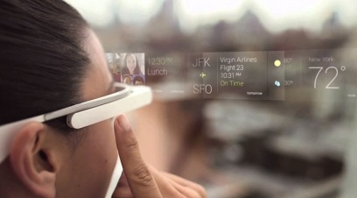
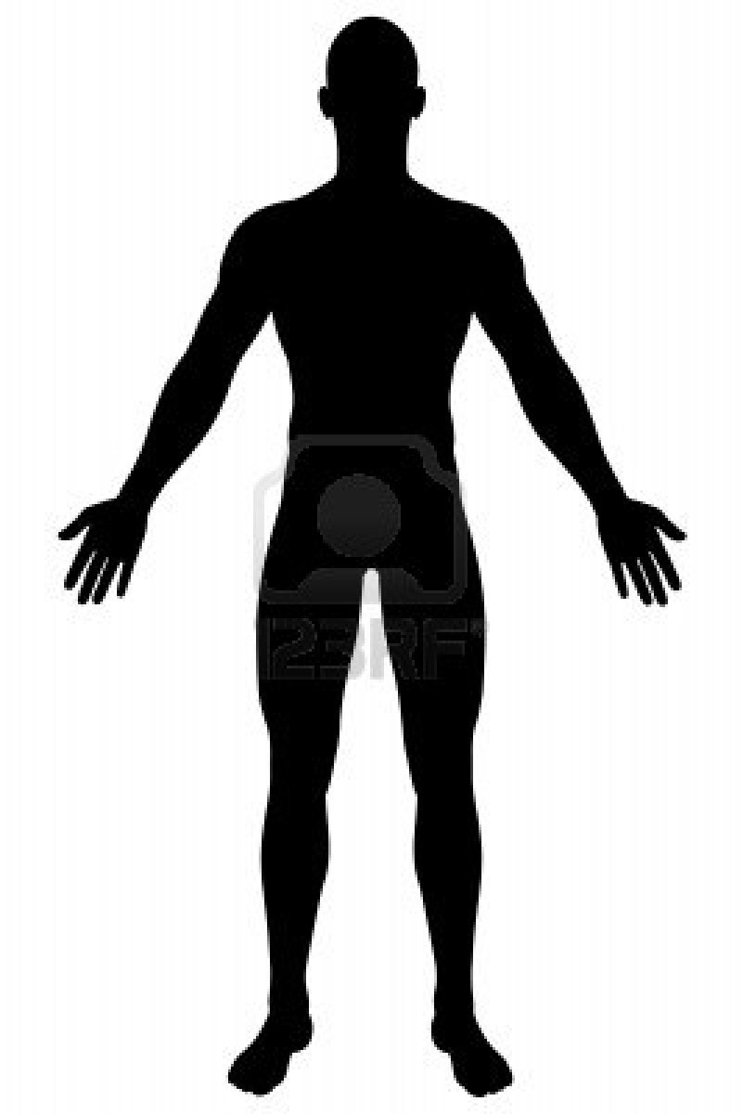
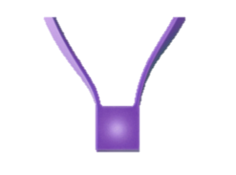
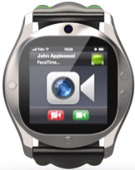
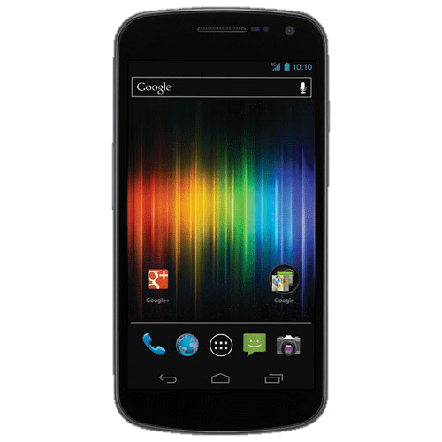
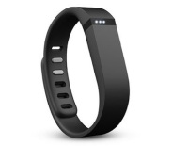
Solutions?
Smart Devices- Smartphone, Watch, Necklace
Glass
Necklace
Available Sensors – Accelerometer, Gyroscope,
Microphone, etc.
Watch
Brace
Our Objectives –
Recognizing Activities of Daily Living (ADL)
Phone
Our comprehensive study –
Six Smart devices - Five smartphones and a smartwatch.
Which sensor we use? - Accelerometer, Gyroscope,
Compass Sensor.

Slide 5
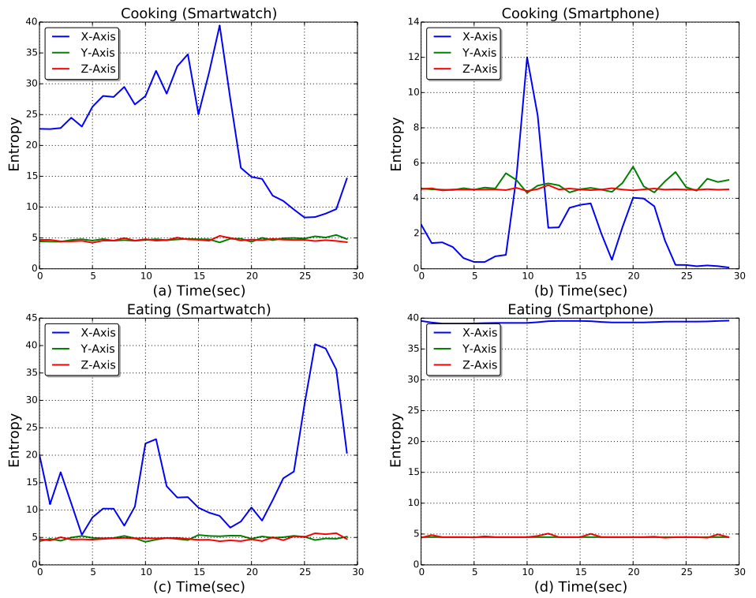
Solutions?
Sensor Selection
How sensor signals changes on each activity?
How efficiently Select Data Source?
Cooking requires both data sources.
Only accelerometer sensors data plotted.
Static Activity (i.e., eating) may only requires smartwatch sensor.
Cooking Activity on two devices

Slide 6
Solutions?
Real-time activity context and sensor selection
Micro-activities (Sitting, Standing etc.)
Finite State Machine (FSM)
Heterogeneous Sensors.
Extracts meaningful features from diverse sensors
Restricted Boltzmann Machine (RBM)
Lightweight High-level activity classifier.
Maximum Entropy Classifier (MaxEnt)
Our Framework
Collaborative Opportunistic Activity Recognition (COAR)

Slide 7
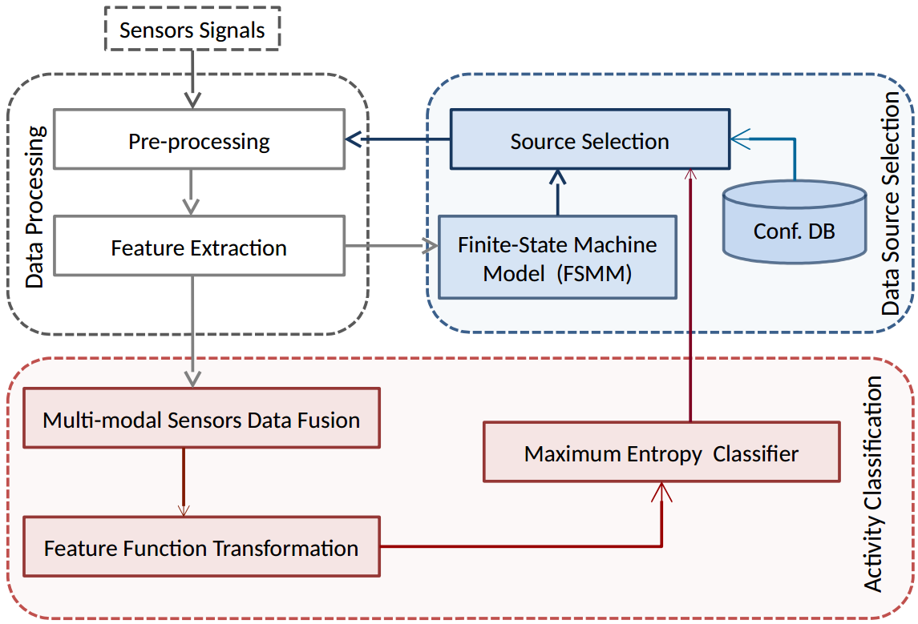
COAR Framework
Preprocessing
Create frames (3 sec).
Remove noise low-pass filter (0-10Hz)
Feature Extraction
Statistical and frequency domain features
Data Source Selection (ODSS)
Finite State Machine Model- micro-activities
Detect micro-activities (sitting, standing)
Data Source Selection (DSS)
Configuration database
Activates sensors based on micro-activities.
Activity Classification
Fuse multimodal sensor data using Random Projection.
Formulate feature function with RBM
Maximum Entropy Classifier recognize Activities

Slide 8
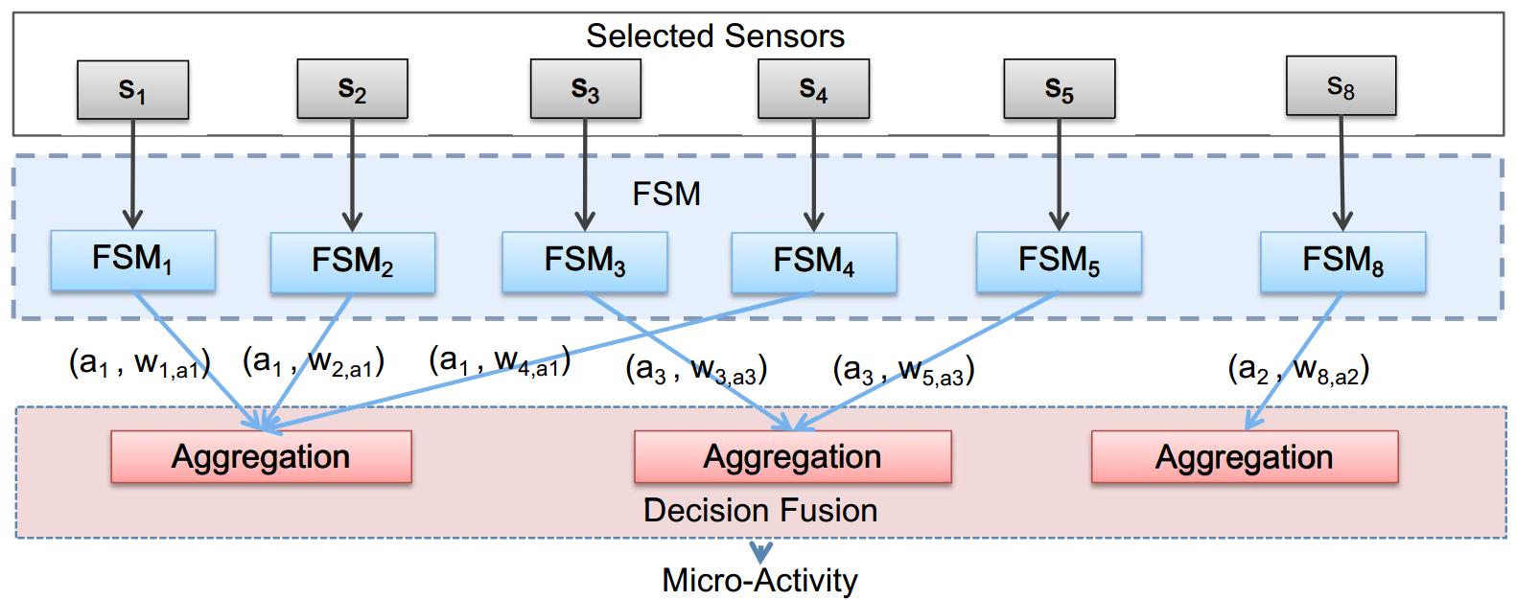
Finite State Machine Model
Finite State Machine
Light-wieght property
Each FSM is associated with a single sensor
Small amount of data determines the state or micro-activity
Micro-activity weight is determined by sensitivity
Decision fusion stage aggregate weights of the micro-activity
Finite State Machine Model

Slide 9
Experimental Setup
Five samrtphones and a smartwatch
Body positions - head, upper arm, waist, thigh, shin, wrist
Sampling frequency 50 Hz
Sensors Accelerometer, gyroscope, compass
Six Activities and Nine sub-activities
Eating (moving hand, sitting), Cooking (stirring, standing, walking), Brushing (walking, moving hand, washing face, standing), Drinking (standing, sitting, sipping), Cleaning (clean table, standing, walking), Jogging (standing, walking,jumping).
Ground truth Microsoft Kinect.
10 participants in the age group 18 to 50 years.

Slide 10
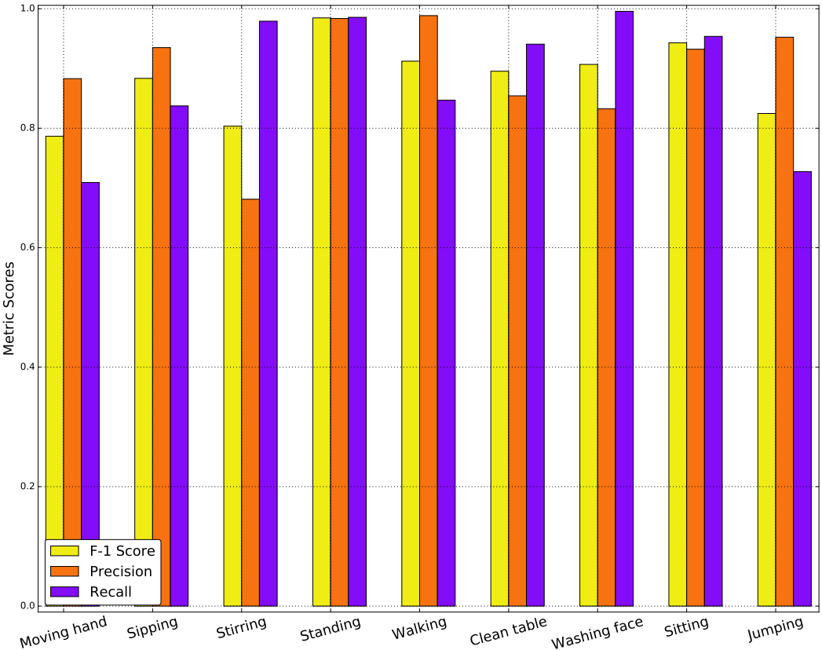
Experimental Evaluation
Sensor Usage Result
FSM trained with all sensor data in offline
Stirring and washing face have precision 0.68 and 0.83, respectively
Stirring has low precision - weighted micro-activity decision fusion and detects as moving hand
Sensor Usage

Slide 11
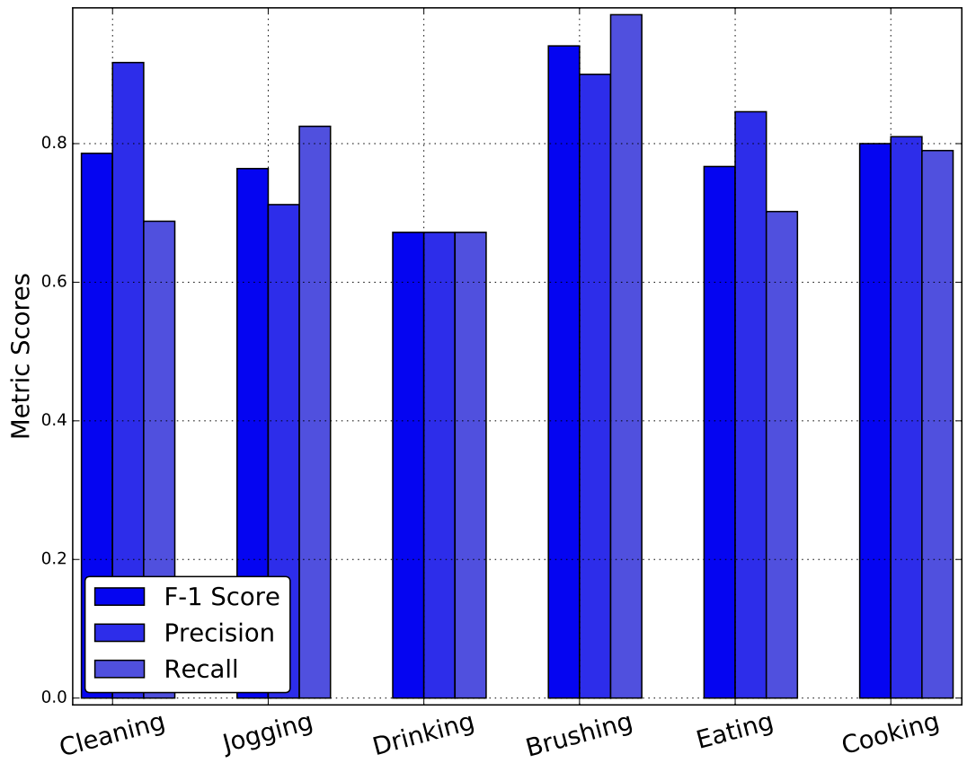
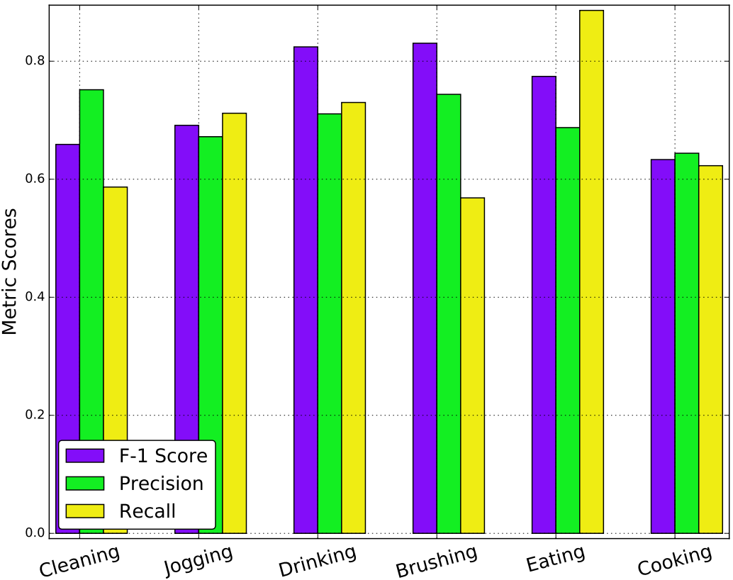
Experimental Evaluation
Standalone Device Result
Trained model on smartphone or smartwatch data
Cooking shows poor accuracy
Detect several body parts movements requires multiple sensors
Smartphone performs slightly poor than smartwatch
Smartphone can't capture upper body part movement
Smartwatch
Smartphone

Slide 12
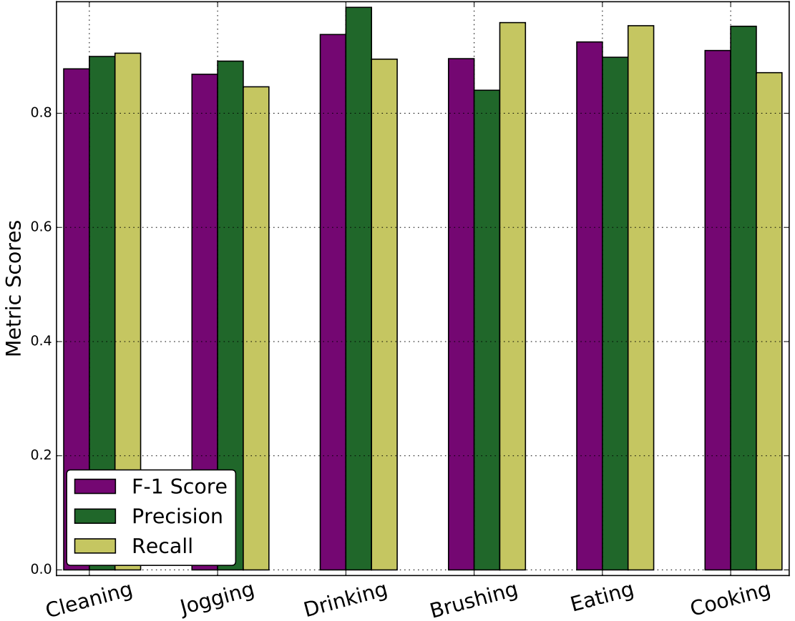
Experimental Evaluation
Opportunistic Process and Results
Sensors selected dynamically
FSM based Micro-activities detection and sensor selection
Fuse data from selected sensors
Maximum Entropy Classifier recognize activities
Dynamic activities gain higher performance
Both types sensors (hand and locomotive gesture) are selected
Joggin achieve F1 scores 0.868
Attests sensor selection approach
Opportunistically Selected Sensors

Slide 13
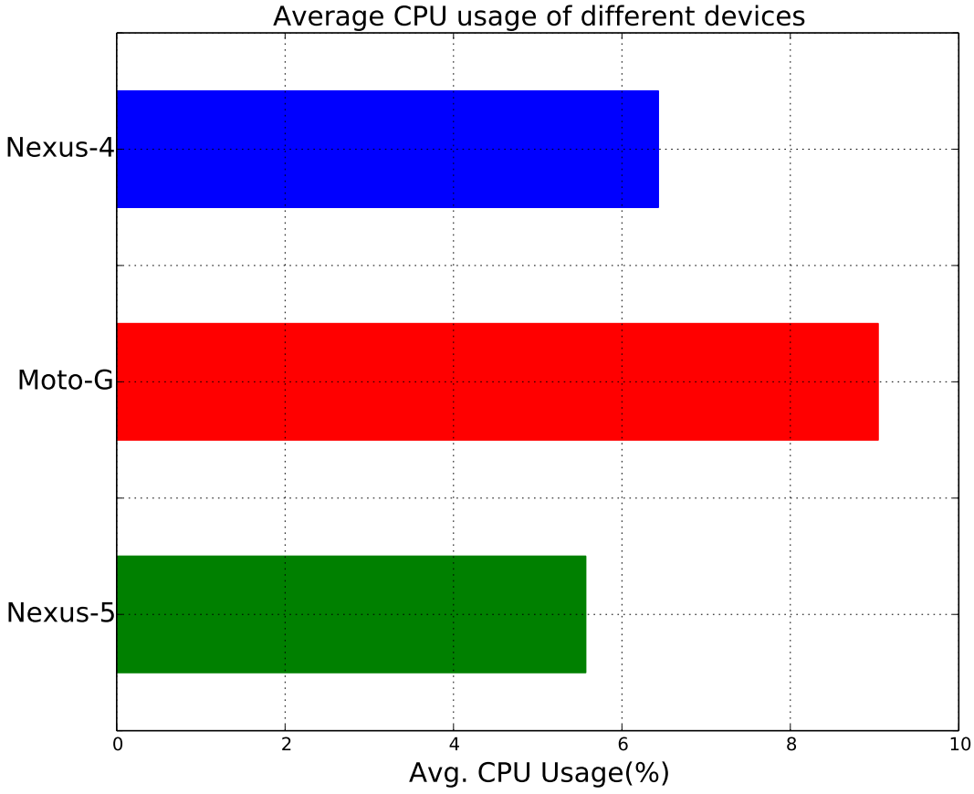
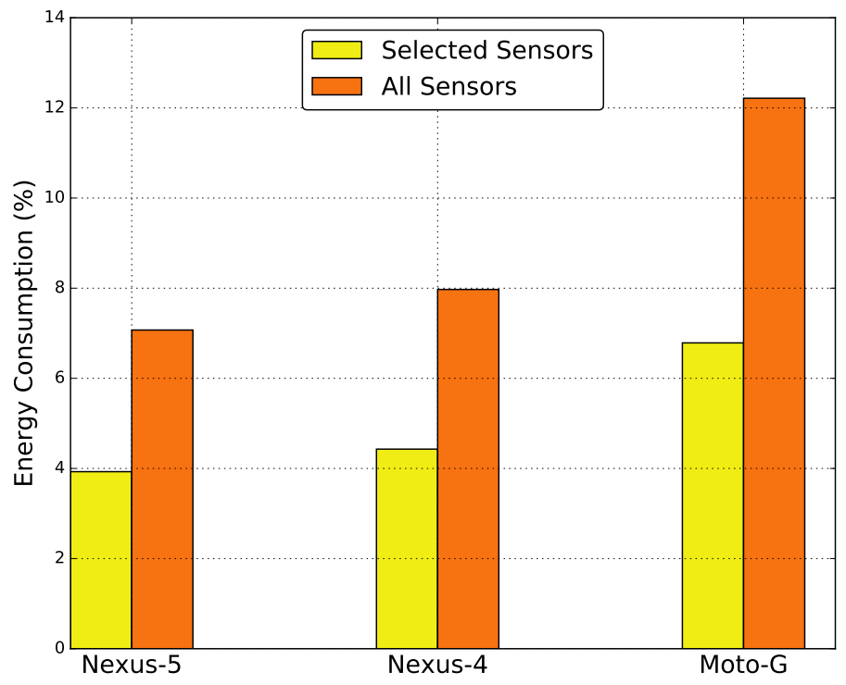
Experimental Evaluation
Device Usage
Nexus-5 has less computational time than Nexus-4 and Moto-G
Nexus-5 has higher configuration
COAR has less power consumption
COAR detects activities with selected sensors compared to all sensors
Average CPU Usage
Average Power Consumption

Slide 14
Conclusions
COAR detects activities from Smartphone and smartwatch collaboratively and opportunistically
Selects heterogeneous sensors according to user's context using FSM
COAR is flexible to include unseen activities using configuration database
Evalutated with real-life settings
Other sensor modalities (videos, audio etc.) need to investigate in future

Slide 15
Thank you?
Nirmalya Roy
Assistant Professor
Department of Information Systems
University of Maryland, Baltimore County.
Email: nroy@umbc.edu
http://userpages.umbc.edu/~nroy/

