Slide 1
OPTIMAL COURSE SCHEDULER
DANCK Solutions offers professional scheduling logistics services. We find your perfect schedule based on criteria that is important to you. Our team understands that some people are early birds while others have trouble waking up before noon. Ever been forced to miss your BIT 3444 class all semester because you didn’t get the section you wanted? DANCK will solve your scheduling needs.

Slide 2

TARGET MARKET
DANCK’s Optimal Course Scheduler is designed for college students, especially those at Southwestern Virginia Land Grant Universities

Slide 3
DATA
The data for the Optimal Course Scheduler comes from the Virginia Tech Timetable of Classes. It is extracted with an included JQuery script and can then be imported into an excel file. The excel file is then formatted with an included VBA macro. From excel the file can be imported into Microsoft Access for use in the application.

Slide 4
IMPROVEMENTS
For future improvements, developing a web API for extracting relevant classes on demand would make data always current. Using current data would allow for optimization based on only classes that have spots available.

Slide 5
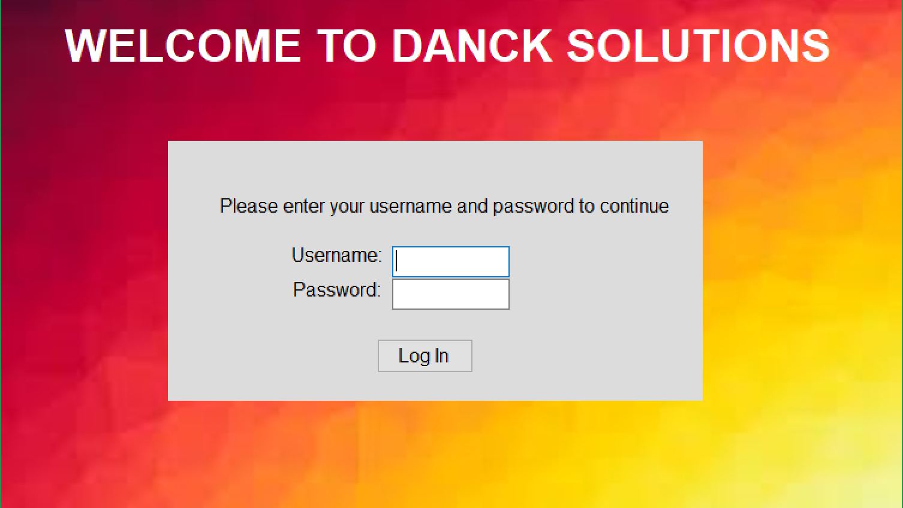

Slide 6
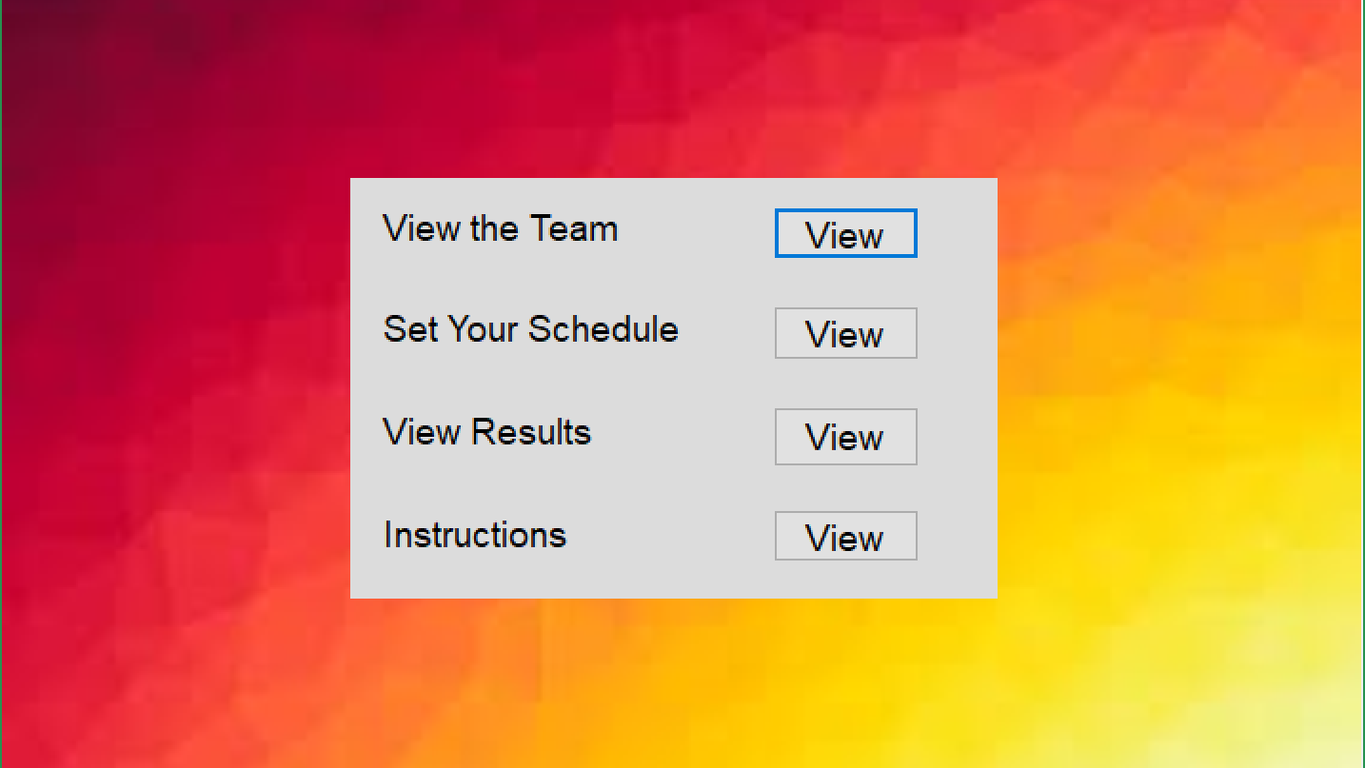

Slide 7
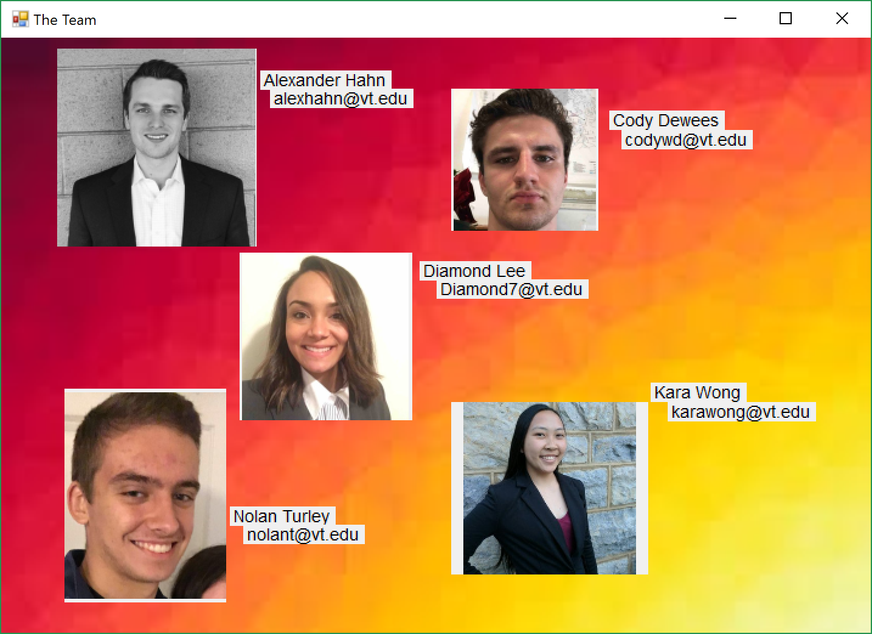

Slide 8
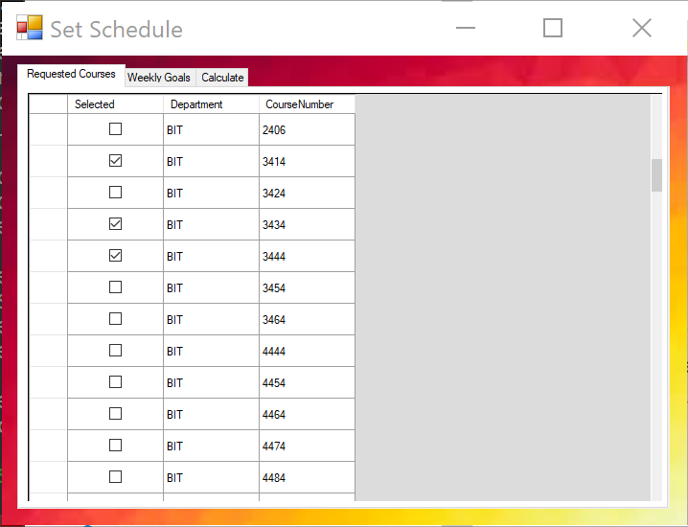

Slide 9
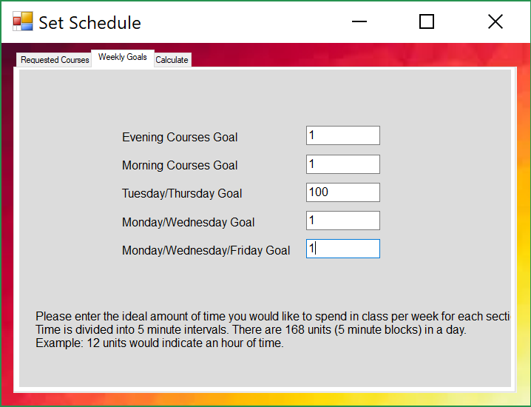

Slide 10
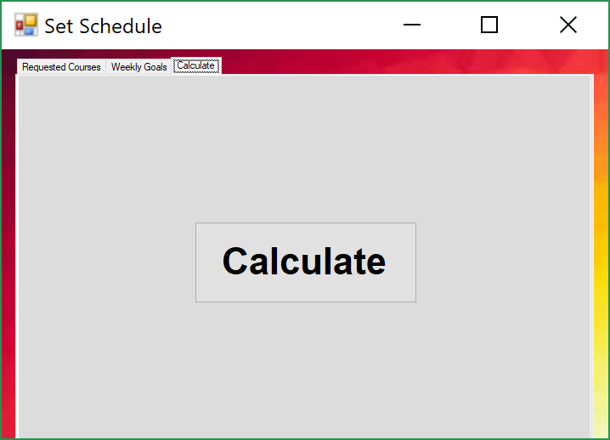

Slide 11
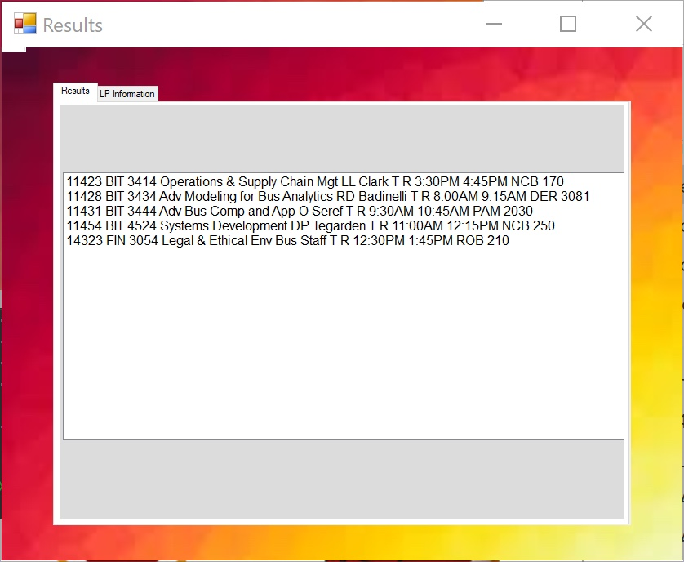

Slide 12
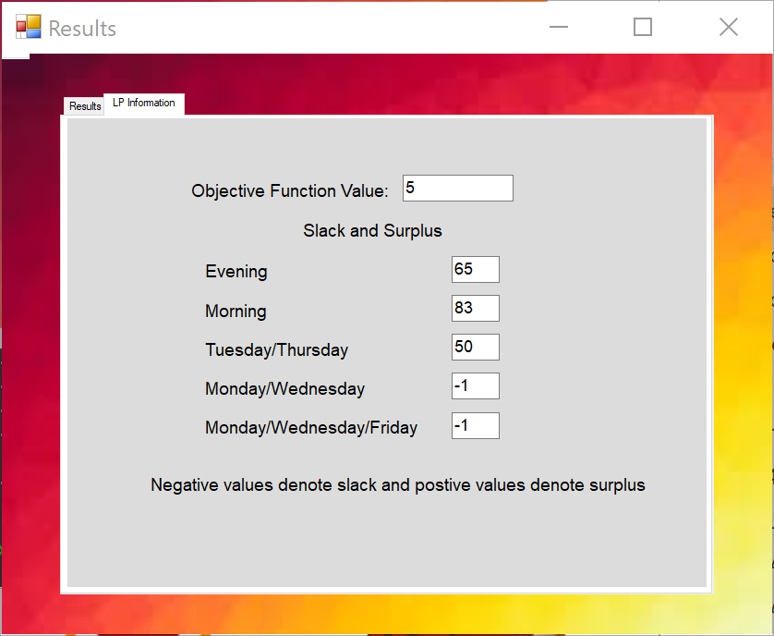

Slide 13
