Slide 1







The Retry Loop
A job that runs out of memory comes back with more of it — without anyone touching the config.
Airflow submits
Pod created
Spark runs
OOMKilled
LLM reads the log
Memory raised
SparkKubernetesOperator
driver + executors
reads source, writes target
exit code 137
diagnoses the failure
2G → 4G
The loop repeats until the job succeeds. The new memory value lives only for this DAG run — on success it is deleted, and tomorrow starts from your normal config again.

Slide 2


What if it is not out of memory?
The LLM reads the same log and picks one of three routes.
Out of memory
OOMKilled, Java heap OOM
Raise memory and retry
Cannot ever work
table missing, bad password, wrong image
Stop now — cancel the remaining retries
LLM reads
the log
Something else
timeout, deadlock, connection reset
Retry unchanged — it may pass next time
The LLM proposes, the code decides. Memory can only go up, never past the ceiling — and if the LLM is unavailable nothing changes and the retries run exactly as they do today.

Slide 3
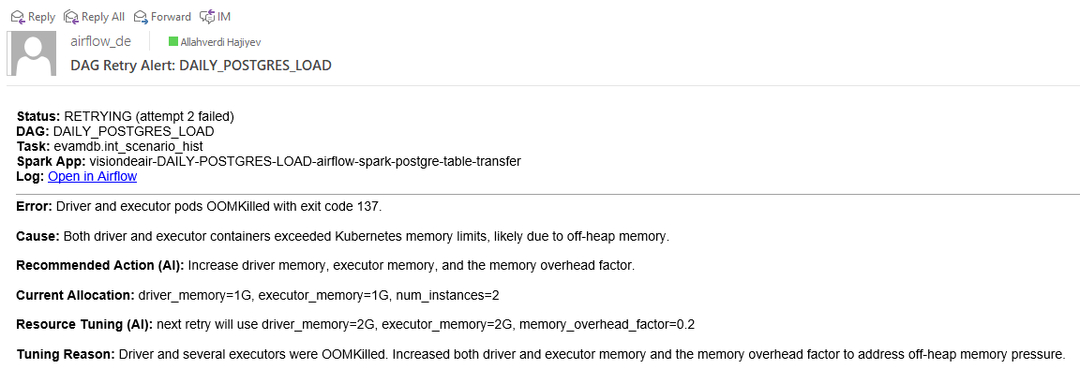

Slide 4
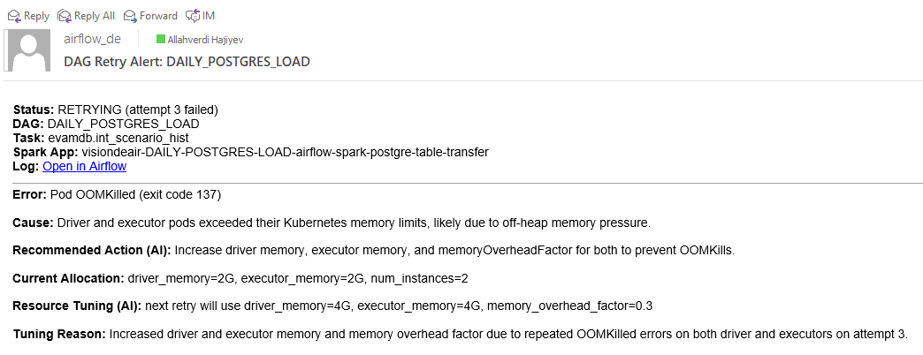

Slide 5
