Slide 1

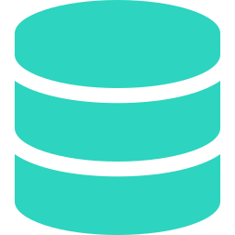




ORACLE DWH → DELTA LAKE
ALL LIVE
Batch loads retired. Continuous Spark Structured Streaming (CDC) now keeps every table in sync.
→
→
→
Oracle DWH
Kafka CDC
Spark Stream
Delta Lake
Source tables
op_type I · U · D
foreachBatch MERGE
Upserted, de-duplicated
12
100%
CDC
24×7
Tables migrated
Jobs succeeded
Insert · Update · Delete
Continuous sync
MIGRATED STREAMING JOBS
cstb_contract_event_log
sttb_record_log
citb_account_ude_values
cstm_function_userdef_fields
citb_amount_paid
citb_account_parties
cftb_contract_charges
glmismapping2
getm_liab_cust
gltm_mis_code
cstb_contract
cstm_contract_userdef_fields

