Slide 1
Big Data Journey of ABB
From Legacy Data to Enterprise Data Platform

Slide 2

WHY the journey started ?

Slide 3
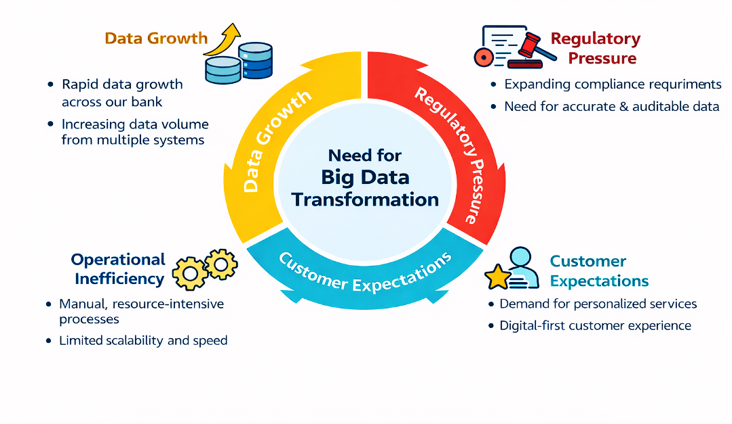
Business Context & Drivers
Rapid growth of enterprise data across banking systems
Increasing regulatory and compliance reporting demands
Need for faster, data-driven decision making
Rising expectations for personalized customer services
Operational efficiency and automation requirements
Demand for scalable and future-ready analytics infrastructure

Slide 4

Vision & Objectives
Establish a unified enterprise data platform
Enable scalable and high-performance analytics
Accelerate data-driven decision making
Strengthen governance, security, and compliance
Support self-service analytics for business teams
Build a future-ready foundation for innovation

Slide 5
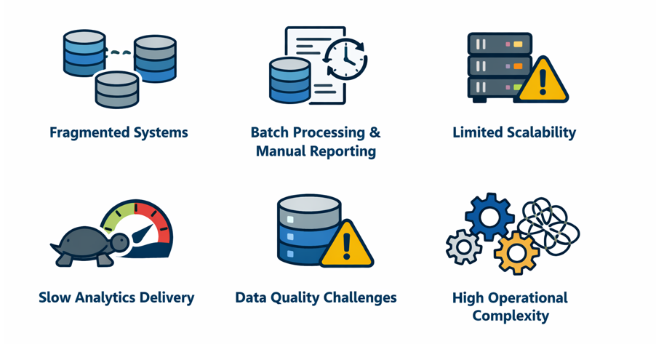
Legacy Data Landscape
Fragmented data stored across multiple isolated systems
Heavy reliance on batch processing and manual reporting
Limited scalability to handle growing data volumes
Slow analytics delivery impacting decision timelines
Inconsistent data quality and governance challenges
High operational effort for integration and maintenance

Slide 6
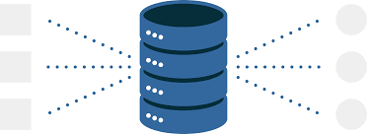

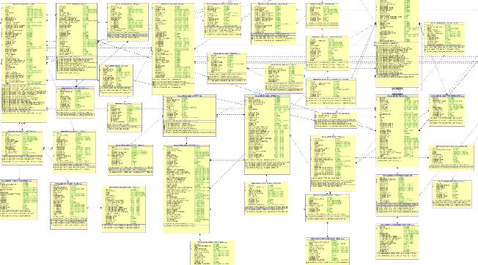
Architecture Evolution
Traditional Data Warehouse
Structured data
Source
Data Warehouse

Slide 7
Business-Aligned Data Marts & Golden Layer
We moved from raw centralized storage → to business-aligned, trusted data marts (Golden Layer)
Strategic Decision
Design business-oriented data marts
Align datasets with business domains (Retail, Corporate, Risk, Finance, etc.)
Single source of truth for reporting
Ready-to-use for BI and analytics
Optimized for performance

Slide 8
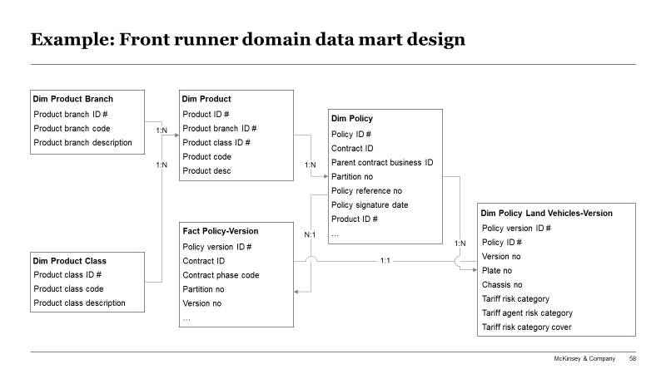

Three steps to design domain data mart
Step 1: Identify best fit data mart tables
Step 2: Extend data mart model
Sample templates and deliverables
Analyze data mart model at the granular level to identify candidate tables which can retain the select CDEs
Design a new data table if select CDE cannot be stored in an existing data table
Ensure select CDE is only stored once because data mart will be the official and reliable single source of data
Define relationships between newly added data entities and existing ones based on the needs of data consumption layer
Create new data entities/tables and build relationships using primary keys
Step 3: Ingest CDEs
Deliverables:
Data marts prioritization and development pipeline
One sample data mart
One data mart model
Write necessary ETL codes required to ingest data from DWH
Perform data enrichment activities to provide crucial information to dashboard/report(s)
Calculate certified KPIs and store them in separate tables

Slide 9






Self Service allows to accelerate reporting process up to 8 times and provide interactive capabilities
Data Marts
Role
Process
Artifact
Backlog Item
Week -3
Week -2
Week -1
Business Person
Week 1
Week 2
Week 3
Data Office
Business Person
Day 1
Day 2
...
Week 4
As Is Process
Describing Business Need
Report Development
Report
To Be Process
Describing Business Need
Building Report with Self Service
Data Office prepares a report based on business need discussion, each iteration required significant time expenditure and allocation of expensive resources
This branch is enabled is existing data marts do not allow to deliver on new business need
Report
Business customers use automated tools for reporting without involving Data Office
Business Person
Data Mart
Class of Needs
Data Mart Development
Business Person
Data Office

Slide 11
Challenges in Business Data Mart Calculations
Different departments used different calculation logic
Same data element existed in multiple systems
Conditional calculations (product type, currency, segment-based rules)
Heavy aggregations across large datasets
Infrastructure

Slide 12
Legacy Data Landscape before transformation
Data Analytics Landscape
Area
Key Gaps and Improvement Opportunities
Gap
Improvement opportunity
Meets expectations
Applications (business features & time-to-market)
Time-to-report can take weeks while self service reporting can provide interactive report generation
Real-time analysis and data driven apps do not have required infrastructure for effective work
On-prem / Cloud Infrastructure
Data Governance Tools
MLOps
Reporting Tools
Self Service Reporting
Analytical Use Cases
Real Time Use Cases
DATA ACCESS LAYER
Real Time Processing
Data Virtualisation
SQL Analysis
Data Analysis (speed & capabilities)
Classic tools used now are not effective for complex analytics, while Big Data tools can provide better performance
SQL Data Analysis
Big Data Access
DATA LAKE
STRUCTURAL DATA LAYER
UNSTRUCTURAL DATA LAYER
Data Storage (cost, volume & flexibility)
Potential for cost optimization of storage by offloading some data storage & processing to Data Lake
Data Lake is required to store unstructured data (clickstream data, audio/video logs, geodata) for analysis and store massive amounts of data cheaply
Datamarts
Data Processing (Spark)
Data Warehouse
Operation Data Store
Low-Cost Data Storage (Minio)
DATA INTEGRATION
Offline Data Integration
Real Time Data Integration
Data Availability (delay & coverage)
Reports based on previous day data only
Integrate additional source data (full EDV data, gelocation etc)
Data Sources

Slide 13
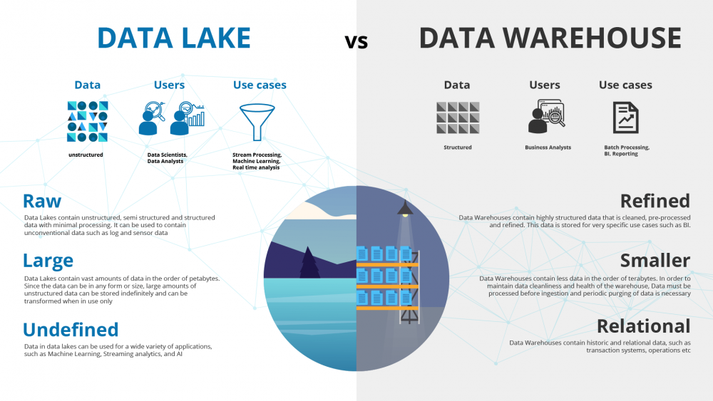
Data lake provides us a low-cost big data processing and data storage capability, whereas data warehouse still remains important to serve as a refined data store accessible to all bank users

Slide 14
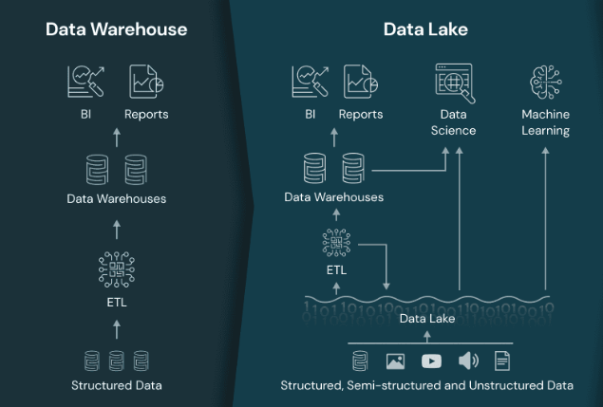
Data Lake vs Data Warehouse in detail
Data Lake: Data Lakes are more suitable for storing large volumes of structured, semi-structured and unstructured,
often used in data exploration and advanced analytics
Data Warehouse: Data Warehouses are designed for structured and organized data storage, optimized
for querying and reporting for business analysis and decision-making
Here are the benefits of employing big data technologies.
High-performance Feature generation for AA use cases
High-performance Data Transformation for Self Service Analytics
Maintaining archival data
Storing data in various file formats including Dataroid data files, filenet

Slide 15
Data Governance, Security & Access Control
Data Quality Governance
Security & Access Control
Purpose: Ensure trusted and validated data
Rule-based data validation framework
Automated quality checks at ingestion & transformation stages
Business rule validation (null checks, thresholds, format validation, reconciliations)
Quality scoring & monitoring
Alerting on rule failures
Purpose: Centralized policy enforcement & fine-grained access control
Role-based access control (RBAC)
Fine-grained table / column-level permissions
Policy-driven authorization

Slide 16
We created ABB AI Factory to unify the missing components, and initiated Self Service BI to close the gaps.
Data Analytics Landscape
Area
Key Gaps and Improvement Opportunities
Gap
Improvement opportunity
Meets expectations
Applications (business features & time-to-market)
Time-to-report can take weeks while self service reporting can provide interactive report generation
Real-time analysis and data driven apps do not have required infrastructure for effective work
On-prem / Cloud Infrastructure
Data Governance Tools
MLOps
Reporting Tools
Self Service Reporting
Analytical Use Cases
Real Time Use Cases
DATA ACCESS LAYER
Real Time Processing
Data Virtualisation
SQL Analysis
Data Analysis (speed & capabilities)
Classic tools used now are not effective for complex analytics, while Big Data tools can provide better performance
SQL Data Analysis
Big Data Access
DATA LAKE
STRUCTURAL DATA LAYER
UNSTRUCTURAL DATA LAYER
Data Storage (cost, volume & flexibility)
Potential for cost optimization of storage by offloading some data storage & processing to Data Lake
Data Lake is required to store unstructured data (full EDV data, audio/video logs, geodata) for analysis and store massive amounts of data cheaply
Datamarts
Data Processing (Spark)
Data Warehouse
Operation Data Store
Low-Cost Data Storage (Minio)
DATA INTEGRATION
Offline Data Integration
Real Time Data Integration
Data Availability (delay & coverage)
Reports based on previous day data only
Integrate additional source data (full EDV data, gelocation etc)
Data Sources

Slide 17














Current architecture
Offline data
Real-time data
Data Sources
Data Ingestion
Data Storage
Presentation layer
External data
Batch
Streaming
File transfer
Data Mart layer
Internal data
DWH
Object storage
Structured Data
RDBMS
BI tools
NoSQL
Alternative data
Reporting tools
Semi-structured Data
APIs
Data Processing
Bussiness applications
Websites
Oracle
Big Data
Unstructured Data
Operational systems
Files
Streaming
Infrastructure

Slide 18
Outcomes & Value Delivered

Slide 19
Future Roadmap

Slide 20
ALIK

Slide 21






















Overall tech stack landscape
TBD
Procurement may be needed
Procurement not needed
Component
Options
Choice
Next Steps
1. Data Format (Data Lake Storage)
All options for differrent purposes (Avro – ingestion, ORC – SQL, Parquet – Spark)
No license procurement required, sizing, roadmapping and cost estimation with hardware
2. Big Data Access & ELT (Data Lake Processing)
3. Big Data Warehouse (Data Lake SQL)
4. Object Storage (Data Lake NoSQL)
5. EDWH
Needs to be sized to determine procurement need, optimization methods to be discussed and implemented
6. ODS
Currently used at the Bank with already procured licenses, performance may be improved using multi-tiered storage and other optimization methods
7. Data Marts

Slide 22




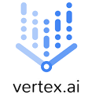




















Overall tech stack landscape
TBD
Procurement may be needed
Procurement not needed
Component
Options
Choice
Next Steps
8. Microservices
No license procurement required, sizing, roadmapping and cost estimation with hardware
Currently used at the Bank, has superior integration options
9. Sandboxes & Advanced Analytics (MLOps)
Need to decide on procurement based on pilot use case implementation cost compared to discounted procured cost
Based on POC results
10. Streaming
No license procurement required, sizing, roadmapping and cost estimation with hardware
- Steaming
Already used at the Bank
- CDC
Waiting for procurement decision
Need to choose target option & initiate procurement
Data Replication
11. Data Virtualization
No procurement required, needs to be roadmapped, not a priority, ETA circa 2024
12. In-Memory Database
Postpone
Not a priority at this moment, procurement (if needed) may be deferred to 2024
13. Reporting & BI
Continuing to use current product
14. Decision Management
Continuing to use current product

Slide 23
















Data Governance stack landscape
TBD
Procurement may be needed
Procurement not needed
Component
Options
Choice
Next Steps
15. Data Quality
Custom
Waiting for decision on approach
16. Metadata Mgmt, Business Catalog
Waiting for decision on approach
Custom
17. Master Data Management
Custom
Waiting for decision on approach
18. Data Model Management
Waiting for decision on approach
19. Data Security
TBD
20. CEP
Postpone

Slide 24


Comparison of data virtualization tools
Leader
The source is not supported by other product
Functionality
Presto
Apache Drill
Open source code
SQL
ANSI
ANSI
Officially supported connectors
Accumulo, BigQuery, Black Hole, Cassandra/Scylla, Druid, Elastic, Google Sheets, JMX, HDFS, Hive,
Kafka, Kinesis, Kudu, MemSQL, MongoDB,
Pinot, Prometheus, Redis, Redshift, Thrift,
PostgreSQL, MySQL, MSSQL, Oracle, Apache Phoenix
HBase, HDFS, Hive, MapR-DB, D3,
HTTPD, OpenTSDB, Kafka, MongoDB, PostgreSQL,
MySQL, MSSQL, Oracle, Apache Derby, H2
Possibility of working without data map
Distributed request execution
Star at GitHub
Forks at GitHub
13.5k
4.6k
1.7k
0.9k

Slide 25



Avro is best used for data ingestion while Parquet works better for complex analytical processing due to higher compression rate and performance
No limitations
Some limitations
Strong limitations
Avro
ORC
Parquet
Store format orientation
Row-oriented
Column-oriented
Column-oriented
Compatibility
e.g. limited nested structures
e.g. insert-only ACID
e.g. insert-only ACID
read-only
experimental support
Streaming (inserts)
Insert/Update Performance, (10k records / sec, higher is better)¹
1x
TBD
0.56x
Random Access Performance, (seconds, less is better)^{1,3}
1x
0.07x
0.04x
Data storage overhead, (relative to Avro, less is better)^{1,2,3}
1x
0.5x
0.6x
Applicability
Staging layer due high performance data ingestion, streaming support and easy data evolution
BI-focused tables with SQL heavy access via Hive
Storing data for further Spark processing or Impala based BI
1. Avro, Parquet, HFile: based on ATLAS EventIndex test with an average record per index 1.5KB long and 56 attributes. Source: Database Services
Benchmarks by Owen O’Malley. Source: O’Reilly
For Orc data relative to Parquet based on Dhareswarganesh benchmark

Slide 26

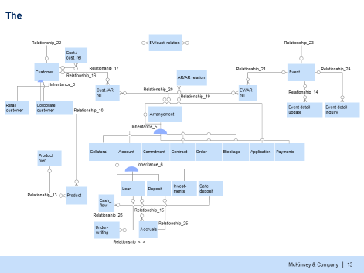
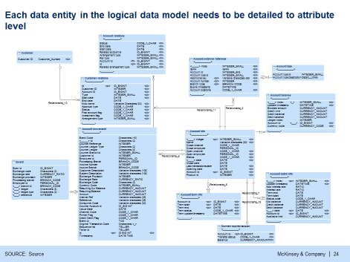

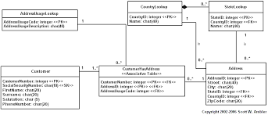

Building an Enterprise Data Model requires 3 phases of data modeling: conceptual, logical and physical
Main objectives of data models...
... For best practices data models are implemented in 3 phases
Defines data entities by domain and the relationships between them (E.g. customers, accounts, etc.)
Phase 1: Conceptual Level (Domain-level data entities and relationships only)
Defines the attributes of each entity and its definitions (E.g. Account Entity may contain Account Number, Open Date, etc.)
Phase 2: Logical Level (Includes all attributes, their data types, and their business definitions)
Meets the requirements of the target repository and the current state of the data. (For example; degree of normalization, granularity, data types, etc.)
Phase 3: Physical Level (Makes the model efficient for physical deployment according to the target repository)
It uses the Physical Data Model and generates a script of physical data structures. (Tables and Fields)
Creates objects in the target repository deploying the physical data model (E.g. Tables, Views)

