Slide 1

ABB-də Big data texnologiyalarının tətbiqi

Slide 2

Agenda
What is Big Data ?
Storage and Data Management
Accessing Data
Data Processing
Orchestration and Workflow Management

Slide 3
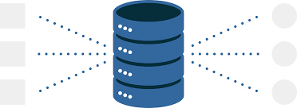
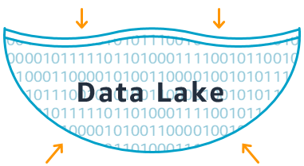
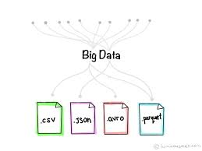
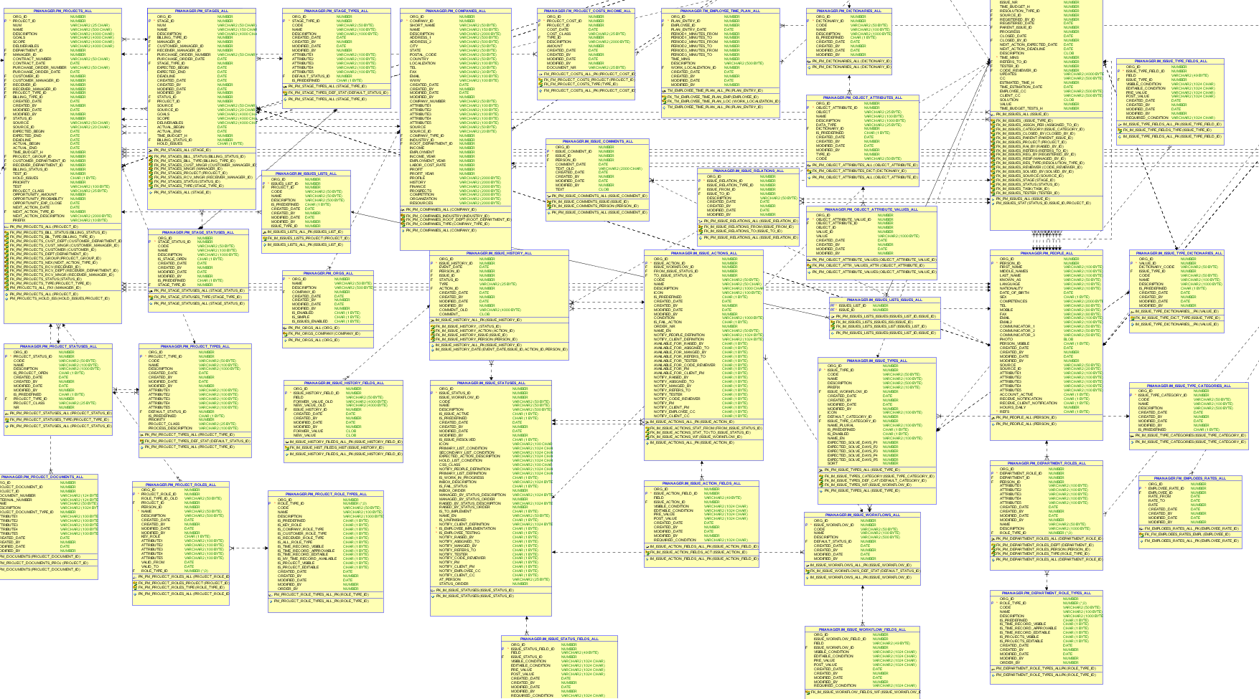
Data Warehouse vs Data Lake
Takes only structured data
Store and manage large amount of data
Takes structured, non-structured, semi-structured data
Data Warehouse

Slide 4
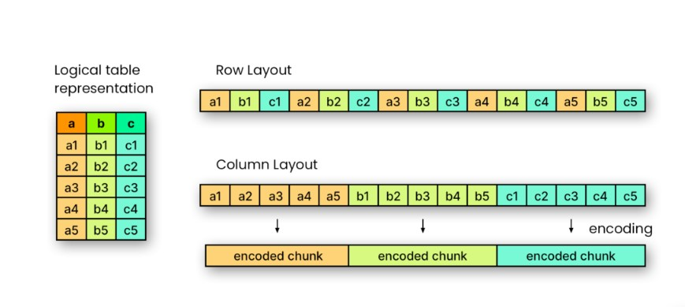
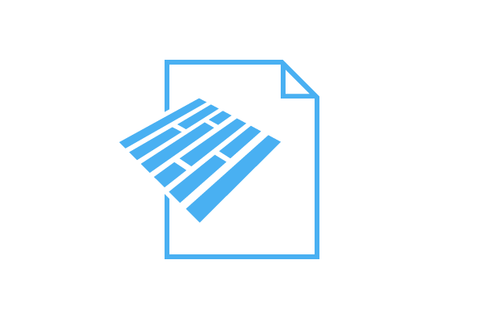

Storage and Data Management:
MinIO is a high-performance, distributed object storage system designed to handle large amounts of unstructured data, such as photos, videos, log files, backups and etc.
Parquet files advantages
Efficient Data Compression (Reduced storage costs)
Columnar Storage Format
Improved Query Performance
Parquet files disadvantages
Complexity in Data Updates

Slide 5

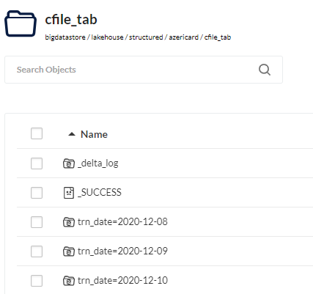
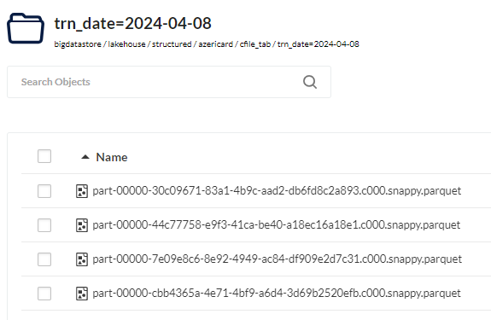
Storage and Data Management:
Delta Lake brings ACID (Atomicity, Consistency, Isolation, Durability) transactions to Apache Spark and big data workloads.
Delta Lake
Provides ACID transactions
Enables Data Modification
Schema Evolution
Versioning and Historical Data Access

Slide 6

Storage and Data Management:
Hive metastore stores metadata about tables, partitions, and schemas, providing a centralized repository for managing data definitions.
Hive metastore
Database and Table Definitions
Partitions Information
Storage Details
Schema Evolution

Slide 7


Data Processing
Apache Spark is distributed computing system designed for big data processing and analytics.
Spark
Parallel Processing
Optimization Techniques
Variety of Data Sources
Source
ETL Offload

Slide 8



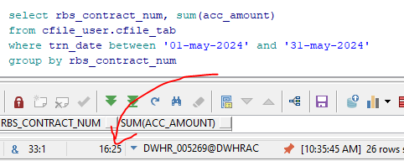
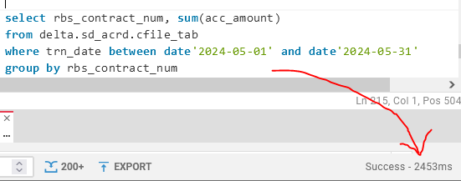
Accessing Data
Enable to query data from multiple sources
High Performance
Oracle
Trino

Slide 9



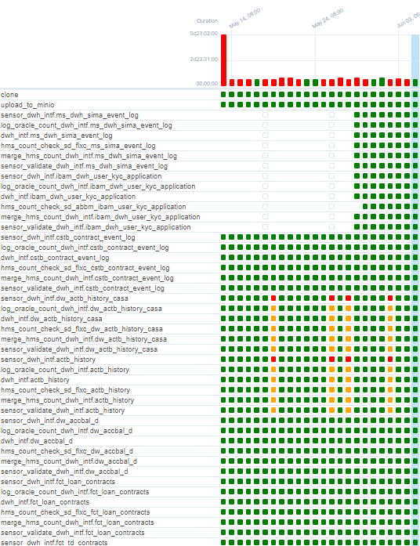
Orchestration and Workflow Management
Initial Setup with Apache NiFi
Performance issues: scalability concerns with large data volumes.
Limited support for complex Spark job orchestration and advanced scheduling.
Transition to Apache Airflow
Improved performance and scalability for Spark jobs.
Enhanced control over workflow execution and dependencies.
Flexibility in defining complex workflows.

Slide 10


