Slide 1



SPONSORED BY

Slide 2


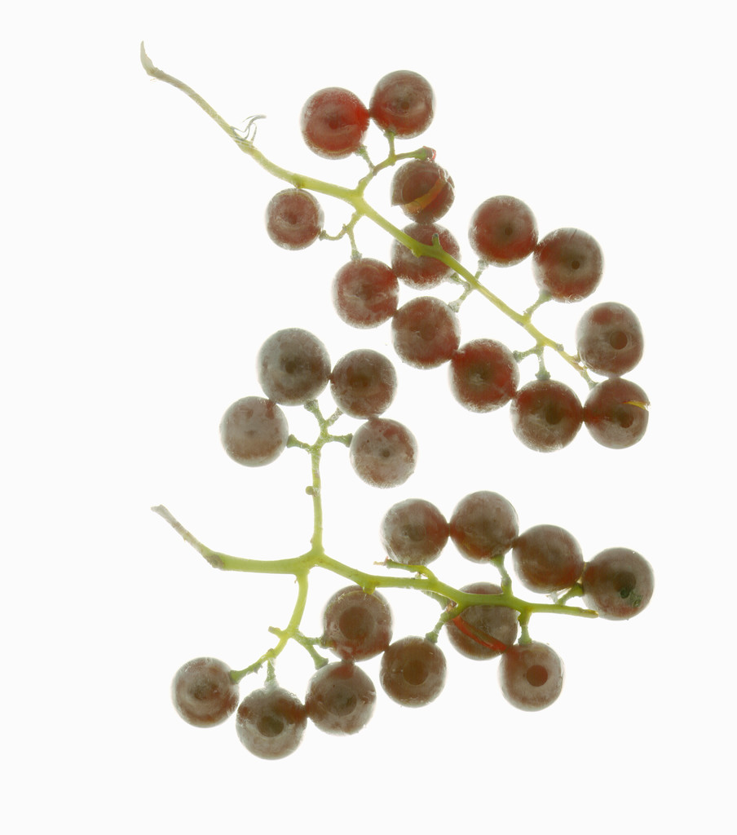

SPONSORED BY

