Slide 1
Churn PreDICTION CASE STUDY

Slide 2
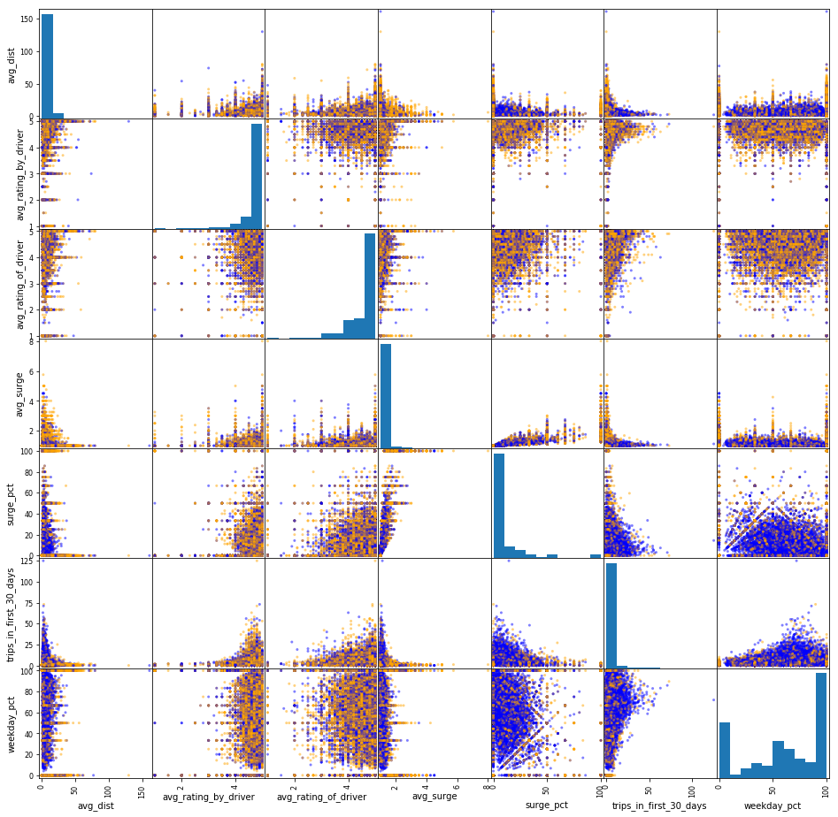
EDA OBSERVATIONS

Slide 3
Scatter Matrix
EDA OBSERVATIONS
The scatter matrix does not show any feature which will clearly separate out active vs. inactive users. Some features do seem to help.
Thus, we probably have a highly non-linear relationship and should consider a random forest or gradient boosted decision tree, which are ensemble versions of a decision tree.

Slide 4
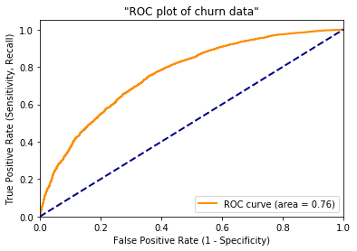
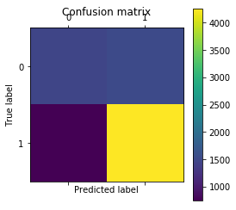
Logistic regression
MODELING

Slide 5
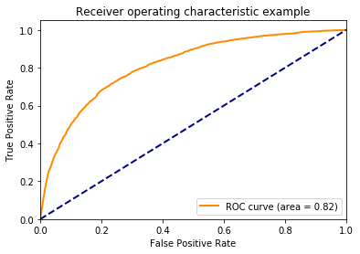
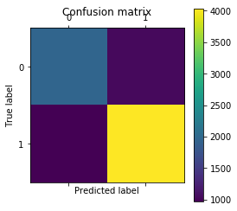
Random forest
Text

Slide 6

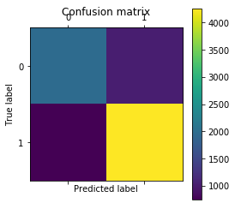
Gradient Boosting
MODELING
This is the best and so it will be fine-tuned further via grid search

Slide 7
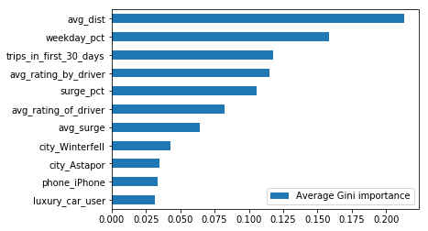
Feature importance
MODELING
The three most importance features are:
avg_dist, weekday_pct, trips_in_first_30_days

Slide 8
COMPARISION
MODELING
Model | Score | AUC
Logistic Regression | 0.7161 | 0.7611
Random Forest | 0.7494 | 0.8151
Gradient Boosting | 0.7784 | 0.8485
Gradient Boosting (Grid Search) | 0.7923 | 0.8548

