Slide 1
Stock Market Predictor
Andrew Cichy
Alex Holmes
Alice Weaver

Slide 2
Neural Network Model

Slide 3
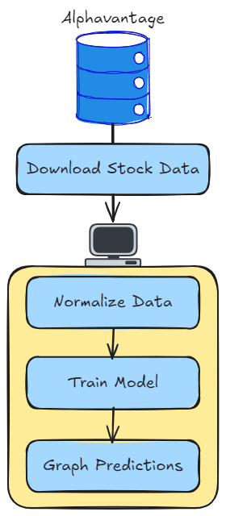
Serial Design
1. Download Stock Data
2. Normalize Data
3. Train Model
4. Graph predictions

Slide 4
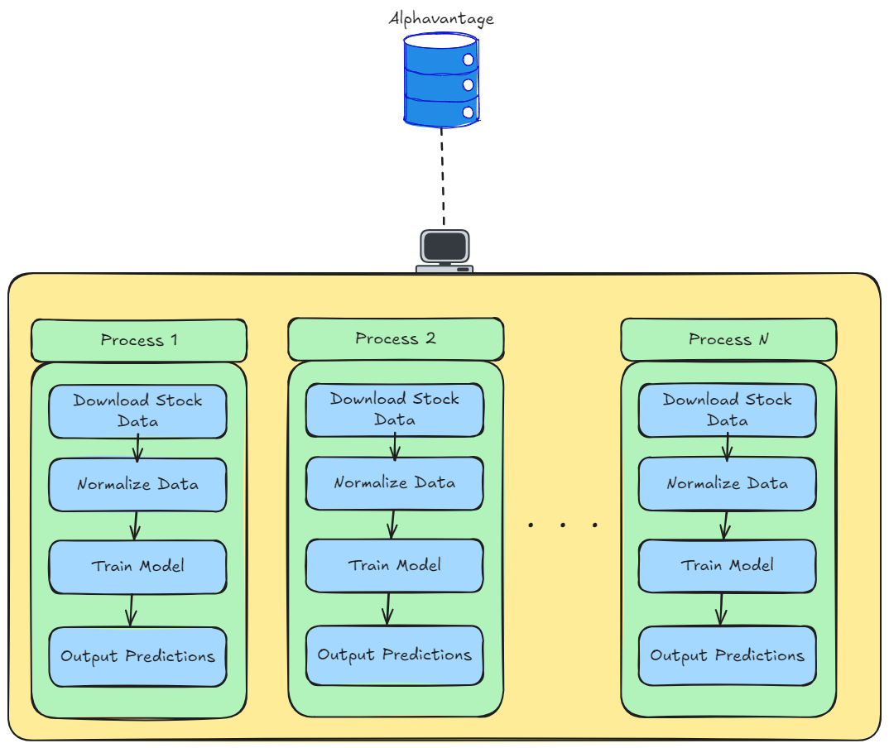
Parallel Design 1 stock per process
Analyze multiple stocks
In parallel.

Slide 5
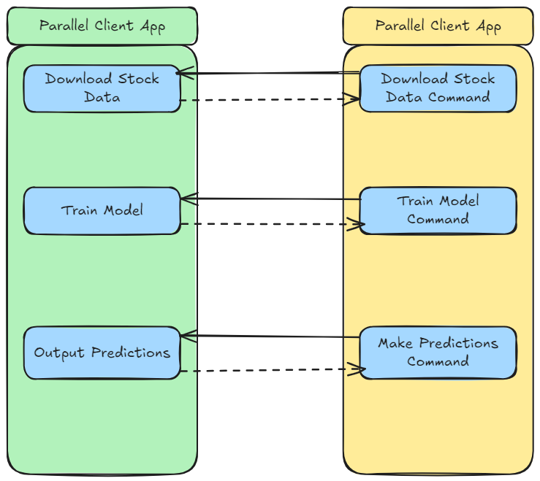
Parallel App Interaction
UDP Messaging
Clients Send confirmation

Slide 6
Neural Network Model Training

Slide 7
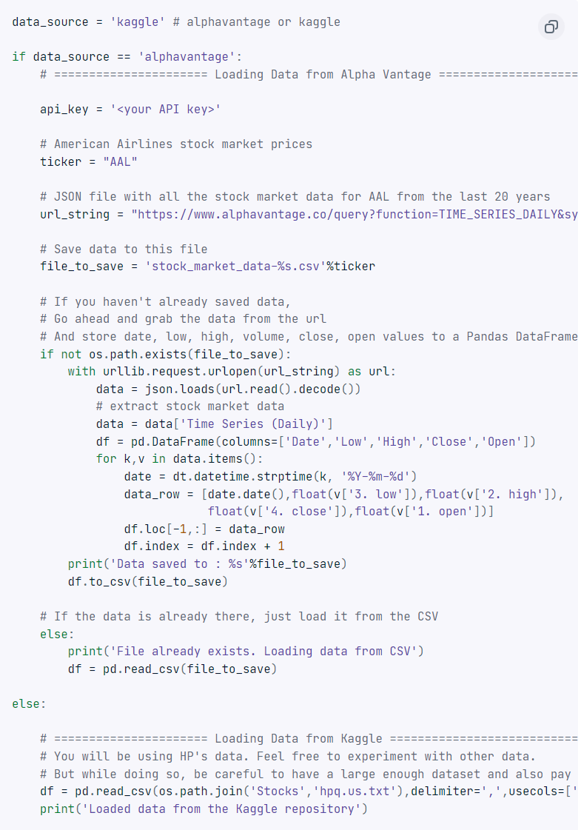
Data collection
Alpha Vantage Web API.
Requires data preprocessing
Kaggle
Data which comes preprocessed.
Still requires normalization

Slide 8
Model training
Neural network model is a LSTM.
LSTM model will learn patterns and temporal relationships within the stock prices over time.
Data set split into training and validation sets.
80-20 split
Visualize results via Python Graphs

Slide 9
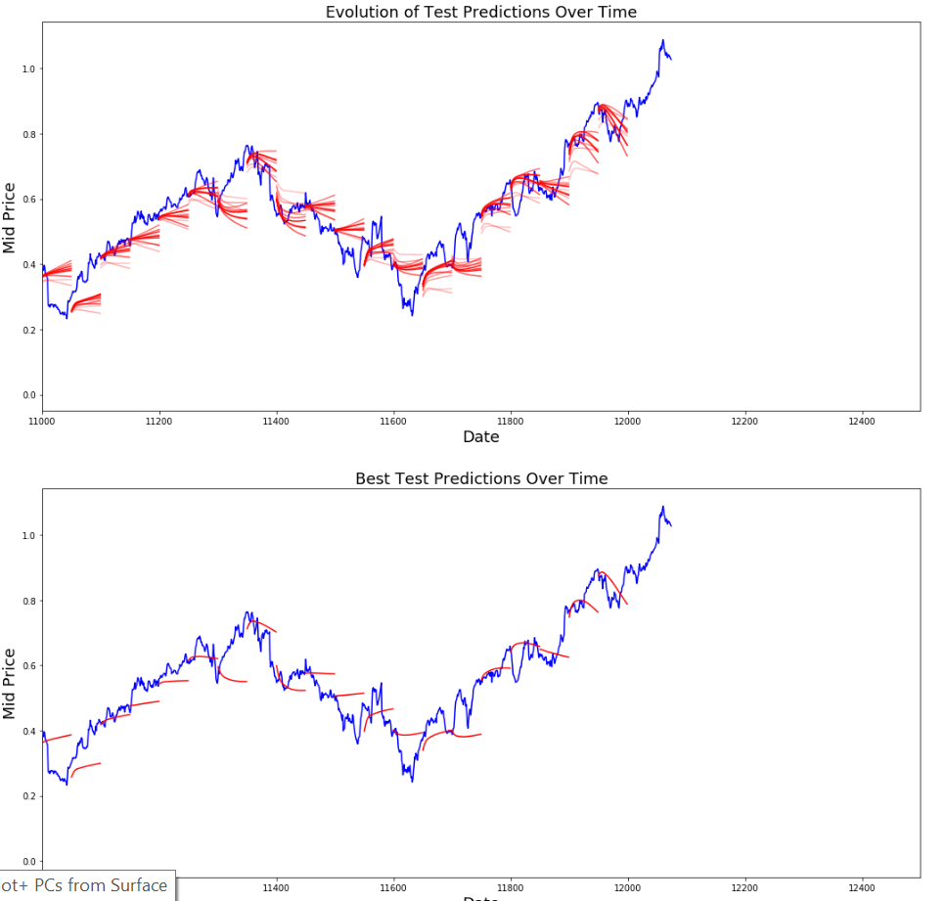

Slide 10
Neural Network Testing
Change stock data
Different time periods
Different markets
Use MSE reduction over training to determine model effectiveness

Slide 11
Parallel Timings
1 App 4 Stock
4 App 4 Stock
Download: 8.5 sec
Train: 63.2 sec
Predict: 34.2 sec
Download: 2.7 sec (S: 3.1, E: 77.5%)
Train: 24.1 sec (S: 2.6, E: 65%)
Predict: 11.2 sec (S: 3.02, E: 75%)

Slide 12
References
https://machinelearningmastery.com/gentle-introduction-backpropagation-time/
https://k21academy.com/datascience-blog/machine-learning/recurrent-neural-networks/#:~:text=To%20train%20an%20RNN%2C%20the,of%20a%20cost%20function%20C.
https://medium.com/@CallMeTwitch/building-a-neural-network-zoo-from-scratch-the-recurrent-neural-network-9357b43e113c#:~:text=The%20above%20photograph%20shows%20how,intermediary%20steps%20of%20the%20network.
https://apmonitor.com/pds/index.php/Main/LongShortTermMemory
https://deepai.org/machine-learning-glossary-and-terms/exploding-gradient-problem#:~:text=The%20exploding%20gradient%20problem%20is,(weights)%20become%20excessively%20large.
https://www.datacamp.com/tutorial/lstm-python-stock-market

