Slide 1
Stock Market Predictor
Andrew Cichy
Alex Holmes
Alice Weaver

Slide 2
Neural Network Model
Serial vs Parallel

Slide 3
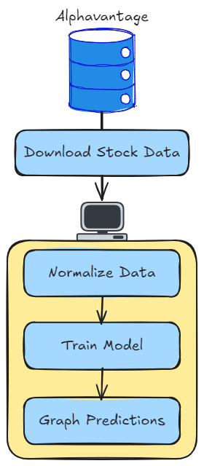
Serial Design
1. Download Stock Data
2. Normalize Data
3. Train Model
4. Graph predictions

Slide 4
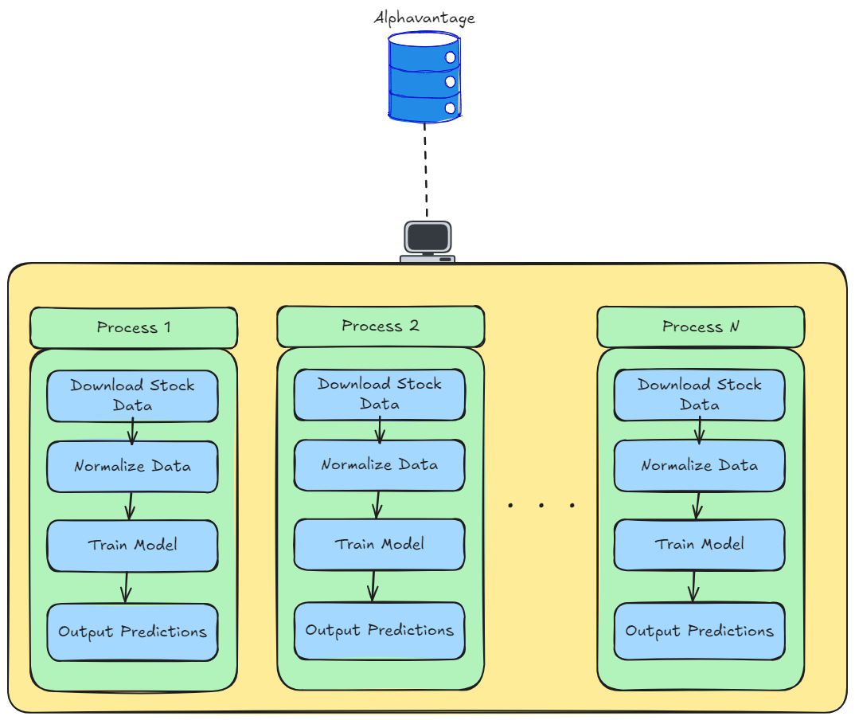
Parallel Design 1 stock per process
Analyze multiple stocks
In parallel.
Parallelize Data
Normalization.

Slide 5
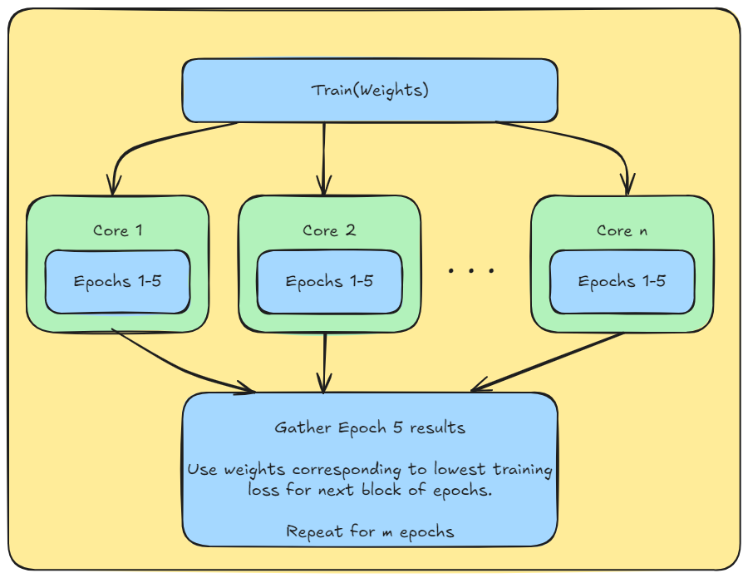
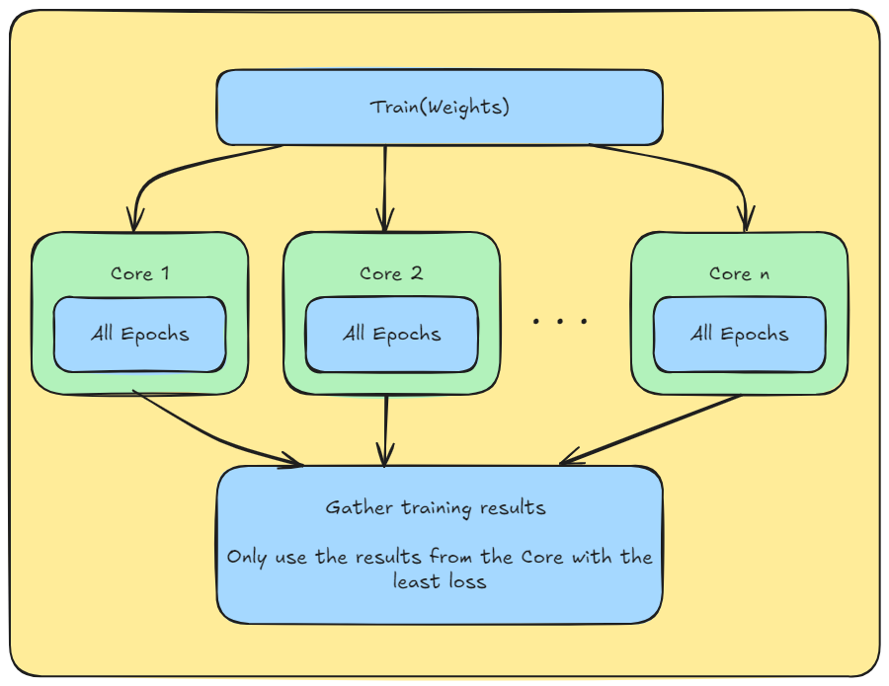
Dividing training among cores

Slide 6
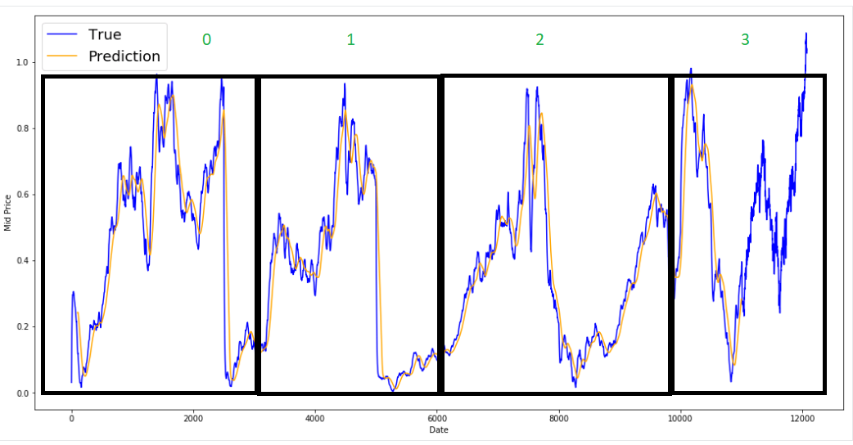
Parallel Prediction of a single stock

Slide 7
Neural Network Model Training

Slide 8
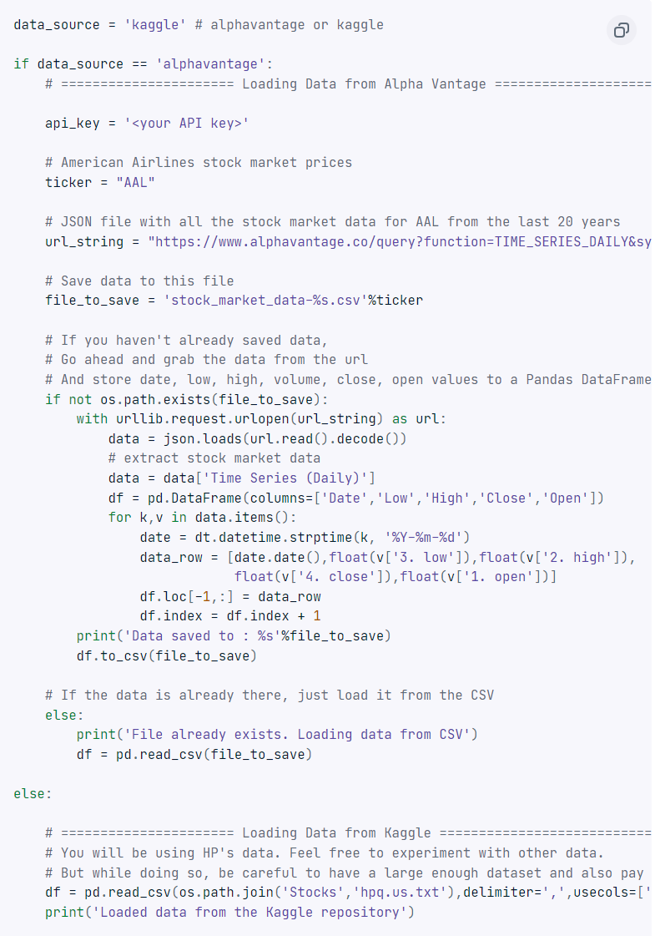
Data collection
Alpha Vantage Web API.
Requires data preprocessing
Kaggle
Data which comes preprocessed.
Still requires normalization

Slide 9
Model training
Neural network model is a LSTM.
LSTM model will learn patterns and temporal relationships within the stock prices over time.
Data set split into training and validation sets.
80-20 split
Training done on a simple American Airlines stock data set from 1970.
Visualize results via Python Graphs

Slide 10
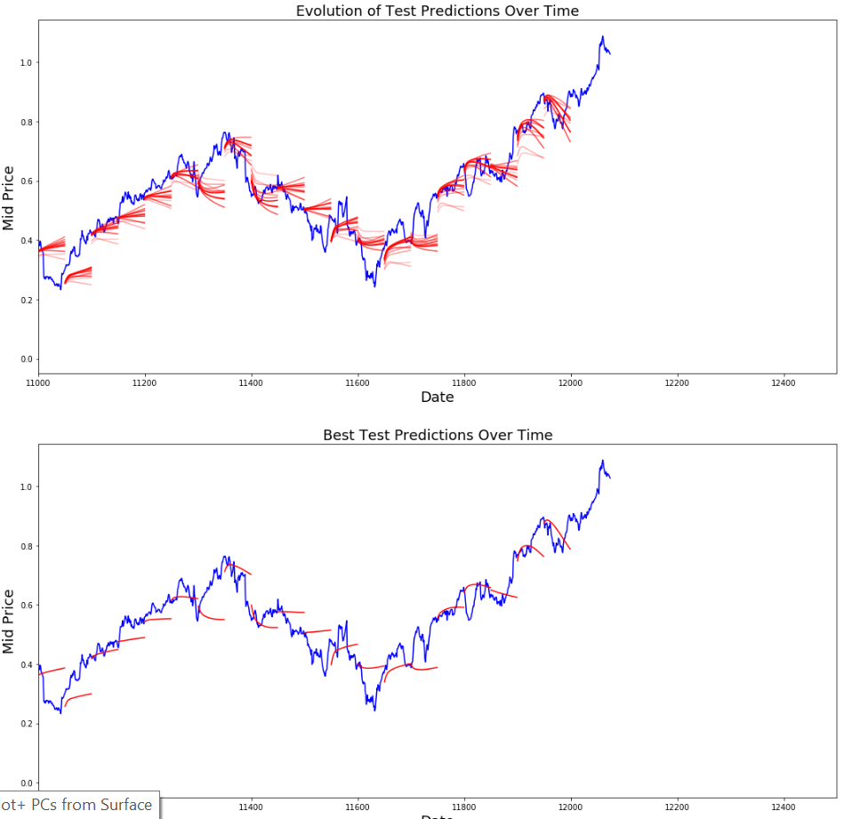

Slide 11
Neural Network Testing
Change stock data
Different time periods
Different markets
Use MSE reduction over training to determine model effectiveness
Use model with fake money in today's market
Requires an investment strategy

Slide 12
Parallel Speedup testing
Time Stock prediction model running serially to predict N stocks.
Time model when splitting N stocks over P processes.
Calculate & plot speedups.
Repeat for different Parallelization strategies.

Slide 13
References
https://machinelearningmastery.com/gentle-introduction-backpropagation-time/
https://k21academy.com/datascience-blog/machine-learning/recurrent-neural-networks/#:~:text=To%20train%20an%20RNN%2C%20the,of%20a%20cost%20function%20C.
https://medium.com/@CallMeTwitch/building-a-neural-network-zoo-from-scratch-the-recurrent-neural-network-9357b43e113c#:~:text=The%20above%20photograph%20shows%20how,intermediary%20steps%20of%20the%20network.
https://apmonitor.com/pds/index.php/Main/LongShortTermMemory
https://deepai.org/machine-learning-glossary-and-terms/exploding-gradient-problem#:~:text=The%20exploding%20gradient%20problem%20is,(weights)%20become%20excessively%20large.
https://www.datacamp.com/tutorial/lstm-python-stock-market

