Slide 1
Elastic network for GTF only classification

Slide 2
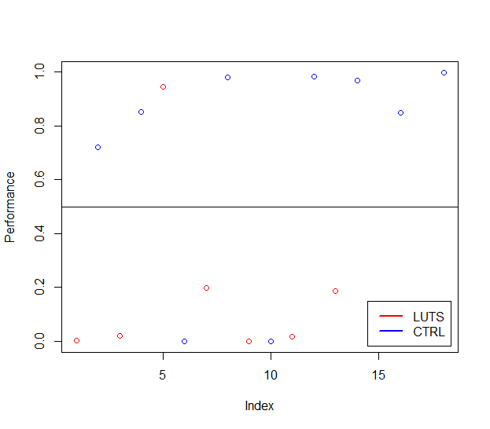
Classification Performance
 | LUTS | CTRL
LUTS | 8 | 1
CTRL | 2 | 7

Slide 3
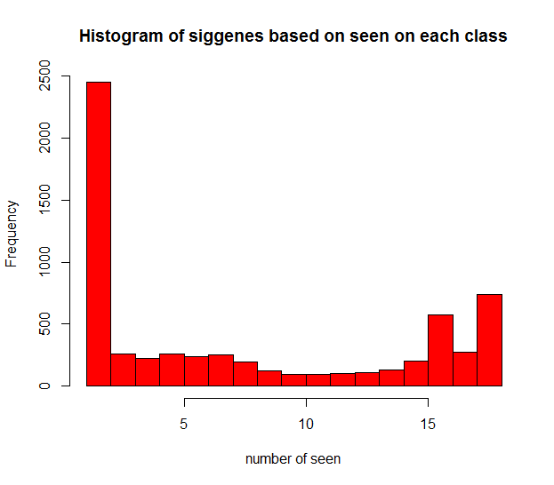
# of seen | Frequency
10 | 95
11 | 92
12 | 98
13 | 104
14 | 126
15 | 202
16 | 573
17 | 271
18 | 737

Slide 4
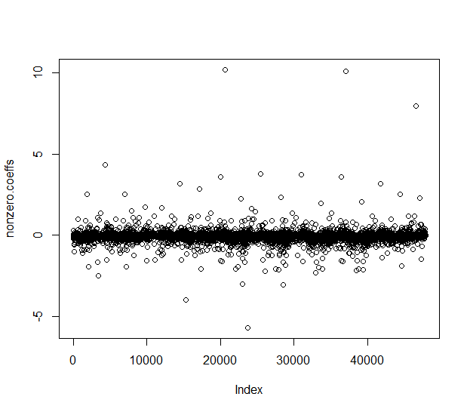
6260 Unique genes

Slide 5
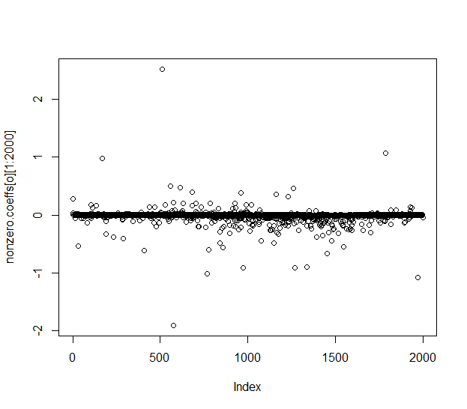
Top 2000 coefficient

