Slide 1
Annotation - Overview
Kasper D Hansen
@KasperDHansen
www.hansenlab.org

Slide 2
Annotation is the process of giving context to your data using external information.
This can be done in many ways, but it usually involves linking your data to online databases.

Slide 3
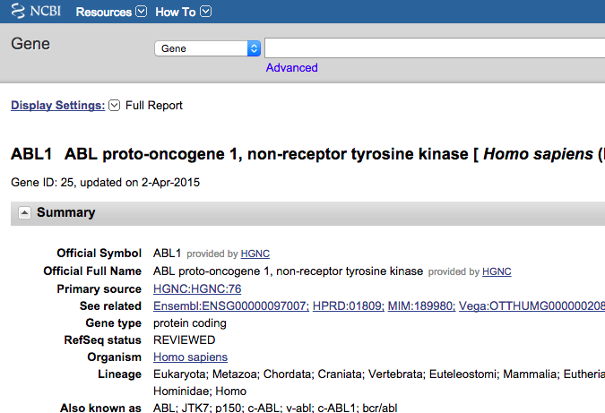
Example: annotating a probeset on the Affymetrix HGU95av2 microarray.
Affymetrix identifier
39730_at
ENTREZ identifier
25
Affymetrix identifier
1635_at

Slide 4
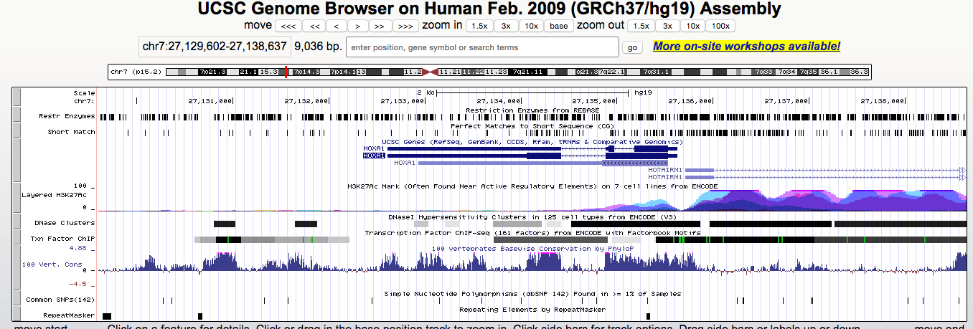
Example: annotating a genomic interval.
Genome coordinates
chr7:27,136,000-27,137,000

Slide 5
Some annotation is just experimental data from other groups.

Slide 6
How to annotate 100-10,000 items?
Need to do this programmatically.
And easily!

Slide 7
Two main approaches in Bioconductor:
Annotation packages: (ex. hgu95av2.db)
This is “preprocessed” and “packaged” annotation.
Query online resources: like UCSC or ENSEMBL.

