Slide 1
Basic Data Types
Kasper D Hansen
@KasperDHansen
www.hansenlab.org

Slide 2
Experimental data
Gene 1 has an expression level of 7.65
Metadata (on exp)
Sample 1 is a 65y woman
Annotation
Gene 1 is highly conserved in yeast

Slide 3
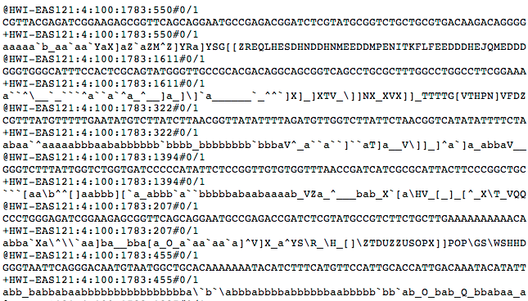
Raw (unprocessed)
Intermediates
Preprocessed data
Gene 1 is expressed at 7.65
Results
Gene 14 is altered in cancer

Slide 4
Data Container
“
If everybody puts their gene expression data into the same kind of box, it doesn’t matter how the data came about, but that box is the same and can be used by analytic tools
”
Robert Gentleman
on “Successful Comp Bio Software”,
Nat. Biotech (2013) 31:894

Slide 5
Raw
Raw
Raw
Preprocessing
(Vendor specific)
Common
Data Container
Analysis
Results

