Slide 1
ExpressionSet (overview)
Kasper D Hansen
@KasperDHansen
www.hansenlab.org

Slide 2
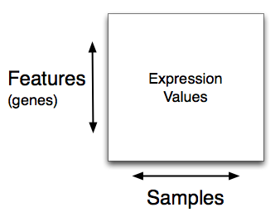
Expression matrix

Slide 3
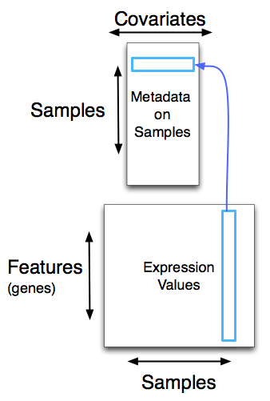
Phenotype data

Slide 4
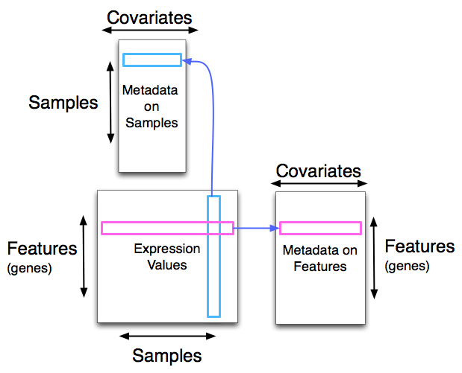
Feature data

Slide 7
Phenotype data
“ExpressionSet”
Expression matrix
Feature data

Slide 8
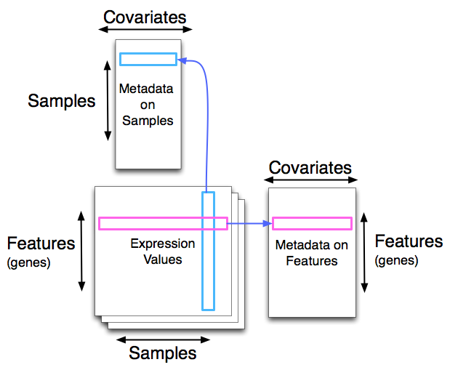
“eSet”

