Slide 1
What is Bioconductor
Kasper D Hansen
@KasperDHansen
www.hansenlab.org
Notes:
Hi and Welcome to the class “Introduction to Bioconductor”
My name is Kasper Daniel Hansen and I am your instructor.
First, let us cover what is Bioconductor and why should you care?

Slide 2

http://www.bioconductor.org
and open development
Notes:
Bioconductor is an open source and open development software project for computational biology.
Open source means anyone can read and modify the underlying code.
Open development means that anyone can contribute to the project.
Bioconductor is build on the R language, which is a widely used language and platform for data science.
R was chosen for a wide range of reason. Importantly, it is a flexible language, specifically designed for data analysis with high-quality graphics, where it is easy to embed tools written in other languages.

Slide 3
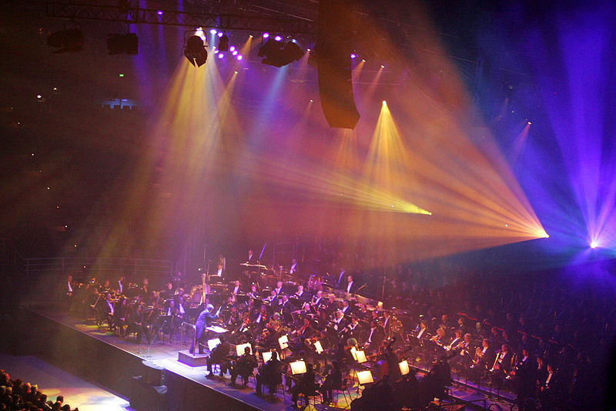
Fir0002/Flagstaffotos
Notes:
There are tons of great tools out there, which are very good at accomplishing a specific task in computational biology. An analysis in computational biology usually involves using multiple such tools together.
One of the ideas behind Bioconductor was the realization that we need a flexible data analysis platform in which we can integrate all of these tools and make them work together.
The mental image is that all these great tool are the individual musicians in an orchestra and the project functions as a conductor and makes them all play together.

Slide 4
More pragmatic: Bioconductor is a software repository of R packages with some rules and guiding principles.
Version 3.9 had 1,741 software packages.
Notes:
From a more pragmatic perspective, Bioconductor is a collection of software packages written or partly written in the statistical language R.
These packages are collected into a single archive; this is called a software repository.
Over the years we have seen an incredible growth in the contributions to Bioconductor.
At the latest release we had almost 1000 software packages
Some of these packages have been around for 10 years, some are brand new.
Some of these packages have very few users. Others are considered the gold-standard analysis tools for their specific domain and are used by many thousands of researchers.

Slide 5


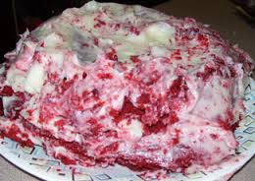


All sizes, shapes and quality
Sometimes there are several choices
Notes:
Since anyone can contribute software packages to Bioconductor, as long as the software meets some minimum requirements, we have a very varied selection available.
Some packages are extremely high quality; others are less polished.
In general, all packages have good documentation compared to other academic software.
Some packages have truly outstanding documentation.
Often there are multiple packages to choose from, when you want to analyze one specific form of data. And sometimes these packages are in direct competition. But that is all good for the end user.

Slide 6
Bioconductor + CRAN
“
The journal has sufficient experience with these resources to endorse their use by authors. We do not yet provide any endorsement for the suitability or usefulness of other solutions.
”
Nature Genetics editorial “Credit for Code” 2014, 46:1
Notes:
In 2014 the journal Nature Genetics had an editorial on sharing and using software for genetics.
At that point in time Bioconductor and CRAN, which is another software repositories, were highlighted as high-quality repositories.
In fact, they were the only software repositories endorsed by this journal.

Slide 7
Bioconductor has emphasized
Reproducible Research
since its start, and has been an early adapter and driver of tools to do this.

Slide 8
Why?
Productivity
Flexibility

Slide 9
“Bioconductor: open software development for computational biology and bioinformatics”
Gentleman et al
Genome Biology 2004, 5:R80
“Orchestrating high-throughput genomic analysis with Bioconductor”
Huber et al
Nature Methods 2015, 12:115-121
Notes:
For the academically inclined, Bioconductor has been described in these two papers.
The first is the original manifest back when the project was started.
The second is a recent update describing where we are now in the project.
Both articles should be accessible to a wide audience.

