Slide 1
Biology 644
Old Title: Bioinformatics for Molecular Biologists
Potential New Title: Integrated Bioinformatics Using R for Both Wet and Dry Scientists
Spring 2014
February 26, 2014
Biology 644: Bioinformatics

Slide 2
Outline
Make-up Classes
Problem Set 3
Two Variance F test
Binomial Test
“Goodness of fit” X² test
Normality, Outliers tests
Wilcoxon Rank Sum Test (Mann Whitney U)
R Lab
Chapter 4
Chapter 4 Supplemental
Biology 644: Bioinformatics

Slide 3
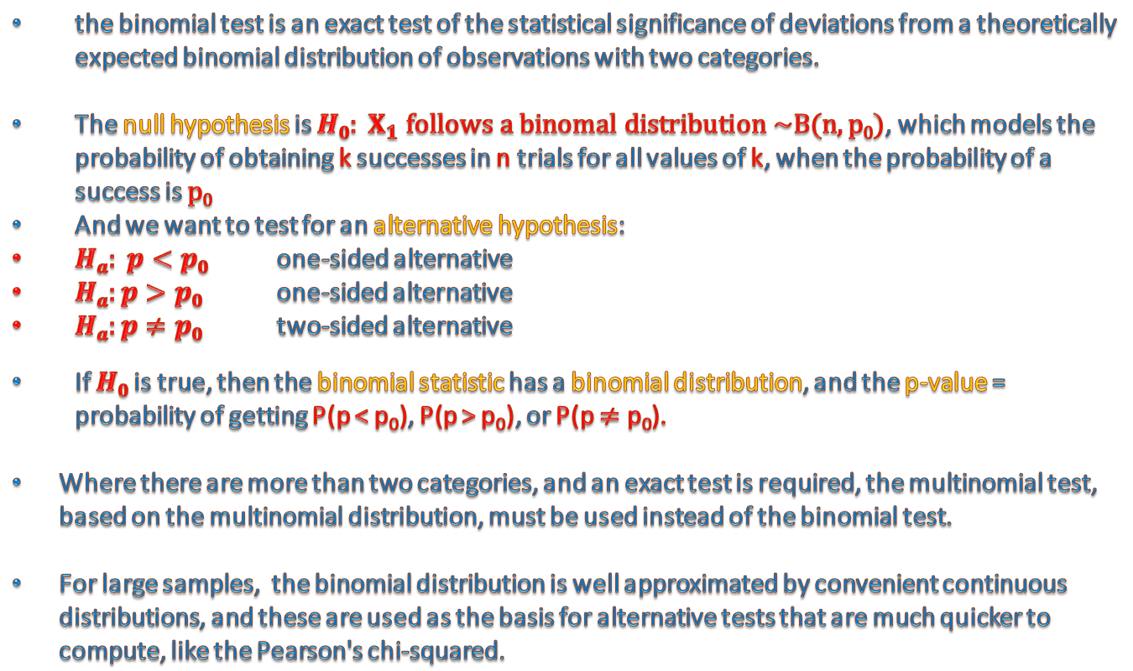
Binomial test
the binomial test is an exact test of the statistical significance of deviations from a theoretically expected binomial distribution of observations with two categories.
The null hypothesis is $H0: X_{1} follows a binomal distribution \sim B(n,p0)$, which models the probability of obtaining k successes in n trials for all values of k, when the probability of a success is $p0$
And we want to test for an alternative hypothesis:
$Ha: p<p0$ one-sided alternative
$Ha:p>p0$ one-sided alternative
$Ha:p≠p0$ two-sided alternative
If $H0$is true, then the binomial statistic has a binomial distribution, and the p-value = probability of getting P(p < p₀), P(p > p₀), or P(p $≠$ p₀).
Where there are more than two categories, and an exact test is required, the multinomial test, based on the multinomial distribution, must be used instead of the binomial test.
For large samples, the binomial distribution is well approximated by convenient continuous distributions, and these are used as the basis for alternative tests that are much quicker to compute, like the Pearson's chi-squared.
Biology 644: Bioinformatics

Slide 4
Binomial test
Suppose that for a certain microRNA researcher believes that the probability of a purine equals a certain value p₀.
However, another researcher has reason to believe that this probability is larger.
In such a setting we want to test the null-hypothesis H₀ : p = p₀ against the one-sided alternative hypothesis H₁ : p > p₀.
Sequencing of a microRNA of length 22 contains 18 purines.
The null hypothesis H₀: p = 0.7 is to be tested against the one-sided H_{a} : p > 0.7.
P(X ≥ 18) = 1 - pbinom(17, 22, 0.7) = 0.1645 ≥ 0.05 = α
Do we reject the null hypothesis?
Biology 644: Bioinformatics

Slide 5
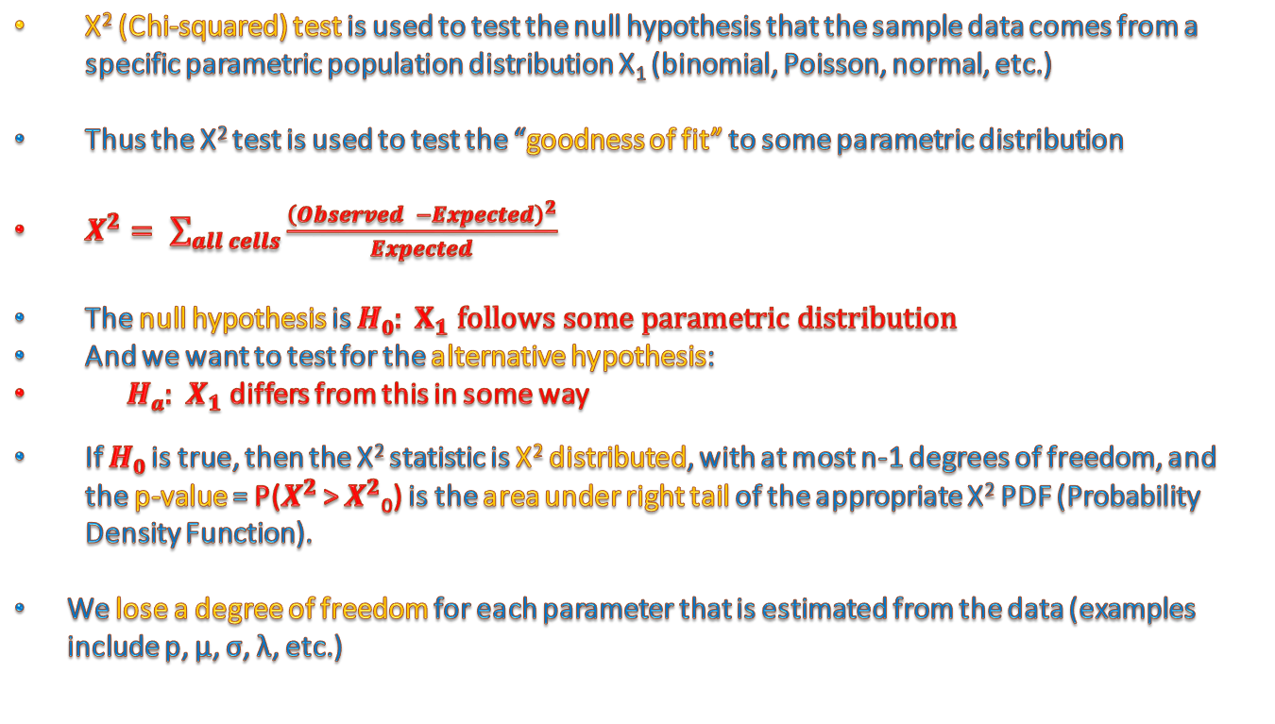
X² test
X² (Chi-squared) test is used to test the null hypothesis that the sample data comes from a specific parametric population distribution X₁ (binomial, Poisson, normal, etc.)
Thus the X² test is used to test the “goodness of fit” to some parametric distribution
$X^{2}= \sum_{all cells}{\frac{{\left(Observed −Expected\right)}^{2}}{Expected}}$
The null hypothesis is $H0: X_{1} follows some parametric distribution$
And we want to test for the alternative hypothesis:
$Ha:{ X}_{1}$ differs from this in some way
If $H0$is true, then the X² statistic is X² distributed, with at most n-1 degrees of freedom, and the p-value = P($X^{2}$ > $X^{2}$₀) is the area under right tail of the appropriate X² PDF (Probability Density Function).
We lose a degree of freedom for each parameter that is estimated from the data (examples include p, μ, σ, λ, etc.)
Biology 644: Bioinformatics

Slide 6
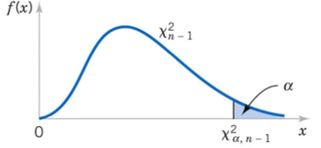
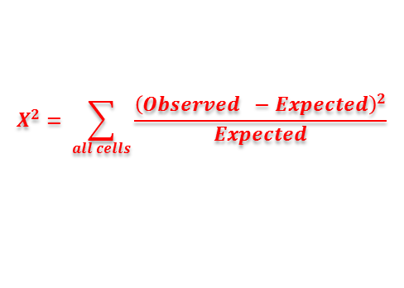

X² test
$$H0: X_{1} follows some parametric distribution$$
$Ha:{ X}_{1}$ differs from this in some way
$$X^{2}= \sum_{all cells}{\frac{{\left(Observed −Expected\right)}^{2}}{Expected}}$$
f(x) = X² distributed, with at most n-1 degrees of freedom
=.05
X²-statistic
X²-critical value = -X²_{α=.05}
With a significance level α=.05, should we reject the null hypothesis?
Biology 644: Bioinformatics

Slide 7
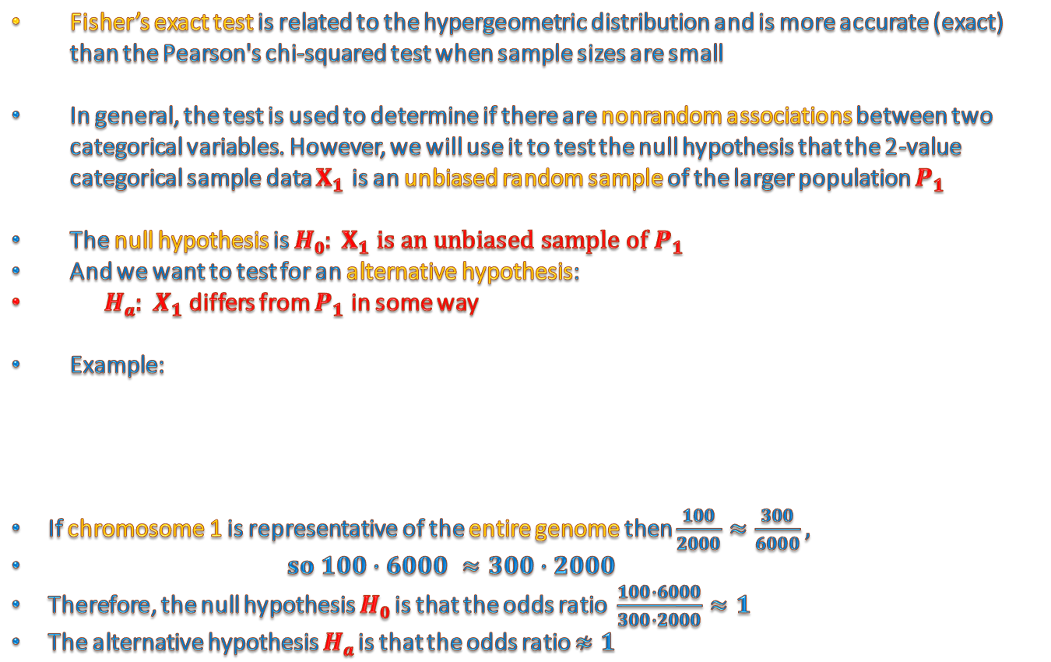
Fisher’s exact test
Fisher’s exact test is related to the hypergeometric distribution and is more accurate (exact) than the Pearson's chi-squared test when sample sizes are small
In general, the test is used to determine if there are nonrandom associations between two categorical variables. However, we will use it to test the null hypothesis that the 2-value categorical sample data $X_{1}$ is an unbiased random sample of the larger population $P_{1}$
The null hypothesis is $H0: X_{1} is an unbiased sample of P_{1}$
And we want to test for an alternative hypothesis:
$Ha:{ X}_{1}$ differs from $P_{1}$ in some way
Example:
If chromosome 1 is representative of the entire genome then $\frac{100}{2000}≈\frac{300}{6000},$
$so 100∙6000 ≈300∙2000$
Therefore, the null hypothesis $H0$is that the odds ratio $\frac{100∙6000}{300∙2000}≈1$
The alternative hypothesis $Ha$is that the odds ratio $≉1$
Biology 644: Bioinformatics

Slide 8
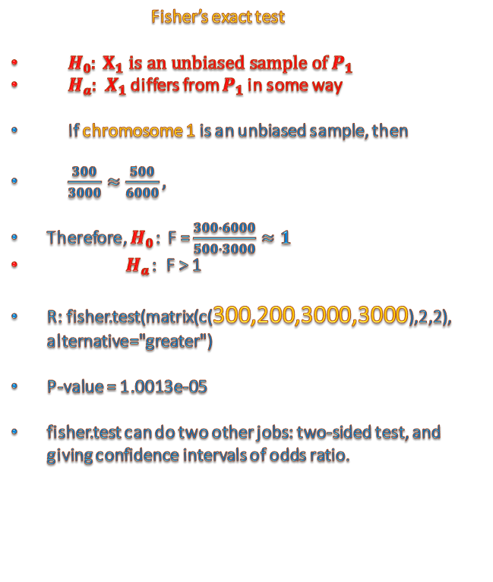

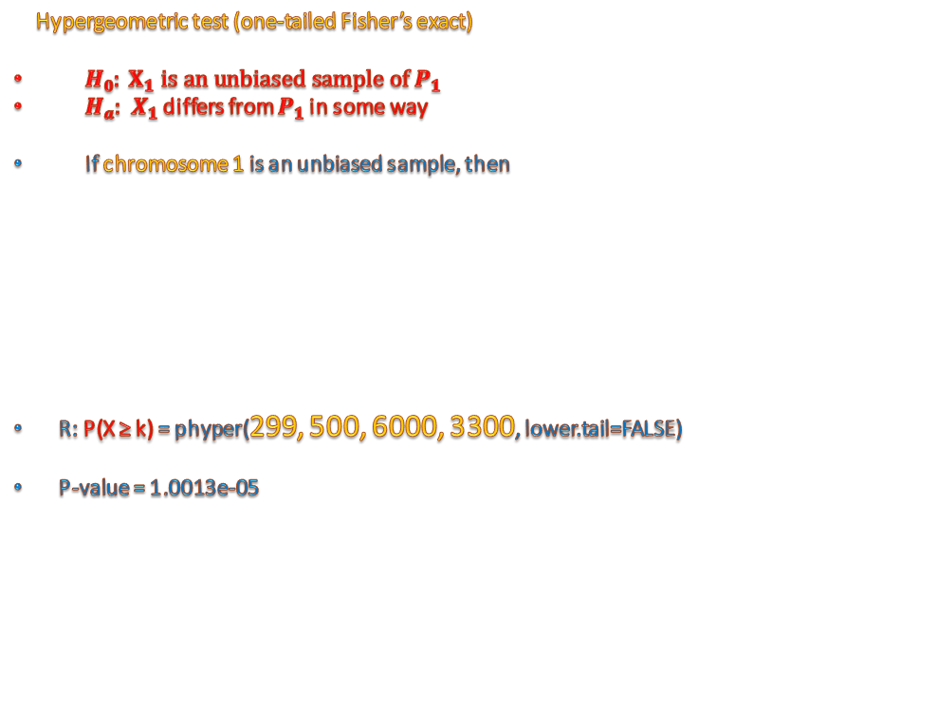
Fisher’s exact test Vs Hypergeometric
300
3000
500
6000
Fisher’s exact test
$H0: X_{1} is an unbiased sample of P_{1}$
$Ha:{ X}_{1}$ differs from $P_{1}$ in some way
If chromosome 1 is an unbiased sample, then
$\frac{300}{3000}≈\frac{500}{6000},$
Therefore, $H0$: F = $\frac{300∙6000}{500∙3000}≈1$
$Ha$: F > 1
R: fisher.test(matrix(c(300,200,3000,3000),2,2), alternative="greater")
P-value = 1.0013e-05
fisher.test can do two other jobs: two-sided test, and giving confidence intervals of odds ratio.
Hypergeometric test (one-tailed Fisher’s exact)
$H0: X_{1} is an unbiased sample of P_{1}$
$Ha:{ X}_{1}$ differs from $P_{1}$ in some way
If chromosome 1 is an unbiased sample, then
R: P(X ≥ k) = phyper(299, 500, 6000, 3300, lower.tail=FALSE)
P-value = 1.0013e-05
$$P\left(X=k\right)= \frac{\left(\begin{matrix}K \\ k\end{matrix}\right)\left(\begin{matrix}N−K \\ n−k\end{matrix}\right)}{\left(\begin{matrix}N \\ n\end{matrix}\right)}$$
Biology 644: Bioinformatics

Slide 9
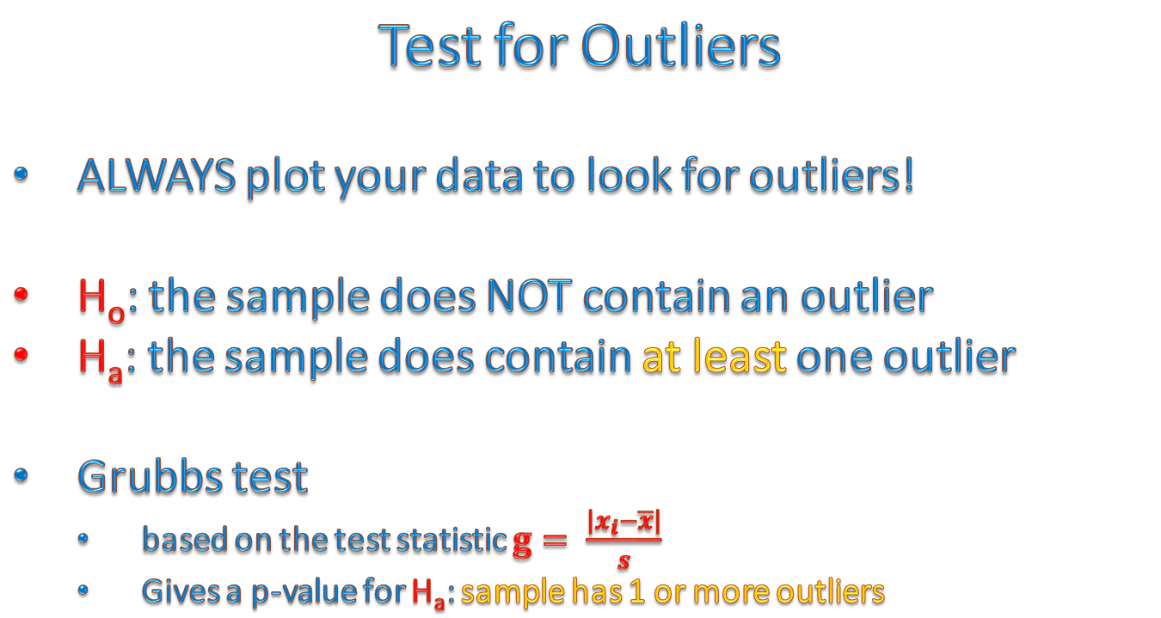
Test for Outliers
ALWAYS plot your data to look for outliers!
H_{o}: the sample does NOT contain an outlier
H_{a}: the sample does contain at least one outlier
Grubbs test
based on the test statistic $g= \frac{\left|x_{i}−\overline{x}\right|}{s}$
Gives a p-value for H_{a}: sample has 1 or more outliers
Biology 644: Bioinformatics

Slide 10
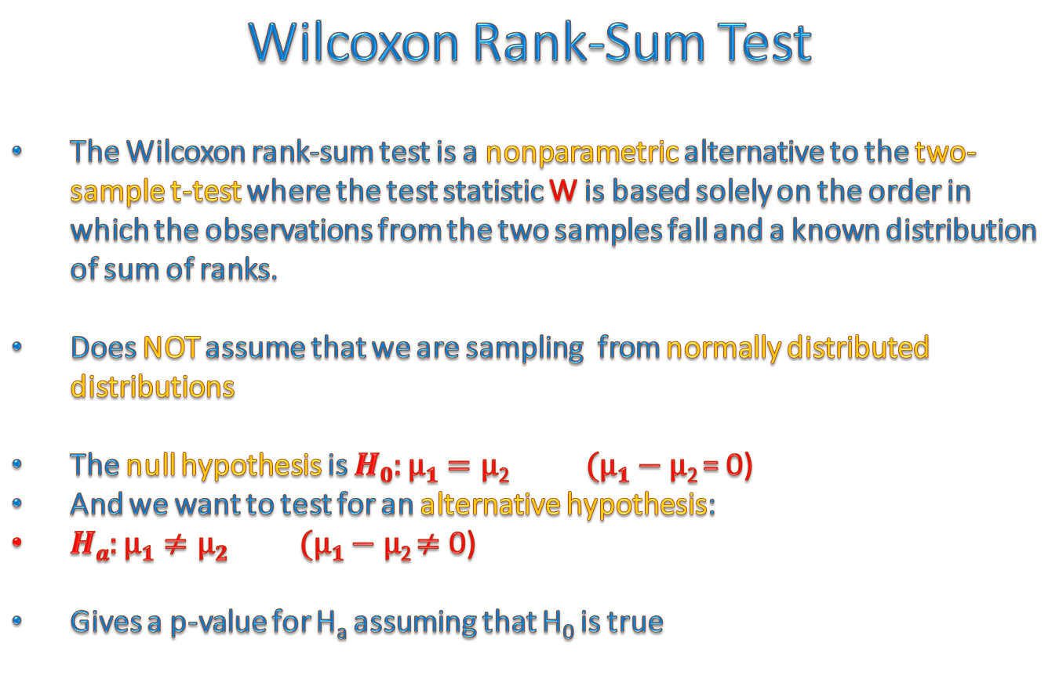
Wilcoxon Rank-Sum Test
The Wilcoxon rank-sum test is a nonparametric alternative to the two-sample t-test where the test statistic W is based solely on the order in which the observations from the two samples fall and a known distribution of sum of ranks.
Does NOT assume that we are sampling from normally distributed distributions
The null hypothesis is $H0:μ1=μ$₂ $(μ1−μ$₂ = 0)
And we want to test for an alternative hypothesis:
$Ha:μ1≠μ2$ $(μ1−μ$₂ $≠$ 0)
Gives a p-value for H_{a} assuming that H₀ is true
Biology 644: Bioinformatics

Slide 11
Paired Vs. Unpaired Tests
A paired difference test is a type of location test that is used when comparing two sets of measurements to assess whether their population means differ when we have two related samples, matched samples, or repeated measurements on a single sample.
The most familiar example of a paired difference test occurs when subjects are measured before and after a treatment.
A paired difference test uses additional information about the sample that is not present in an ordinary unpaired testing situation, either to increase the statistical power, or to reduce the effects of confounders.
Such a "repeated measures" test compares these measurements within subjects, rather than across subjects, and will generally have greater power than an unpaired test.
Biology 644: Bioinformatics

Slide 12
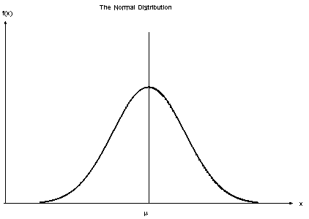
Paired Vs. Unpaired Tests
Sample 1
Sample 2
Unpaired
Biology 644: Bioinformatics

Slide 13
Paired Vs. Unpaired Tests
Sample 1
Sample 2
Paired
Are these distributions more similar after pairing?
Biology 644: Bioinformatics

Slide 14
Paired Vs. Unpaired Tests
Sample 1
Sample 2
Paired
Are these distributions more similar after pairing?
Biology 644: Bioinformatics

