Slide 1
Molecular phylogeny
Computer lab
December 11, 2009
Genomics
J. Pevsner
pevsner@kennedykrieger.org

Slide 2
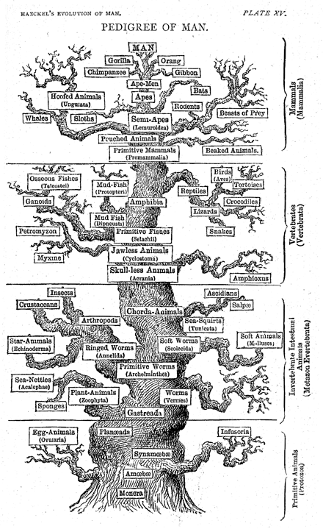
Five kingdom
system
(Haeckel, 1879)
mammals
vertebrates
animals
invertebrates
plants
fungi
protists
protozoa
monera
Page 516

Slide 3
Goals of the lab
Introduction to evolution and phylogeny
Nomenclature of trees
Five stages of molecular phylogeny:
[1] selecting sequences
[2] multiple sequence alignment
[3] models of substitution
[4] tree-building
[5] tree evaluation
Practical approaches to making trees

Slide 4
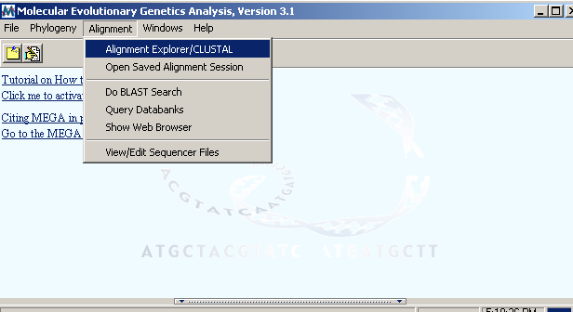

Slide 5
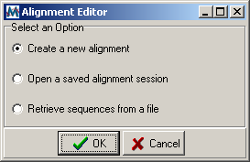
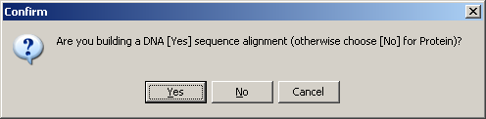


Slide 6
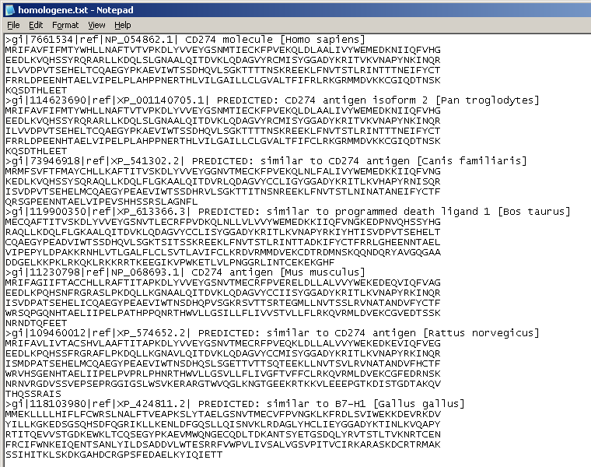

Slide 7
Goals of the lecture
Introduction to evolution and phylogeny
Nomenclature of trees
Five stages of molecular phylogeny:
[1] selecting sequences
[2] multiple sequence alignment
[3] models of substitution
[4] tree-building
[5] tree evaluation
Practical approaches to making trees

Slide 8
Introduction
Charles Darwin’s 1859 book (On the Origin of Species
By Means of Natural Selection, or the Preservation
of Favoured Races in the Struggle for Life) introduced
the theory of evolution.
To Darwin, the struggle for existence induces a natural
selection. Offspring are dissimilar from their parents
(that is, variability exists), and individuals that are more
fit for a given environment are selected for. In this way,
over long periods of time, species evolve. Groups of
organisms change over time so that descendants differ
structurally and functionally from their ancestors.
Page 215

Slide 9
Introduction
At the molecular level, evolution is a process of
mutation with selection.
Molecular evolution is the study of changes in genes
and proteins throughout different branches of the
tree of life.
Phylogeny is the inference of evolutionary relationships.
Traditionally, phylogeny relied on the comparison
of morphological features between organisms. Today,
molecular sequence data are also used for phylogenetic
analyses.
Page 216

Slide 10
Goals of molecular phylogeny
Phylogeny can answer questions such as:
How many genes are related to my favorite gene?
Was the extinct quagga more like a zebra or a horse?
Was Darwin correct that humans are closest
to chimps and gorillas?
How related are whales, dolphins & porpoises to cows?
Where and when did HIV originate?
What is the history of life on earth?

Slide 11
Molecular phylogeny in bioinformatics
Many of the topics we have discussed so far involve
explicit or implicit models of evolution.
Dayhoff et al. (1978) describe scoring matrices: “An
accepted point mutation in a protein is a replacement of
one amino acid by another, accepted by natural selection.
It is the result of two distinct processes: the first is the
occurrence of a mutation in the portion of the gene
template producing one amino acid of a protein; the
second is the acceptance of the mutation by the species
as the new predominant form.
Page 217

Slide 12
Historical background
Studies of molecular evolution began with the first
sequencing of proteins, beginning in the 1950s.
In 1953 Frederick Sanger and colleagues determined
the primary amino acid sequence of insulin.
(The accession number of human insulin is NP_000198)
Page 219

Slide 13
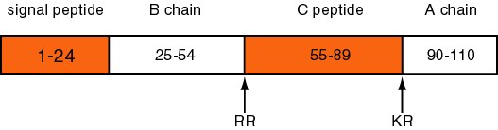
Mature insulin consists of an A chain and B chain
heterodimer connected by disulphide bridges
The signal peptide and C peptide are cleaved,
and their sequences display fewer
functional constraints.
Fig. 7.3
Page 220

Slide 14
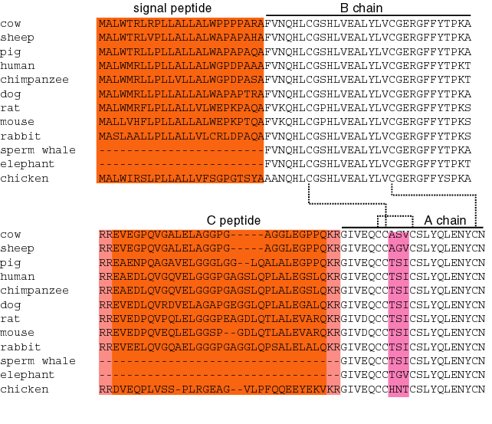
Fig. 7.3
Page 220

Slide 15
Note the sequence divergence in the
disulfide loop region of the A chain
Fig. 7.3
Page 220

Slide 16
Historical background: insulin
By the 1950s, it became clear that amino acid
substitutions occur nonrandomly. For example, Sanger
and colleagues noted that most amino acid changes in the
insulin A chain are restricted to a disulfide loop region.
Such differences are called “neutral” changes
(Kimura, 1968; Jukes and Cantor, 1969).
Subsequent studies at the DNA level showed that rate of
nucleotide (and of amino acid) substitution is about six-
to ten-fold higher in the C peptide, relative to the A and B
chains.
Page 219

Slide 17
0.1 x 10⁻⁹
1 x 10⁻⁹
0.1 x 10⁻⁹
Number of nucleotide substitutions/site/year
Fig. 7.3
Page 220

Slide 18
Historical background: insulin
Surprisingly, insulin from the guinea pig (and from the
related coypu) evolve seven times faster than insulin
from other species. Why?
The answer is that guinea pig and coypu insulin
do not bind two zinc ions, while insulin molecules from
most other species do. There was a relaxation on the
structural constraints of these molecules, and so
the genes diverged rapidly.
Page 219

Slide 19
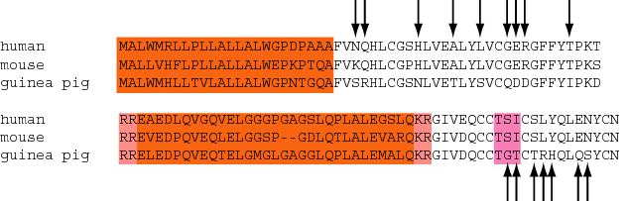
Guinea pig and coypu insulin have undergone an
extremely rapid rate of evolutionary change
Arrows indicate positions at which guinea pig
insulin (A chain and B chain) differs
from both human and mouse
Fig. 7.3
Page 220

Slide 20
Molecular clock hypothesis
In the 1960s, sequence data were accumulated for
small, abundant proteins such as globins,
cytochromes c, and fibrinopeptides. Some proteins
appeared to evolve slowly, while others evolved rapidly.
Linus Pauling, Emanuel Margoliash and others
proposed the hypothesis of a molecular clock:
For every given protein, the rate of molecular
evolution is approximately constant in all
evolutionary lineages
Page 221

Slide 21
Molecular clock hypothesis
As an example, Richard Dickerson (1971) plotted data
from three protein families: cytochrome c,
hemoglobin, and fibrinopeptides.
The x-axis shows the divergence times of the species,
estimated from paleontological data. The y-axis shows
m, the corrected number of amino acid changes per
100 residues.
n is the observed number of amino acid changes per
100 residues, and it is corrected to m to account for
changes that occur but are not observed.
N
100
= 1 – e^{-(m/100)}
Page 222

Slide 22
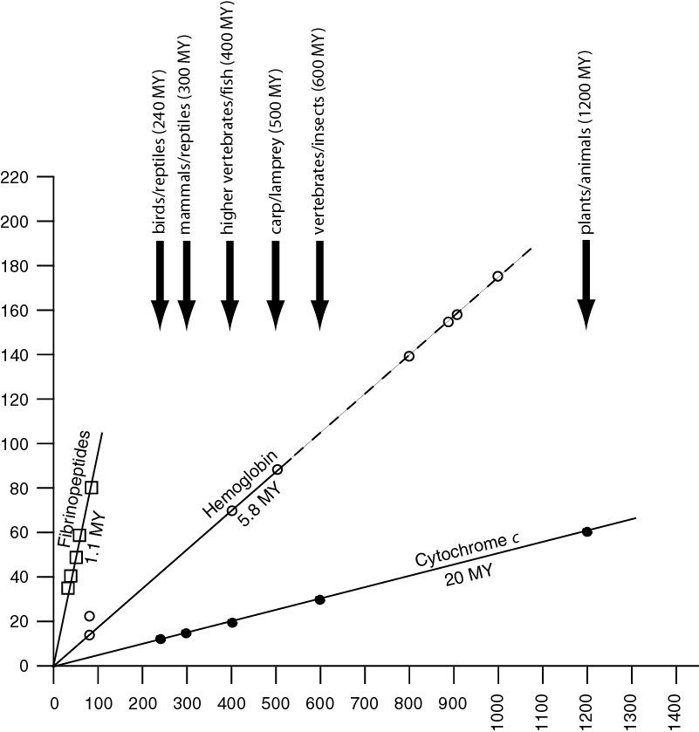
Dickerson
(1971)
corrected amino acid changes
per 100 residues (m)
Fig. 7.5
Page 222
Millions of years since divergence

Slide 23
Molecular clock hypothesis: conclusions
Dickerson drew the following conclusions:
For each protein, the data lie on a straight line. Thus,
the rate of amino acid substitution has remained
constant for each protein.
The average rate of change differs for each protein.
The time for a 1% change to occur between two lines
of evolution is 20 MY (cytochrome c), 5.8 MY
(hemoglobin), and 1.1 MY (fibrinopeptides).
The observed variations in rate of change reflect
functional constraints imposed by natural selection.
Page 223

Slide 24
Molecular clock hypothesis: λ and PAM
The rate of amino acid substitution is measured by λ,
the number of substitutions per amino acid site per year.
Consider serum albumin:
= 1.9 x 10⁻⁹
x 10⁹ = 1.9
Dayhoff et al. (Box 3.3, page 50) reported the rate of
mutation acceptance for serum albumin as 19 PAMs
per amino acid residue per 100 million years.
(19 subst./1 aa/10⁸ years = 1.9 subst./100 aa/10⁹ years)
Page 223

Slide 25
Molecular clock for proteins:
rate of substitutions per aa site per 10⁹ years
Fibrinopeptides 9.0
Kappa casein 3.3
Lactalbumin 2.7
Serum albumin 1.9
Lysozyme 0.98
Trypsin 0.59
Insulin 0.44
Cytochrome c 0.22
Histone H2B 0.09
Ubiquitin 0.010
Histone H4 0.010
Table 7-1
Page 223

Slide 26
Molecular clock hypothesis: implications
If protein sequences evolve at constant rates,
they can be used to estimate the times that
sequences diverged. This is analogous to dating
geological specimens by radioactive decay.
Page 225

Slide 27
Positive and negative selection
Darwin’s theory of evolution suggests that, at the phenotypic level, traits in a population that enhance survival are selected for, while traits that reduce fitness are selected against. For example, among a group of giraffes millions of years in the past, those giraffes that had longer necks were able to reach higher foliage and were more reproductively successful than their shorter-necked group members, that is, the taller giraffes were selected for.
In the mid-20th century, a conventional view was that molecular sequences are routinely subject to positive (or negative) selection.
Page 227

Slide 28
Positive and negative selection
Darwin’s theory of evolution suggests that, at the phenotypic level, traits in a population that enhance survival are selected for, while traits that reduce fitness are selected against. For example, among a group of giraffes millions of years in the past, those giraffes that had longer necks were able to reach higher foliage and were more reproductively successful than their shorter-necked group members, that is, the taller giraffes were selected for.
Positive selection occurs when a sequence undergoes significantly increased rates of substitution, while negative selection occurs when a sequence undergoes change slowly. Otherwise, selection is neutral.
Page 227

Slide 29
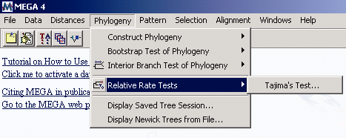
Tajima’s relative rate test in MEGA
Page 228

Slide 30
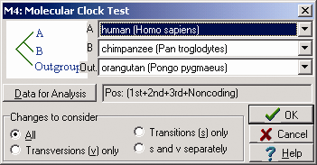
Tajima’s relative rate test
Page 228

Slide 31
A to B: known distance
A to outgroup: known distance
A to X: unknown (and solvable)
B to X: unknown (and solvable)
Question: is X-to-A the same length as X-to-B?
X

Slide 32
Neutral theory of evolution
An often-held view of evolution is that just as organisms
propagate through natural selection, so also DNA and
protein molecules are selected for.
According to Motoo Kimura’s 1968 neutral theory
of molecular evolution, the vast majority of DNA
changes are not selected for in a Darwinian sense.
The main cause of evolutionary change is random
drift of mutant alleles that are selectively neutral
(or nearly neutral). Positive Darwinian selection does
occur, but it has a limited role.
As an example, the divergent C peptide of insulin
changes according to the neutral mutation rate.
Page 230

Slide 33
Molecular phylogeny: nomenclature of trees
There are two main kinds of information inherent
to any tree: topology and branch lengths.
We will now describe the parts of a tree.
Page 231

Slide 34
Molecular phylogeny uses trees to depict evolutionary
relationships among organisms. These trees are based
upon DNA and protein sequence data.
2
A
2
A
F
1
1
1
1
2
G
B
B
I
2
C
H
2
C
2
2
1
D
1
D
6
6
E
one unit
E
time
Fig. 7.8
Page 232

Slide 35
Tree nomenclature
taxon
taxon
2
A
2
A
F
1
1
1
1
2
G
B
B
I
2
C
H
2
C
2
2
1
D
1
D
6
6
E
one unit
E
time
Fig. 7.8
Page 232

Slide 36
Tree nomenclature
operational taxonomic unit (OTU)
such as a protein sequence
taxon
2
A
2
A
F
1
1
1
1
2
G
B
B
I
2
C
H
2
C
2
2
1
D
1
D
6
6
E
one unit
E
time
Fig. 7.8
Page 232

Slide 37
Tree nomenclature
Node (intersection or terminating point
of two or more branches)
branch
(edge)
2
A
2
A
F
1
1
1
1
2
G
B
B
I
2
C
H
2
C
2
2
1
D
1
D
6
6
E
one unit
E
time
Fig. 7.8
Page 232

Slide 38
Tree nomenclature
Branches are unscaled...
Branches are scaled...
2
A
2
A
F
1
1
1
1
2
G
B
B
I
2
C
H
2
C
2
2
1
D
1
D
6
6
E
one unit
E
time
…OTUs are neatly aligned,
and nodes reflect time
…branch lengths are
proportional to number of
amino acid changes
Fig. 7.8
Page 232

Slide 39
Tree nomenclature
bifurcating
internal
node
multifurcating
internal
node
2
A
2
A
F
1
1
1
2
G
B
B
I
2
C
H
2
C
2
2
1
D
1
D
6
6
E
one unit
E
time
Fig. 7.9
Page 233

Slide 40
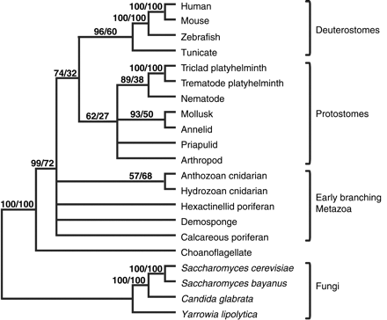
Examples of multifurcation: failure to resolve the branching order
of some metazoans and protostomes
Rokas A. et al., Animal Evolution and the Molecular Signature of Radiations
Compressed in Time, Science 310:1933 (2005), Fig. 1.

Slide 41
Tree nomenclature: clades
Clade ABF (monophyletic group)
2
A
F
1
1
2
G
B
I
H
2
C
1
D
6
E
time
Fig. 7.8
Page 232

Slide 42
Tree nomenclature
Clade ABF/CDH/G
2
A
F
1
1
2
G
B
I
H
2
C
1
D
6
E
time
Fig. 7.8
Page 232

Slide 43
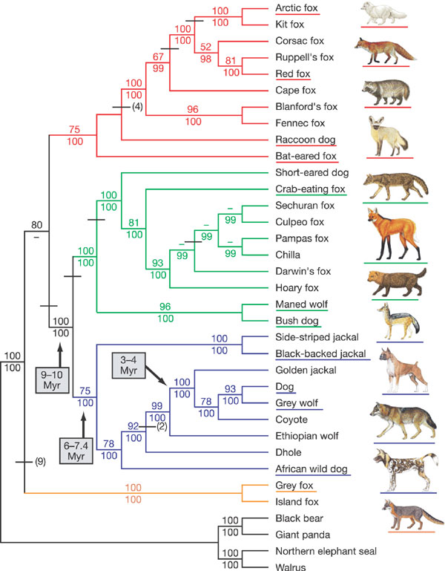
Examples of clades
Lindblad-Toh et al., Nature 438: 803 (2005), fig. 10

Slide 44
Tree roots
The root of a phylogenetic tree represents the
common ancestor of the sequences. Some trees
are unrooted, and thus do not specify the common
ancestor.
A tree can be rooted using an outgroup (that is, a
taxon known to be distantly related from all other
OTUs).
Page 233

Slide 45
Tree nomenclature: roots
past
9
1
7
8
5
6
2
3
7
8
present
4
2
6
4
1
5
3
Rooted tree
(specifies evolutionary
path)
Unrooted tree
Fig. 7.10
Page 234

Slide 46
Tree nomenclature: outgroup rooting
past
root
9
10
7
8
7
9
6
8
present
2
3
4
2
3
4
6
Outgroup
(used to place the root)
1
5
1
5
Rooted tree
Fig. 7.10
Page 234

Slide 47
Enumerating trees
Cavalii-Sforza and Edwards (1967) derived the number
of possible unrooted trees (N_{U}) for n OTUs (n > 3):
N_{U} =
The number of bifurcating rooted trees (N_{R})
N_{R} =
For 10 OTUs (e.g. 10 DNA or protein sequences),
the number of possible rooted trees is ≈ 34 million,
and the number of unrooted trees is ≈ 2 million.
Many tree-making algorithms can exhaustively
examine every possible tree for up to ten to twelve
sequences.
(2n-5)!
2^{n-3}(n-3)!
(2n-3)!
2^{n-2}(n-2)!
Page 235

Slide 48
Numbers of trees
Number Number of Number of
of OTUs rooted trees unrooted trees
2 1 1
3 3 1
4 15 3
5 105 15
10 34,459,425 105
20 8 x 10²¹ 2 x 10²⁰
Page 235

Slide 49
Species trees versus gene/protein trees
Molecular evolutionary studies can be complicated
by the fact that both species and genes evolve.
speciation usually occurs when a species becomes
reproductively isolated. In a species tree, each
internal node represents a speciation event.
Genes (and proteins) may duplicate or otherwise evolve
before or after any given speciation event. The topology
of a gene (or protein) based tree may differ from the
topology of a species tree.
Page 238

Slide 50
Species trees versus gene/protein trees
past
speciation
event
present
species 1
species 2
Fig. 7.14
Page 238

Slide 51
Species trees versus gene/protein trees
Gene duplication
events
speciation
event
species 1
species 2
Fig. 7.14
Page 238

Slide 52
Species trees versus gene/protein trees
Gene duplication
events
speciation
event
OTUs
species 1
species 2
Fig. 7.14
Page 238

Slide 53
Five stages of phylogenetic analysis
[1] Selection of sequences for analysis
[2] Multiple sequence alignment
[3] Selection of a substitution model
[4] Tree building
[5] Tree evaluation
Page 243

Slide 54
Stage 1: Use of DNA, RNA, or protein
For some phylogenetic studies, it may be preferable
to use protein instead of DNA sequences. We saw
that in pairwise alignment and in BLAST searching,
protein is often more informative than DNA (Chapter 3).
Page 240

Slide 55
Stage 1: Use of DNA, RNA, or protein
For phylogeny, DNA can be more informative.
--The protein-coding portion of DNA has synonymous
and nonsynonymous substitutions. Thus, some DNA
changes do not have corresponding protein changes.
Page 240

Slide 56
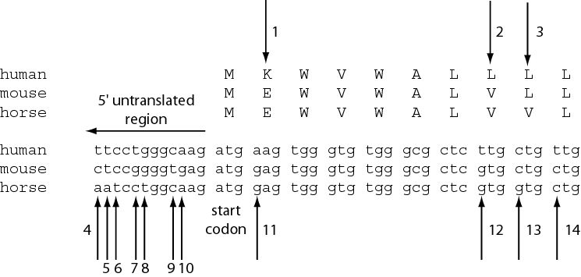
Fig. 7.16
Page 241

Slide 57
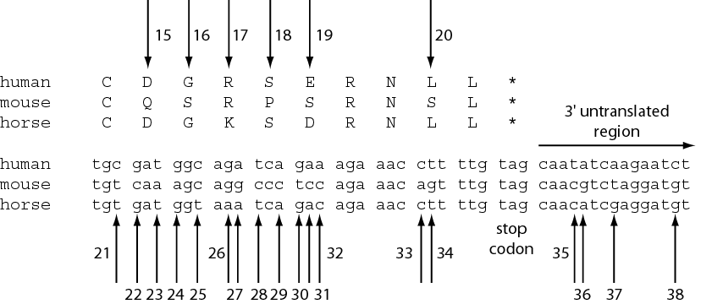
Fig. 7.16
Page 241

Slide 58
Stage 1: Use of DNA, RNA, or protein
For phylogeny, DNA can be more informative.
--The protein-coding portion of DNA has synonymous
and nonsynonymous substitutions. Thus, some DNA
changes do not have corresponding protein changes.
If the synonymous substitution rate (d_{S}) is greater than
the nonsynonymous substitution rate (d_{N}), the DNA
sequence is under negative (purifying) selection. This
limits change in the sequence (e.g. insulin A chain).
If d_{S} < d_{N}, positive selection occurs. For example, a
duplicated gene may evolve rapidly to assume
new functions.
Page 230

Slide 59
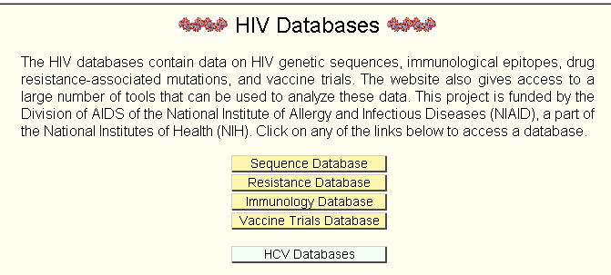
Stage 1: Use of DNA, RNA, or protein
You can measure the synonymous and nonsynonymous substitution rates by pasting your fasta-formatted sequences into the SNAP program at the Los Alamos National Labs HIV database (hiv-web.lanl.gov/).

Slide 60
Stage 1: Use of DNA, RNA, or protein
For phylogeny, DNA can be more informative.
--Some substitutions in a DNA sequence alignment can
be directly observed: single nucleotide substitutions,
sequential substitutions, coincidental substitutions.
Page 241

Slide 61
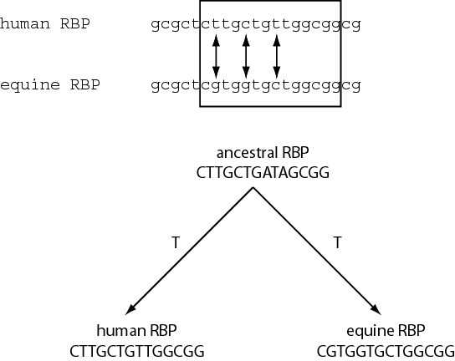
Fig. 7.16
Page 241

Slide 62
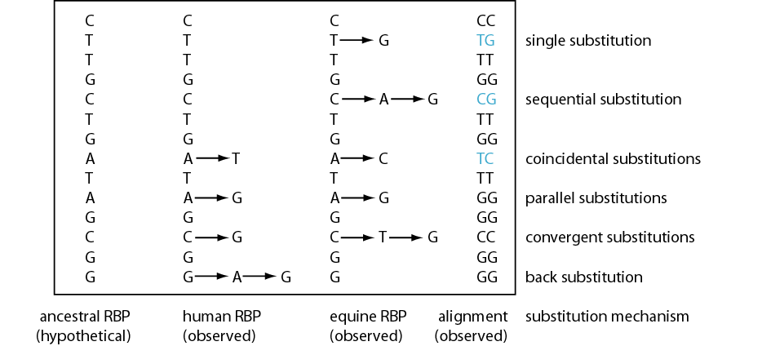
Fig. 7.16
Page 241

Slide 63
Stage 1: Use of DNA, RNA, or protein
For phylogeny, DNA can be more informative.
--Some substitutions in a DNA sequence alignment can
be directly observed: single nucleotide substitutions,
sequential substitutions, coincidental substitutions.
Additional mutational events can be inferred by
analysis of ancestral sequences. These changes
include parallel substitutions, convergent substitutions,
and back substitutions.
Page 241

Slide 64
Stage 1: Use of DNA, RNA, or protein
For phylogeny, DNA can be more informative.
--Noncoding regions (such as 5’ and 3’ untranslated
regions) may be analyzed using molecular phylogeny.
--Pseudogenes (nonfunctional genes) are studied by
molecular phylogeny
--Rates of transitions and transversions can be
measured.
Transitions: purine (A G) or pyrimidine (C T) substitutions
Transversion: purine pyrimidine
Page 242

Slide 65
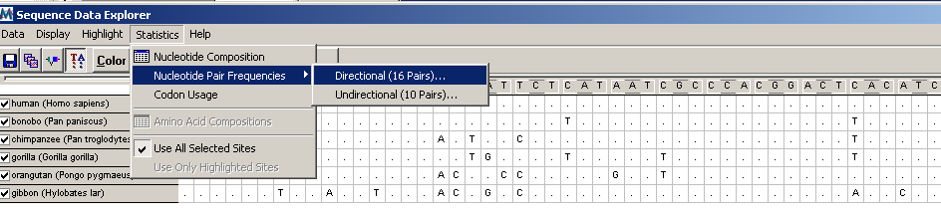
MEGA outputs transition and transversion frequencies

Slide 66
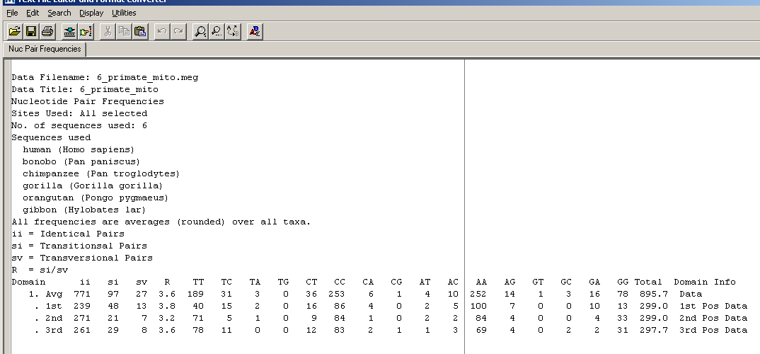
MEGA outputs transition and transversion frequencies
For primate mitochondrial DNA, the ratio of transitions to transversions is particularly high

Slide 67
Stage 1: Use of DNA, RNA, or protein
For phylogeny, protein sequences are also often used.
--Proteins have 20 states (amino acids) instead of only
four for DNA, so there is a stronger phylogenetic signal.
Nucleotides are unordered characters: any one
nucleotide can change to any other in one step.
An ordered character must pass through one or more
intermediate states before reaching the final state.
Amino acid sequences are partially ordered character
states: there is a variable number of states between
the starting value and the final value.
Page 243

Slide 68
Five stages of phylogenetic analysis
[1] Selection of sequences for analysis
[2] Multiple sequence alignment
[3] Selection of a substitution model
[4] Tree building
[5] Tree evaluation
Page 244

Slide 69
Stage 2: Multiple sequence alignment
The fundamental basis of a phylogenetic tree is
a multiple sequence alignment.
(If there is a misalignment, or if a nonhomologous
sequence is included in the alignment, it will still
be possible to generate a tree.)
Consider the following alignment of 13 orthologous
retinol-binding proteins (see Fig. 3.2)
Page 244

Slide 70
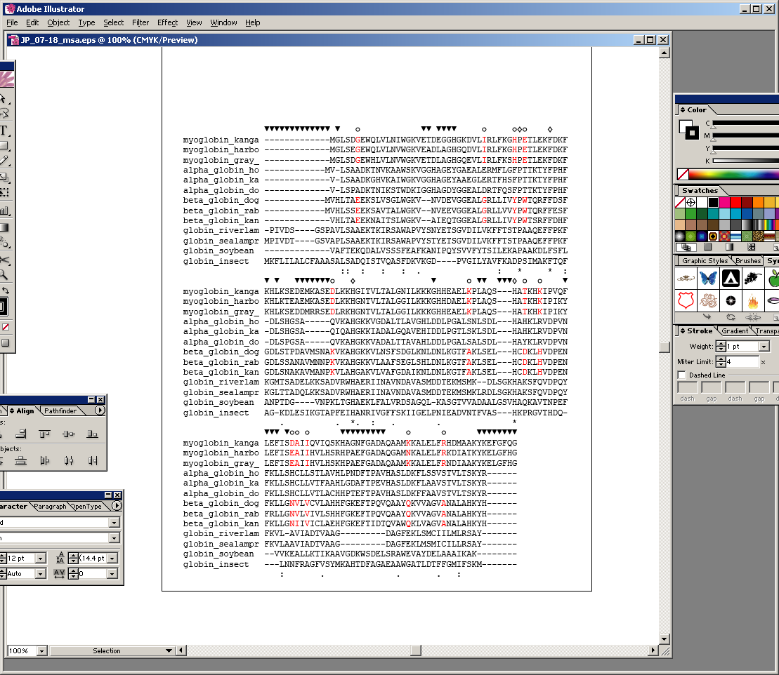
Fig. 7.18
Page 245

Slide 71
open circles: positions that distinguish
myoglobins, alpha globins, beta globins
100%
conserved
gaps
Fig. 7.18
Page 245

Slide 72
Stage 2: Multiple sequence alignment
[1] Confirm that all sequences are homologous
[2] Adjust gap creation and extension penalties
as needed to optimize the alignment
[3] Restrict phylogenetic analysis to regions of the multiple
sequence alignment for which data are available for all
taxa (delete columns having incomplete data).
[4] Many experts recommend that you delete any
column of an alignment that contains gaps
(even if the gap occurs in only one taxon)
[5] In this example, note that four RBPs are from fish, while the others are vertebrates that evolved more recently.
Page 244

Slide 73
Five stages of phylogenetic analysis
[1] Selection of sequences for analysis
[2] Multiple sequence alignment
[3] Selection of a substitution model
[4] Tree building
[5] Tree evaluation
Page 246

Slide 74
Stage 4: Tree-building methods: distance
The simplest approach to measuring distances
between sequences is to align pairs of sequences, and
then to count the number of differences. The degree of
divergence is called the Hamming distance. For an
alignment of length N with n sites at which there are
differences, the degree of divergence D is:
D = n / N
Page 247

Slide 75
Stage 4: Tree-building methods: distance
The simplest approach to measuring distances
between sequences is to align pairs of sequences, and
then to count the number of differences. The degree of
divergence is called the Hamming distance. For an
alignment of length N with n sites at which there are
differences, the degree of divergence D is:
D = n / N
But observed differences do not equal genetic distance!
Genetic distance involves mutations that are not
observed directly (see Figure 11.11).
Page 247

Slide 76
Stage 4: Tree-building methods: distance
Jukes and Cantor (1969) proposed a corrective formula:
3
4
4
3
D = (- ) ln (1 – p)
This model describes the probability that one nucleotide
will change into another. It assumes that each residue
is equally likely to change into any other (i.e. the rate of
transversions equals the rate of transitions). In practice,
the transition is typically greater than the transversion
rate.
Page 249

Slide 77
Models of nucleotide substitution
transition
A
G
transversion
transversion
C
T
transition
Fig. 7.21
Page 250

Slide 78
Jukes and Cantor one-parameter
model of nucleotide substitution (α=β)
A
α
G
α
α
α
α
T
C
α
Fig. 7.21
Page 250

Slide 79
Kimura model of nucleotide
substitution (assumes α ≠ β)
A
α
G
β
β
β
β
T
C
α
Fig. 7.21
Page 250

Slide 80
Stage 4: Tree-building methods: distance
Jukes and Cantor (1969) proposed a corrective formula:
3
4
4
3
D = (- ) ln (1 – p)
Page 249

Slide 81
Stage 4: Tree-building methods: distance
Jukes and Cantor (1969) proposed a corrective formula:
3
4
4
3
D = (- ) ln (1 – p)
Consider an alignment where 3/60 aligned residues differ.
The normalized Hamming distance is 3/60 = 0.05.
The Jukes-Cantor correction is
3
4
4
3
D = (- ) ln (1 – 0.05) = 0.052
When 30/60 aligned residues differ, the Jukes-Cantor
correction is more substantial:
3
4
4
3
D = (- ) ln (1 – 0.5) = 0.82
Page 250

Slide 82
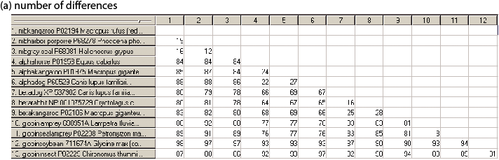
Fig. 7.19
Page 248

Slide 83
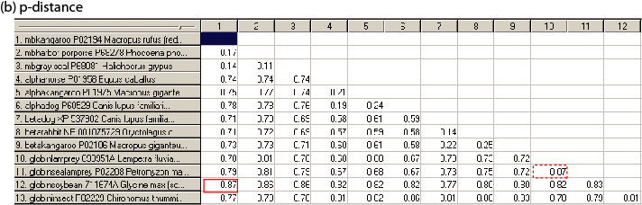
Fig. 7.19
Page 248

Slide 84
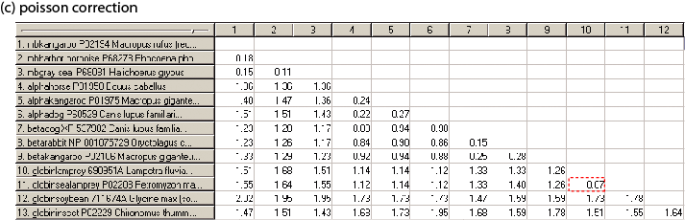
Fig. 7.19
Page 248

Slide 85
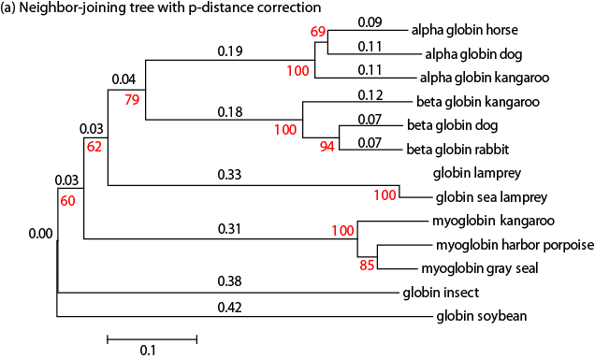
Fig. 7.20
Page 249

Slide 86
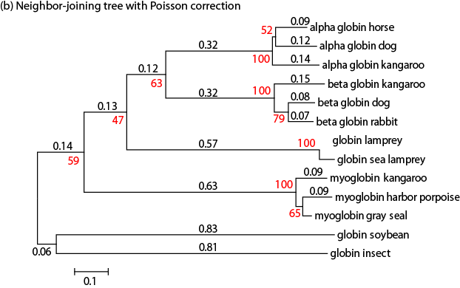
Fig. 7.20
Page 249

Slide 87
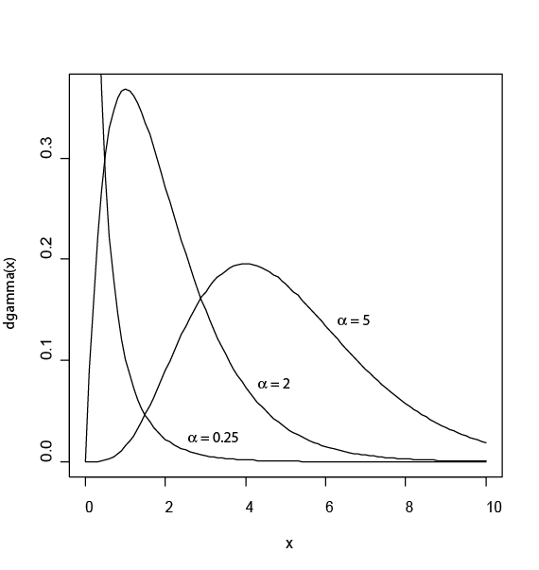
Gamma models account for unequal substitution rates across variable sites
Fig. 7.22
Page 252

Slide 88
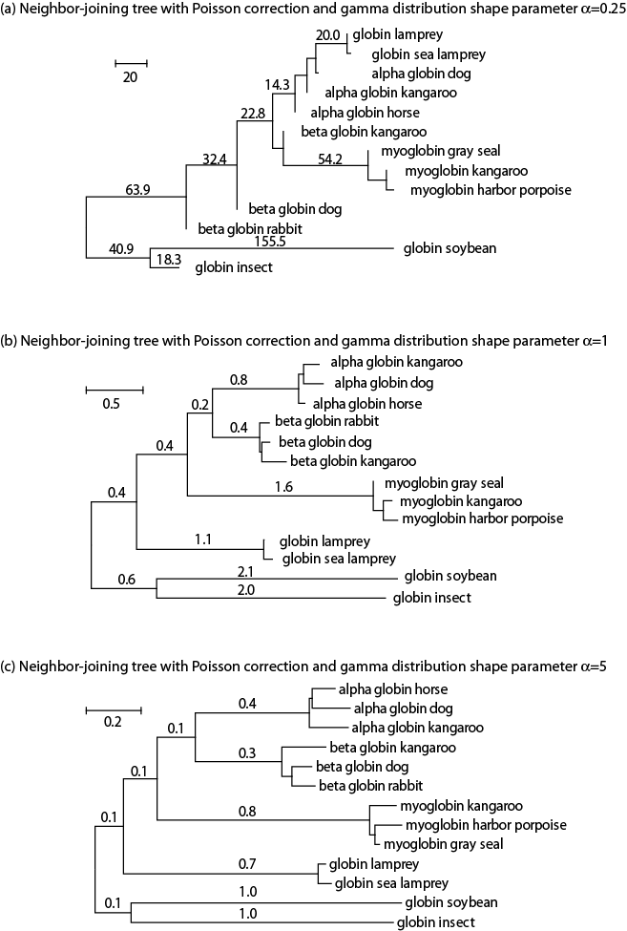
α = 0.25
α = 1
α = 5
Fig. 7.23
Page 253

Slide 89
Five stages of phylogenetic analysis
[1] Selection of sequences for analysis
[2] Multiple sequence alignment
[3] Selection of a substitution model
[4] Tree building
[5] Tree evaluation
Page 254

Slide 90
Stage 4: Tree-building methods
We will discuss two tree-building methods:
distance-based and character-based.
Distance-based methods involve a distance metric,
such as the number of amino acid changes between
the sequences, or a distance score. Examples of
distance-based algorithms are UPGMA and
neighbor-joining.
Page 254

Slide 91
Stage 4: Tree-building methods
Distance-based methods involve a distance metric,
such as the number of amino acid changes between
the sequences, or a distance score. Examples of
distance-based algorithms are UPGMA and
neighbor-joining.
Character-based methods include maximum parsimony
and maximum likelihood. Parsimony analysis involves
the search for the tree with the fewest amino acid
(or nucleotide) changes that account for the observed
differences between taxa.
Page 254

Slide 92
Stage 4: Tree-building methods
We can introduce distance-based and character-based
tree-building methods by referring to a tree of 13
orthologous retinol-binding proteins, and the
multiple sequence alignment from which the tree
was generated.
Page 255

Slide 93
common carp
Orthologs:
members of a
gene (protein)
family in various
organisms.
This tree shows
RBP orthologs.
zebrafish
rainbow trout
teleost
African
clawed
frog
chicken
human
mouse
horse
rat
pig
cow
rabbit
10 changes
See page 51

Slide 94
common carp
zebrafish
Fish RBP
orthologs
rainbow trout
teleost
African
clawed
frog
chicken
Other vertebrate
RBP orthologs
human
mouse
horse
rat
pig
cow
rabbit
10 changes

Slide 95
Fig. 7.18
Page 245

Slide 96
Distance-based tree
Calculate the pairwise alignments;
if two sequences are related,
put them next to each other on the tree

Slide 97
Character-based tree: identify positions that best describe how characters (amino acids) are derived from common ancestors

Slide 98
Stage 4: Tree-building methods
Regardless of whether you use distance- or
character-based methods for building a tree,
the starting point is a multiple sequence alignment.
ReadSeq is a convenient web-based program that
translates multiple sequence alignments into
formats compatible with most commonly used
phylogeny programs such as PAUP and PHYLIP.
Page 254

Slide 99
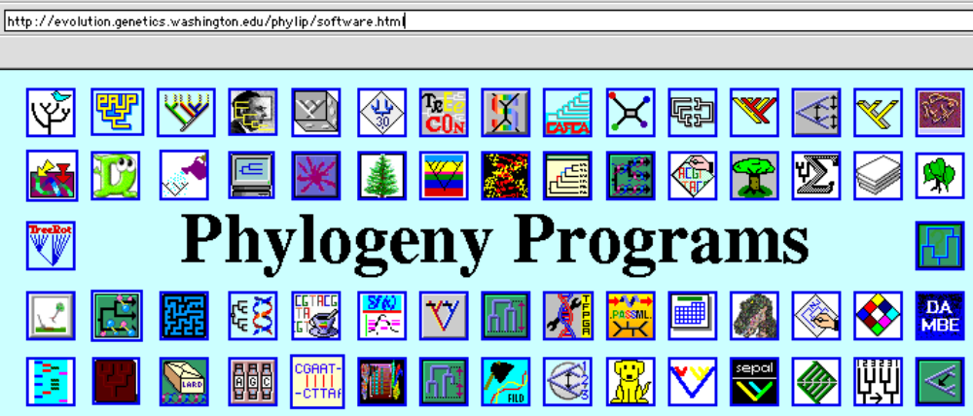
http://evolution.genetics.washington.edu/phylip/software.html
This site lists 200 phylogeny packages. Perhaps the best-
known programs are PAUP (David Swofford and colleagues)
and PHYLIP (Joe Felsenstein).

Slide 100
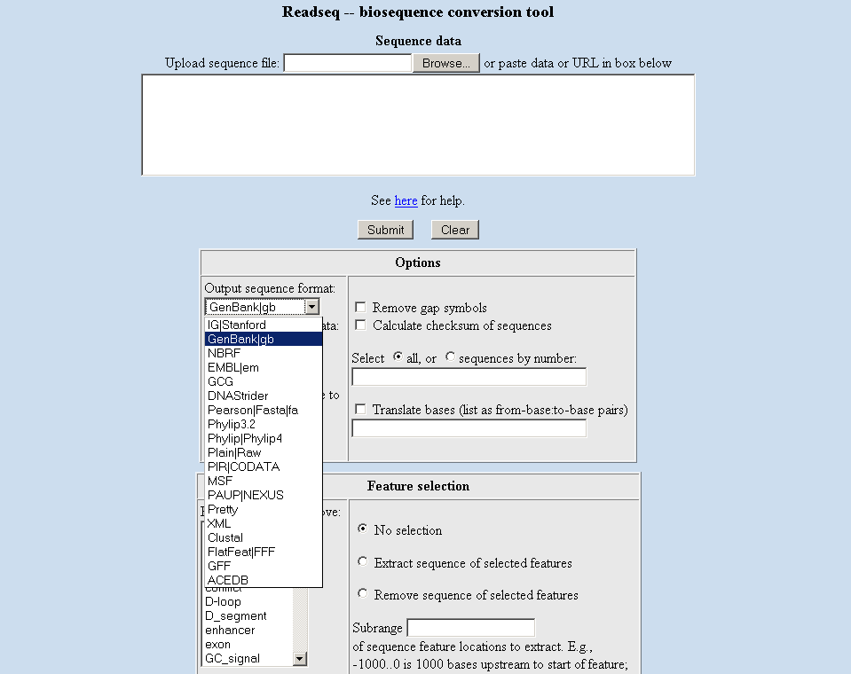
ReadSeq is widely available;
try the “tools” menu at the LANL HIV database

Slide 101
Stage 4: Tree-building methods
[1] distance-based
[2] character-based: maximum parsimony
[3] character- and model-based: maximum likelihood
[4] character- and model-based: Bayesian

Slide 102
Stage 4: Tree-building methods: distance
Many software packages are available for making
phylogenetic trees.
Page 255

Slide 103
Stage 4: Tree-building methods: distance
Many software packages are available for making
phylogenetic trees. We will describe two programs.
[1] MEGA (Molecular Evolutionary Genetics Analysis) by Sudhir Kumar, Koichiro Tamura, and Masatoshi Nei. Download it from http://www.megasoftware.net/
[2] Phylogeny Analysis Using Parsimony (PAUP), written by David Swofford. See http://paup.csit.fsu.edu/.
We will next use MEGA and PAUP to generate trees by the distance-based method UPGMA.
Page 255

Slide 104
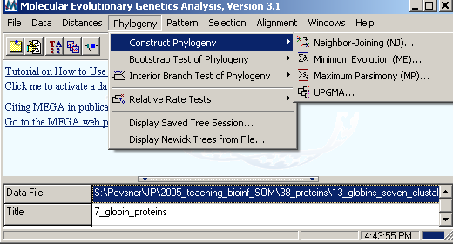
How to use MEGA to make a tree
[1] Enter a multiple sequence alignment (.meg) file
[2] Under the phylogeny menu, select one of these
four methods…
Neighbor-Joining (NJ)
Minimum Evolution (ME)
Maximum Parsimony (MP)
UPGMA

Slide 105
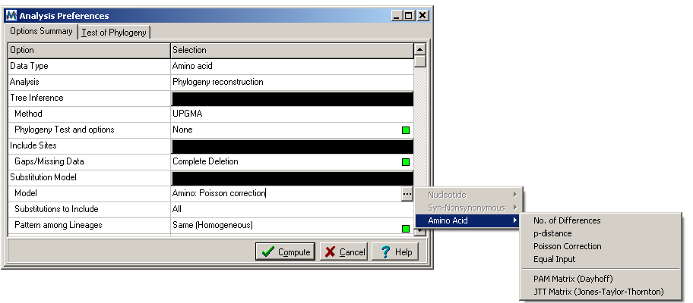
Use of MEGA for a distance-based tree: UPGMA
Click green boxes
to obtain options
Click compute
to obtain tree

Slide 106
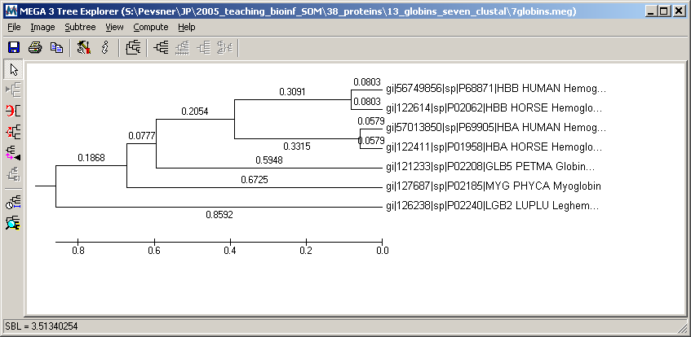
Use of MEGA for a distance-based tree: UPGMA

Slide 107
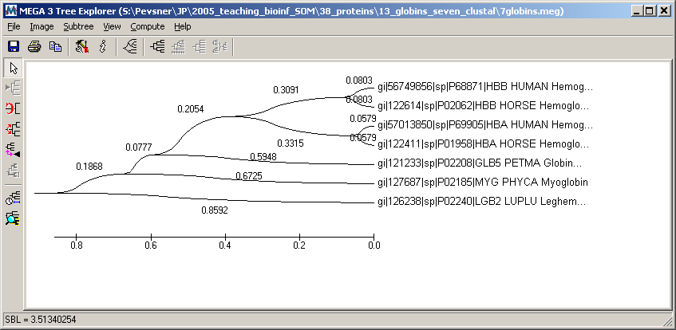
Use of MEGA for a distance-based tree: UPGMA
A variety of styles are available for tree display

Slide 108
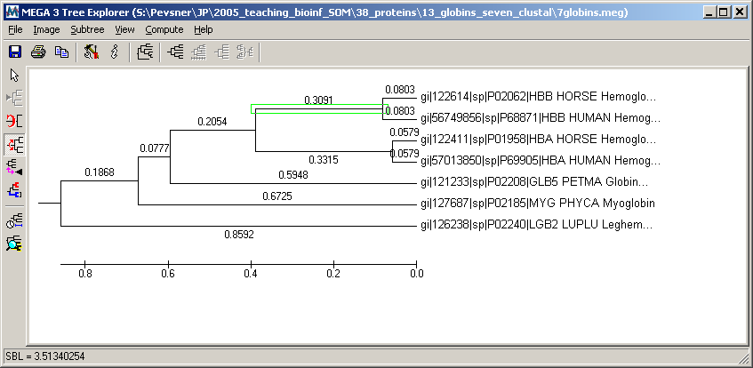
Use of MEGA for a distance-based tree: UPGMA
Flipping branches around a node creates
an equivalent topology

Slide 109
Tree-building methods: UPGMA
UPGMA is
unweighted pair group method
using arithmetic mean
1
2
3
4
5
Fig. 7.26
Page 257

Slide 110
Tree-building methods: UPGMA
Step 1: compute the pairwise distances of all
the proteins. Get ready to put the numbers 1-5
at the bottom of your new tree.
1
2
3
4
5
Fig. 7.26
Page 257

Slide 111
Tree-building methods: UPGMA
Step 2: Find the two proteins with the
smallest pairwise distance. Cluster them.
1
2
6
3
1
2
4
5
Fig. 7.26
Page 257

Slide 112
Tree-building methods: UPGMA
Step 3: Do it again. Find the next two proteins
with the smallest pairwise distance. Cluster them.
1
2
6
7
1
2
4
5
3
4
5
Fig. 7.26
Page 257

Slide 113
Tree-building methods: UPGMA
Step 4: Keep going. Cluster.
8
1
2
7
6
3
4
1
2
4
5
3
5
Fig. 7.26
Page 257

Slide 114
Tree-building methods: UPGMA
Step 4: Last cluster! This is your tree.
9
1
2
8
7
3
4
6
5
1
2
4
5
3
Fig. 7.26
Page 257

Slide 115
Distance-based methods: UPGMA trees
UPGMA is a simple approach for making trees.
An UPGMA tree is always rooted.
An assumption of the algorithm is that the molecular
clock is constant for sequences in the tree. If there
are unequal substitution rates, the tree may be wrong.
While UPGMA is simple, it is less accurate than the
neighbor-joining approach (described next).
Page 256

Slide 116
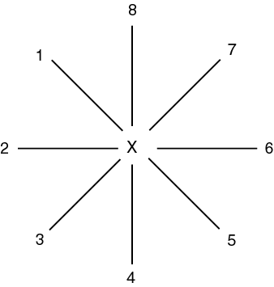
Making trees using neighbor-joining
The neighbor-joining
method of Saitou and Nei
(1987) Is especially useful
for making a tree having a
large number of taxa.
Begin by placing all the taxa in a star-like structure.
Page 259

Slide 117
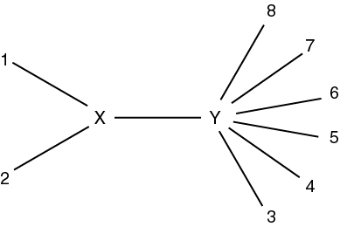
Tree-building methods: Neighbor joining
Next, identify neighbors (e.g. 1 and 2) that are most closely
related. Connect these neighbors to other OTUs via an
internal branch, XY. At each successive stage, minimize
the sum of the branch lengths.
Page 259

Slide 118
Tree-building methods: Neighbor joining
Define the distance from X to Y by
d_{XY} = 1/2(d_{1Y} + d_{2Y} – d₁₂)
Page 259

Slide 119
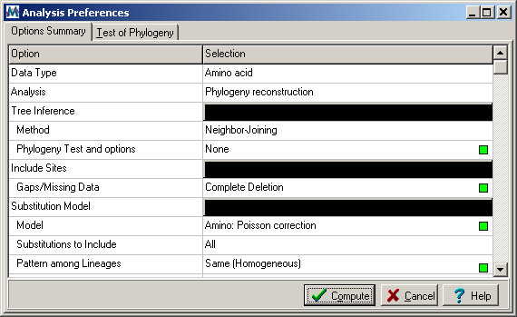
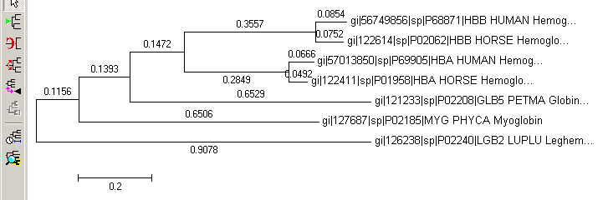
Use of MEGA for a distance-based tree: NJ
Neighbor Joining
produces a
reasonably
similar tree as
UPGMA

Slide 120
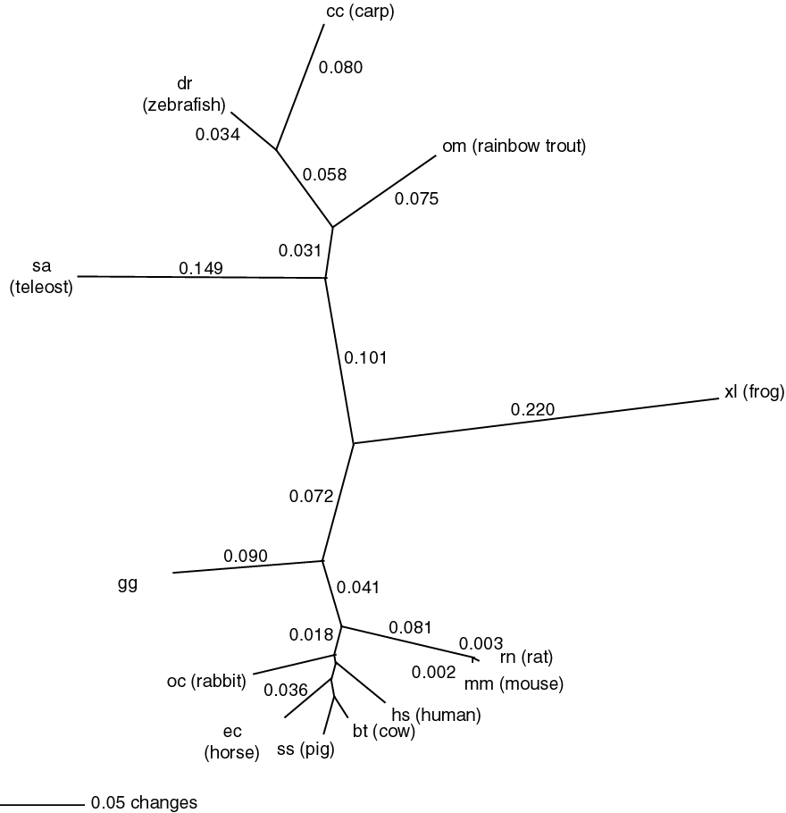
Example of a
neighbor-joining
tree: phylogenetic
analysis of 13
RBPs

Slide 121
Stage 4: Tree-building methods
We will discuss four tree-building methods:
[1] distance-based
[2] character-based: maximum parsimony
[3] character- and model-based: maximum likelihood
[4] character- and model-based: Bayesian

Slide 122
Tree-building methods: character based
Rather than pairwise distances between proteins,
evaluate the aligned columns of amino acid
residues (characters).
Tree-building methods based on characters include
maximum parsimony and maximum likelihood.
Page 260

Slide 123
Making trees using character-based methods
The main idea of character-based methods is to find
the tree with the shortest branch lengths possible.
Thus we seek the most parsimonious (“simple”) tree.
Identify informative sites. For example, constant
characters are not parsimony-informative.
Construct trees, counting the number of changes
required to create each tree. For about 12 taxa or
fewer, evaluate all possible trees exhaustively;
for >12 taxa perform a heuristic search.
Select the shortest tree (or trees).
Page 260

Slide 124
As an example of tree-building using maximum
parsimony, consider these four taxa:
AAG
AAA
GGA
AGA
How might they have evolved from a
common ancestor such as AAA?
Page 261

Slide 125
Tree-building methods: Maximum parsimony
AAA
1
AAA
AAA
1
AAA
1
AGA
1
AAA
1
AAA
2
1
AAA
2
AAA
1
AAG
AAA
GGA
AGA
AAG
AGA
AAA
GGA
AAG
GGA
AAA
AGA
Cost = 3
Cost = 4
Cost = 4
In maximum parsimony, choose the tree(s) with the
lowest cost (shortest branch lengths).
Page 261

Slide 126
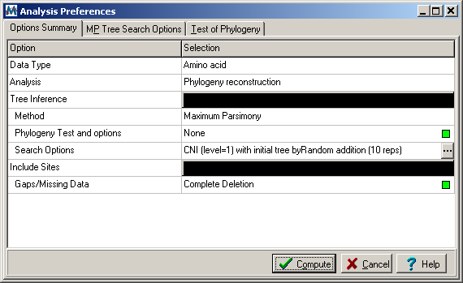
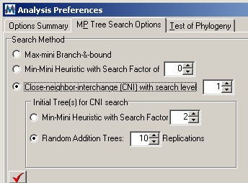
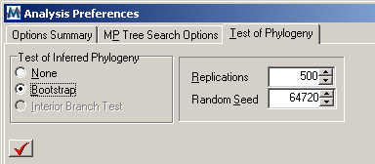
MEGA for maximum parsimony (MP) trees
Options include heuristic approaches,
and bootstrapping

Slide 127
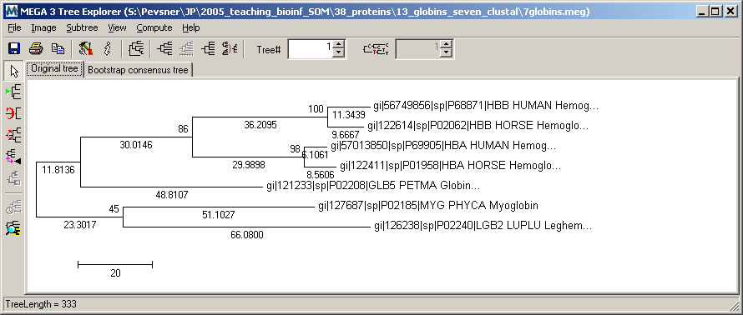
MEGA for maximum parsimony (MP) trees
In maximum parsimony, there may be more than one tree
having the lowest total branch length. You may compute
the consensus best tree.

Slide 128
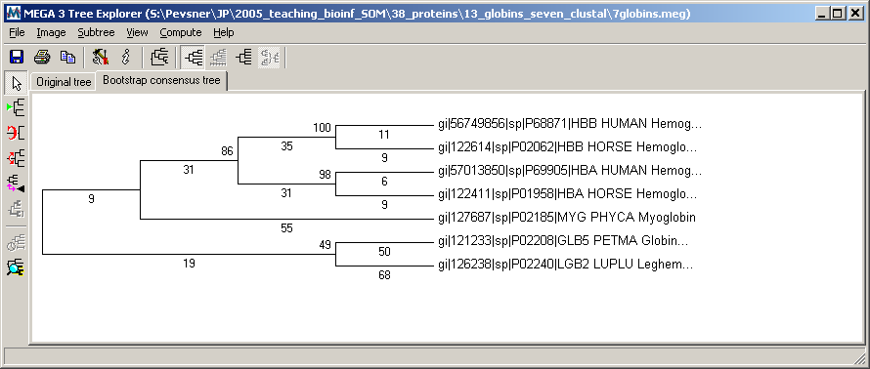
MEGA for maximum parsimony (MP) trees
Bootstrap values show the percent of times each clade
is supported after a large number (n=500) of replicate
samplings of the data.

Slide 129
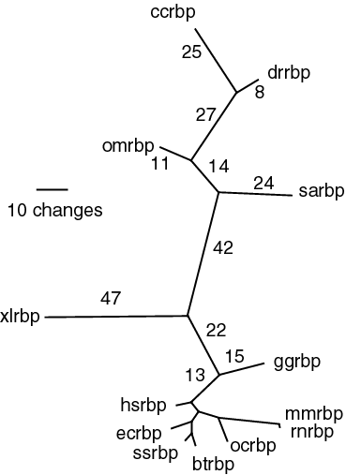
Phylogram
(values are
proportional
to branch
lengths)

Slide 130
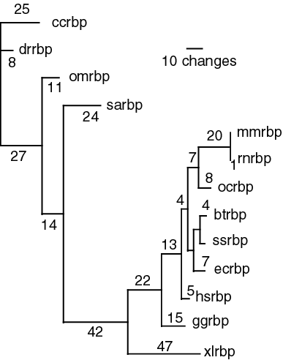
Rectangular
phylogram
(values are
proportional
to branch
lengths)
Fig. 11.22
Page 387

Slide 131
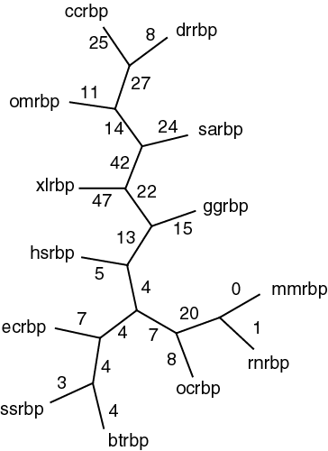
Cladogram
(values are not
proportional
to branch
lengths)
Fig. 11.22
Page 387

Slide 132
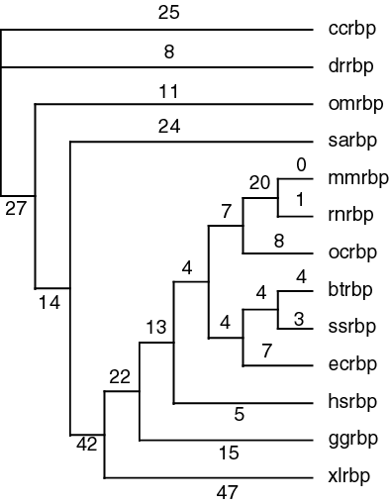
Rectangular
cladogram
(values are not
proportional
to branch
lengths)
These four trees display the same data
in different formats.
Fig. 11.22
Page 387

Slide 133
Stage 4: Tree-building methods
We will discuss four tree-building methods:
[1] distance-based
[2] character-based: maximum parsimony
[3] character- and model-based: maximum likelihood
[4] character- and model-based: Bayesian

Slide 134
Making trees using maximum likelihood
Maximum likelihood is an alternative to maximum
parsimony. It is computationally intensive. A likelihood
is calculated for the probability of each residue in
an alignment, based upon some model of the
substitution process.
What are the tree topology and branch lengths that have the greatest likelihood of producing the observed data set?
ML is implemented in the TREE-PUZZLE program,
as well as PAUP and PHYLIP.
Page 262

Slide 135
Maximum likelihood: Tree-Puzzle
(1) Reconstruct all possible quartets A, B, C, D.
For 12 myoglobins there are 495 possible quartets.
(2) Puzzling step: begin with one quartet tree.
N-4 sequences remain. Add them to the branches systematically, estimating the support for each internal branch. Report a consensus tree.

Slide 136
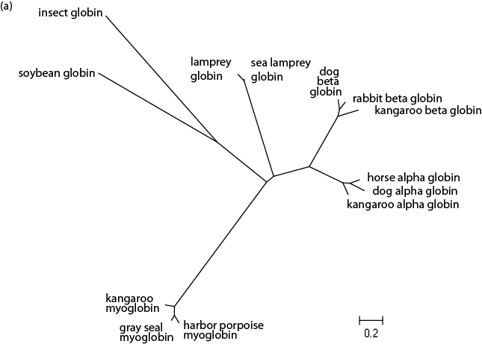
Maximum likelihood tree

Slide 137

Quartet puzzling

Slide 138
Stage 4: Tree-building methods
We will discuss four tree-building methods:
[1] distance-based
[2] character-based: maximum parsimony
[3] character- and model-based: maximum likelihood
[4] character- and model-based: Bayesian

Slide 139
Bayesian inference of phylogeny with MrBayes
Calculate:
Pr [ Tree | Data] =
Pr [ Data | Tree] x Pr [ Tree ]
Pr [ Data ]
Pr [ Tree | Data ] is the posterior probability distribution of trees. Ideally this involves a summation over all possible trees. In practice, Monte Carlo Markov Chains (MCMC) are run to estimate the posterior probability distribution.
Notably, Bayesian approaches require you to specify prior assumptions about the model of evolution.

Slide 140
Five stages of phylogenetic analysis
[1] Selection of sequences for analysis
[2] Multiple sequence alignment
[3] Selection of a substitution model
[4] Tree building
[5] Tree evaluation
Page 266

Slide 141
Stage 5: Evaluating trees
The main criteria by which the accuracy of a
phylogentic tree is assessed are consistency,
efficiency, and robustness. Evaluation of accuracy
can refer to an approach (e.g. UPGMA) or
to a particular tree.
Page 266

Slide 142
Stage 5: Evaluating trees: bootstrapping
Bootstrapping is a commonly used approach to
measuring the robustness of a tree topology.
Given a branching order, how consistently does
an algorithm find that branching order in a
randomly permuted version of the original data set?
Page 266

Slide 143
Stage 5: Evaluating trees: bootstrapping
Bootstrapping is a commonly used approach to
measuring the robustness of a tree topology.
Given a branching order, how consistently does
an algorithm find that branching order in a
randomly permuted version of the original data set?
To bootstrap, make an artificial dataset obtained by
randomly sampling columns from your multiple
sequence alignment. Make the dataset the same size
as the original. Do 100 (to 1,000) bootstrap replicates.
Observe the percent of cases in which the assignment
of clades in the original tree is supported by the
bootstrap replicates. >70% is considered significant.
Page 266

Slide 144


In 61% of the bootstrap
resamplings, ssrbp and btrbp
(pig and cow RBP) formed a
distinct clade. In 39% of the
cases, another protein joined
the clade (e.g. ecrbp), or one
of these two sequences joined
another clade.

