Slide 1
Completed Genomes:
Bacteria and archaea
Wednesday, November 2, 2011
Genomics
260.605.01
Johns Hopkins
J. Pevsner
pevsner@kennedykrieger.org

Slide 2
Copyright notice
Many of the images in this powerpoint presentation
are from Bioinformatics and Functional Genomics
(2nd edition) by J Pevsner. Copyright © 2009 by Wiley-Blackwell.
Please contact me (pevsner@kennedykrieger.org) for permission to use these images and materials.
Visit http://www.bioinfbook.org

Slide 3
Announcements
Friday’s lecture will be by Dr. Egbert Hoiczyk. He will discuss several topics related to bacterial genomes.
Read the following: Goldman BS (2006) Evolution of sensory complexity recorded in a myxobacterial genome. PNAS 103(41):15200-15205.
Next Monday’s lab will include several websites:
►The Comprehensive Microbial Resource e.g. MUMmer)
►NCBI (e.g. COGs and TaxPlot).

Slide 4
Outline of today’s lecture
Introduction to bacteria and archaea
Classification
…based on morphology
…based on genome size
…based on lifestyle
…based on human disease relevance
…based on rRNA or other sequences
Analysis of bacterial genomes
Nucleotide composition
Genes
Lateral gene transfer
Annotation and comparison
Comparison of bacterial and archaeal genomes
COG
TaxPlot
MUMmer

Slide 5
Bacteria and archaea: genome analysis
Bacteria and archaea constitute two of the three main
branches of life.
Bacteria and archaea are single-celled organisms (although some form colonies). They are characterized by a lack of a membrane-bound nucleus, a lack of extensive intracellular organelles, and lack of a cytoskeleton—features that are common to eukaryotes.
The word microbe refers to microorganisms that cause disease. These include both bacteria and archaea and a variety of eukaryotes (e.g. fungi and protozoa) that we will discuss later. The term “prokaryotes” is now considered
Page 598

Slide 6
Bacteria and archaea: major resources
There are several key websites for the study of prokaryotes:
[1] Entrez Genomes at NCBI
Major features include:
►a list of sequenced genomes
►TaxPlot
►COGs
Page 599

Slide 7
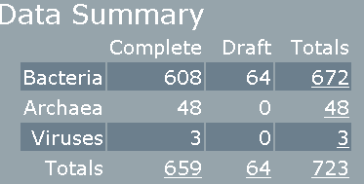
Bacteria and archaea: major resources
There are several key websites for the study of prokaryotes:
[2] The Comprehensive Microbial Resource (CMR) at the J. Craig Venter Institute (JCVI, formerly TIGR). Visit http://cmr.jcvi.org/.
current 11/11
Page 599

Slide 8
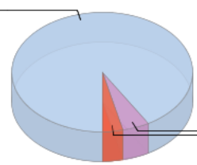
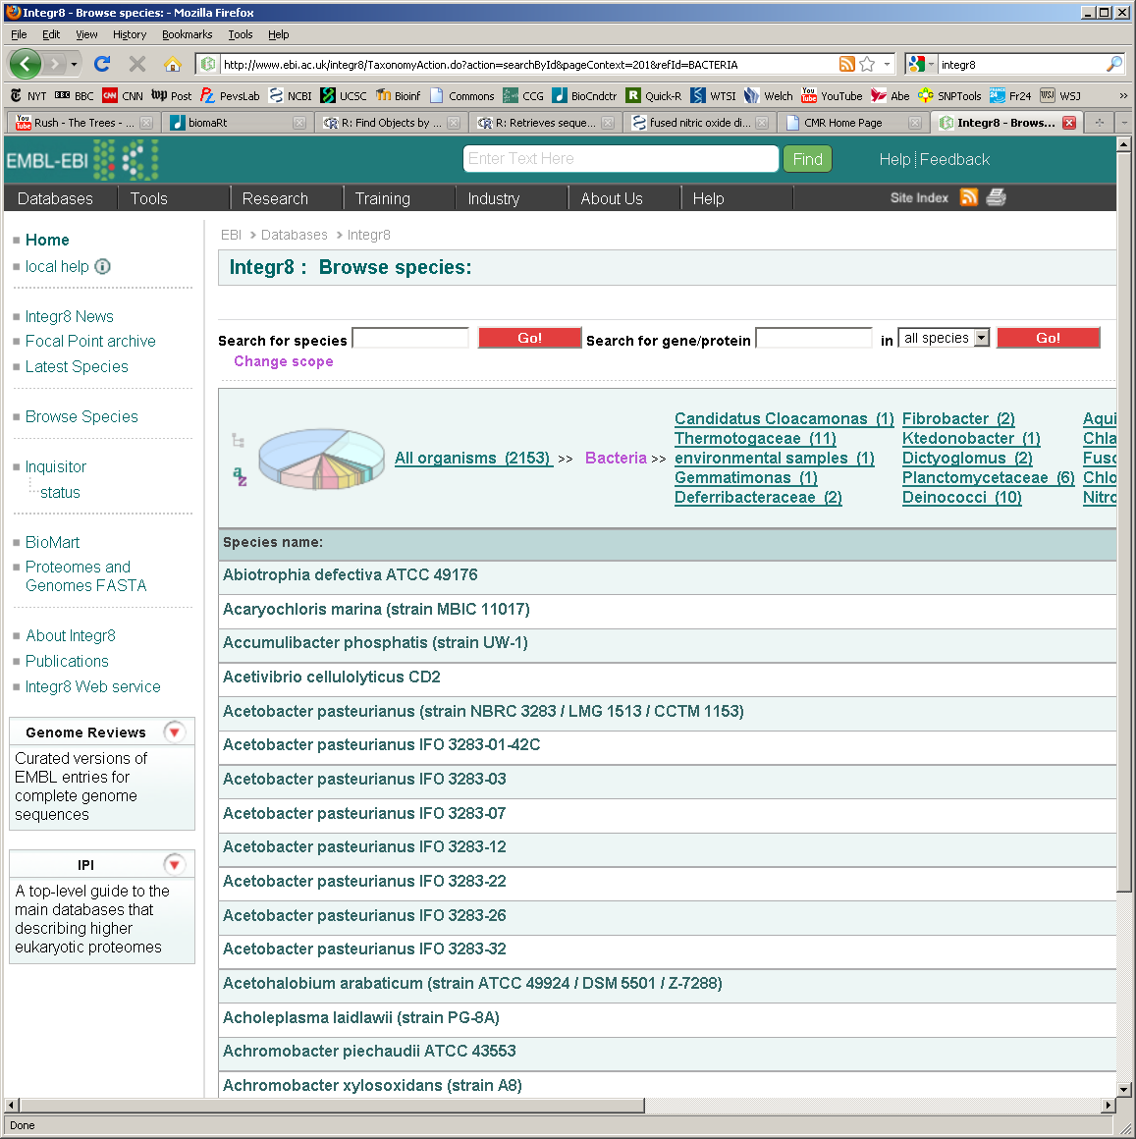
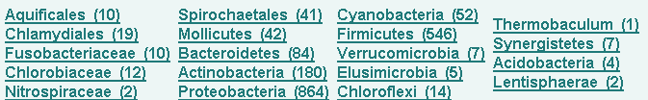
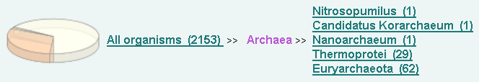
Bacteria and archaea: major resources
[3] Integr8 at the European Bioinformatics Institute (EBI). Visit http://www.ebi.ac.uk/integr8.
bacteria = 2592
eukaryota = 136
archaea = 106
current 11/11

Slide 9
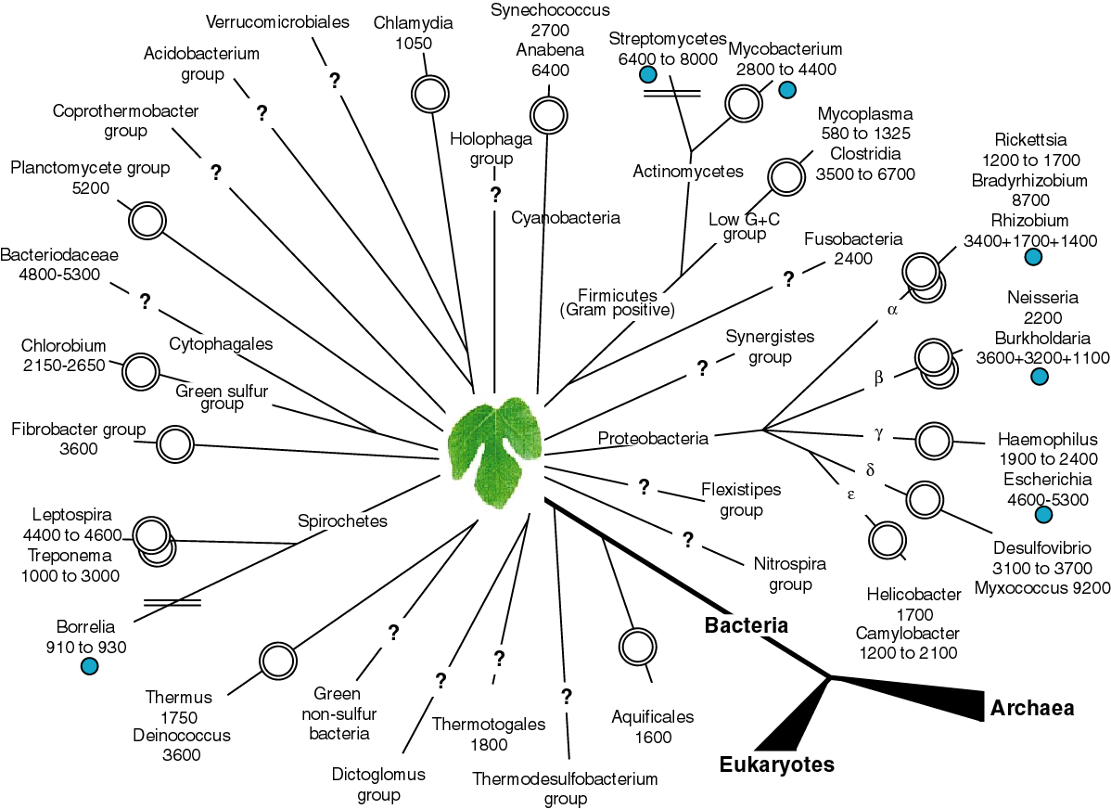
Fig. 15.1
Page 603

Slide 10
Outline of today’s lecture
Introduction to bacteria and archaea
Classification
…based on morphology
…based on genome size
…based on lifestyle
…based on human disease relevance
…based on rRNA or other sequences
Analysis of prokaryotic genomes
Nucleotide composition
Genes
Lateral gene transfer
Annotation and comparison
Comparison of prokaryotic genomes
COG
TaxPlot
MUMmer

Slide 11
Bacteria and archaea: genome analysis
We can classify bacteria based on six criteria:
[1] morphology
[2] genome size
[3] lifestyle
[4] relevance to human disease
[5] molecular phylogeny (rRNA)
[6] molecular phylogeny (other molecules)
Page 599

Slide 12
Bacterial classification: morphology
The gram stain is absorbed by about half of all bacteria.
(It reflects the protein and peptidoglycan composition of the cell wall.) Most bacteria can be classified in the following groups:
Type Examples
Gram-positive cocci † Staphylococcus aureus
Gram-positive rods Bacillus anthracis (anthrax)
Gram-negative cocci Neisseria
Gram-negative rods Escherichia coli, Vibrio cholerae
Other Mycobacterium leprae (leprosy)
Borrelia burgdorferi (Lyme)
Chlamydia trachomatis
Mycoplasma pneumoniae
† having a spherical shape
Page 601

Slide 13
Bacteria, archaea classification: genome size
Bacterial and archaeal genomes vary over a 25-fold range from ~0.5 megabases (Mb) to ~13 Mb.
Bacteria: typically ~0.5 Mb to 13.2 Mb
Smallest: Candidatus Carsonella ruddii PV (0.16 Mb)
Largest: Solibacter usitatus Ellin6076 (10 Mb)
Archaea: ~0.5 Mb to ~6 Mb
Smallest: Nanoarchaeum equitans Kin4-M (0.49 Mb)
Largest: Methanosarcina acetivorans C2A (5.75 Mb)
Updated 10/09
Page 602

Slide 14
Bacteria, archaea classification: genome size
Genome size comparisons:
Size (Mb) Genes
Arch Nanoarchaeum equitans 0.49 582
Bact Mycoplasma genitalium 0.58 506
Virus Mimivirus 1.2 1200
Bact Streptomyces coelicolor 8.7 7800
Bact Myxococcus xanthus 9.14 7388
Euk Schizosaccharomyces pombe 13 4800
Page 602

Slide 15
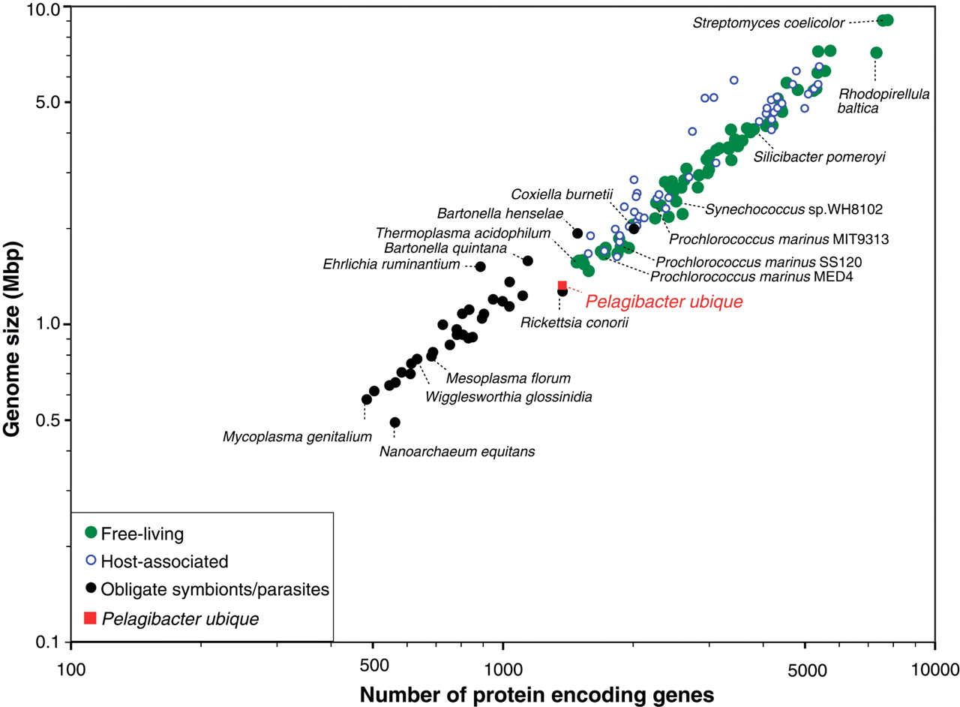
Linear relationship between genome size and number of genes
genome size
Number of predicted protein-encoding genes versus genome size for 244 complete published genomes from bacteria and archaea. P. ubique has the smallest number of genes (1354 open reading frames) for any free-living organism. Giovannoni SJ (2005) Science 309:1242

Slide 16
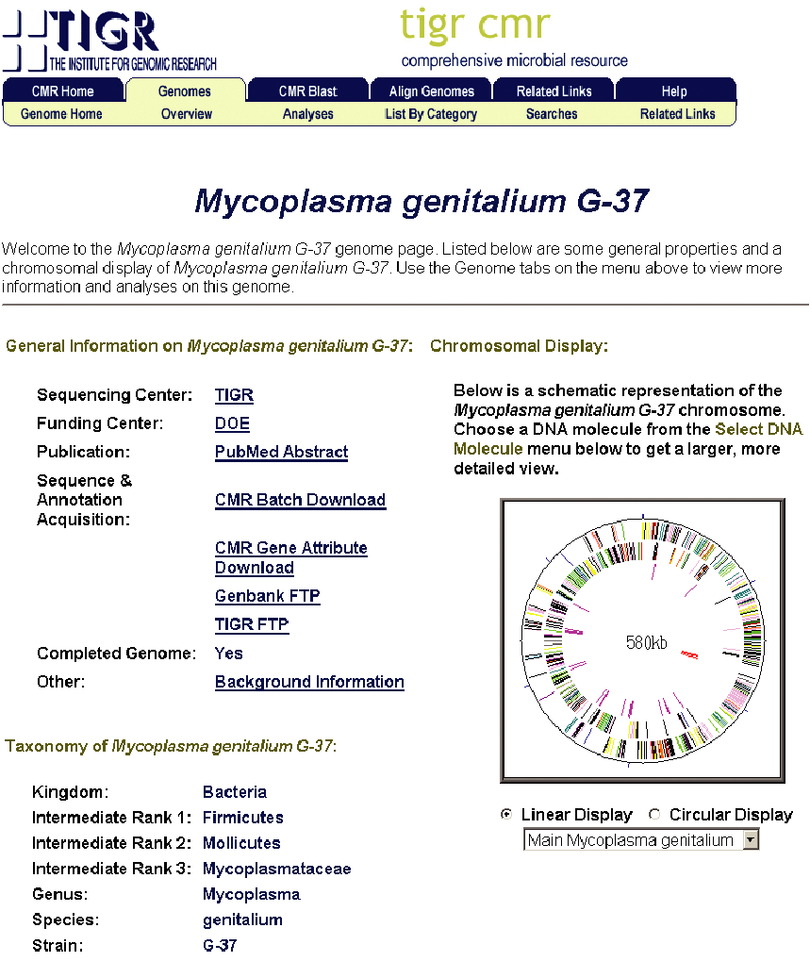
M. genitalium has
one of the smallest
bacterial genome
sizes (578 kb).
View its genome at
www.jcvi.org
Page 604

Slide 17
Prokaryotic classification: lifestyles
We may distinguish six prokaryotic lifestyles:
[1] extracellular (e.g. E. coli)
[2] facultatively intracellular (Mycobacterium tuberculosis)
[3] extremophilic (e.g. M. jannaschi)
[4] epicellular bacteria (e.g. Mycoplasma pneumoniae)
[5] obligate intracellular and symbiotic (B. aphidicola)
[6] obligate intracellular and parasitic (Rickettsia)
*
*
These tend to have an extreme reduction in genome size
Page 607

Slide 18
Prokaryotic classification: disease relevance
Vaccine-preventable bacterial diseases
Anthrax Bacillus anthracis
Diarrheal disease (cholera) Vibrio cholerae
Diphtheria Cornyebacterium diphtheriae
Lyme disease Borrelia burgdorferi
Meningitis Haemophilus influenzae type B Streptococcus pneumoniae Neisseria meningitidis
Pertussis Bordetella pertussis
Tetanus Clostridium tetani
Tuberculosis Mycobacterium tuberculosis
Typhoid Salmonella typhi
Page 611

Slide 19
Prokaryotic classification: rRNA phylogeny
16S ribosomal RNA (rRNA) based trees by Woese and colleagues showed distinct superkingdoms of bacteria and archaea.
The following figure (adapted from Casjens, 1998) summarizes bacterial chromosome size and geometry.
23 major named bacterial phyla are shown. Geometry (circular or linear chromosomes) and genome sizes (in kb) are indicated. Branch lengths are not proportional to evolutionary distance.
Note that four phyla have been sampled most extensively: Proteobacteria, Firmicutes, Actinobacteria, and Bacteroidetes. These account for >90% of known bacteria.
Page 611

Slide 20
Fig. 15.1
Page 603

Slide 21
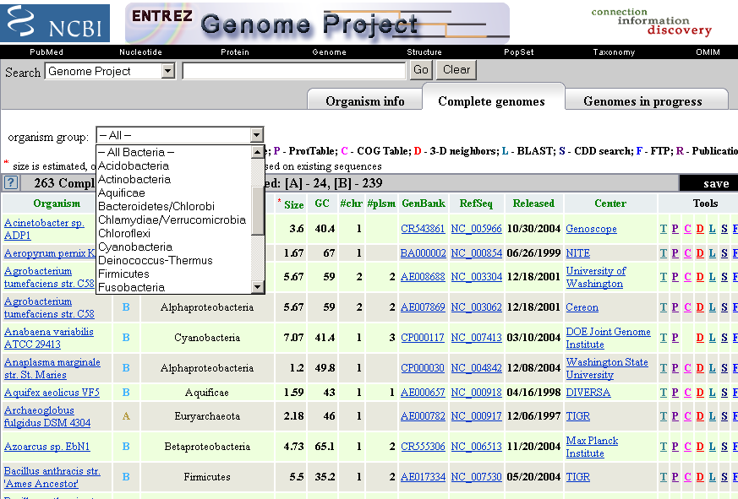
Visit NCBI → All databases → Genome Projects → for data on prokaryotic genome projects

Slide 22
Classification: archaea
Amongst the archaea, the three major divisions are
[1] euryarchaeota (e.g. Methanococcus jannaschii, sequenced in 1996 and renamed Methanocaldococcus jannaschii)
[2] crenarchaeota (e.g. Aeropyrum pernix, a strictly aerobic hyperthermophilic archaeon that is highly motile, lives in volcanic hydrothermal areas, and thrives at 90-95°C).
[3] nanoarchaeota (i.e. Nanoarchaeum equitans) represents a new phylum with one very small symbiont. Genome size: 490,885 base pairs.
Page 612

Slide 23
Outline of today’s lecture
Introduction to bacteria and archaea
Classification
…based on morphology
…based on genome size
…based on lifestyle
…based on human disease relevance
…based on rRNA or other sequences
Analysis of bacterial genomes
Nucleotide composition
Genes
Lateral gene transfer
Annotation and comparison
Comparison of bacterial and archaeal genomes
COG
TaxPlot
MUMmer

Slide 24
We begin our discussion of the composition of prokaryotic
genomes with a sample paper describing a genome.
Heidelberg JF et al. DNA sequence of both chromosomes of the cholera pathogen Vibrio cholerae. Nature 406, 477- 483 (2000)
Cholera is an acute diarrheal disease endemic in India, parts of Africa and Southeast Asia. It is caused by V. cholerae, and in some cases leads to rapid death. The following slide shows the Nature article’s abstract.

Slide 25
Here we determine the complete genomic sequence of the gram negative, gamma-Proteobacterium Vibrio cholerae El Tor N16961 to be 4,033,460 base pairs (bp). The genome consists of two circular chromosomes of 2,961,146 bp and 1,072,314 bp that together encode 3,885 open reading frames. The vast majority of recognizable genes for essential cell functions (such as DNA replication, transcription, translation and cell-wall biosynthesis) and pathogenicity (for example, toxins, surface antigens and adhesins) are located on the large chromosome. In contrast, the small chromosome contains a larger fraction (59%) of hypothetical genes compared with the large chromosome (42%), and also contains many more genes that appear to have origins other than the gamma-Proteobacteria. The small chromosome also carries a gene capture system (the integron island) and host 'addiction' genes that are typically found on plasmids; thus, the small chromosome may have originally been a megaplasmid that was captured by an ancestral Vibrio species. The V. cholerae genomic sequence provides a starting point for understanding how a free-living, environmental organism emerged to become a significant human bacterial pathogen.

Slide 26
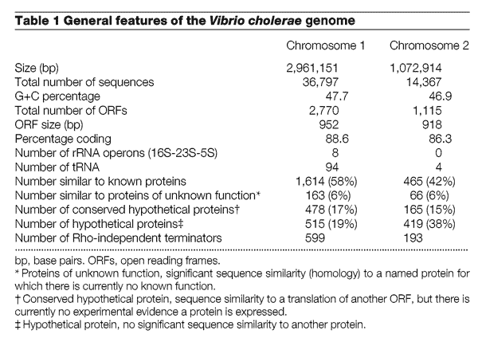

Slide 27
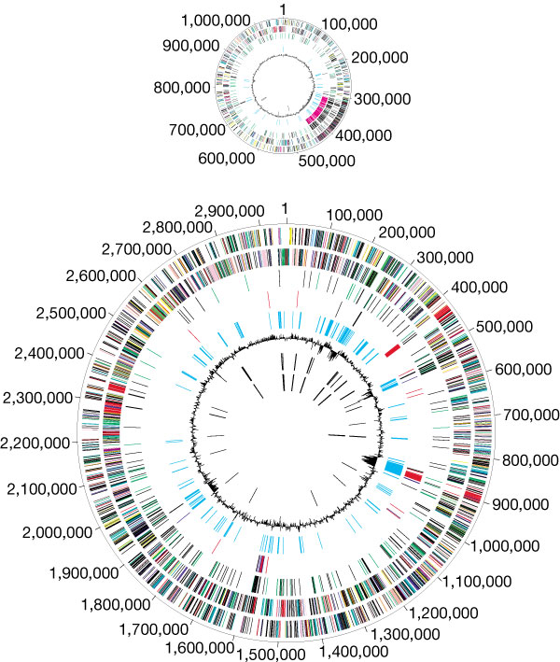
Eight circles
protein-coding, + strand
protein-coding, - strand
recently duplicated genes
transposon, phage-related
trinucleotide composition
% GC in relation to mean
tRNA
rRNA

Slide 28
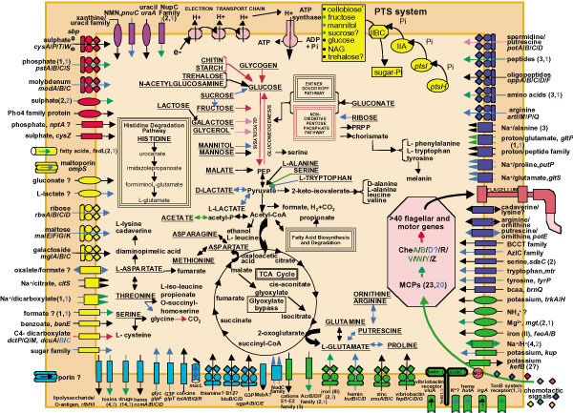
Metabolism and transport in V. cholerae.

Slide 29
Outline of today’s lecture
Introduction to bacteria and archaea
Classification
…based on morphology
…based on genome size
…based on lifestyle
…based on human disease relevance
…based on rRNA or other sequences
Analysis of bacterial genomes
Nucleotide composition
Genes
Lateral gene transfer
Annotation and comparison
Comparison of bacterial and archaeal genomes
COG
TaxPlot
MUMmer

Slide 30
How to retrieve the E. coli K12 genome from NCBI
NCBI → taxonomy browser → E. coli → Genome sequences → select Escherichia coli str. K-12 substr. MG1655 chromosome, complete genome; follow link to: NC_000913. In the table from Entrez Genome, follow the link to «GenBank FTP». Right-click to download the fna format. There is also a report (.rpt) file:
Accession: U00096.2
GI: 48994873
DNA length = 4639675
Taxname: Escherichia coli str. K-12 substr. MG1655
Taxid: 511145
Genetic Code: 11
Publications: 16397293; 9278503;
Protein count: 4146
CDS count: 4320
Pseudo CDS count: 174
RNA count: 176
Gene count: 4496
Pseudo gene count: 179

Slide 31
Bacteria and archaea: nucleotide composition
The guanine plus cytosine (GC) content in bacteria ranges from ~20% to 75% (in archaea from ~28% to 66%). GC content often correlates with bacterial phylum (see tree).
We will see in a later lecture that eukaryotic genomes have GC contents that often have a restricted range from ~35-50% (about 40%-45% in vertebrates).
Page 615

Slide 32
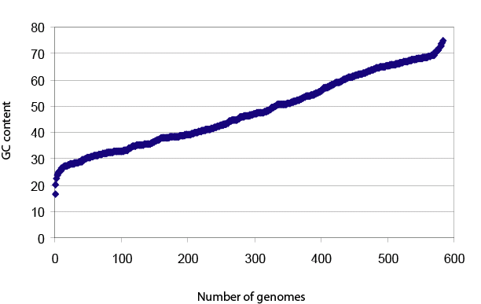
GC content for 584 sequenced prokaryotic genomes
Fig. 15.6
Page 616
Updated 12/07

Slide 33
GC content for 584 sequenced prokaryotic genomes
What is the consequence of extreme GC content on protein composition?
Fig. 15.6
Page 616
Updated 12/07

Slide 34
67-74% GC
~25-31%
~40%
~50%
40-60% GC
~23-35%
~30-33%
Fig. 15.1
Page 603

Slide 35
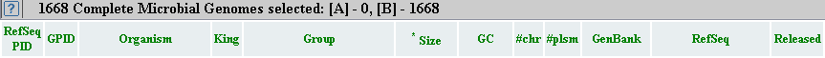
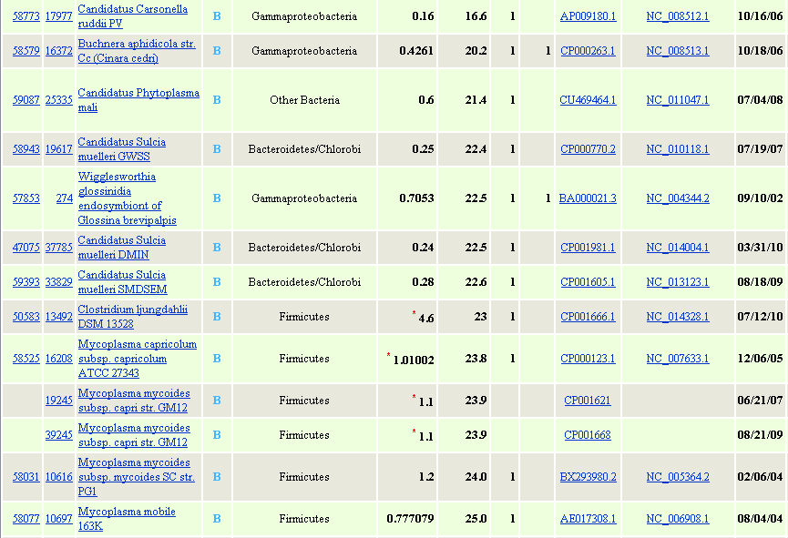
Bacteria with low GC content (16% to 25%; NCBI, 11/11)

Slide 36
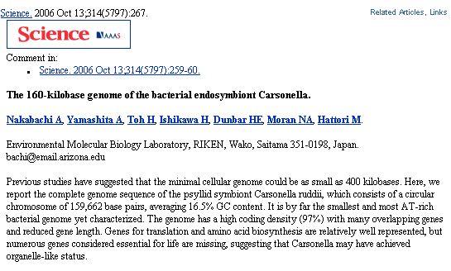
C. carsonella: low GC content (16%) and smallest genome
C. carsonella “may have achieved organelle-like status”

Slide 37
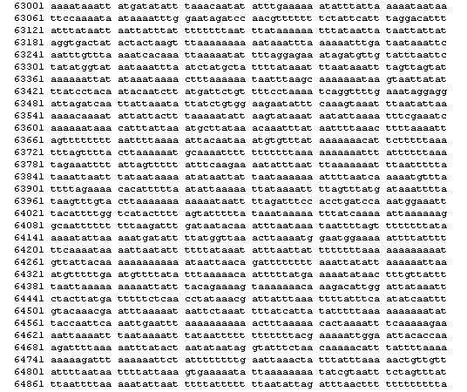
Example of a C. carsonella contig (note AT richness)
Candidatus Carsonella ruddii PV
159,662 nt
NC_008512

Slide 38
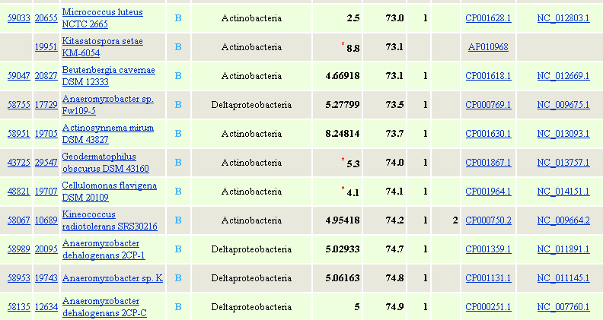
Bacteria with high GC content (NCBI November 2011)

Slide 39
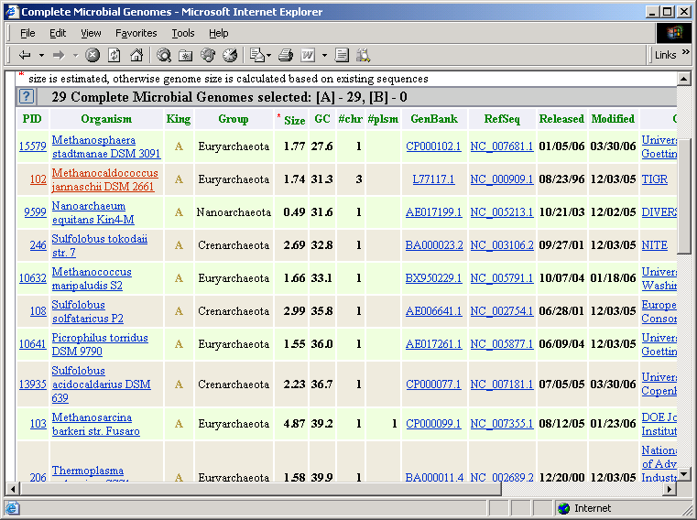
Archaea with low GC content (NCBI 11/06)

Slide 40
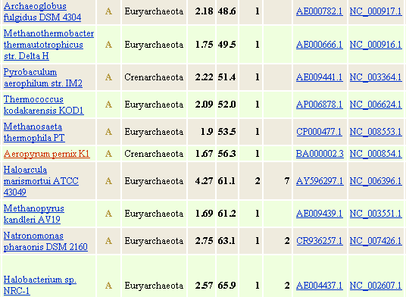
Archaea with high GC content (NCBI 11/06)

Slide 41
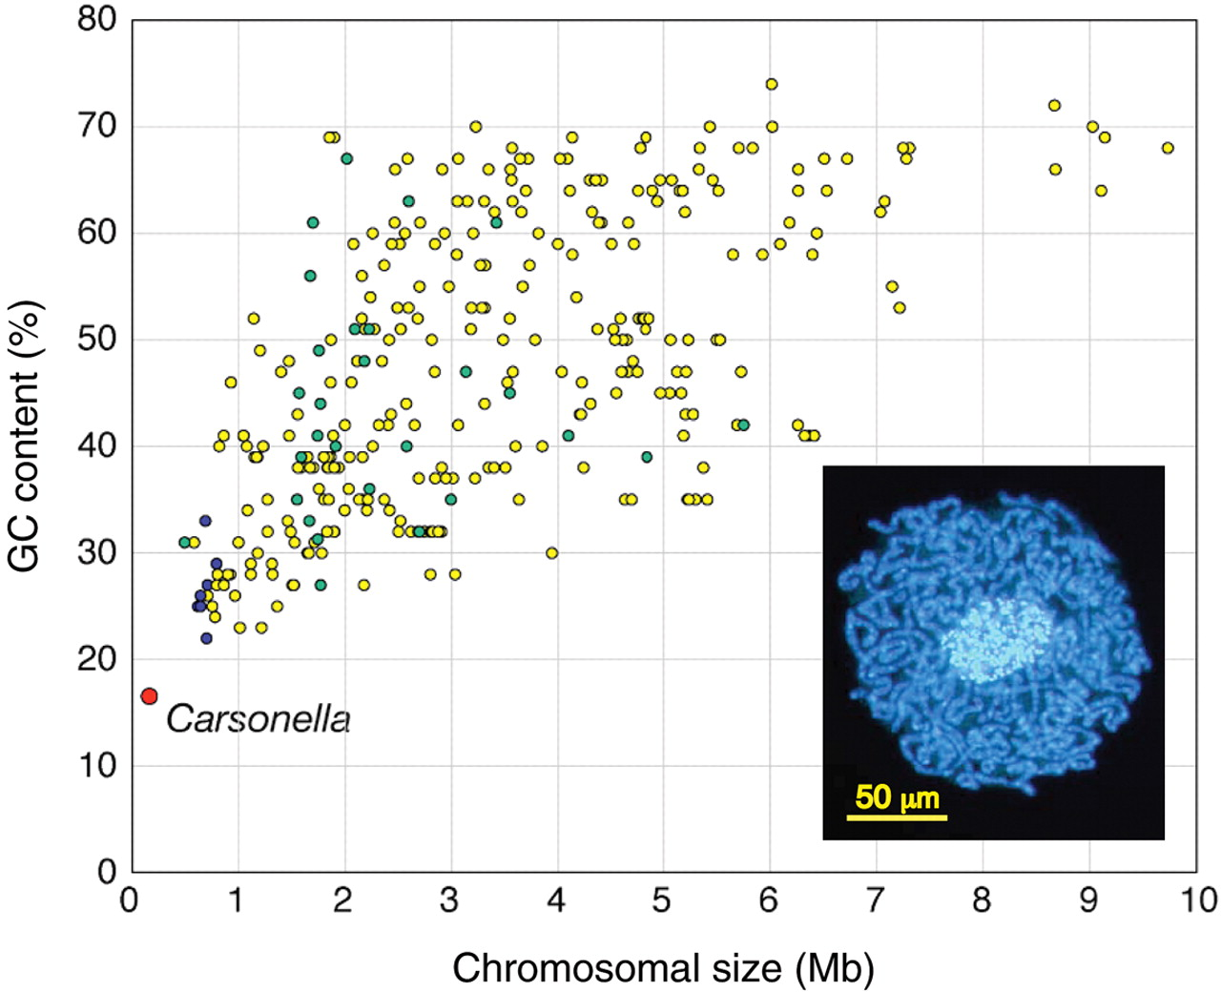
Correlation between genome size and GC content
(182 ORFs, most devoted to translation
and amino acid metabolism. 97.3% gene-coding density)
Relationship between genome sizes and GC content of 358 complete genomes from Bacteria and Archaea: red indicates Carsonella; blue represents endosymbionts Buchnera, Blochmannia, Wigglesworthia, and Baumannia; yellow, other Bacteria; and green, Archaea. Nakabachi A (2006) Science 314:267.

Slide 42
Bacteria and archaea: nucleotide composition
Variation in GC content in bacteria could reflect an adaptation to environmental conditions. GC-rich codons (encoding ala, arg) are more stable in hot environments; AT-rich codons (encoding ser, lys) are thermally unstable. TT dimers are sensitive to radiation, so soil- and air-exposed prokaryotes may have a higher GC content.
GC content could also be determined by biases in the mutation patterns.
(Page 616)

Slide 43
Bacteria and archaea: finding genes
Genome annotation involves the identification of features such as protein-coding genes, noncoding genes, or regulatory elements.
For the annotation of genes, four main features of genomic DNA are useful. In particular, genes must be distinguished from randomly occurring open reading frames.
[1] Open reading frame length. An ORF begins with a start codon (ATG or sometimes GTG or TTG in bacteria) and ends with a stop codon (TAA, TAG, TGA)
[2] Consensus for ribosome binding (Shine-Dalgarno)
[3] Pattern of codon usage
[4] Homology of putative gene to other genes
Page 617

Slide 44
Glimmer for bacterial gene finding
Glimmer (Gene Locator and Interpolated Markov Modeler) uses interpolated Markov models (IMMs) to identify coding regions and distinguish them from noncoding DNA.
The Glimmer home page is:
http://cbcb.umd.edu/software/glimmer/
Glimmer involves two steps:
[1] Training the algorithm for a particular organism. This involves first identifying all ORFs, and sometimes also involves blast searching them against other organisms
[2] Running the trained algorithm against the genome sequence.
Page 618

Slide 45
Glimmer for prokaryotic gene finding
Glimmer sequentially scans nucleotide sequences for particular kmers (e.g. the 5mer ATGGC) and estimates the probability of that pattern occurring in a real gene. The statistical model of a gene is then used to analyze the complete set of unknown genomic DNA. The ORFs that are analyzed by Glimmer must exceed some minimum length (e.g. 99 base pairs).
Glimmer uses a hidden Markov model (HMM) approach. HMMs are statistical models of the patterns of nucleotides comprising a gene. The HMM includes observed states (e.g. nucleotide sequence including a start or stop codon) and hidden states (genes in DNA).
Page 618

Slide 46
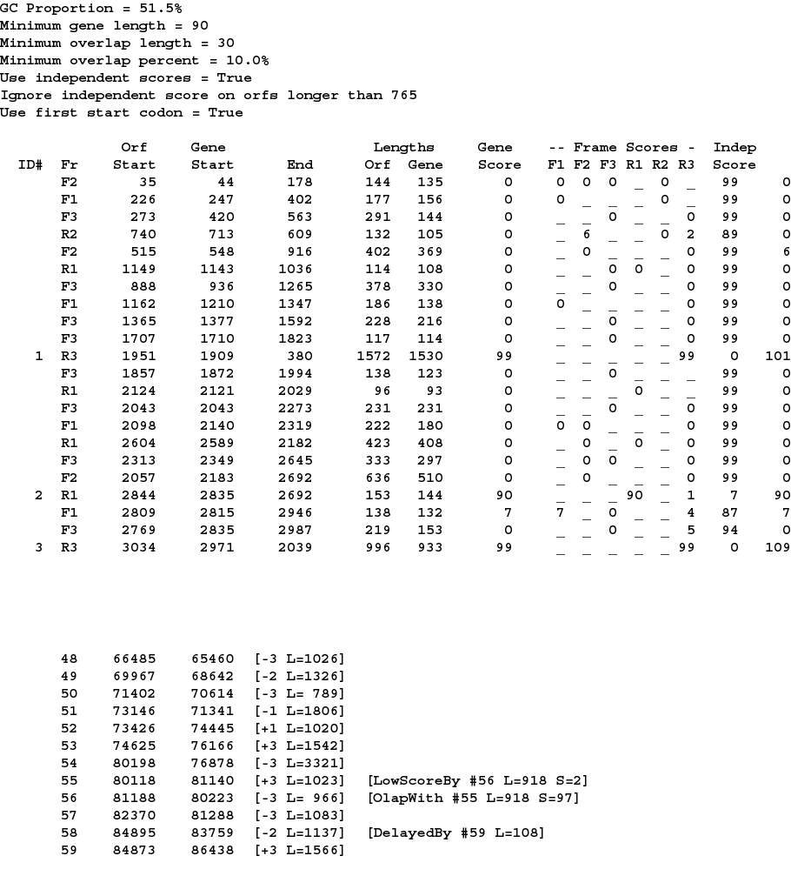
GLIMMER for gene-finding in prokaryotes (76,000 nucleotides of E. coli genomic DNA)
frame
gene score
frame scores
list of
identified genes
Fig. 15.8
Page 619

Slide 47
Bacteria and archaea: lateral gene transfer
Lateral gene transfer (LGT), also called horizontal gene transfer (HGT), is a phenomenon in which a genome acquires a gene from another organism directly, but not by descent. The gene transfer is unidirectional (rather than involving a reciprocal exchange of DNA).
Page 620

Slide 48
Lateral gene transfer: significance
LGT may represent a major, “alternative” form of non-vertical evolution. It is a process that offers organisms the capacity to adopt novel functions. LGT is significant as a possible source of error in phylogenetic analyses.
LGT may be incorrectly ascribed when other mechanisms operate such as selection, variable evolutionary rates, and biased sampling (see JA Eisen [2000] Curr. Op. Genet. Devel. 10:606).
Page 620

Slide 49
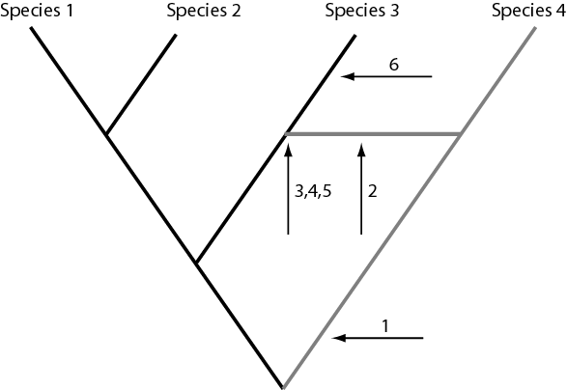
Lateral gene transfer occurs in stages
[1] Four species evolved from a common ancestor.
[2] A gene transfers from species 4 to 3.
The gene is:
[3] fixed in some individual genomes,
[4] maintained under strong selection, and
[5] spread through the population.
[6] The laterally transferred gene continues to evolve.
Fig. 15.9
Page 621

Slide 50
Lateral gene transfer: examples
There are many examples of LGT, both in many bacterial genomes, and between distantly related organisms.
►It has occurred in the parasitic amoeba Entamoeba histolytica. It may have received metabolic genes from bacterial co-habitants in the human gastrointestinal tract. (See Loftus B et al. (2005) Nature Feb. 24)
►Proteorhodopsin has been transferred between marine planktonic bacteria and archaea. In an upper water column of the ocean, archaea of the order Thermoplasmatales have proteorhodopsins that otherwise have been thought to be present in proteobacteria or other bacteria (Frigaard N-U et al. (2006) Nature 439:847).
Page 622

Slide 51
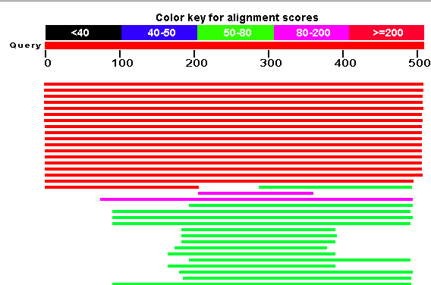
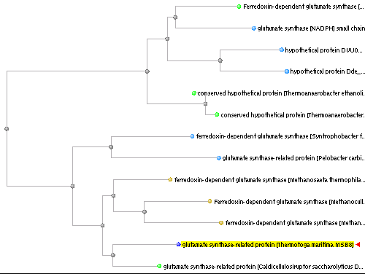
Blastp using Thermotoga maritima gltB (a bacterial protein; NP_228864) as a query

Slide 52
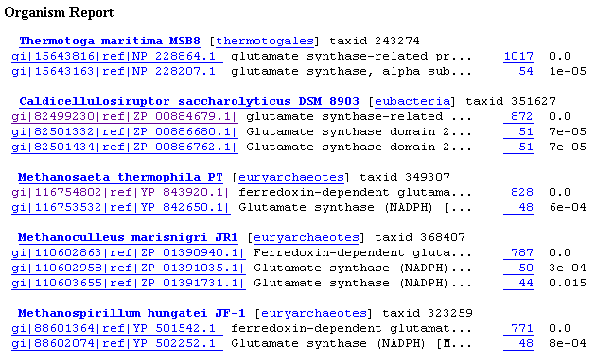
Blastp using Thermotoga maritima gltB (NP_228864) as a query: after two bacterial matches, the next best matches are to euryarchaeotes (i.e. archaea)
Significance: this bacterium may have acquired gltB from archaea by lateral gene transfer

Slide 53
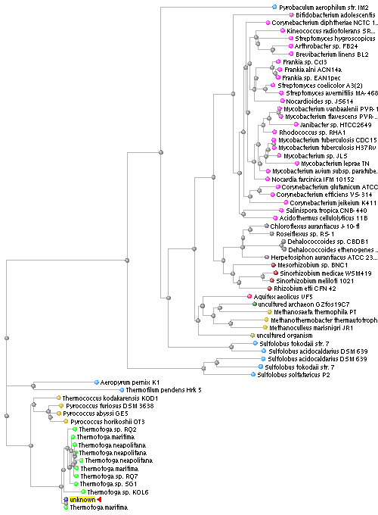
Blastp using Thermotoga maritima myo-inositol-1-phosphate synthase-related protein (bacterial; NP_229219) as a query

Slide 54
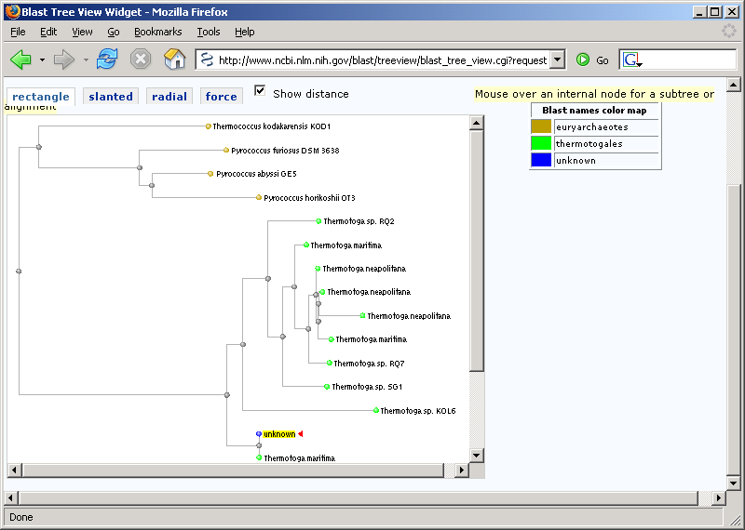
Blastp using Thermotoga maritima myo-inositol-1-phosphate synthase-related protein (NP_229219) as a query…
…shows close matches to archaea

Slide 55
Clusters of Orthologous Groups (COGs)
The COG project defines groups of orthologous genes in various prokaryotic (COGs) and eukaryotic (KOGs) species. The COG database provides a functional and phylogenetic classification of protein groups based on “best-hit” blast results.
Page 622

Slide 56
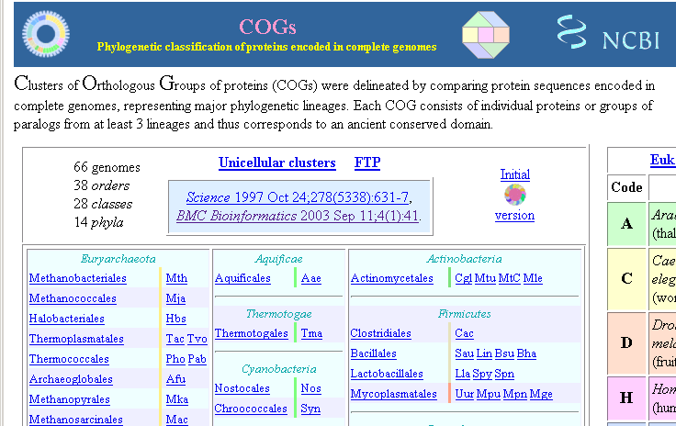
Page 623

Slide 57
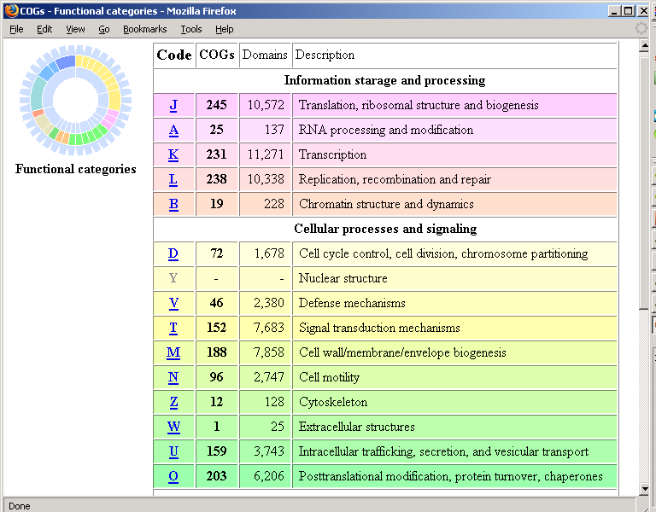
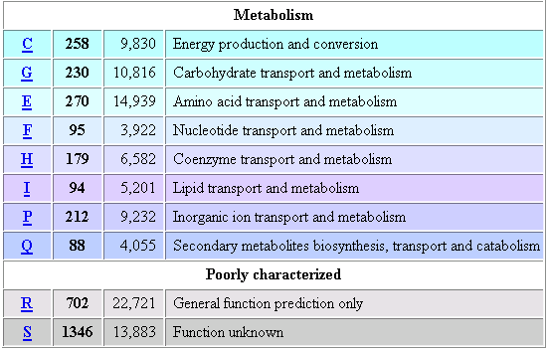
As an example click on code J…

Slide 58
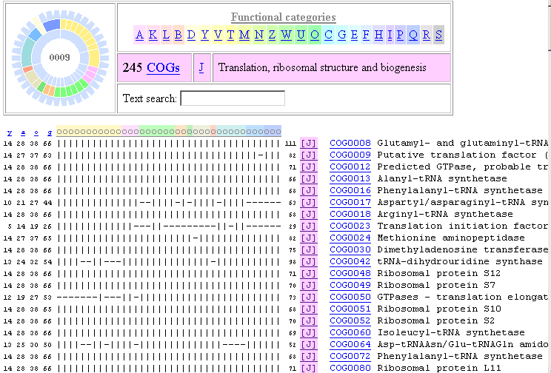
For functional category J there are 245 COGs; some highly conserved (present in all prokaryotic species indicated…)
Page 624

Slide 59
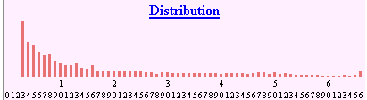
Distribution of COGs across genomes
Some COGs are not phylogenetically distributed
Some COGs are present in all prokaryotic genomes sampled
Page 624

Slide 60
Outline of today’s lecture
Introduction to bacteria and archaea
Classification
…based on morphology
…based on genome size
…based on lifestyle
…based on human disease relevance
…based on rRNA or other sequences
Analysis of bacterial genomes
Nucleotide composition
Genes
Lateral gene transfer
Annotation and comparison
Comparison of bacterial and archaeal genomes
COG
TaxPlot
MUMmer

Slide 61
How can whole genomes be compared?
-- molecular phylogeny
-- You can BLAST (or PSI-BLAST) all the DNA and/or
protein in one genome against another
-- TaxPlot and COG for bacterial (and for
eukaryotic) genomes
-- PipMaker, MUMmer and other programs align large
stretches of genomic DNA from multiple species
Page 625

Slide 62
TaxPlot at NCBI
To use TaxPlot, select a query genome then select two more genomes for comparison. The tool plots blastp scores from the predicted proteins encoded by each genome. The shape of the output plot may reveal differences between two comparison genomes of interest. For example, one can explore which proteins differ in a pathogenic versus a benign strain of E. coli.
Page 626

Slide 63
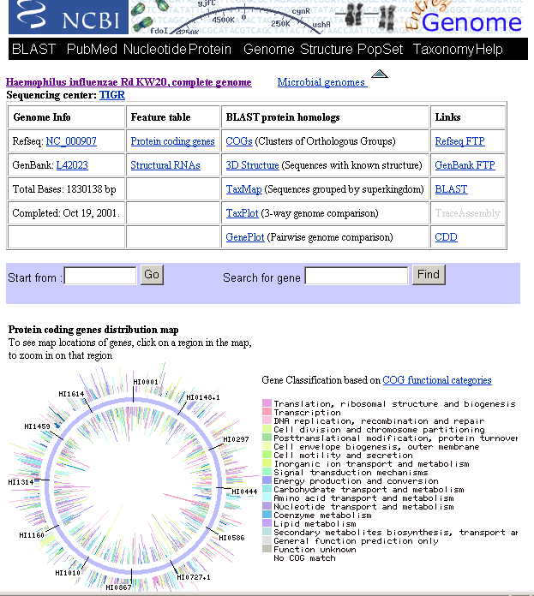
Page 626

Slide 64
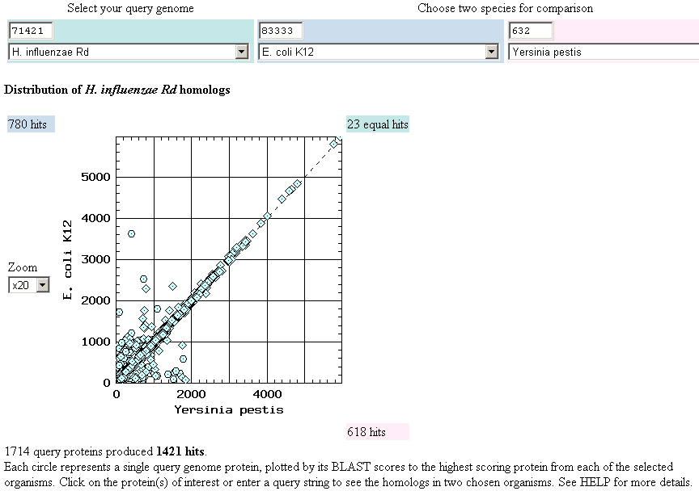
TaxPlot shows which proteins from two comparison species are most closely related to a third, reference species.
The outliers can be functionally important!
Fig. 15.14
Page 627

Slide 65
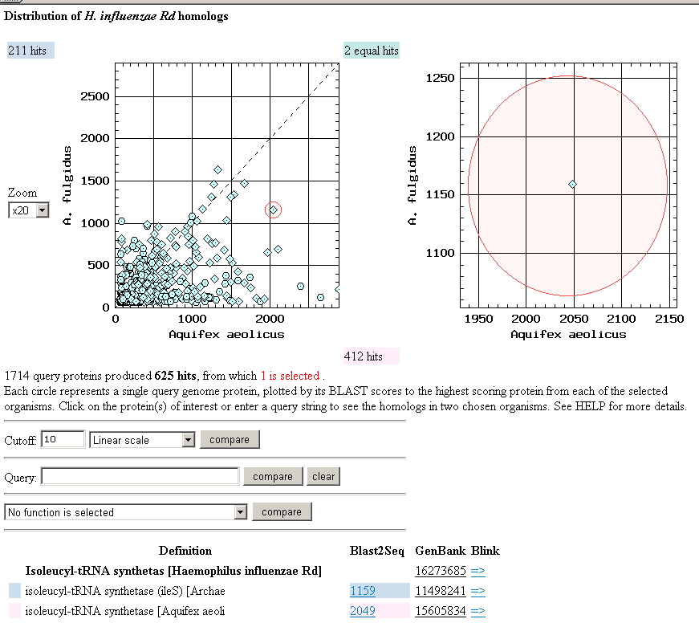
TaxPlot outliers are clickable; you can link to pairwise alignments
Fig. 15.14
Page 627

Slide 66
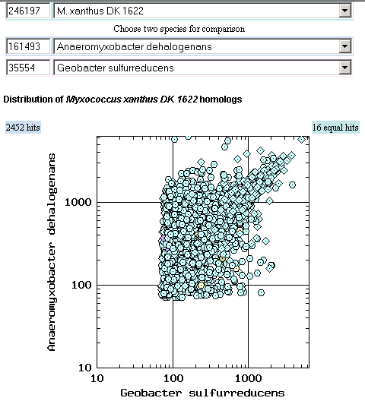
TaxPlot options include log-log scale

Slide 67
Aligning genomes: MUMmer
MUMmer is a tool for DNA alignments of complete genomes (or of chromosomes). The algorithm uses a suffix tree approach to identify all exact matches of nucleotide subsequences that are at least some minimum length (e.g. 20 or 150 base pairs). In this way maximal unique matching subsequences (MUMs) are identified.
Page 628

Slide 68
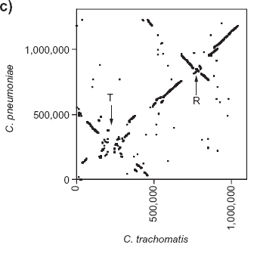
MUMmer pairwise genome alignment: visualizing shared regions, inversions, translocations
Eisen JA et al. (2000) Genome Biology 1(6)

Slide 69
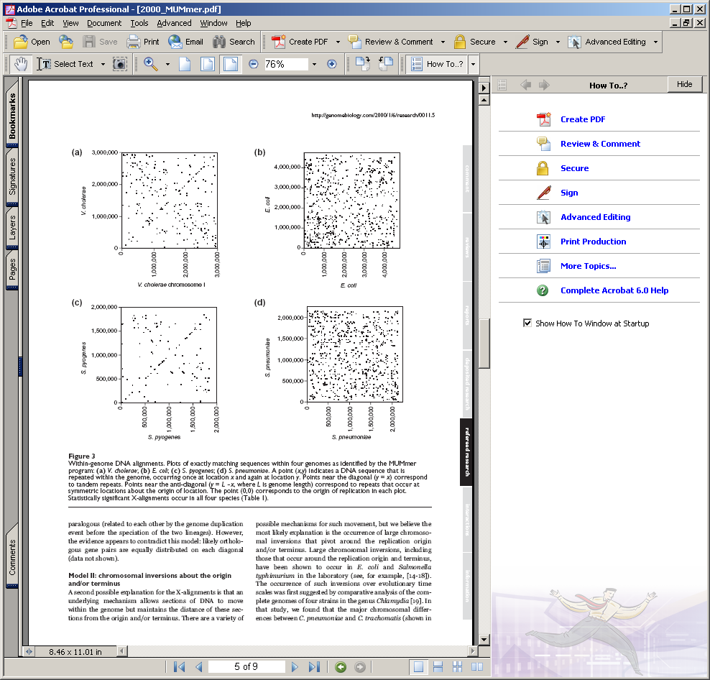
MUMmer pairwise genome alignment: comparisons within V. cholerae
Eisen JA et al. (2000) Genome Biology 1(6)

Slide 70
Eisen JA et al. (2000) Genome Biology 1(6)
MUMmer within-genome alignment (S. pyogenes)

Slide 71
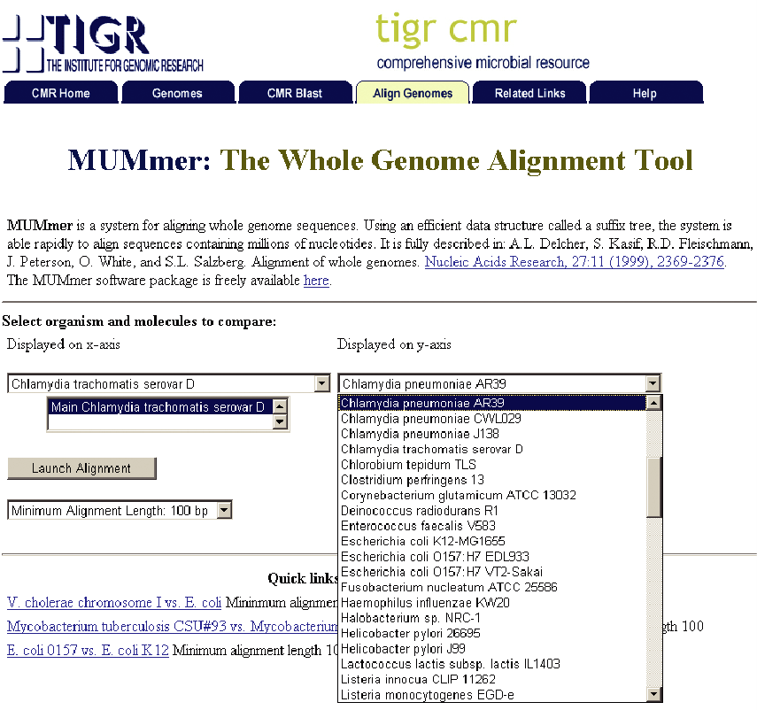

Slide 72
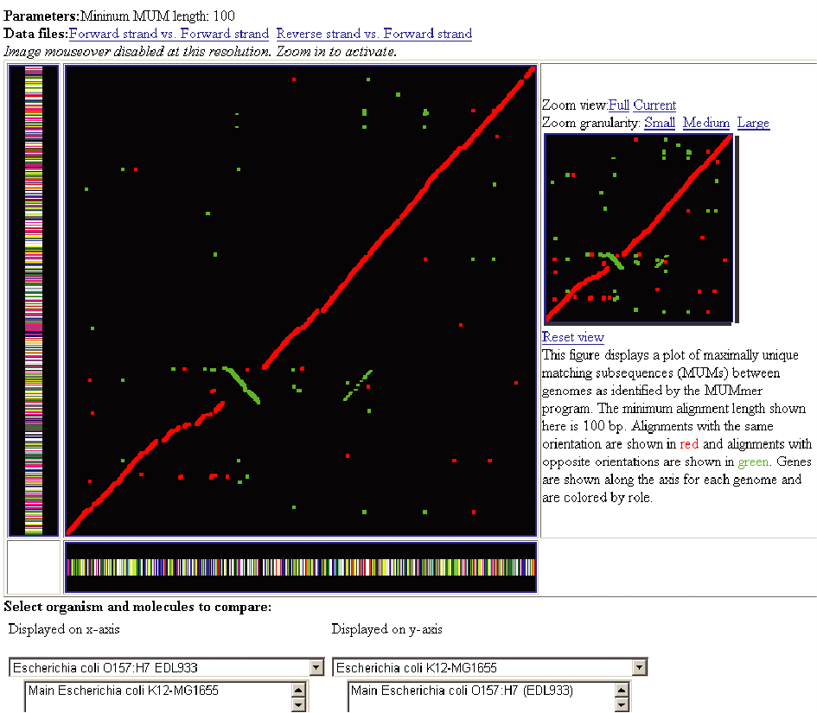
Fig. 15.15
Page 629

Slide 73
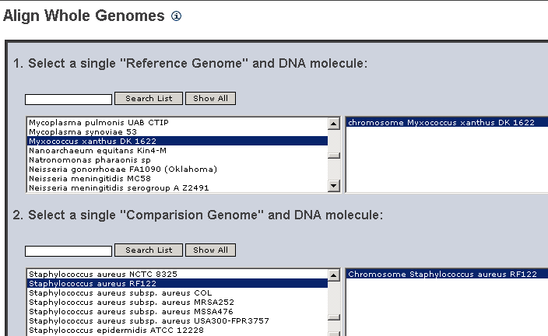
Compare Mycobacterium tuberculosis and M. leprae

Slide 74
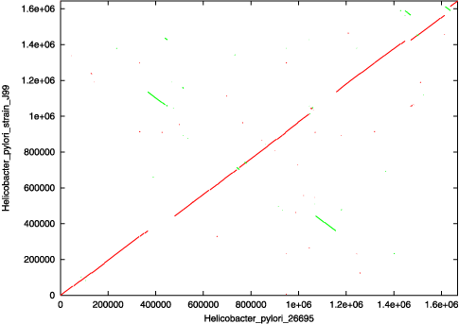
For a dot plot, the reference sequence is laid across the x-axis, while the query sequence is on the y-axis. Wherever the two sequences agree, a colored line or dot is plotted. The forward matches are displayed in red, while the reverse matches are displayed in green. If the two sequences were perfectly identical, a single red line would go from the bottom left to the top right. However, two sequences rarely exhibit this behavior, and in the plot below, multiple gaps and inversions can be identified between these two strains of Helicobacter pylori.
http://mummer.sourceforge.net/manual/

Slide 75
Aligning genomes: MUMmer
Running MUMmer there are three options:
MUMmer
NUCmer
PROmer

Slide 76
NUCmer (NUCleotide MUMmer) is the most user-friendly alignment script for standard DNA sequence alignment. It is a robust pipeline that allows for multiple reference and multiple query sequences to be aligned in a many vs. many fashion. For instance, a very common use for nucmer is to determine the position and orientation of a set of sequence contigs in relation to a finished sequence, however it can be just as effective in comparing two finished sequences to one another. Like all of the other alignment scripts, it is a three step process - maximal exact matching, match clustering, and alignment extension. It begins by using mummer to find all of the maximal unique matches of a given length between the two input sequences. Following the matching phase, individual matches are clustered into closely grouped sets with mgaps. Finally, the non-exact sequence between matches is aligned via a modified Smith-Waterman algorithm, and the clusters themselves are extended outwards in order to increase the overall coverage of the alignments. nucmer uses the mgaps clustering routine which allows for rearrangements, duplications and inversions; as a consequence, nucmer is best suited for large-scale global alignments, as is shown in the following plot.
http://mummer.sourceforge.net/manual/

Slide 77
Helicobacter pylori J99
Helicobacter pylori 26695
http://mummer.sourceforge.net/manual/

Slide 78
Aligning genomes: PROmer
PROmer (PROtein MUMmer) is a close relative to the NUCmer script. It follows the exact same steps as NUCmer and even uses most of the same programs in its pipeline, with one exception - all matching and alignment routines are performed on the six frame amino acid translation of the DNA input sequence. This provides promer with a much higher sensitivity than nucmer because protein sequences tends to diverge much slower than their underlying DNA sequence. Therefore, on the same input sequences, promer may find many conserved regions that nucmer will not, simply because the DNA sequence is not as highly conserved as the amino acid translation.
http://mummer.sourceforge.net/manual/

Slide 79
All of this is performed behind the scenes, as the input is still the raw DNA sequence and output coordinates are still reported in reference to the DNA, so the two programs (nucmer and promer) exhibit little difference in their interfaces and usability. Because of its greatly increased sensitivity, it is usually best to use promer on those sequences that cannot be adequately compared by nucmer, because if run on very similar sequences the promer output can be quite voluminous. This is because promer makes no effort to distinguish between proteins and junk amino acid translations, therefore a single highly conserved gene may have up to six alignments in promer output, one for each of the six amino acid reading frames, when only the correct reading frame would be sufficient. This makes promer ideally suited for highly divergent sequences that show little DNA sequence conservation, as is shown in the following two plots.
http://mummer.sourceforge.net/manual/

Slide 80
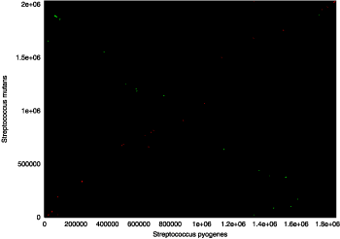
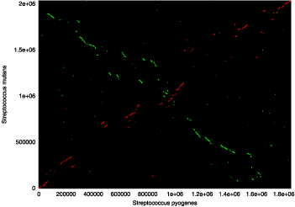
These dot plots represent two comparisons of Streptococcus pyogenes (x-axis) and Streptococcus mutans (y-axis), with forward matches colored red and reverse matches colored green. The graph generated with nucmer output is on the left, while the graph generated with promer output is on the right (both run with default parameters). It is clearly visible that promer has aligned the two genomes with a much greater sensitivity, thus demonstrating the effectiveness of comparing two divergent genomes on the amino acid level.
http://mummer.sourceforge.net/manual/

Slide 81
Next in the class
Friday Nov. 4: Egbert Hoicyzk
Monday Nov. 7: Computer lab: The eukaryotic chromosome
Wednesday Nov. 9: The eukaryotic chromosome (Ch. 16)
Friday Nov. 11: The fungi including S. cerevisiae (Ch. 17)

