Slide 1
Biology 644
Old Title: Bioinformatics for Molecular Biologists
Potential New Title: Integrated Bioinformatics Using R for Both Wet and Dry Scientists
Spring 2014
February 20, 2014
Biology 644: Bioinformatics

Slide 2
Outline
Make-up Classes
χ² Distribution
T-Distribution
F-Distribution
Hypergeometric Distribution
R Lab
Problem Set 2
Chapter 3
Chapter 3 Supplemental
Biology 644: Bioinformatics

Slide 3


χ2 Distribution
The chi-squared distribution (also chi-square or χ²-distribution) with k degrees of freedom is the distribution of a sum of the squares of k independent standard normal random variables.
If Z₁, ..., Z_{k} are independent, standard normal random variables, then the sum of their squares,
is distributed according to the chi-squared distribution with k degrees of freedom. This is usually denoted as
The chi-squared distribution has one parameter: k — a positive integer that specifies the number of degrees of freedom (i.e. the number of Z_{i}’s)
$$Q = \sum_{i=1}^{k}{Z_{i}^{2}}$$
$Q \sim χ2\left(k\right) or Q \sim χ_{k}^{2}$
Biology 644: Bioinformatics

Slide 4
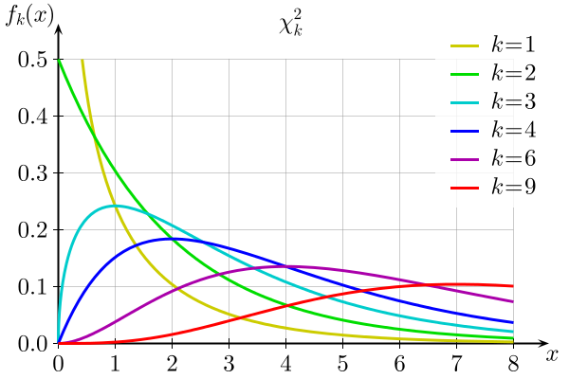
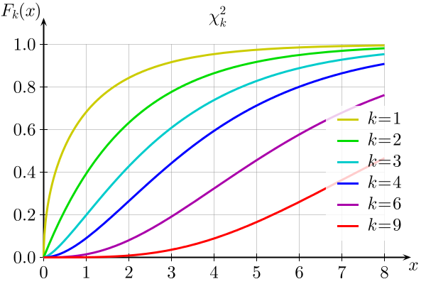
χ2 Distribution
Probability density function
Cumulative distribution function
Biology 644: Bioinformatics

Slide 5
χ2 Distribution
The chi-squared distribution is used in the common chi-squared tests for:
goodness of fit of an observed distribution to a theoretical one
the independence of two criteria of classification of qualitative data
in confidence interval estimation for a population standard deviation of a normal distribution from a sample standard deviation.
Many other statistical tests also use this distribution, like Friedman's analysis of variance by ranks.
The chi-squared distribution is a special case of the gamma distribution.
Biology 644: Bioinformatics

Slide 6
(Student’s) t-Distribution
Student's t-distribution (or simply the t-distribution) is a family of continuous probability distributions that arises when estimating the mean of a normally distributed population in situations where the sample size is small (< 30) and population standard deviation is unknown.
It plays a role in a number of widely used statistical analyses including
the Student's t-test for assessing the statistical significance of the difference between two sample means
the construction of confidence intervals for the difference between two population means
linear regression analysis.
Biology 644: Bioinformatics

Slide 7
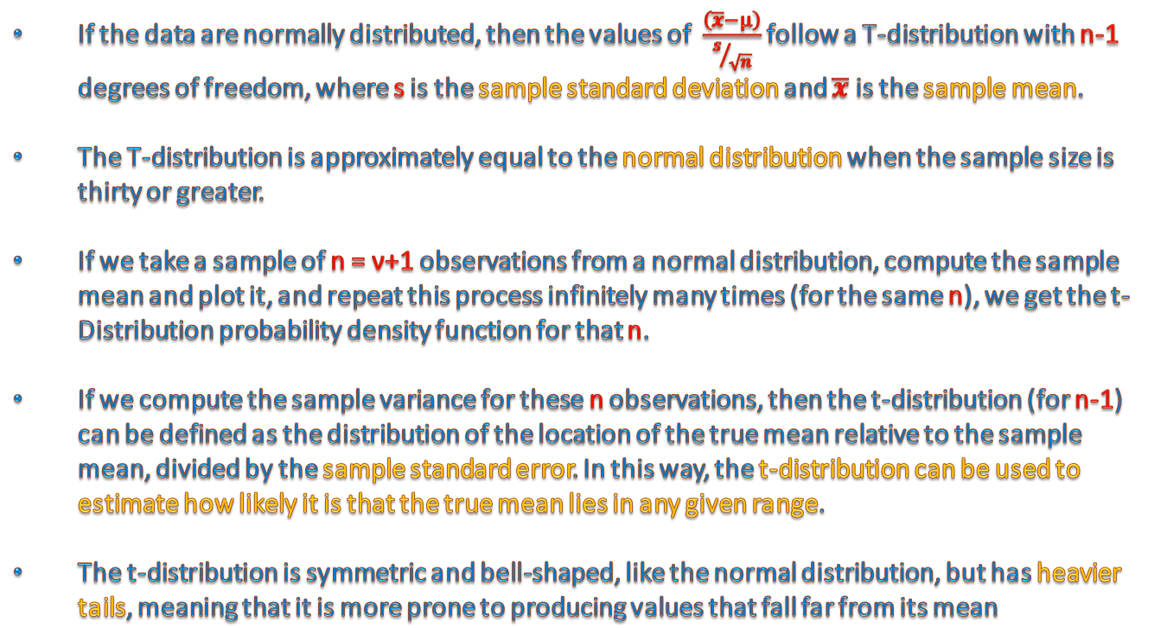
(Student’s) t-Distribution
If the data are normally distributed, then the values of $\frac{\left(\overline{x}−μ\right)}{s/{\sqrt{n}}}$ follow a T-distribution with n-1 degrees of freedom, where s is the sample standard deviation and $\overline{x}$ is the sample mean.
The T-distribution is approximately equal to the normal distribution when the sample size is thirty or greater.
If we take a sample of n = ν+1 observations from a normal distribution, compute the sample mean and plot it, and repeat this process infinitely many times (for the same n), we get the t-Distribution probability density function for that n.
If we compute the sample variance for these n observations, then the t-distribution (for n-1) can be defined as the distribution of the location of the true mean relative to the sample mean, divided by the sample standard error. In this way, the t-distribution can be used to estimate how likely it is that the true mean lies in any given range.
The t-distribution is symmetric and bell-shaped, like the normal distribution, but has heavier tails, meaning that it is more prone to producing values that fall far from its mean
Biology 644: Bioinformatics

Slide 8
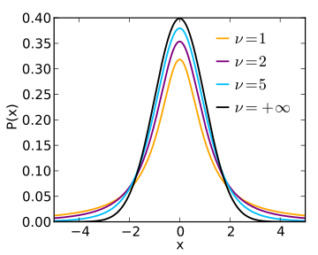
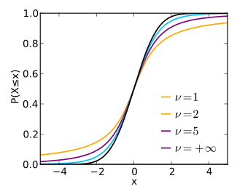
(Student’s) t-Distribution
Probability density function
Cumulative distribution function
Biology 644: Bioinformatics

Slide 9
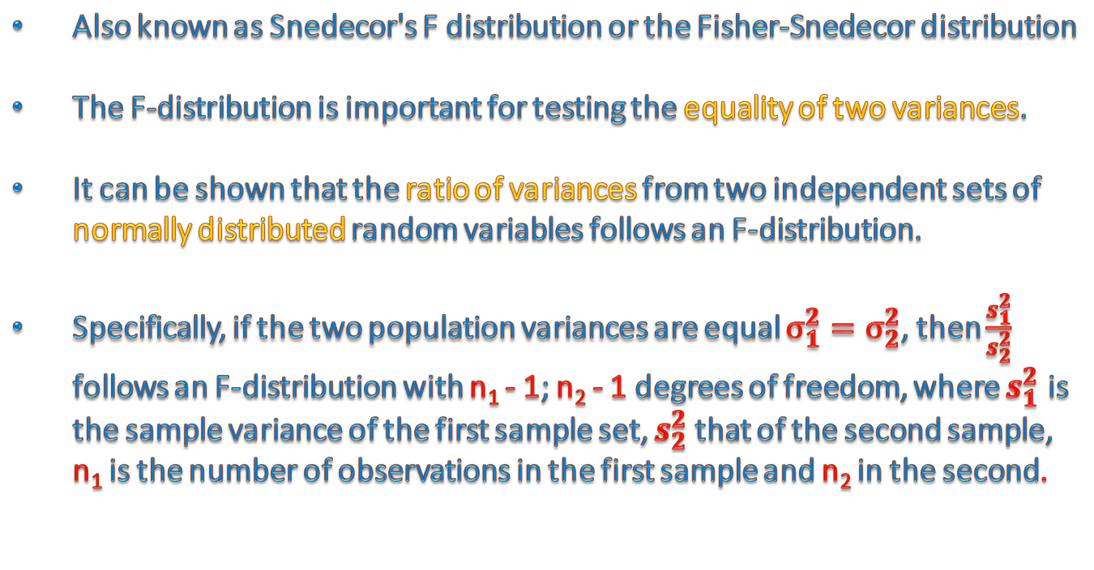
F-Distribution
Also known as Snedecor's F distribution or the Fisher-Snedecor distribution
The F-distribution is important for testing the equality of two variances.
It can be shown that the ratio of variances from two independent sets of normally distributed random variables follows an F-distribution.
Specifically, if the two population variances are equal $σ_{1}^{2}=σ_{2}^{2}$, then $\frac{s_{1}^{2}}{s_{2}^{2}}$ follows an F-distribution with n₁ - 1; n₂ - 1 degrees of freedom, where $s_{1}^{2}$ is the sample variance of the first sample set, $s_{2}^{2}$that of the second sample, n₁ is the number of observations in the first sample and n₂ in the second.
Biology 644: Bioinformatics

Slide 10
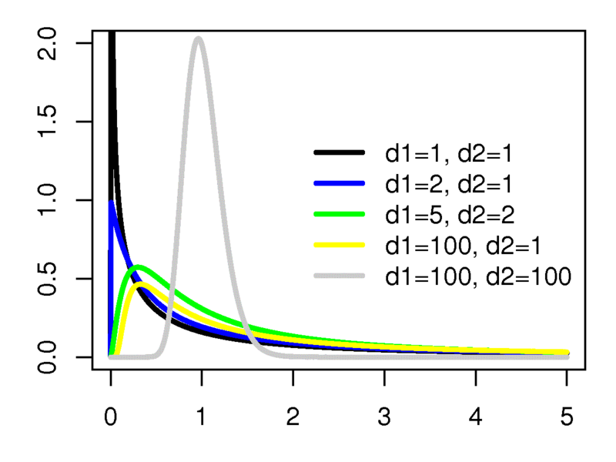
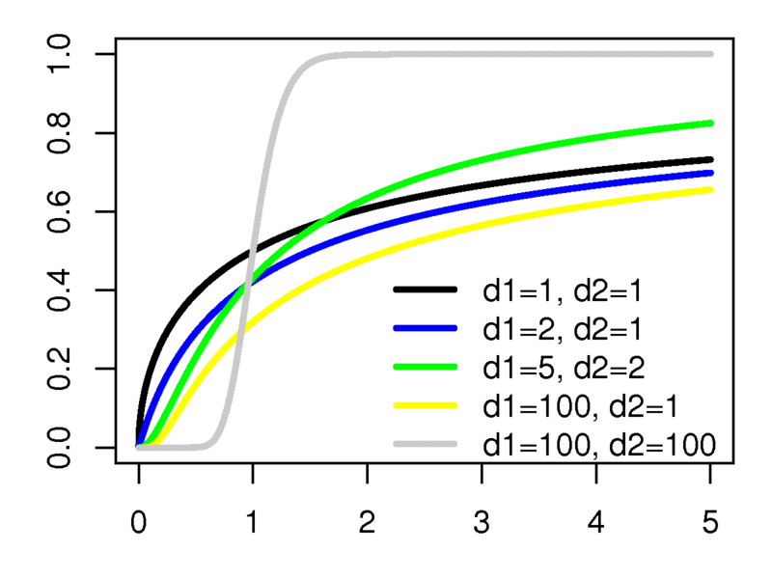
F-Distribution
Probability density function
Cumulative distribution function
Biology 644: Bioinformatics

Slide 11
Hypergeometric Distribution
The hypergeometric distribution is a discrete probability distribution that describes the probability of k successes in n draws without replacement from a finite population of size N containing exactly K successes.
This is in contrast to the binomial distribution, which describes the probability of k successes in n draws with replacement.
Biology 644: Bioinformatics

Slide 12
Hypergeometric Distribution
The hypergeometric distribution applies to sampling without replacement from a finite population whose elements can be classified into two mutually exclusive categories like Pass/Fail, Male/Female or Employed/Unemployed.
As random selections are made from the population, each subsequent draw decreases the population causing the probability of success to change with each draw.
The following conditions characterize the hypergeometric distribution:
The result of each draw can be classified into one or two categories.
The probability of a success changes on each draw.
Biology 644: Bioinformatics

Slide 13

Hypergeometric Distribution
A random variable X follows the hypergeometric distribution if its probability mass function (pmf) is given by
is the population size
is the number of success states in the population
is the number of draws
is the number of successes
Biology 644: Bioinformatics

