Slide 1
Introduction to Docker
Matt Eldridge
CRUK-CI Bioinformatics Core

Slide 2
What is Docker?
A virtualization platform
A way to package an application, and all its dependencies, and share it with others
An isolated environment in which to install and try new software
docker
/ˈdɒkə/
Noun
A container system for wrapping a piece of software in a complete file system with everything it needs to run
A person employed in a port to load and unload ships

Slide 3
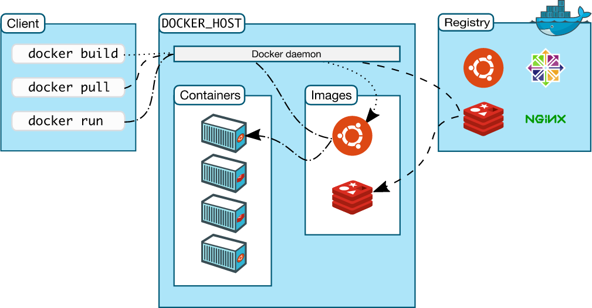
Docker Components
Image from Docker website https://docs.docker.com/engine/understanding-docker

Slide 4
Docker Containers
WRITABLE CONTAINER
Add shiny server – image
WRITABLE CONTAINER
Add shiny – image
Add apache– image
Add R – image
Add emacs – image
Add development tools – image
Ubuntu – image
CentOS – image
KERNEL
Layered filesystem – sharing common files for efficient disk usage and image downloads
Images can be built using Dockerfile templates

Slide 5
Getting Started
Pull an image from a repository
docker pull bioconductor/release_base
Run a command within a new container based on this image
docker run -it bioconductor/release_base R

Slide 6
Building an image
1 Start from an existing image, e.g. the base CentOS image, and create a container running a shell
docker run -it centos bash
2 Install new software, add data files, etc.
3 Exit from the shell and find the container ID
docker ps –a
4 Save the container as a new image
docker commit cranky_feynmann myimage
Builds can be automated using a Dockerfile

Slide 7
Dockerfile
A Dockerfile is a set of instructions for assembling an image
Example: Shiny server
FROM centos:7
RUN yum groupinstall -y 'development tools'
RUN yum install -y wget
RUN rpm -Uvh https://dl.fedoraproject.org/pub/epel/epel-release-latest-7.noarch.rpm
RUN yum install -y R
RUN R -e "install.packages(c('shiny', 'rmarkdown'), repos='https://cran.rstudio.com')"
RUN R -e "install.packages('devtools', repos='http://mirrors.ebi.ac.uk/CRAN')"
RUN wget https://download3.rstudio.org/centos6.3/x86_64/shiny-server-1.5.0.730-rh6-x86_64.rpm
RUN yum install -y --nogpgcheck shiny-server-1.5.0.730-rh6-x86_64.rpm
EXPOSE 3838
COPY shiny-server.sh /usr/bin/shiny-server.sh
CMD ["/usr/bin/shiny-server.sh"]

Slide 8
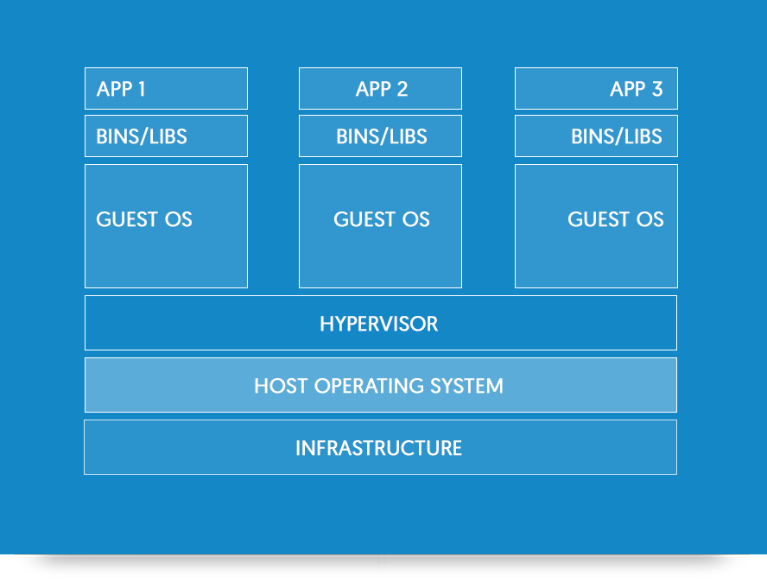
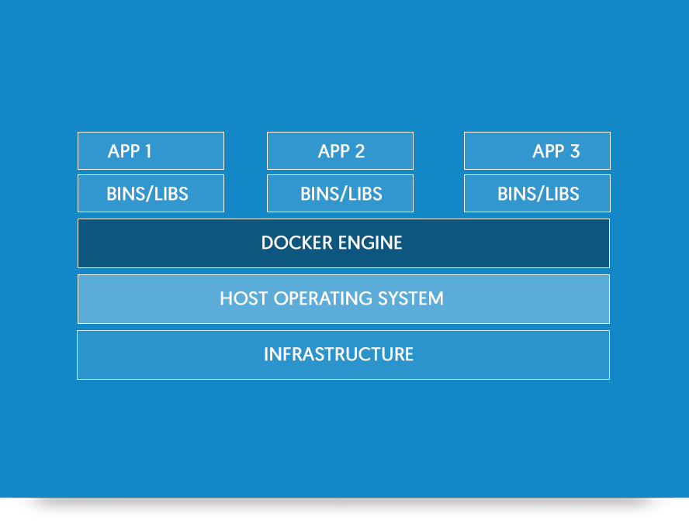
Docker vs Virtual Machines
Virtual Machines (VMware, VirtualBox)
Each virtual machine includes the entire guest OS – tens of GBs, can take minutes to start up
Docker
Containers run as isolated processes on the host OS – lightweight, start instantly, use less memory

Slide 9
Security issues
Elevated privileges
Docker daemon requires root privileges on linux
Allows containers to have root access to the host filesystem
Weaker isolation than VMs
Attacks (viruses, intrusions) can propagate down to the underlying OS and into other containers
Cannot run dockerized apps on the CRUK-CI HPC clusters ☹

Slide 10
How have we used Docker?
Running third party software packaged as “dockerized apps” | Sanger Cancer Genome Project analysis pipeline (variant calling for whole genome sequencing) Polysolver (HLA typing)
Installing and running third party software | MutSigCV (mutational significance)
Deploying Shiny applications | Proteomics TMT analysis (Bioinformatics Core) Breast Cancer PDTX Encyclopaedia (Caldas lab, Bioinformatics Core)
Packaging and distributing tools developed in-house | SVclone tumour clonality analysis tool for ICGC-TCGA-DREAM Challenge (Geoff MacIntyre) ParaBam tool for optimized processing of BAM files (Henry Farmery)
Training | CRUK Summer School on cancer genome analysis

Slide 11
So how can Docker help me?
Trialing new software
Clean, unpolluted starting point
Isolated environment, won’t affect other applications
Superuser privileges and complete control over what you install
Bioinformatics developers increasingly using docker to package and distribute applications
Deployment of an application during development
Share your environment with a colleague to run on their machine
Update a production system with minimum downtime

