Slide 1
JOINT ADMISSION CONTROL AND ROUTING VIA ADP FOR STREAMING VIDEO OVER SDN

Slide 2
GUIDED BY,
Mrs.Malavika
DONE BY,
Ahalya.K (1418101)
Madhumitha.T (1418122)
Malathie.C (1418123)

Slide 3
Why to Combine Admission Control and Routing?
The Standard Protocol used for routing is OSPF.
But, in OSPF overhead is created due to traffic. In our paper we overcome this problem by combining admission control and routing.
Admission Control is a validation process in communication systems where a check is performed before a connection is established to see if current resources are sufficient for the proposed connection.
Routing is the process of moving packets across a network from one host to a another.

Slide 4
LITERATURE SURVEY
SNO | TITLE | AUTHOR | PUBLICATION | ADVANTAGE | DISADVANTAGE
1 | Joint Admission Control and RoutingVia Approximate Dynamic Programming for Streaming Video Over Software-Defined Networking | Jian Yang | March,2017 | self-optimization | Fixed bandwidth
2 | Are we ready for SDN? Implementation challenges for software-defined networks | David Lake, Marc Miller. | July,2013 | Dynamic topology control. | challenge to achieve node bandwidth beyond 100Gbps.
3 | Rate Adaptive Multimedia Streams: Optimization and Admission Control | Steven Weber. | Dec,2014 | Reduces the dynamic adaptation. | Incompatability in reducing network congestion.

Slide 5
S.No | TITLE | AUTHOR | PUBLICATION | ADVANTAGE | DISADVANTAGE
4. | Call Admission Control and Routing in Integrated services Networks using Neuro-Dynamic Programming. | P. Marbach | Feb,2015 | Reward obtained by NDP is more than OSPF. | The CAC algorithm includes large state space.
5. | Joint Admission Control and Routing(Based on Mesh Networks) | F. Richard and Victor.F.M | April,2016 | QoS guarantee and Optimal solution is provided. | Packet Delay

Slide 6
Software-Defined Networks(SDN):
It is an approach to computer networking that allows network administrators to “programmatically initialize, control, change and manage network behaviour dynamically via open interfaces and abstraction of lower level functionality”.
Open-Flow Controller:
It uses the open flow protocol to connect and configure the network devices to determine the best path for application traffic.

Slide 7
SDN CONTROLLER:
NOX
POX
FloodLight
Ryu
OpendayLight
We use POX Controller because it enables rapid development and prototyping.
Emulator: Mininet.

Slide 8
Study of Mininet:
Mininet is a network emulator. It runs a collection of end-hosts, switches, routers, and links on a single Linux kernel.
It uses lightweight virtualization to make a single system look like a complete network, running the same kernel, system, and user code.
Mininet is being used here to create custom topologies: a single switch, larger Internet-like topologies or anything else.

Slide 9
ADP: Markov Decision Process
MDPs are useful for optimization problems solved via dynamic programming and reinforcement learning.
we formulate the joint admission control and routing into Markov decision problem of maximizing the overall “revenue” while guaranteeing the QoS.

Slide 10
Modules:
Setting up the Network Topology.
Connecting and Configuring Remote Controller.
Video Streaming in Network.
Algorithm implementation as SDN application using Rest API.
Evaluating the Result.

Slide 11
Module 1: Setting up Network Topology
Mininet Installation.
Code for setting up topology.
from mininet.topo import Topo
class MinimalTopo( Topo ):
def build( self ):
# Create two hosts.
h1 = self.addHost( 'h1' )
h2 = self.addHost( 'h2' )
# Create a switch
s1 = self.addSwitch( 's1' )

Slide 12
# Add links between the switch and each host
self.addLink( s1, h1 )
self.addLink( s1, h2 )
# Allows the file to be imported using `mn --custom <filename> --topo minimal`
topos = {
'minimal': MinimalTopo
}
Command to execute the code:
python topo.py

Slide 13
SIMPLE NETWORK TOPOLOGY:
3
2
users
Access Points
1
users
server

Slide 14
Module 2:Connecting and Configuring Remote Controller
Command to kill the local host connection
kill -9 pid(port id)
Command to start the pox controller
cd /home/ubuntu/pox && ./pox.py
Command to connect switches with the controller
sudo mn --topo triple,2 --mac --controller remote –switch

Slide 15
Module 3: Video Streaming in Network
With streaming video or streaming media, a Web user does not have to wait to download a file to play it. Instead, the media is sent in a continuous stream of data and is played as it arrives.

Slide 16
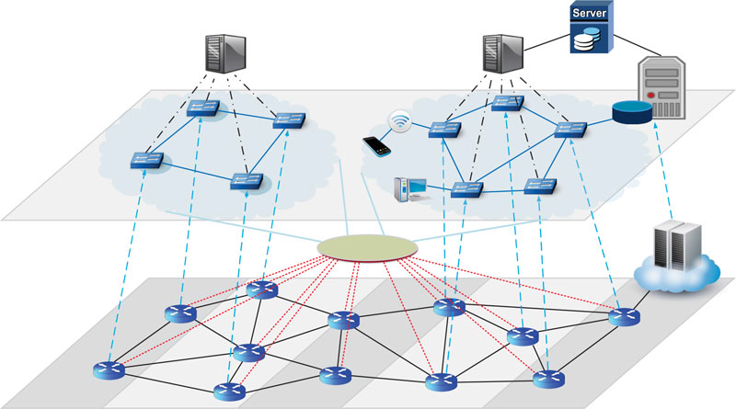
Virtualized network for video streaming service.
Management server
OpenFlow Controller
Video provider
Virtual Network
Cloud data center
Flow visor
Physical Network

Slide 17
THANK YOU!!!

