Slide 1




NEXT GEN EMPLOYABILITY PROGRAM
Creating a future-ready workforce
Team Members
College Name
Student Name : ANAS AHAMED A
Reg No: 422721104005
V.R.S College of Engineering and Technology

Slide 2
CAPSTONE PROJECT SHOWCASE
Project Title
Car Rentals Application with Django Framework
Abstract | Problem Statement | Project Overview | Proposed Solution | Technology Used | Modeling & Results | Conclusion

Slide 3
NEXT GEN EMPLOYABILITY PROGRAM
Abstract
Django Car Rental is a web application developed using the Django framework, designed to facilitate the rental and management of vehicles. The application provides a user-friendly interface for customers to browse available cars, make reservations, and manage their bookings. It also offers administrative functionalities for car owners or rental agencies to add, update, and remove vehicles, as well as manage reservations and customer data.

Slide 4
NEXT GEN EMPLOYABILITY PROGRAM
Problem Statement
Develop a web-based car rental application using Django framework that allows users to browse available cars, view details such as make, model, year, and rental price, reserve cars for specific dates, and manage their reservations. The application should have authentication and authorization features to ensure only registered users can reserve cars and manage their bookings.

Slide 5
NEXT GEN EMPLOYABILITY PROGRAM
Project Overview
The Car Rental Application aims to provide a user-friendly platform for renting cars online. The application will allow users to browse through a variety of cars, view details, make reservations, and manage their bookings. Administrators will have access to an admin interface to manage cars, users, and reservations efficiently.

Slide 6
NEXT GEN EMPLOYABILITY PROGRAM
Proposed Solution
The solution involves building a web-based car rental platform using Django, a high-level Python web framework. The application will consist of various components, including user authentication, car listings management, booking system, payment integration, and administrative functionalities.

Slide 7
NEXT GEN EMPLOYABILITY PROGRAM
Key Components
User Authentication and Authorization: - Implement a user authentication system to allow users to register, login, and logout. - Ensure proper authorization mechanisms to control access to different parts of the application based on user roles.
Car Listings Management: - Develop a database schema to store information about available cars, including make, model, year, rental price, and availability status. - Create CRUD (Create, Read, Update, Delete) functionalities to manage car listings through an admin interface.
Booking System: - Develop a booking system that enables users to select rental dates and reserve cars for specific durations. - Implement logic to check for conflicts and prevent double bookings of the same car for overlapping periods.

Slide 8
NEXT GEN EMPLOYABILITY PROGRAM
4. Payment Integration: - Integrate a payment gateway (e.g., Stripe, PayPal) to facilitate secure online payments for reservations. - Handle payment processing, including calculating rental fees, generating invoices, and handling refunds or cancellations.
5. Admin Interface: - Provide administrators with an interface to manage car listings, user accounts, and reservations. - Admins should be able to add, edit, and delete cars, view reservation details, and manage user accounts (e.g., ban users, reset passwords).
6. Notifications: - Implement email notifications to confirm bookings, send payment receipts, and remind users of upcoming reservations.
7. Security Measures: - Implement security best practices, such as HTTPS, CSRF protection, input validation, and password hashing, to protect user data and prevent security vulnerabilities.

Slide 9
NEXT GEN EMPLOYABILITY PROGRAM
Modelling & Results
-In developing a car rental application with the Django framework, the process typically begins by defining the models that represent the core entities of the system. For instance, you'd create a Car model to store details like make, model, year, and price per day. -Additionally, a Rental model would be necessary to manage rental transactions, associating rented cars with users, recording rental periods, total costs, and tracking whether the car has been returned. After establishing the models, the next steps involve creating views and templates to handle user interactions, such as browsing available cars, renting vehicles, and managing rental transactions.

Slide 10
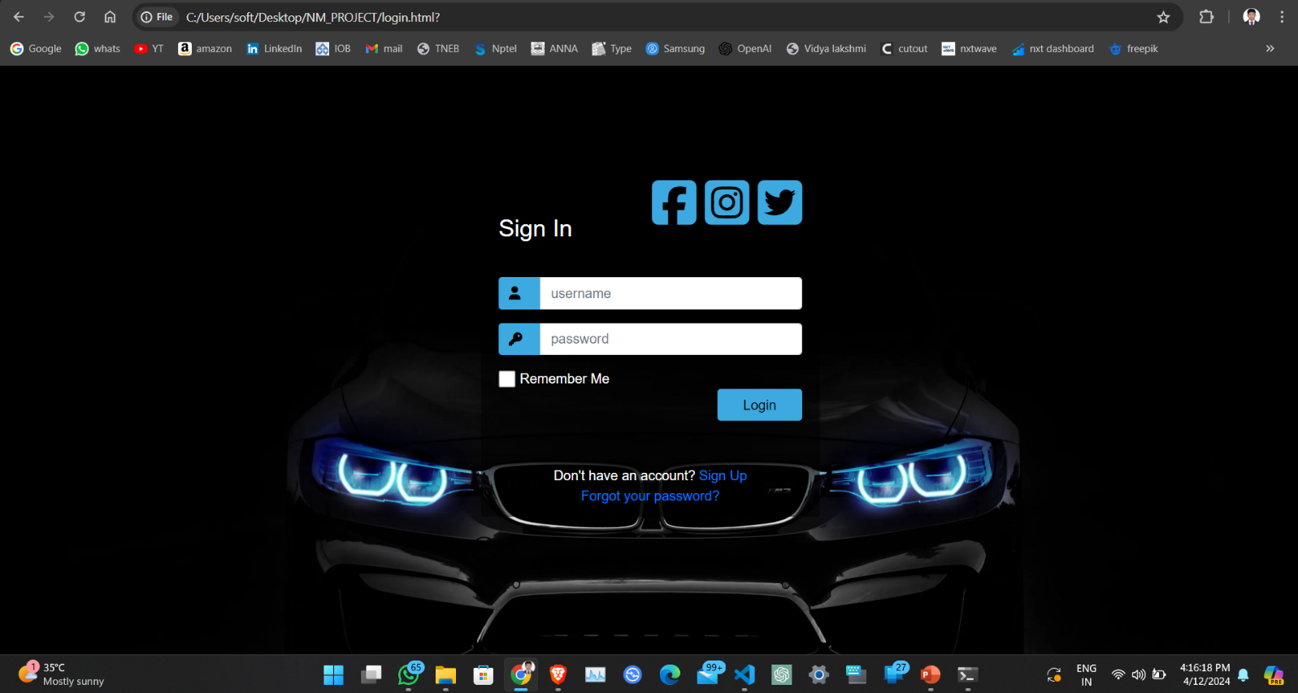
NEXT GEN EMPLOYABILITY PROGRAM
Login page

Slide 11
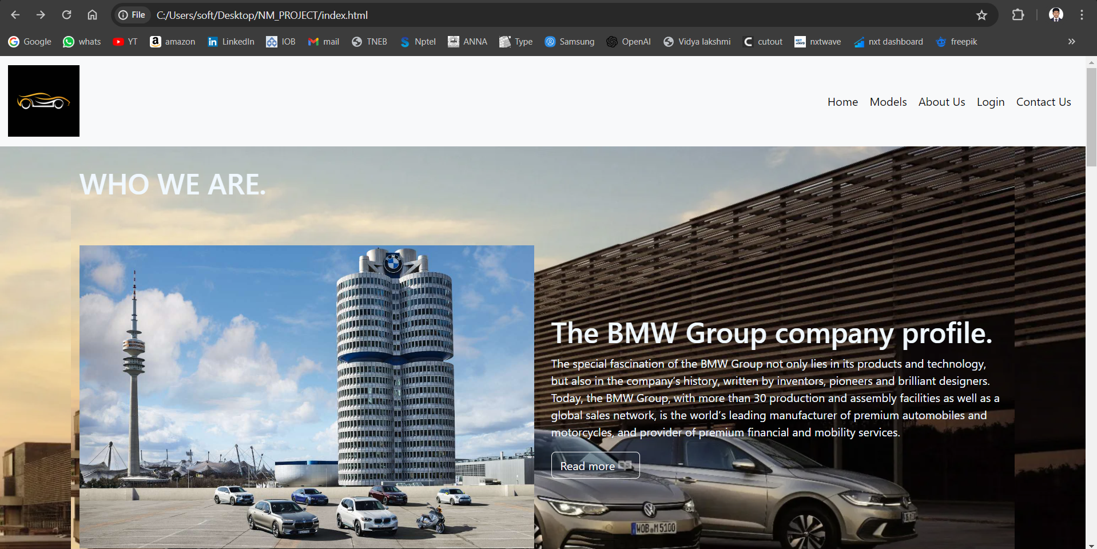
NEXT GEN EMPLOYABILITY PROGRAM
Homepage

Slide 12
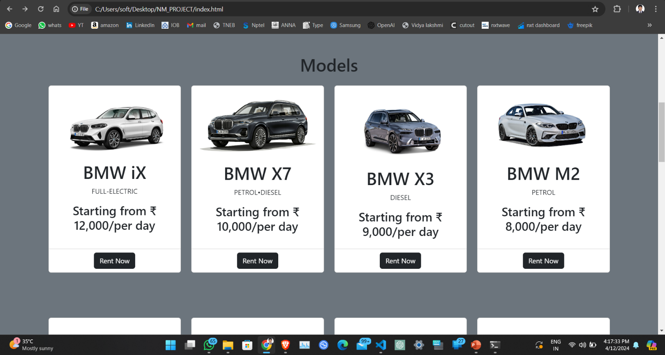
NEXT GEN EMPLOYABILITY PROGRAM
Available cars page 1

Slide 13
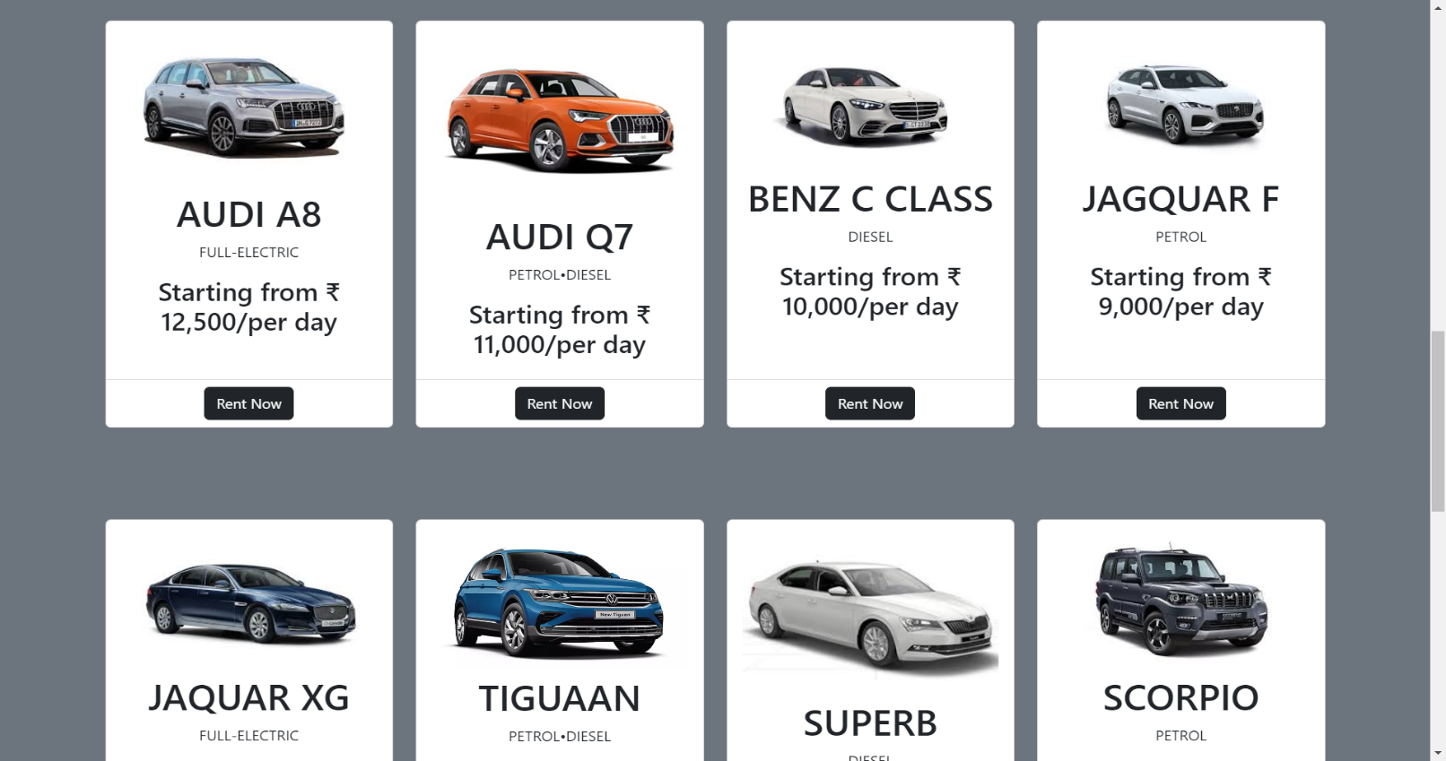
NEXT GEN EMPLOYABILITY PROGRAM
Available cars page 2

Slide 14
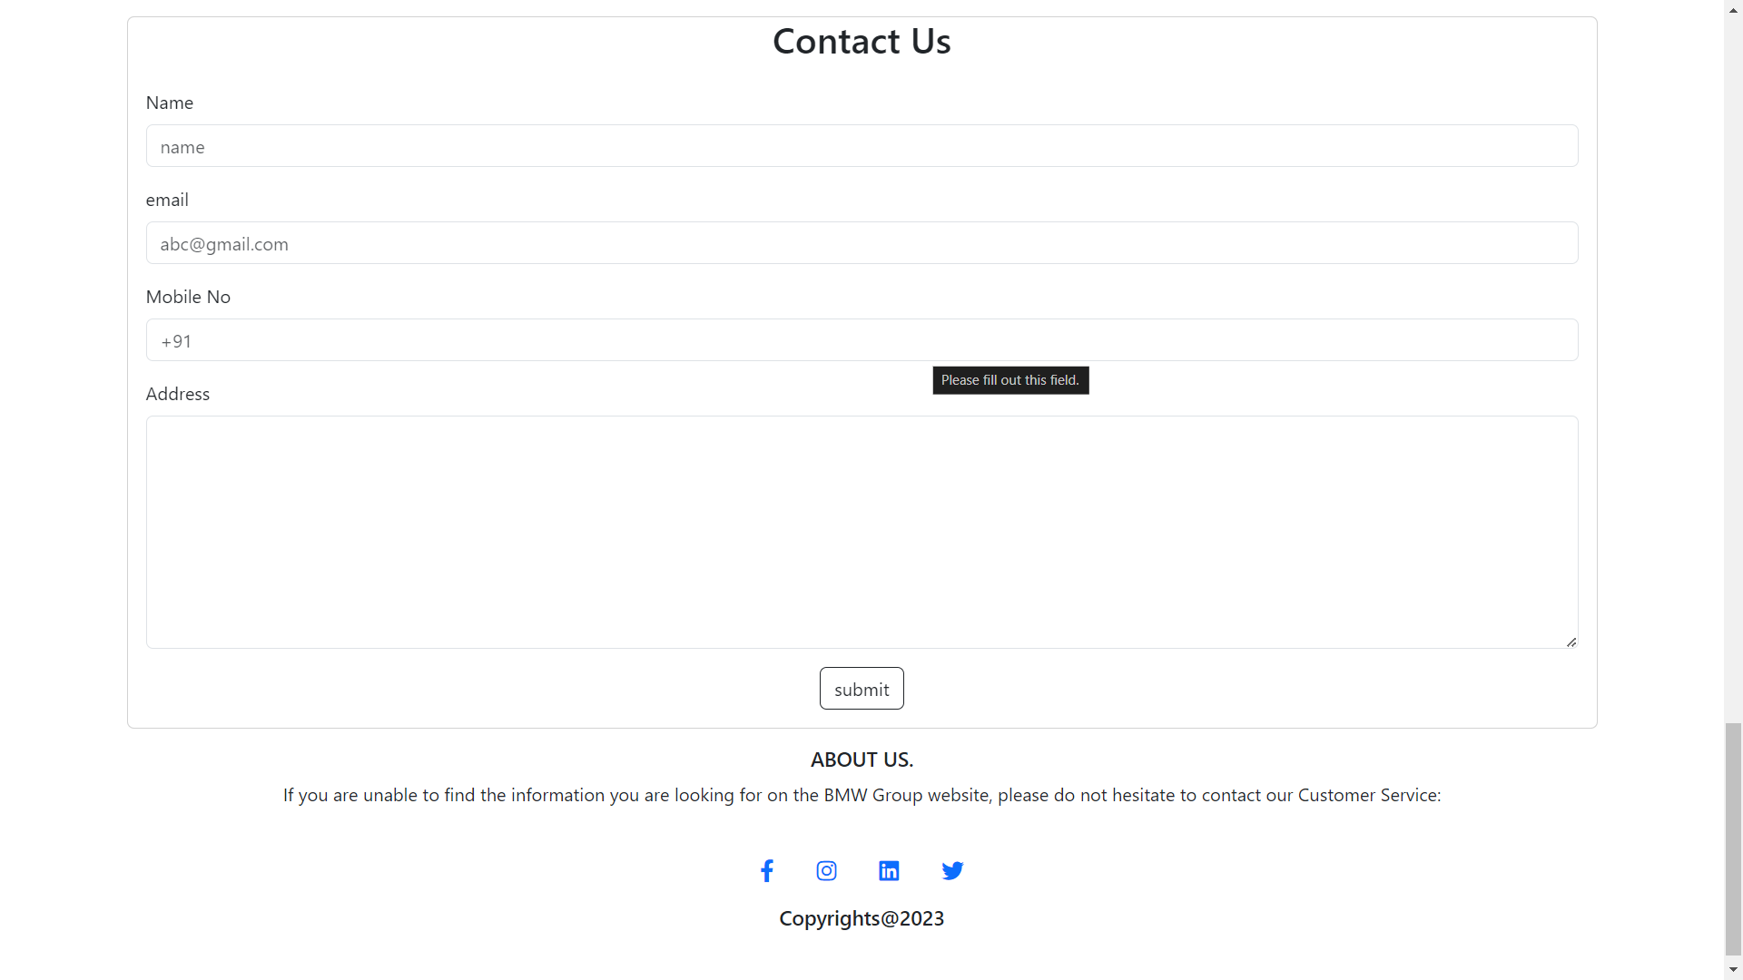
NEXT GEN EMPLOYABILITY PROGRAM
Contact us & About-Us-Page

Slide 15
NEXT GEN EMPLOYABILITY PROGRAM
Future Enhancements:
In future engagements with the Django framework for your car rental application, there's an array of avenues to explore for refining and expanding the system. One significant area of focus could be enhancing the user experience to ensure seamless interaction with the platform. This involves implementing responsive design principles to accommodate users across various devices, coupled with accessibility enhancements to cater to a diverse user base. Additionally, refining the search and filtering functionalities can empower users to quickly find the perfect rental vehicle by integrating advanced search options like faceted search and keyword search. Moreover, implementing dynamic pricing strategies, such as demand-based pricing and long-term rental discounts, can optimize revenue generation while attracting more customers.

Slide 16
NEXT GEN EMPLOYABILITY PROGRAM
Conclusion
In conclusion, developing a car rental application with the Django framework offers immense potential for providing users with a seamless and efficient rental experience. By leveraging Django's powerful features for model definition, views, and templates, you can create a robust system capable of managing rental transactions, user accounts, and inventory seamlessly. The application can be enhanced further by focusing on aspects such as user experience improvements, advanced search and filtering capabilities, dynamic pricing strategies, integration with payment gateways, and ongoing maintenance.

Slide 17
NEXT GEN EMPLOYABILITY PROGRAM
Thank You!

