Slide 1
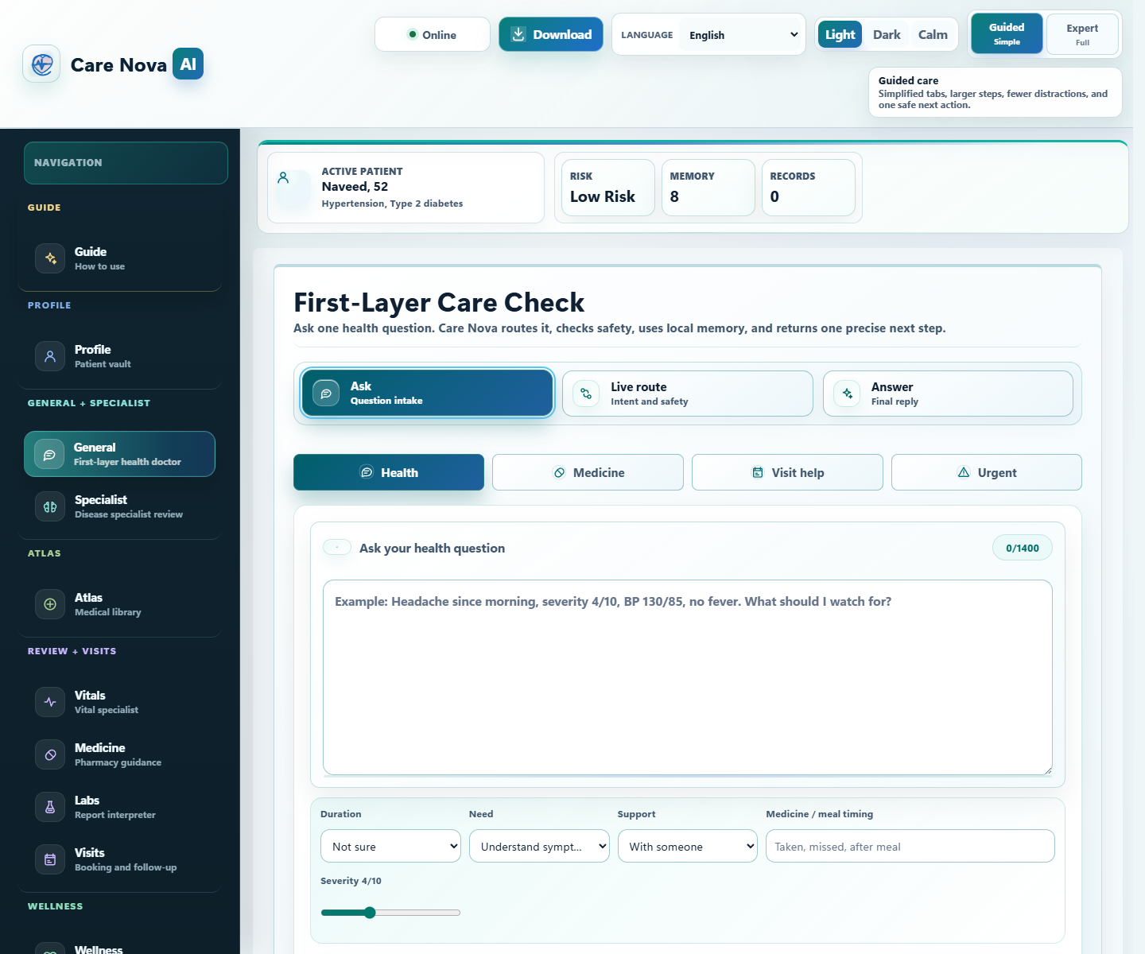
CARE NOVA AI
From fragmented patient data to one safe next step.
Local-first multi-agent healthcare AI for symptoms, medicines, labs, records, and guided next-step support.
Local-first privacy
Specialist agent routing
Evidence-grounded and safety-checked
Built for healthcare, not generic chat.
Memory, specialist routing, retrieval, and guardrails work before the reply.
LIVE PRODUCT VIEW
Memory, risk, specialist routes, and the guided answer flow in one workspace.
1

Slide 2
AGENTIC WORKFLOW
It reasons in stages before it answers.
Input | Local memory | Intent route | RAG evidence | Safety check | Next step
1
2
3
Understand the case
Route with evidence
Answer safely
Reads the patient question and reloads the local patient context.
Classifies intent, selects the right agent, and retrieves grounded evidence.
Checks risk, blocks unsafe wording, and returns one focused next step.
This staged flow makes Care Nova agentic, grounded, and safer than one-pass chat.
2

Slide 3
WHY IT STANDS OUT
This is a governed healthcare system, not a normal chatbot.
Generic chatbot
Care Nova AI
One broad answer path
Remembers local patient context
Little patient continuity
Routes to the right specialist agent
Uses retrieval before the answer
Weak healthcare boundaries
Applies safety checks before the reply
Faster triage
Consistent guidance
Privacy by default
Demo scope: governed assistant system with healthcare safety boundaries.
3

