Slide 1
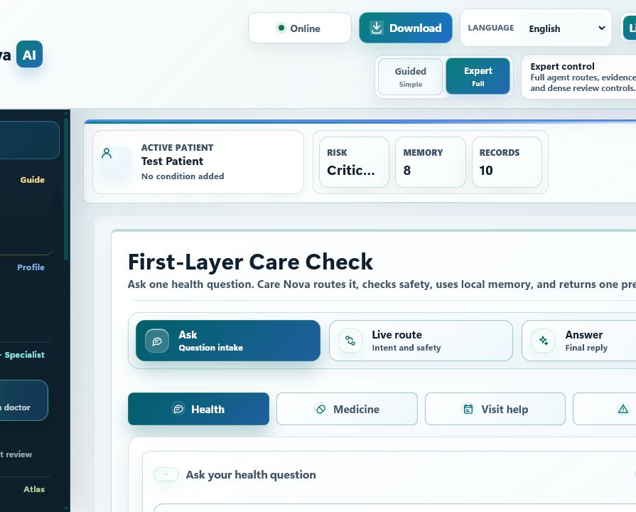
HEALTHCARE AI DEMO
Care Nova AI
Turns fragmented healthcare context into one clear, safety-checked next step.
Built for healthcare, not generic chat.
Local-first privacy
Specialist routing + evidence
Safety boundary built in
Cloud access is optional, not required.

Slide 2
APPLICATION
From fragmented care data to one next step
Scattered care context becomes one focused, safety-checked response.
What comes in
What comes out
Healthcare context is usually scattered.
One focused,
safety-checked next step.
Symptoms
Vitals
Medicines
Labs
Relevant risk level
Records
Insurance
Evidence-backed reason
Focused next action
Users struggle to turn this into one safe action.
Not a broad answer. A guided next step.
Care Nova organizes context before it answers.

Slide 3
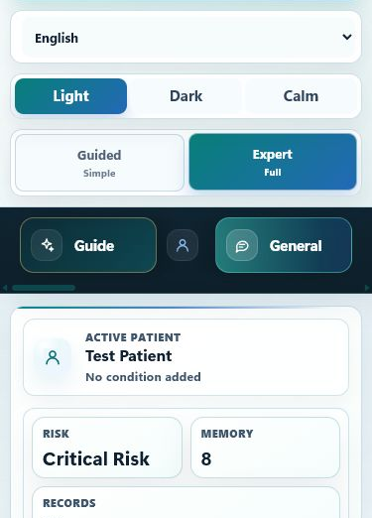
APPLICATION MODES
One product. Two modes.
Simple guidance for patients. Deep review for teams.
Guided mode
Low-friction experience
Fast, patient-friendly first pass.
Clear safe answer
Expert mode
Review risk and evidence
Full review surface for routes, evidence, and records.
Inspect records and memory
Focused workspaces
Vitals
Labs
Wellness
Records
Insurance
Summary
Local-first PWA: laptop, mobile, and installable app shells.
One surface can support both quick guidance and deep review.

Slide 4
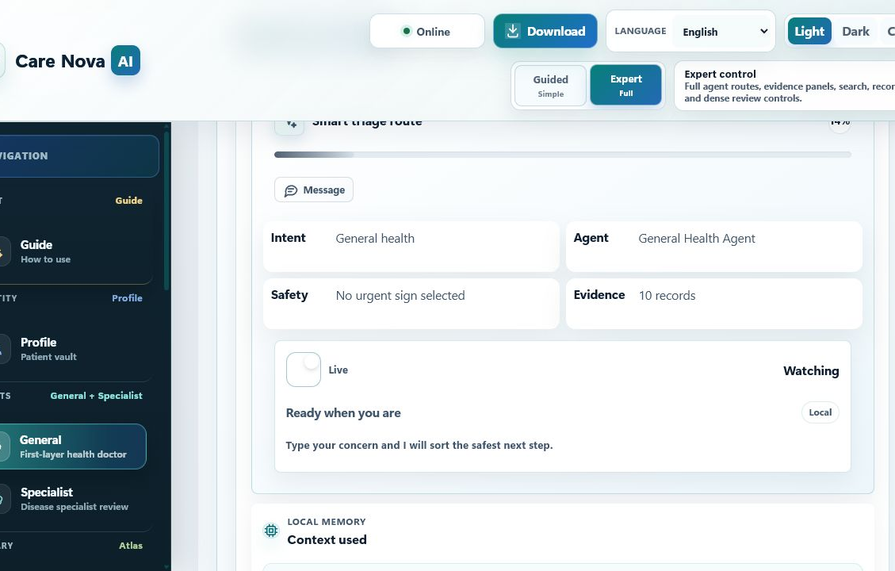
MODEL WORKFLOW
Why it is not a normal chatbot
A generic chatbot answers once. Care Nova checks, routes, and guards first.
1
Patient input
Symptom, reading, medicine question, or care request enters.
2
Memory load
Recent patient context reloads before analysis starts.
3
Intent classify
The request is routed into the correct care path.
4
Evidence + specialist
Local evidence and specialist workflow shape the answer.
5
Safety-checked reply
Guardrails check the response before it is shown.
The reply is shaped by workflow, not by one free-form prompt.

Slide 5
SYSTEM DESIGN
The system routes each case to the right specialist
One governed workflow chooses the right route before it answers.
Four routes. One governed workflow.
RAG Agent
Pharmacy Agent
Memory reloads, intent is classified, evidence is retrieved, and safety is checked before any reply.
Grounds answers in local medical evidence.
Checks medicine questions with medication safeguards.
Scheduling Agent
Alert Agent
Supports visit prep and follow-up coordination.
Escalates urgent patterns into a safety-first path.
Multi-agent
RAG
Safe
Workspaces: Vitals, Labs, Wellness, Records, Insurance, Summary.
That is why it answers narrowly, not broadly.

Slide 6
RAG + MEMORY
Retrieval grounds facts. Memory grounds context.
Together they cut broad guessing and keep answers patient-specific.
RAG
MEMORY
Grounds medical facts
Grounds patient context
Query is built from the message, vitals, profile, and memory.
Persistent local context reloads before every analysis.
Ranks local healthcare knowledge
Patient memory, records, and knowledge graph
Can reuse approved cached references
The system is not stateless
Grounds the reply in evidence
Result is stored for the next turn
Approved sources
MedlinePlus
RxNorm
openFDA
LOINC
SMART on FHIR
Result: answers use local evidence and prior patient context, not raw model memory alone.

Slide 7
BUSINESS RELEVANCE
Local-first makes deployment practical
Private by default. Reliable on weak networks. Low-friction pilots.
Default mode
0
Why pilots start
mandatory cloud calls
It does not require a cloud dependency to begin.
The core workflow still runs locally, even without reliable cloud access.
Business impact
Privacy by default for patient context
Faster first-level triage
Reliable on weak or unstable networks
More consistent patient guidance
Works in controlled environments
Lower deployment friction for pilots

Slide 8
SAFETY BOUNDARY
The system helps, but it does not overstep
That keeps the demo useful and honest.
Does help
Never does
Risk review and triage
Final diagnosis
Medicine, lab, and insurance guidance
Prescribing
Doctor-ready summary and follow-up prep
Dose calculation
Urgent cases can force a safety-first route
Appointment booking or emergency calls
Patient context can grow. Clinical boundaries stay locked.

Slide 9
WHY IT STANDS OUT
Why it stands out in healthcare
Three design choices change the result.
MEMORY
Remembers patient context
Generic AI starts cold.
ROUTING
Routes to the right specialist
Generic AI gives one broad answer.
SAFETY
Stops unsafe medical advice
Generic AI can overstep.
Result: faster triage, clearer guidance, safer boundaries.

