Slide 1
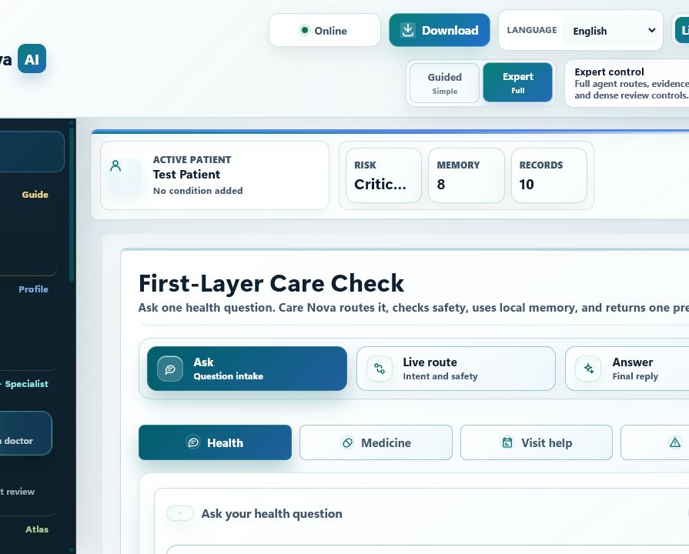
HEALTHCARE AI DEMO
Care Nova AI
Turns fragmented healthcare context into one clear, safety-checked next step.
Built for healthcare, not generic chat.
Local-first privacy
Specialist routing + evidence
Safety boundary built in
Cloud access is optional, not required.

Slide 2
APPLICATION
From fragmented care data to one next step
Scattered care context becomes one focused, safety-checked response.
What comes in
What comes out
Healthcare context is usually scattered.
One focused,
safety-checked next step.
Symptoms
Vitals
Medicines
Labs
Relevant risk level
Records
Insurance
Evidence-backed reason
Focused next action
Users struggle to turn this into one safe action.
Not a broad answer. A guided next step.
Care Nova organizes context before it answers.

Slide 3
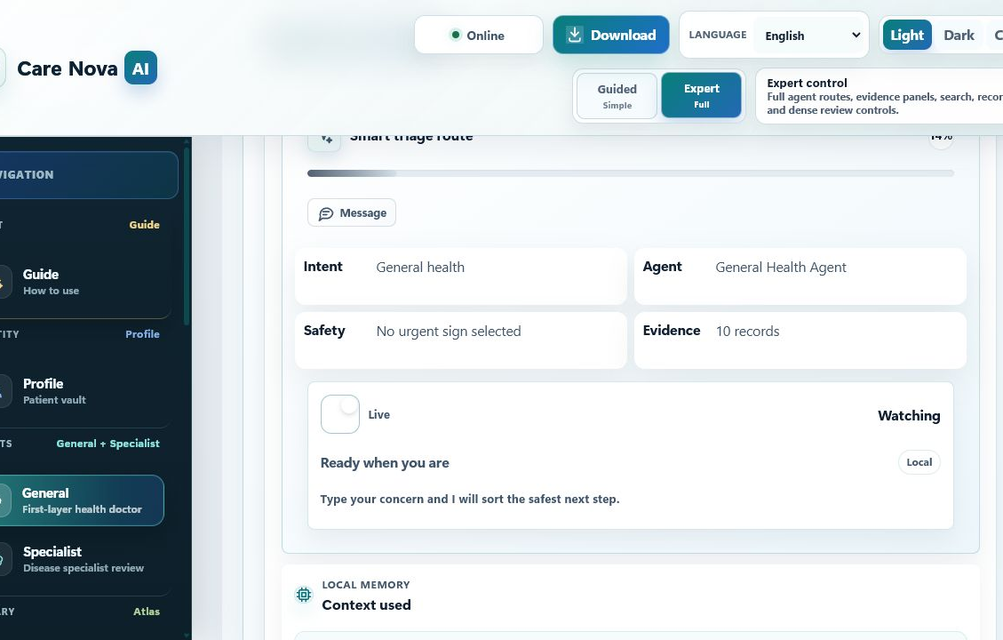
MODEL WORKFLOW
Why it is not a normal chatbot
A generic chatbot answers once. Care Nova checks, routes, and guards first.
1
Patient input
Symptom, reading, medicine question, or care request enters.
2
Memory load
Recent patient context reloads before analysis starts.
3
Intent classify
The request is routed into the correct care path.
4
Evidence + specialist
Local evidence and specialist workflow shape the answer.
5
Safety-checked reply
Guardrails check the response before it is shown.
The reply is shaped by workflow, not by one free-form prompt.

Slide 4
SYSTEM DESIGN
Each request is routed to the right specialist path
Single model? No. Agentic? Yes. RAG? Yes, with memory and safety.
System, not a flat chatbot call.
RAG Agent
Pharmacy Agent
The workflow reloads memory, classifies intent, selects a specialist path, retrieves evidence, and then checks safety.
Grounds general medical answers in local healthcare evidence.
Handles medicine questions with medication-specific safety checks.
Scheduling Agent
Alert Agent
Single model
No
Supports visit prep, follow-up flow, and coordination requests.
Escalates urgent patterns into a safety-first response path.
Agentic
Yes
RAG
Yes, memory + safety
Focused workspaces: Vitals, Labs, Wellness, Records, Insurance, Summary.
That is why Care Nova can answer narrowly instead of broadly.

Slide 5
BUSINESS RELEVANCE
Local-first makes Care Nova practical to adopt
Privacy, reliability, and low deployment friction turn the demo into a usable product.
Default mode
0
Why it deploys
mandatory cloud calls
Patient memory, records, graph facts, and app state stay local by default, so pilots do not start with a cloud dependency.
The core workflow still runs locally, even when cloud access is limited or unavailable.
Business impact
Privacy by default for patient context
Faster first-level triage
Reliable on weak or unstable networks
More consistent patient guidance
Works in controlled environments
Lower deployment friction for pilots

Slide 6
RAG + MEMORY
Retrieval grounds facts. Memory grounds context.
Together they cut broad guessing and keep answers patient-specific.
RAG
MEMORY
Grounds medical facts
Grounds patient context
Query is built from the message, vitals, profile, and memory.
Persistent local context reloads before every analysis.
Ranks local healthcare knowledge
Patient memory, records, and knowledge graph
Can reuse approved cached references
The system is not stateless
Grounds the reply in evidence
Result is stored for the next turn
Approved sources
MedlinePlus
RxNorm
openFDA
LOINC
SMART on FHIR
Result: answers use local evidence and prior patient context, not raw model memory alone.

Slide 7
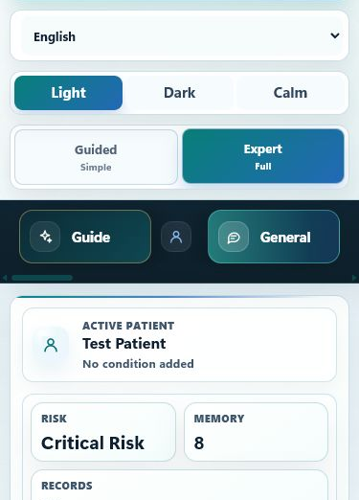
APPLICATION MODES
Guided for patients. Expert for deep review.
The same local engine supports simple guidance and detailed evidence review.
Guided mode
Low-friction experience
Safe default path
Simple patient flow that turns fragmented context into one safe next step.
Clear answer
Expert mode
Review risk and evidence
Inspect records and memory
Full routes, evidence panels, records, and deeper review controls.
Navigate specialist workspaces
Focused workspaces
Vitals
Labs
Wellness
Records
Insurance
Summary
Local-first PWA: laptop, mobile, and installable app shells.
One product surface can support both fast guidance and detailed review.

Slide 8
SAFETY BOUNDARY
The system helps, but it does not overstep
That keeps the demo useful and honest.
Does help
Never does
Risk review and triage
Final diagnosis
Medicine, lab, and insurance guidance
Prescribing
Doctor-ready summary and follow-up prep
Dose calculation
Urgent cases can force a safety-first route
Appointment booking or emergency calls
Patient context can grow. Clinical boundaries stay locked.

Slide 9
WHY IT STANDS OUT
Care Nova adds the layers generic AI misses
Memory, routing, and safety shift the answer from broad to focused.
MEMORY
Care Nova reloads patient memory, records, and graph context.
Generic AI starts cold.
ROUTING
Care Nova chooses the right specialist path before replying.
Generic AI gives one broad answer.
SAFETY
Care Nova blocks diagnosis, prescribing, and dosage advice in the demo build.
Generic AI can overstep.
Result: faster triage, more consistent guidance, and one clear next step.

